Slide 1
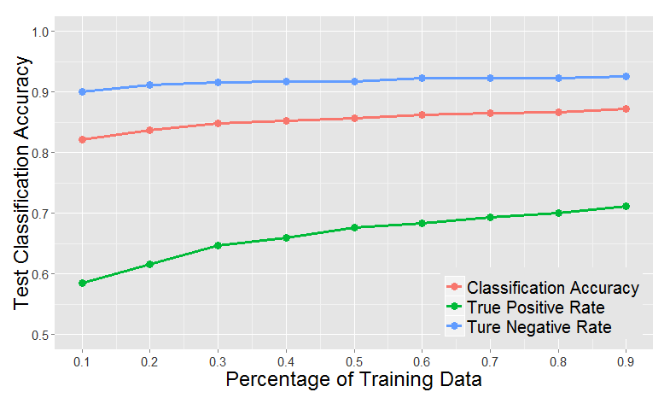
RANDOM FOREST (RF) MODEL
Eagle Ford Oil Producer Sweet Spots (658 out of 2631)
 | Classification Accuracy | Transparency
Kaggle’s Model | ~ 78% | Black box
Shell’s RF Model | ~ 87% | Fully transparent
 | Predictive Model
True |  | Top quartile | Not top quartile
 | Top quartile | True “+” | False “-”
 | Not top quartile | False “+” | True “-”

Slide 2
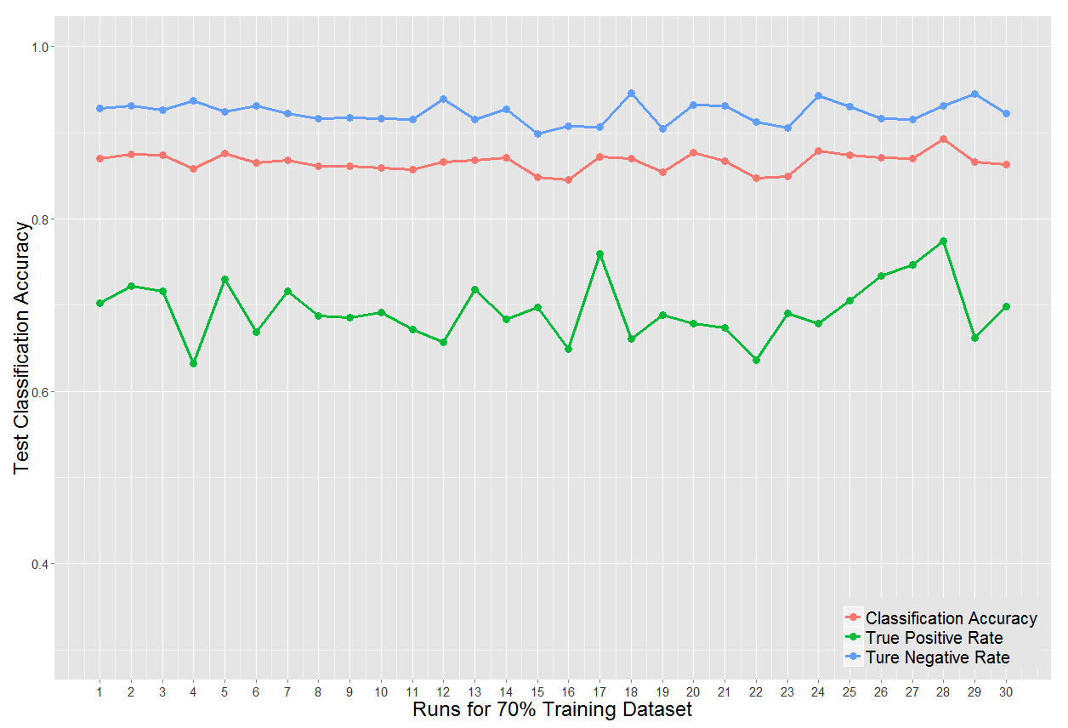
RF MODEL STABILITY
Eagle Ford Oil Producer Sweet Spots (658 out of 2631)

