Slide 1
PROBLEM STATEMENT
Farmers can suffer crop losses when diseases and health problems are not identified at an early stage. Without quick and easy guidance, it can be difficult to understand what is affecting a crop and what action should be taken.
PROPOSED SOLUTION
Mana Pantalu is an AI farming support app that helps farmers identify possible crop diseases using a photo, understand the issue, and receive practical suggestions for crop care, prevention, and suitable treatment options. With Telugu-first and voice-friendly guidance, the app makes early action easier.

Slide 2
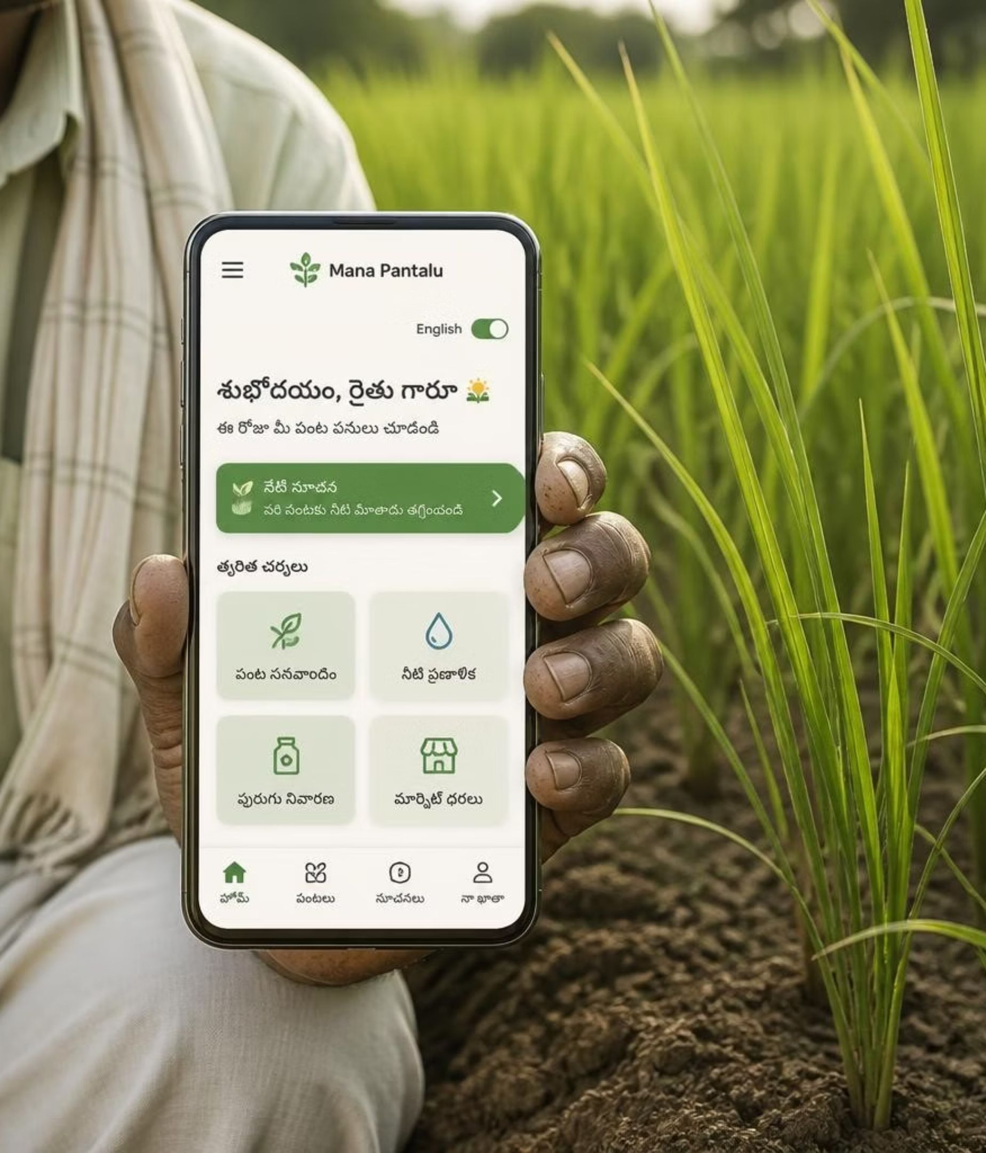
AI FARMING SUPPORT · INDIA
Mana Pantalu
AI farming support made simple for Indian farmers.
Telugu-first · Voice-friendly · Action-oriented

Slide 3
PRODUCT PROMISE
Every crop decision should feel easier.
See the problem
Hear the guidance
Understand a crop issue with a photo.
Get practical help in simple Telugu.
Choose your language
Use your voice
Switch to English anytime.
Speak or read when reading is difficult.
Designed for limited smartphone experience: large targets, familiar icons, obvious next actions.

Slide 4
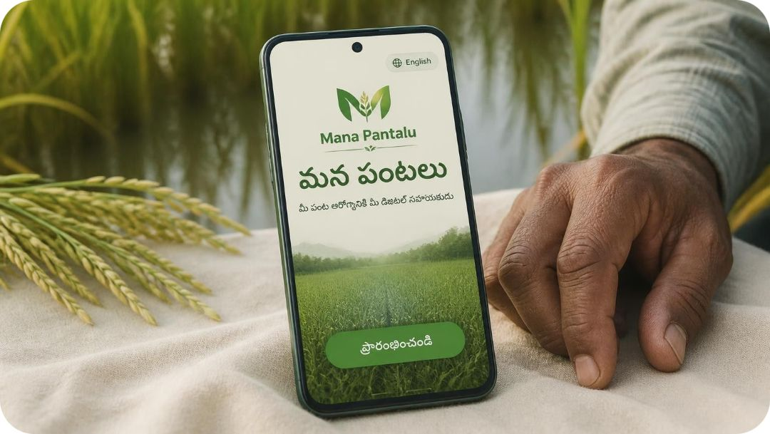
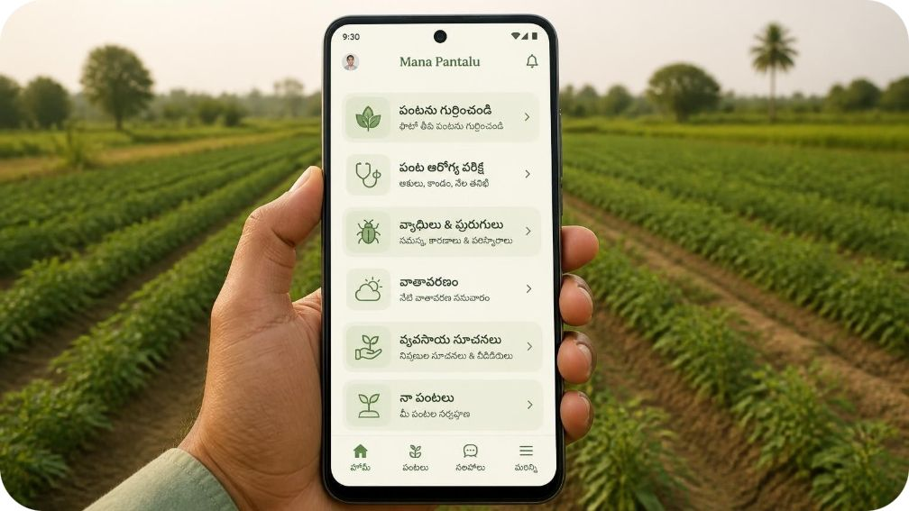
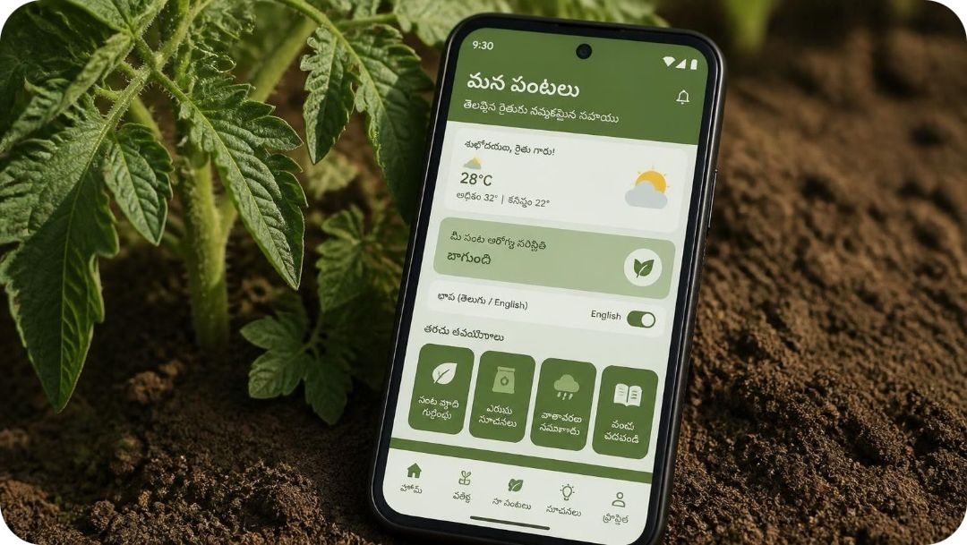
Welcome into a focused home
The first screen makes the next useful task obvious.
Welcome
Home
Language + comfort
A clear promise in Telugu, with English one tap away.
Six familiar routes, sized for a thumb and a quick glance.
Readable copy, familiar icons, and a consistent way back.

Slide 5
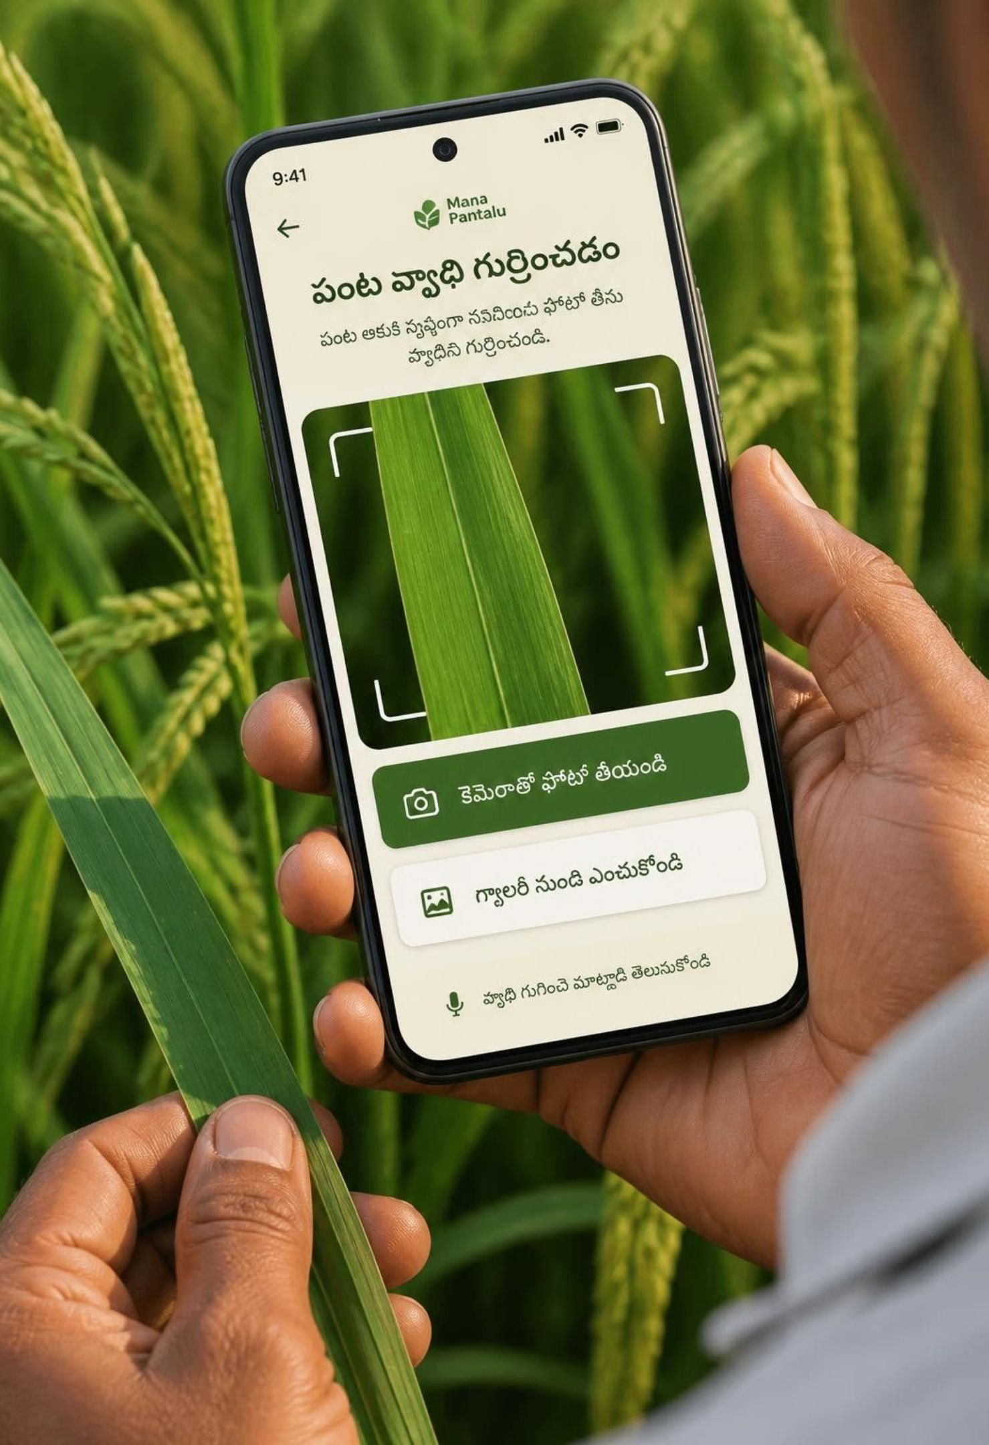
PHOTO DIAGNOSIS
Diagnose with a photo, then watch it scan
Start with the camera or choose a photo already on the phone. A short voice prompt explains how to frame one useful leaf.
1 · Capture
2 · Scan
3 · Continue
“కెమెరాతో ఫోటో తీయండి” or “గ్యాలరీ నుంచి ఎంచుకోండి”.
“పంటను పరిశీలిస్తోంది…” with a calm scan line and crop outline.
Large Android-friendly buttons keep the task comfortable.
Voice and text support stay available throughout the flow.

Slide 6
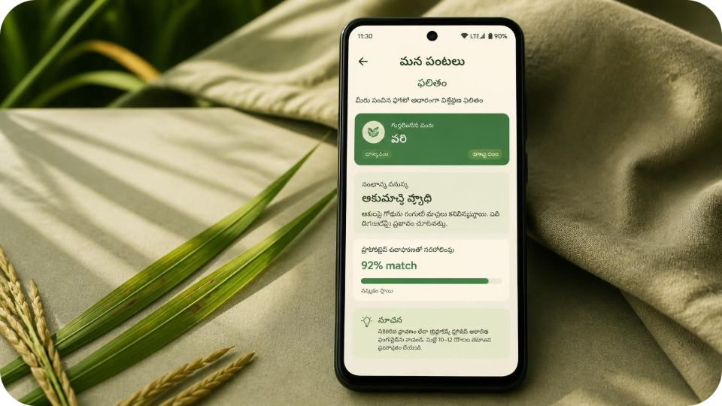
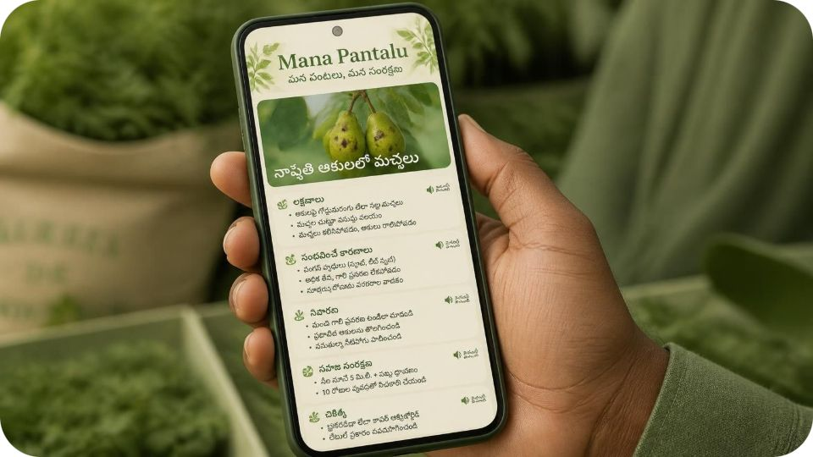
Results explain the problem and the next action
Explain simply
Make action visible
Detected crop: వరి. Possible issue: ఆకుమచ్చ వ్యాధి. Prototype example: 92% match.
Voice playback + readable text. Symptoms, likely causes, prevention, care, and treatment: short Telugu steps.
TRUST NOTE
Low-confidence results ask for expert confirmation.

Slide 7
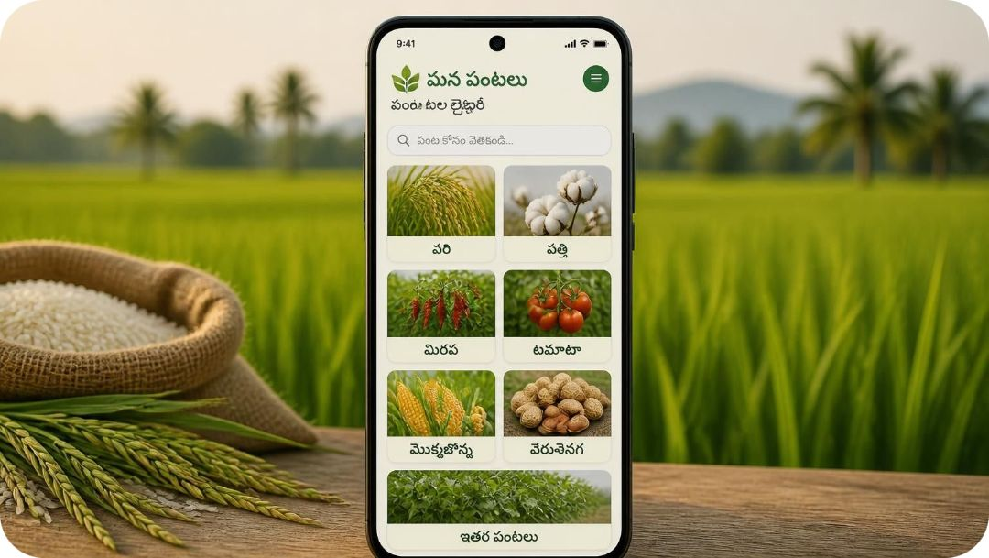
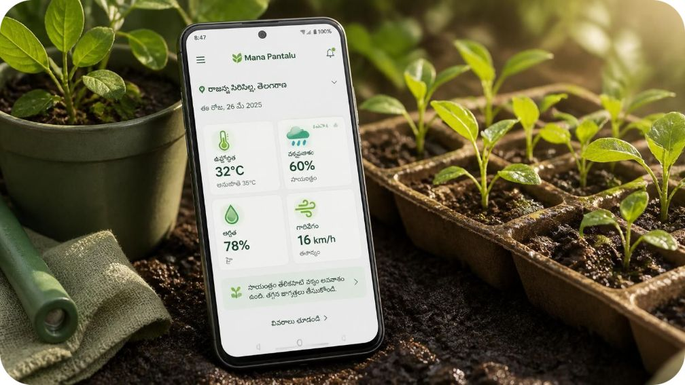
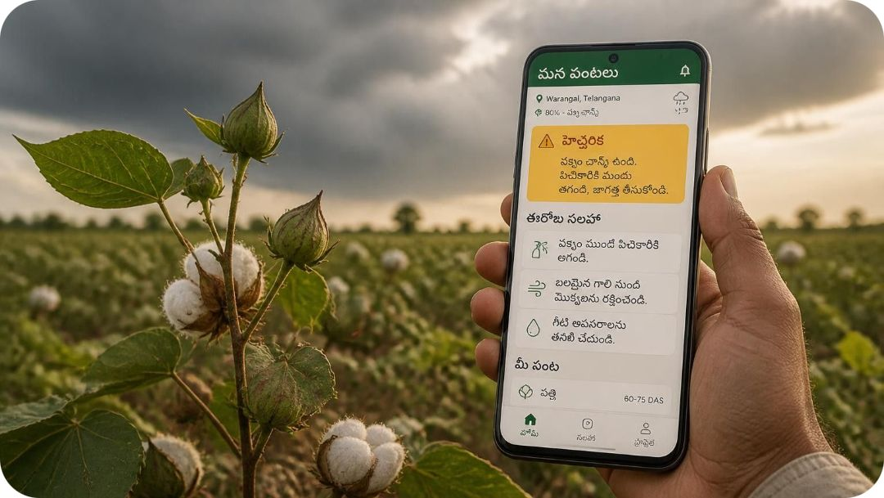
Recognize crops and read the weather in one place
Know the crop
Read the weather
Act on alerts
Choose from the crops farmers already grow.
Keep temperature, rain possibility, humidity, and wind together.
Turn conditions into practical reminders, not another dashboard.

Slide 8
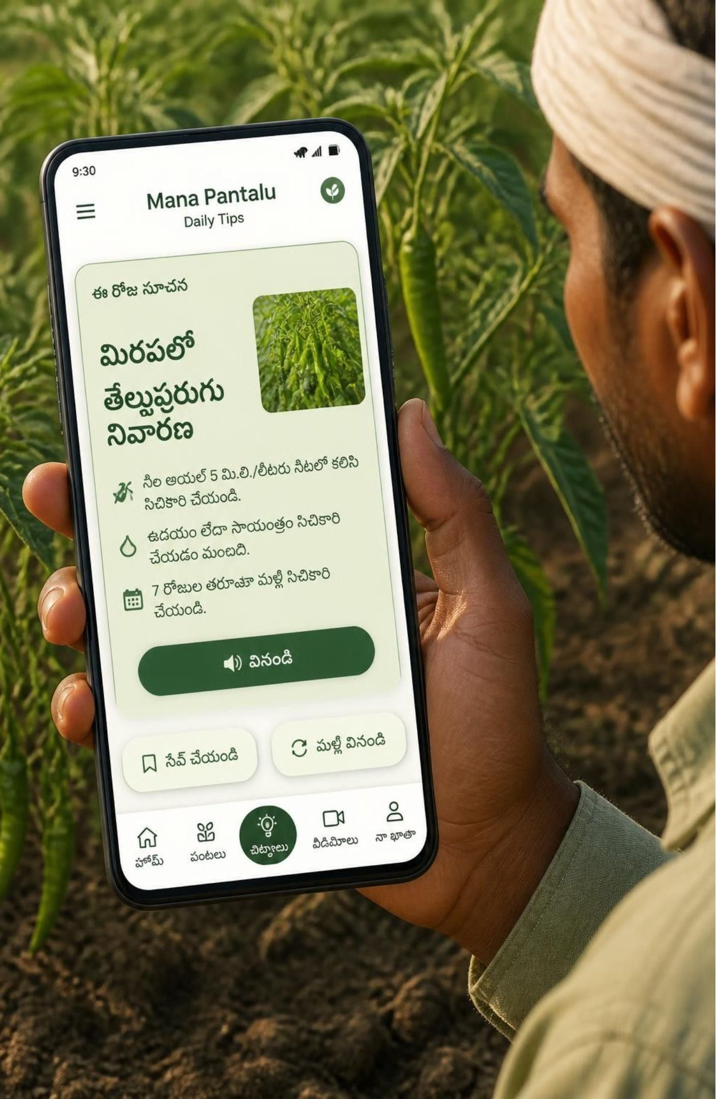
Daily tips in voice or text
Useful guidance should fit between field work, not create more work.
Today’s crop-care tip
Fertilizer by stage
Guidance that follows crop growth.
One short action for the crop in front of you.
Irrigation + weather
Pest prevention
Small reminders before a problem spreads.
Suggestions that respond to changing conditions.
Short voice cards, readable text cards, save and replay.

Slide 9
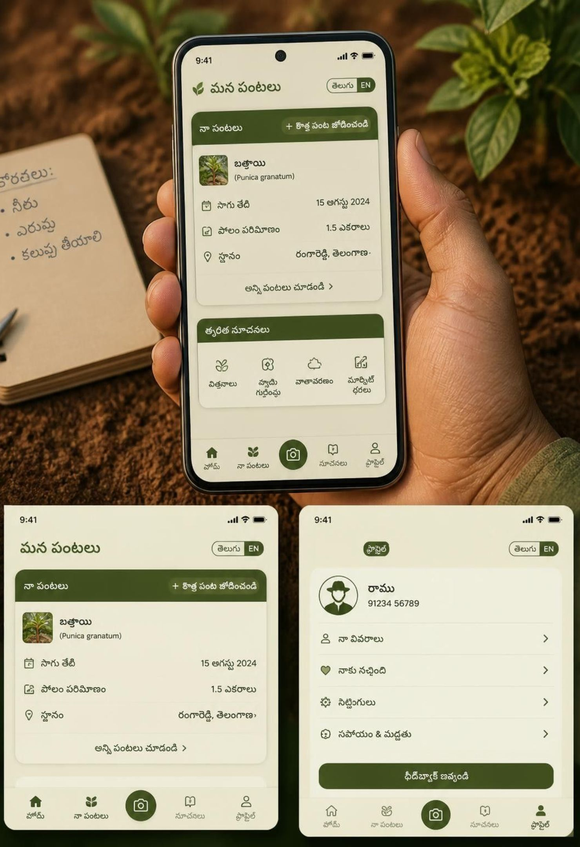
PERSONAL SETUP
My Crops and Profile keep the app personal
Save the details that make guidance feel relevant: crop, sowing date, field size, and location.
My Crops
Profile
Feedback
See the next care action and receive reminders.
Choose తెలుగు / English, notifications, location permission, help, and feedback.
Send a voice note or text when something needs improving.
Personal does not mean complicated: one place to update the basics.

Slide 10
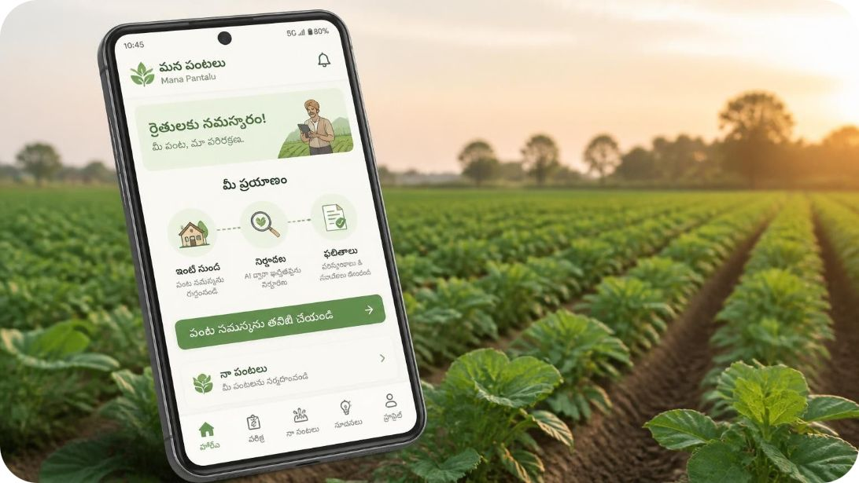
One clear navigation system connects every task
1
Start at Home
Welcome → Home → Diagnose → Camera or Gallery.
2
Follow the answer
AI Scan → Disease Result → Treatment.
3
Explore support
Each route starts simply, keeps the next action visible, and returns to the same home.
Home → Weather / Tips / My Crops / Profile.
4
Return anytime
Persistent bottom navigation: హోమ్, పరీక్ష, నా పంటలు, సూచనలు, ప్రొఫైల్.

Slide 11
THE PRODUCT IN ONE LINE
Mana Pantalu makes the next action clear
A Telugu-first farming assistant with photo diagnosis, voice support, weather alerts, crop reminders, and practical care guidance.
Simple enough
for a first-time smartphone user.
Useful enough
to return to every day.
Ready for action
with voice or text.
One calm interface for clearer farming decisions.

