Slide 1
A deep dive into optimizing Multi-Scalar Multiplication
By Niall Emmart
nemmart@yrrid.com

Slide 2
Talk Roadmap
Introductory Material
Algorithmic Optimizations
Bucket Method and Gus Gutowski’s talk
GPU Implementation
WebAssembly (WASM) Implementation
Multiple Precision Integer Representations

Slide 3
Multi-Scalar Multiplication (MSM)
Given a cyclic group G, and n group elements, G₁,…,G_{n} and n integers values, s₁,…,s_{n} between 0 and |G|, compute:
MSM = s₁G₁ + s₂G₂ + … + s_{n}G_{n}

Slide 4
Motivation: Zero Knowledge Proofs
Many ZKP systems use MSM over elliptic curves on finite fields, in particular the BLS and BN curves.
Group elements are points on the curve. |G| is the main subgroup order.
MSM is very compute heavy
Represents 80-90% of the total runtime to generate a proof in some ZKP systems.
GOAL: Improve MSM performance

Slide 5
MSM Runtime Breakdown
total run time = Overhead + # of FF ops ∙ Average time per FF op
Typically small, 10-20% of total run time.
Driven by high level algs and EC point representation
Dominated by FF multiplication time
FF op = Finite Field Op: add, sub, multiplication, inverse

Slide 6
Algorithmic Optimizations

Slide 7
Bucket Method (Pippenger’s Alg) In Brief
The Bucket method computes an MSM in three phases:
Bucket accumulation
Bucket reduction to window sums
Final MSM computation
Gus Gutowski’s Talk
YouTube link: https://www.youtube.com/watch?v=Bl5mQA7UL2I

Slide 8

Bucket Method (Pippenger’s Alg) In Brief
b bits in length
s_{i} =
. . .
c bits chunks
c bits
Number of chunks aka windows is: $w=\left\lceil \frac{b}{c}\right\rceil$
Notation:
n – number of pts & scalars w – the number of windows k – a bucket index, 0 .. 2^{c}-1
b – bit length of the scalar i – a point/scalar index, 1 .. n s_{i}[j] – value of the j^{th} chunk of s_{i}
c – window chunk size in bits j – a window index, 0 .. w-1 B[j, k] – accumulator bucket

Slide 9
Bucket Accumulation Phase
Pseudo-Code for bucket accumulation:
… initialize all buckets to 0 …
for(i=1;i<=n;i++) {
for(j=0;j<w;j++)
B[j, s_{i}[j]] += P_{i};
}
Things of note:
Total numbers of buckets is w ∙ 2^{c}
Each point is added to w buckets
Total number of point adds is w ∙ n

Slide 10

Bucket Reduction Phase
For each window j, we compute:
$$W_{j}= \sum_{k=1}^{2^{c}−1}{k⋅B[j, k]}$$
W_{j} can be efficiently computed using the sum of sums algorithm:
sum = 0;
sumOfSums = 0;
for(k=2^{c}-1;k>0;k--) {
sum += B[j, k];
sumOfSums += sum;
}
W_{j} = sumOfSums;

Slide 11
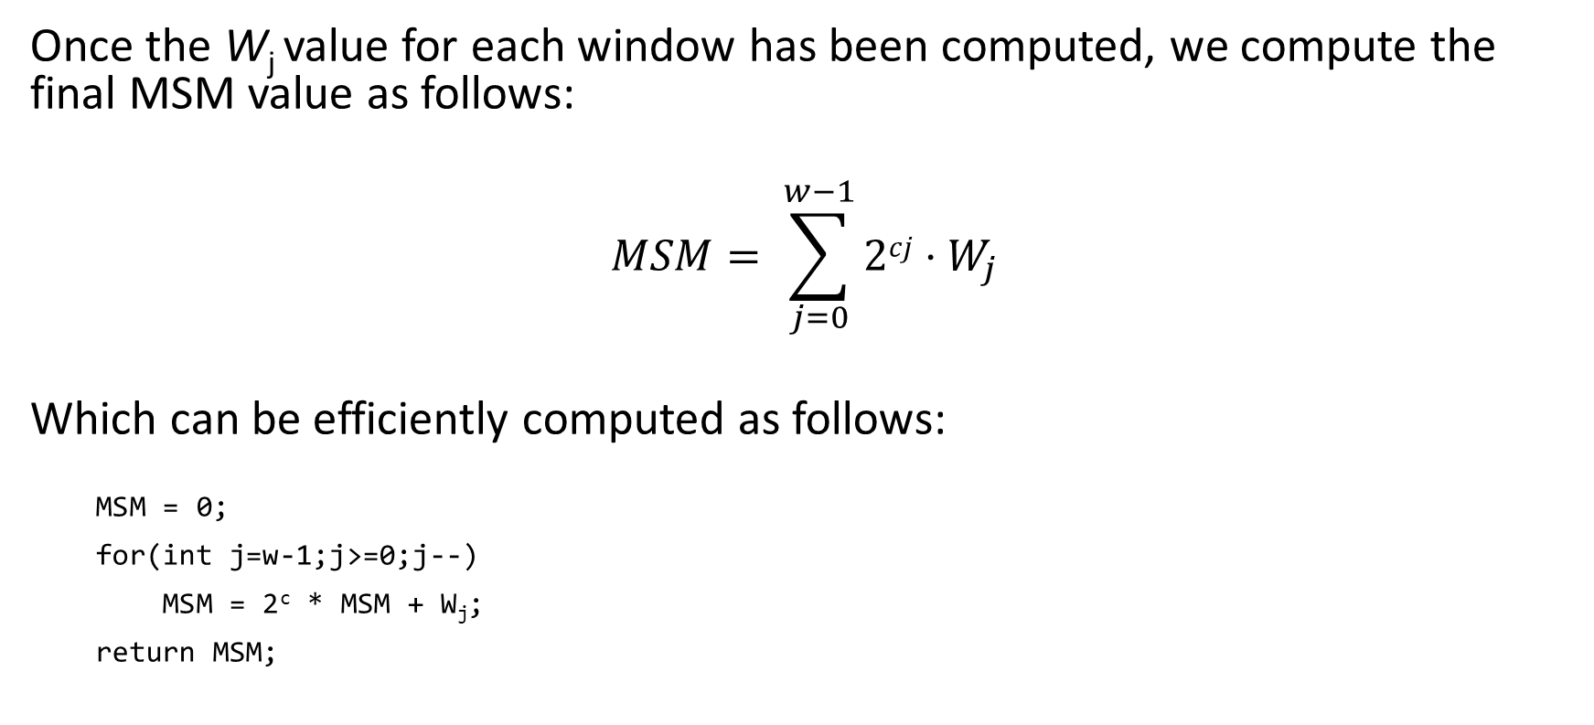
Final MSM Result
Once the W_{j} value for each window has been computed, we compute the final MSM value as follows:
$$MSM= \sum_{j=0}^{w−1}{2cj⋅W_{j}}$$
Which can be efficiently computed as follows:
MSM = 0;
for(int j=w-1;j>=0;j--)
MSM = 2^{c} * MSM + W_{j};
return MSM;

Slide 12
Signed Digits Endomorphism
Since we can efficiently compute -Pi [instead of (x, y) it’s just (x, -y)], we can preprocess the scalars as follows and cut the number of bucket accumulators in half:
for(int i=1;i<=n;i++) {
for(int j=0;j<w;j++) {
if(s_{i}[j]>2^{c}/2) {
s_{i}[j]=2^{c}-s_{i}[j];
s_{i}[j+1]++;
// instead of adding Pi, we add –Pi to B[j, s_{i}[j]]
}
}
}
Requires that c does not evenly divide b

Slide 13

Cube Root of One Endomorphism
The BLS curves have a cube root endomorphism. It is best explained with an example curve.
For every BLS12-381 point, P=(x, y), the exists another point, $\overline{P}$, where $\overline{P}=(βx, y)=λP$.
Thus we can re-express any point and scalar pair, $sP,$ where $s≤\left|G\right|$ and $P=\left(x,y\right)$ as:
$sP=s_{1}\overline{P}+s_{2}P=s_{1}\left(βx, y\right)+s_{2}P$
where $s_{1}=s div λ, s_{2}=s \text{mod} λ,$and we have both $s_{1},s_{2}<2^{128}$. The smaller s₁ and s₂ scalars can improve performance in some cases.
Some of the BLS12-381 Curve Parameters
Field Modulus q | 0x1a0111ea397fe69a4b1ba7b6434bacd764774b84f38512bf6730d2a0f6b0f6241eabfffeb153ffffb9feffffffffaaab
Field Order (|G|) | 0x73eda753299d7d483339d80809a1d80553bda402fffe5bfeffffffff00000001
beta (β³ = 1 mod q) | 0x1a0111ea397fe699ec02408663d4de85aa0d857d89759ad4897d29650fb85f9b409427eb4f49fffd8bfd00000000aaac
lambda (λ³ = 1 mod |G|) | 0xac45a4010001a40200000000ffffffff

Slide 14
Two Open Questions
Can we extract more conflict free parallel work?
Can we efficiently use signed digits when c evenly divides b?

Slide 15
Algorithmic Optimizations
GPU Implementation

Slide 16
ZPrize – GPU MSM Competition
Generates 2^26 random points (BLS12-377, on the CPU)
Allowed to copy points to GPU memory and do limited untimed precomputation on the points
Generates 4 sets of 2^26 scalars (on the CPU)
Timer starts
Minimize the time to compute 4 MSM values, corresponding to the 4 scalars sets against the point set.
A40 GPU (48 GB GPU mem).

Slide 17
Extract Parallelism
To achieve maximum efficiency on the GPU requires tens of thousands of threads running in parallel.
Q: How can we extract that much parallelism?
A: Simple, instead of looping over the points, adding each P_{i} to w buckets, we use sorting to build lists of the points to be added to each bucket. Then we process those lists in parallel, one thread per bucket.

Slide 18
Bucket Accumulator Point Representation
Accumulation Phase:
Representation | Second Addition | Third (and up) Addition
Jacobian: XYZ += XY | 4 modmul, 2 modsqr (6 mults) | 7 modmul, 4 modsqr (11 mults)
Extended Jacobian: XYZZ += XY | 4 modmul, 2 modsqr (6 mults) | 8 modmul, 2 modsqr (10 mults)
Batched affine addition: XY += XY | 5 modmul, 1 modsqr (6 mults) † | 5 modmul, 1 modsqr (6 mults) †
Reduction Phase:
Representation | Second (and up) Addition
Jacobian: XYZ += XYZ | 11 modmul, 5 modsqr (16 mults)
Extended Jacobian: XYZZ += XYZZ | 12 modmul, 2 modsqr (14 mults)
Batched affine addition: XY += XY | 5 modmul, 1 modsqr (6 mults) †
From: https://www.hyperelliptic.org/EFD/g1p/auto-shortw.html
† Requires batched addition – discussed later in the talk

Slide 19
Best Window Size?
Table of mod-mul counts: BLS12-377, thus b=253:
 | Without signed digits |  |  | With signed digits
Size | Acc Phase | Red Phase | Total | Acc Phase | Red Phase | Total | Using Trick
c=21 | 8.04 | 0.70 | 8.74 | 8.38 | 0.35 | 8.73
c=22 | 7.41 | 1.29 | 8.70 | 7.73 | 0.65 | 8.38
c=23 | 6.09 | 2.58 | 8.67 | 7.07 | 1.29 | 8.36
c=24 | 5.03 | 4.70 | 9.73 | 6.21 | 2.35 | 8.56
8.03
All counts in billions of modmuls per MSM
When c=23, c evenly divides b (23*11=253)

Slide 20
Trick: sP = (-s)(-P)
Can we efficiently handle signed digits in the case where c evenly divides b? This is the case for b=253 and c=23!
Naïve solution: create an extra window to handle the scalars where the msb is set.
Better solution:
Note, sP = (-s)(-P)
Proof: (-s)(-P) = (|G| - s)(-P) = |G|(-P) - (s(-P)) = 0 - (s(-P)) = 0 + sP = sP
When the msb of s_{i} is set we can negate both the scalar and point, and the msb of -s_{i} will be clear.
This trick saves us approx. 335 million modmuls.

Slide 21
Precomputed Points
For each P_{i}, we precompute 5 other points:
2⁴⁶ P_{i} , 2⁹² P_{i} , 2¹³⁸ P_{i} , 2¹⁸⁴ P_{i} , 2²³⁰ P_{i}.
Adding 2⁴⁶ P_{i} to window 0 is equivalent to adding P_{i} to window 2.
Thus, we can reduce the 11 windows down to 2.
Final count, 7.50 billion modmuls
Wasn’t able to exploit the cube root endomorphism

Slide 22
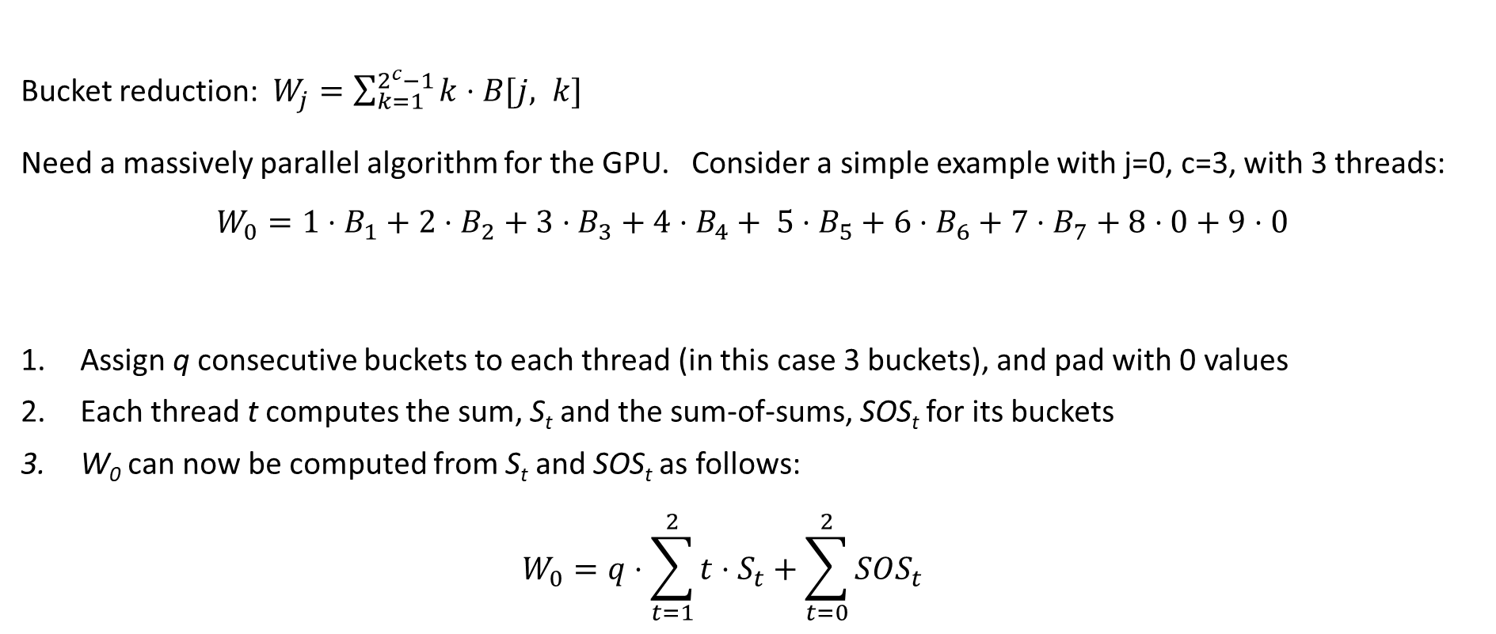
Parallel Bucket Reduction
Bucket reduction: $W_{j}=\sum_{k=1}^{2^{c}−1}{k⋅B[j, k]}$
Need a massively parallel algorithm for the GPU. Consider a simple example with j=0, c=3, with 3 threads:
$$W_{0}={1⋅B}_{1}+2⋅B_{2}+3⋅B_{3}+4⋅B_{4}+ 5⋅B_{5}+6⋅B_{6}+7⋅B_{7}+8⋅0+9⋅0$$
Assign q consecutive buckets to each thread (in this case 3 buckets), and pad with 0 values
Each thread t computes the sum, S_{t} and the sum-of-sums, SOS_{t} for its buckets
W₀ can now be computed from S_{t} and SOS_{t} as follows: $W_{0}=q⋅\sum_{t=1}^{2}{t⋅S_{t}+\sum_{t=0}^{2}{SOS_{t}}}$
†
Thread 0
Thread 1
Thread 2
† Shorthand notation: B_{i} = B[0, i]

Slide 23
Correction-less EC Point Routines
For some curves and operations, in particular BLS12-377, XYZZ + affine point, implemented using Montgomery multiplication, we can build correction-less versions.
Process to add an affine point (X2, Y2) to an XYZZ (X1, Y1, ZZ1, ZZZ1) accumulator:
U2 = X2 * ZZ1; S2 = Y2 * ZZZ1; P = U2 – X1; R = S2 – Y1; PP = P²; PPP = P * PP; Q = X1 * PP; X3 = R² – (PPP + 2*Q); Y3 = R * (Q-X3) – Y1 * PPP; ZZ3 = ZZ1 * PP; ZZZ3 = ZZZ1 * PPP; return (X3, Y3, ZZ3, ZZZ3);
From https://www.hyperelliptic.org/EFD/g1p/auto-shortw-xyzz.html#addition-madd-2008-s

Slide 24
Correction Steps
Correction steps are often needed to ensure that the result of a finite field operation remains in the valid range, [0, N), where N is the field prime modulus. For example:
BigNum add(BigNum A, BigNum B) { BigNum S=A+B; if(S>=N) // correction step S=S-N; }
BigNum sub(BigNum A, BigNum B) { BigNum D=A-B; if(D<0) // correction step D=D+N; }
BigNum mul(BigNum A, BigNum B) { BigNum R=redc(A*B); if(R>=N) // correction step R=R-N; }
GOAL: get rid of correction steps!

Slide 25
Bounds
We will ensure three properties:
Every intermediate value will be positive (>= 0)
Every intermediate value will have an upper bound
The bounds are stated in terms of multiples of N, e.g., X in [0, 3.4] means 0<=X<=3.4N.
Operations:
addBound(aBound, bBound) => aBound + bBound
subBound(aBound, bBound) => aBound + ceil(bBound)
montMulBound(aBound, bBound) => (aBound*bBound/152) + 1 †
† This bound is specific to BLS12-377. Proof on next slide.

Slide 26
Bounds for Montgomery Multiplication
From Montgomery’s original paper, we have:
MontMul(BigNum A, BigNum B) = (A*B + Q*N) / R (for some 0<=Q<R, where R=2³⁸⁴).
Rewrite in terms of aBound and bBound:
MontMul(aBound*N, bBound*N) < (aBound*bBound*N*N + R*N)/R
< N*(aBound*bBound/(R/N) + 1) [ for BLS12-377, R/N>152, thus… ]
< (aBound*bBound/152 + 1)*N
We state the bounds in terms of multiples of N, therefore:
montMulBound(aBound, bBound) = (aBound*bBound/152) + 1
Note, montMulBound(7.4, 8.3) = 1.41, is considerably smaller than 7.4 or 8.3. Contrary to what one might expect, MontMul shrinks the bounds!

Slide 27
Correction-less EC Algorithms
Process to accumulate XYZZ (X1, Y1, ZZ1, ZZZ1) an affine points (X2, Y2):
// Input asserts / requirements: // X1 <= 6N, Y1 <= 4N, ZZ1 <= 2N, ZZZ1 <= 2N // X2 <= 1N, Y2 <= 1N
U2 = X2 * ZZ1; // 1*2/152+1 = 1.02 // U2 <= 1.02 N S2 = Y2 * ZZZ1; // 1*2/152+1 = 1.02 // S2 <= 1.02 N P = U2 – X1 + 6N; // 1.02 + 6 // P <= 7.02 N R = S2 – Y1 + 4N; // 1.02 + 4 // R <= 5.02 N PP = P²; // 7.02^2/152+1 = 1.33 // PP <= 1.33 N PPP = P * PP; // 7.02*1.33/152+1 = 1.07 // PPP <= 1.07 N Q = X1 * PP; // 6*1.33/152+1 = 1.06 // Q <= 1.06 N X3 = R² – (PPP + 2*Q) + 4N; // 5.02^2/152+1+4 = 5.17 // X3 <= 5.17 N YP = Y1*PPP; // 4*1.07/152+1 = 1.03 // YP <= 1.03 N Y3 = R*(Q - X3 + 6N) – YP + 2N; // 5.02*7.03/152+1+2 = 3.24 // Y3 <= 3.24 N ZZ3 = ZZ1 * PP; // 2*1.33/152+1 = 1.02 // ZZ3 <= 1.02 N ZZZ3 = ZZZ1 * PPP; // 2*1.07/152+1 = 1.02 // ZZZ3 <= 1.02 N
// Output assertions: // X3 <= 6N, Y3 <= 4N, ZZ3 <= 2N, ZZZ3 <= 2N // Output assertions match input requirements!!

Slide 28
GPU Specific Optimizations
Use 384 threads per SM (this requires careful register usage management)
Use state machines to avoid thrashing the instruction cache
Overlap compute and CPU -> GPU copy using GPU streams
Matter Labs: For the first MSM, break it into two MSMs of ¼ the size and remaining ¾ for better compute/copy overlap.

Slide 29
Algorithmic Optimizations
WASM Implementation

Slide 30
ZPrize – WASM MSM Competition
Generates random MSM problems that range in size from 2^12 to 2^18.
Uses BLS12-381, with b=255.
Score is the average speed-up of the submitted code over the provided baseline code running on Chrome (v96).
No WASM vector ops, only allowed to use a single thread

Slide 31
Approach
Bucket method, c is chosen empirically based on MSM size
Endomorphisms: signed digits and cube root of one
Use the sP=(-s)(-P) trick when c evenly divides b
Use batched affine point accumulators for both the accumulator phase and the reduction phase.

Slide 32
Affine Point Accumulation
Process to add two affine points (X1, Y1) and (X2, Y2):
D = X1 – X2; // X1==X2 case requires special processing
I = D⁻¹; // inverse operation is very expensive
T = (Y1 – Y2) * I;
X3 = T² + X1 + X2;
Y3 = T * (X2 – X3) – Y2;
return (X3, Y3);
Expensive op count: 2 modmul, 1 modsqr, 1 modinv

Slide 33
Batch Inversion
Example of inverting a batch of 4: A, B, C, D
T₀ = A∙B; // T₀ = AB
T₁ = T₀∙C; // T₁ = ABC
T₂ = T₁∙D; // T₂ = ABCD
I = T₂⁻¹; // I = (ABCD)⁻¹ Note: (ABCD)⁻¹ = A⁻¹B⁻¹C⁻¹D⁻¹
D⁻¹ = I∙T₁; // D⁻¹ = (ABCD)⁻¹(ABC)
I = I∙D ; // I = (ABCD)⁻¹(D) = (ABC)⁻¹
C⁻¹ = I∙T₀; // C⁻¹ = (ABC)⁻¹(AB)
I = I∙C; // I = (ABC)⁻¹(C) = (AB)⁻¹
B⁻¹ = I∙A; // B⁻¹ = (AB)⁻¹(A)
A⁻¹ = I∙B; // A⁻¹ = (AB)⁻¹(B)
Inverting a batch of n finite fields requires 3n-3 modmul, and one modular inverse.

Slide 34
Batched Affine Accumulator
Given a list (i.e., a batch) of tuples (Bucket, Point), iterate over the list, adding the points to the buckets. This algorithm runs in phases:
First phase – construct the list of values to invert
Run the batch invert algorithm
Third phase – complete the point adds
Important caveat: you can’t add two points to the same bucket in a batch.
Cost: 5 modmuls, 1 modsqr per point add (6 mults)
1 mod inverse per batch

Slide 35
Collision Method
Typical implementations generate lists of points for each bucket (essentially sorting). These are used to build conflict free batches. But it is expensive and wanted something more efficient:
We have a lock flag for each bucket and a collision list.
We process the scalars/points in order. If the target bucket is not locked, we add the point/bucket to the current batch and lock the bucket. If it is locked, we add the point/bucket to the collision list.
If we have a full batch, or the collision list reaches its limit, we process the batch and repeat. When we start the next batch we reset the locks and add what we can from the collision list to the new batch.
Repeat until all points have been processed and the collision list is empty.

Slide 36
Bucket Reduction Phase
The key challenge for the reduction phase is constructing independent batches of adds. Essentially we can use the same strategy we used on the GPU. Break the window sum into smaller sums of size q.
Since each group is independent of the other groups, each group can provide an add to the batch without conflicts.
$$W_{0}={1⋅B}_{1}+2⋅B_{2}+3⋅B_{3}+4⋅B_{4}+ 5⋅B_{5}+6⋅B_{6}+7⋅B_{7}+8⋅0+9⋅0$$
Group 0
Group 1
Group 2

Slide 37
Summary

Slide 38
Noteworth Contributions
Correction-less EC algorithms
sP=(-s)(-P) trick for when c evenly divides b
Collision method for building batches
Batched affine accumulators for the reduction phase

Slide 39
Multiple Precision Integer Representation

Slide 40
GPU - Basics
We represent a BLS12-377 finite field value as a sequence of 12 32-bit limbs (m).
The x, y, zz, and zzz finite field values are entirely stored in registers on each thread.
Addition and subtraction are linear O(m), approx. 12 instructions each.
The modmul operation uses simple O(m^2) algorithms for both the multiplication and the Montgomery reduction. Fully unrolled, approx. 400 instructions in length.
Modsqr takes advantage of fast-squaring, approx. 320 instructions.
Modmul and modsqr are by far the most expensive ops and must be carefully optimized.
Matter Labs optimization: MontRed(a*b) + MontRed(c*d) = MontRed(a*b + c*d) which can save a MontRed step.

Slide 41
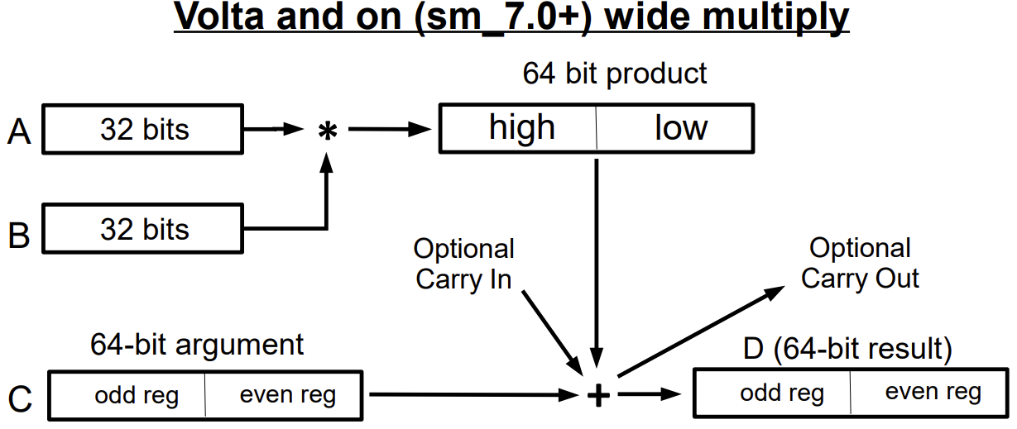
GPU IMAD.WIDE Instruction
Volta+ GPUs have a 64-bit multiplication instruction: IMAD.WIDE D, A, B, C
Computes A*B + C, stores the result in D. A and B are 32 bit source registers. C and D are pairs of even aligned 32-bit registers. Supports optional carry in and optional carry out.
Throughput: 128 IMAD.WIDE ops every 4-5 cycles per SM.

Slide 42
Alignment Problem
A₃ A₂ A₁ A₀
B₃ B₂ B₁ B₀
H(A₂B₀) L(A₂B₀) H(A₀B₀) L(A₀B₀)
B0 rows
H(A₃B₀) L(A₃B₀) H(A₁B₀) L(A₁B₀)
H(A₃B₀) L(A₃B₀) H(A₁B₀) L(A₁B₀)
H(A₂B₁) L(A₂B₁) H(A₀B₁) L(A₀B₁)
H(A₂B₁) L(A₂B₁) H(A₀B₁) L(A₀B₁)
H(A₃B₁) L(A₃B₁) H(A₁B₁) L(A₁B₁)
B1 rows
H(A₂B₂) L(A₂B₂) H(A₀B₂) L(A₀B₂)
H(A₃B₂) L(A₃B₂) H(A₁B₂) L(A₁B₂)
B2 rows
H(A₃B₂) L(A₃B₂) H(A₁B₂) L(A₁B₂)
H(A₂B₃) L(A₂B₃) H(A₀B₃) L(A₀B₃)
H(A₂B₃) L(A₂B₃) H(A₀B₃) L(A₀B₃)
H(A₃B₃) L(A₃B₃) H(A₁B₃) L(A₁B₃)
B3 rows
odd even odd even odd even odd even

Slide 43
Even-Odd Solution
Even aligned terms
A₃ A₂ A₁ A₀
B₃ B₂ B₁ B₀
H(A₂B₀) L(A₂B₀) H(A₀B₀) L(A₀B₀)
H(A₃B₁) L(A₃B₁) H(A₁B₁) L(A₁B₁)
H(A₂B₂) L(A₂B₂) H(A₀B₂) L(A₀B₂)
H(A₃B₃) L(A₃B₃) H(A₁B₃) L(A₁B₃)
odd even odd even odd even odd even aligned accs
Odd aligned terms
H(A₂B₁) L(A₂B₁) H(A₀B₁) L(A₀B₁)
H(A₃B₀) L(A₃B₀) H(A₁B₀) L(A₁B₀)
H(A₃B₂) L(A₃B₂) H(A₁B₂) L(A₁B₂)
H(A₂B₃) L(A₂B₃) H(A₀B₃) L(A₀B₃)
odd even odd even odd even unaligned accs
result = aligned accs + (unaligned accs<<32)

Slide 44
Fast Squaring
A₃ A₂ A₁ A₀
A₃ A₂ A₁ A₀
L(A₃A₀)
L(A₂A₀)
L(A₁A₀)
L(A₀A₀)
H(A₀A₀)
H(A₂A₀)
H(A₃A₀)
H(A₁A₀)
L(A₃A₁) L(A₂A₁) L(A₁A₁) L(A₀A₁)
H(A₃A₁) H(A₂A₁) H(A₁A₁) H(A₀A₁)
L(A₃A₂) L(A₂A₂) L(A₁A₂) L(A₀A₂)
H(A₃A₂) H(A₂A₂) H(A₁A₂) H(A₀A₂)
L(A₃A₃) L(A₂A₃) L(A₁A₃) L(A₀A₃)
H(A₃A₃) H(A₂A₃) H(A₁A₃) H(A₀A₃)
Compute the Red values, double it and add in the grey diagonal values

Slide 45
Key Take-Aways
You need a deep understand the underlying hardware architecture, and the available math instructions
When possible, write the low level math routines in assembly
When not possible, check what the compiler is generating, ensure it’s efficient code
Try out different algorithms and variants to see which work best

Slide 46
Web Assembly Environment
We implemented our submission in C.
Work flow:
JavaScript loads the .wasm, creates and manages the wasm object, handles integration with the web page.
TurboFan JITs the .wasm byte code to native x86
Chrome
JS + TurboFan
C source
clang
.wasm
JIT: Native x86

Slide 47
WASM - Basics
We represent a BLS12-381 finite field value as a sequence of 13 30-bit limbs (m) embedded in 64-bit unsigned ints.
WASM byte code does not support the carry flag.
Addition and subtraction are fast. Modmul and modsqr are slow. Both use Montgomery multiplication.
We use one level of Karatsuba multiplication in modmul, and fast squaring in modsqr.

Slide 48
Multiplication
. . .
A₃ A₂ A₁ A₀
B₃ B₂ B₁ B₀
. . .
A₃B₀ A₂B₀ A₁B₀ A₀B₀
A₃B₁ A₂B₁ A₁B₁ A₀B₁
A₃B₂ A₂B₂ A₁B₂ A₀B₂
A₃B₃ A₂B₃ A₁B₃ A₀B₃
. . .
The idea behind 30-bit limbs is the multiplier. Consider a column in a 13x13 multiplication. We are guaranteed that we can accumulate 16 A_{i}∙B_{j} terms without needing to worry about overflowing a 64-bit accumulator. The cost of a 13th limb is much less than the cost of resolving the overflows.

Slide 49
Carry Handling - Addition
Add routine. Results can have 31 bits of data in each limb.
FF381 add(FF381 a, FF381 b) {
FF381 res;
res.limb0 = a.limb0 + b.limb0; res.limb1 = a.limb1 + b.limb1; res.limb2 = a.limb2 + b.limb2;
. . .
res.limb12 = a.limb12 + b.limb12;
return res;
}

Slide 50
Carry Handling - Resolving Carries
Resolve any carries that have built up in the limbs:
FF381 resolveCarries(FF381 f) {
FF381 res; uint64_t mask=0x3FFFFFFF; // 30 bit mask
res.limb1 = f.limb1 + (f.limb0>>30); res.limb2 = f.limb2 + (f.limb1>>30);
. . .
res.limb12 = f.limb12 + (f.limb11>>30);
res.limb0 = res.limb0 & mask; res.limb1 = res.limb1 & mask;
. . .
res.limb11 = res.limb11 & mask;
return res;
}

Slide 51
Carry Handling - Subtraction
For subtraction, we need to know the N bound to guarantee a positive result. In this routine, we require that b is less than 2N:
FF381 subPlus2N(FF381 a, FF381 b) {
// input requirement: b must be resolved, i.e., no carry bits
FF381 res;
// a - b + 2N res.limb0 = a.limb0 – b.limb0 + 0xFFFF5556u; // The 2N constant is subtle. These are 32 res.limb1 = a.limb1 – b.limb1 + 0xCFF7FFFCu; // bit values, top two bits are always 3, res.limb2 = a.limb2 – b.limb2 + 0xEA7FFFF4u; // which guarantees the limb will be positive, res.limb3 = a.limb3 – b.limb3 + 0xD5FFFF55u; // even in the case where b.f3 > a.f3.
. . .
res.limb11 = a.limb11 – b.limb11 + 0xF51CBFF0u; res.limb12 = a.limb12 – b.limb12 + 0x00340220u; return res;
}

Slide 52
Thank you!!
Questions?

