Slide 1
Extended GPS Spoofing Detection Method
GPS spoofing detection methods:
Noise level
Automatic gain control (AGC)
Time jump (new method suggested by Venkatesh)
Comparing the internal time and the time determined by the GPS module. A severe jump can point to the presence of spoofing.
We need to decide a proper threshold to detect the time jump.
Experiment locations:
A static position
Purdue campus
Downtown Chicago
Details of the time jump method: https://gpspatron.com/spoofing-attacks-chapter-2/#:~:text=PPS%20monitoring%20with%20time%20server

Slide 2
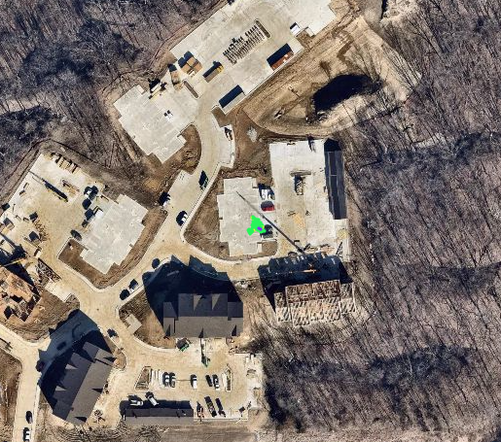
1. Time Jump in a Static Position
Duration: 31 minutes
Distance: 0 km
Average speed: 0 km/h
Millisecond
7,000 ms
(i.e., 7 seconds)
Place where the experiment was conducted
Detailed in https://review.px4.io/plot_app?log=bd456e2a-5849-484b-94f3-0104b6ced40b

Slide 3
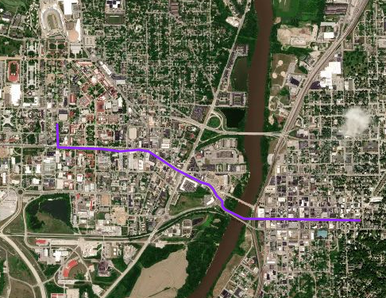

2. Time Jump in Purdue campus
I measured the time jump while driving a vehicle.
Duration: 8 minutes
Distance: 2.41 km
Average speed: 24.5 km/h
End
Purdue campus
Millisecond
4,000 ms
(i.e., 4 seconds)
Start
Detailed in https://review.px4.io/plot_app?log=c140c794-0731-40d6-a74b-35ba552459f4

Slide 4
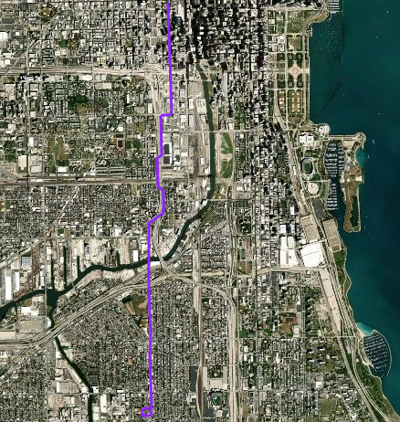
3. Time Jump in Downtown Chicago (1)
I measured the time jump while driving a vehicle.
Duration: 30 minutes
Distance: 1.8 km
Average speed: 8.5 km/h
End
Millisecond
13,800 ms
(i.e., 13.8 seconds)
Start
Detailed in https://review.px4.io/plot_app?log=0b1d5a3f-1c8c-4d08-86f8-9e6356339c46

Slide 5
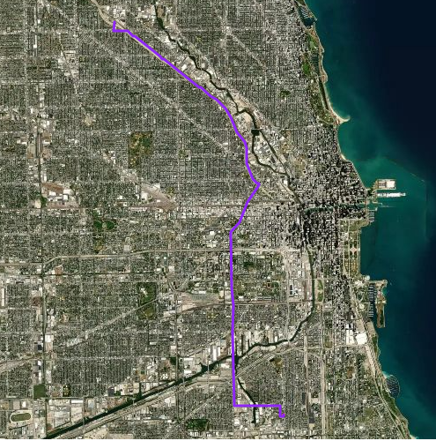
3. Time Jump in Downtown Chicago (2)
I measured the time jump while driving a vehicle.
Duration: 37 minutes
Distance: 9.5 km
Average speed: 29.5 km/h
End
Millisecond
30,200 ms
(i.e., 30.2 seconds)
Start
Detailed in https://review.px4.io/plot_app?log=0dafd179-fde1-4044-b87a-c09493515ce1

Slide 6
Takeaway
Time jump-based detection method:
Is feasible because attackers might change not only positions but also time.
Proper threshold :
1 minute (60 seconds) will be reasonable to detect GPS spoofing attacks.

