Slide 1
Road Accident Risk Prediction & Comparative Analysis
JP Purushothama Reddy [PES2201800473]
Nikhil Karle [PES2201800642]
Sagar S [PES2201800343]

Slide 2
Introduction
Road accidents are main cause of deaths among youngsters.
In 2015, US lost 37000 individuals in car accidents, which is more than 7.2% from previous years.
The cost of fatalities and injuries will greatly affect the general people.
Reducing traffic accidents is a public safety challenge.

Slide 3
PROBLEM STATEMENT
Reducing traffic accidents is an essential public safety challenge all over the world; therefore, accident analysis has been a subject of much research in recent decades
The objective of the project is to analyze the US accident data from 50 states to understand, insights trends, and possible causes of traffic accidents and what could be done to reduce them.

Slide 4
Project Scope
Problem statement
Dataset
Challenges
Increase of road accidents
Public safety
Analyse the factors increasing the accidents
Accident risk prediction
The dataset consists of 3million records and 49 columns
Contains labels as theseverity of the accident ranging from 0 to 4.(levels of severity of accident)
Employing the huge dataset.
The labels of this dataset are skewed
We had lots of categorical variables.
Determining the actual factors lead to accidents.

Slide 5
PLAN FOR PROJECT

Slide 6
Data Visualization for understanding the data distribution and features
Data cleaning, data transformation, dimensionality reduction, scaling and normalization
Accuracy score
Exploratory Data Analysis
Feature selection
Preprocessing
Model selection
Evaluation
Selecting relevant features that contribute to the prediction of risk
Modeling and ensemble modeling

Slide 7
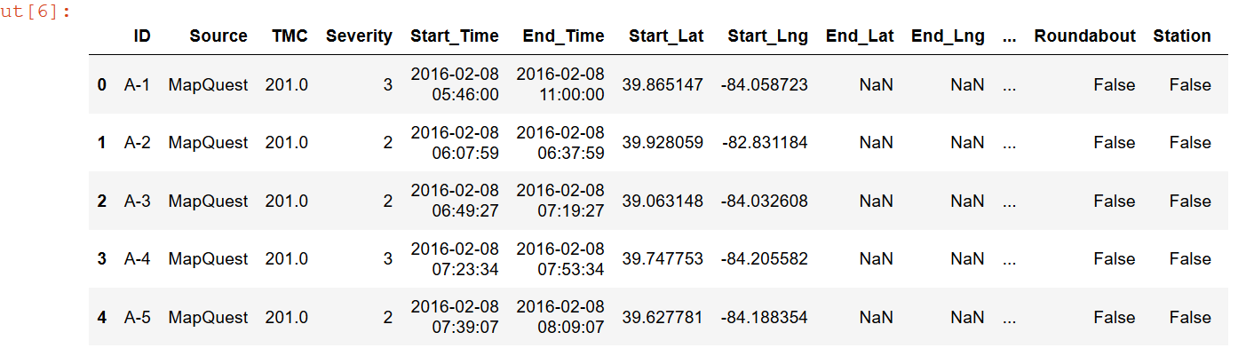
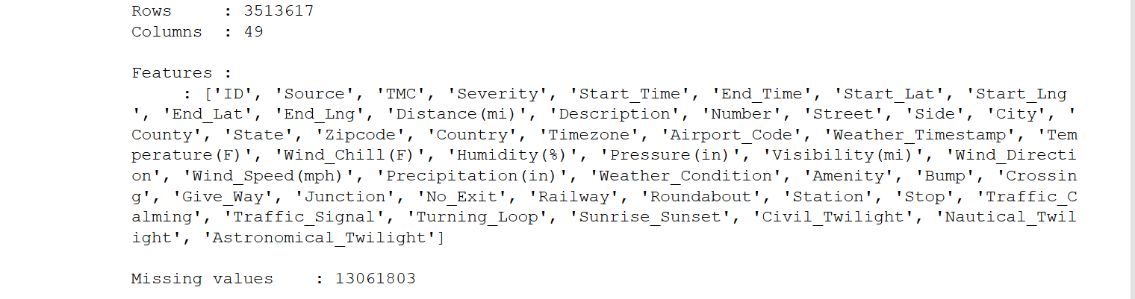
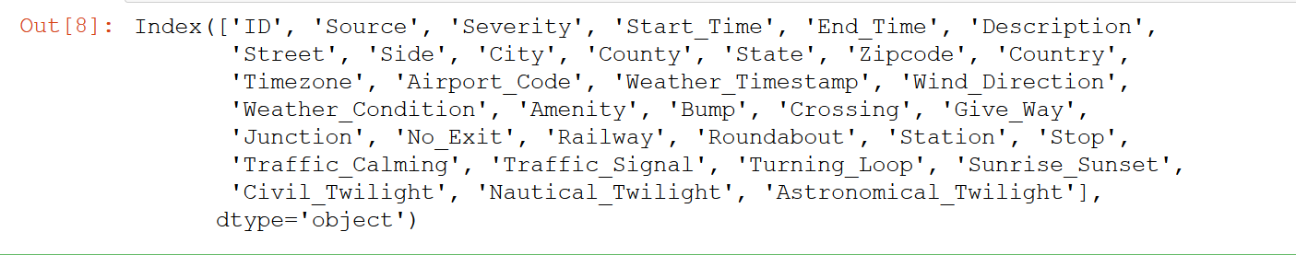
Exploratory Data Analysis
A. Dataset (summary):
3513617rows*49columns
finding out columns with categorical Values, there are :
Notes:
Proximity to Traffic Objects: Pie chart that shows percentage of accidents near various traffic objects. Here most accidents happened near the traffic signals
Data distribution of accidents based on severity level

Slide 8
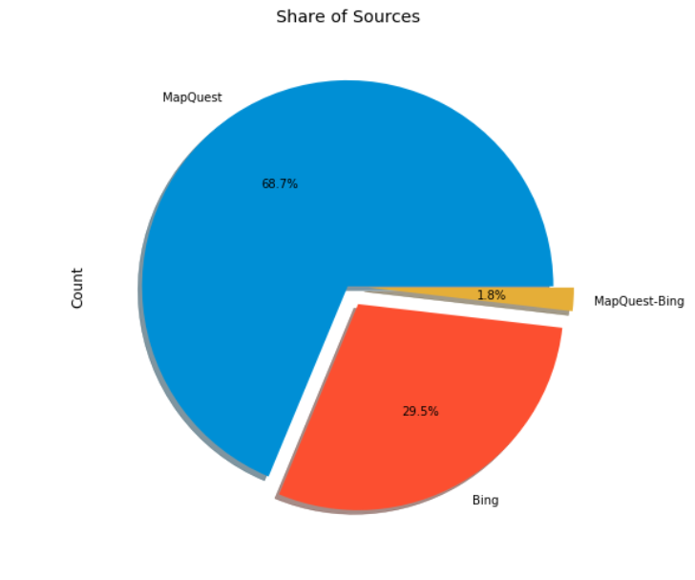
B. Source of Data:
The dataset which we taken is of streaming data which comes from a different source:
MapQuest shares 68.7%, Bing 29.5%, MapQuest-Bing (other resources) 1.8%

Slide 9
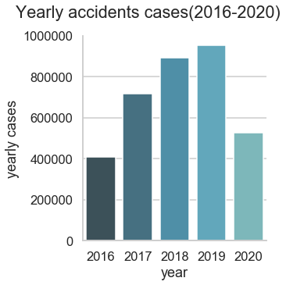
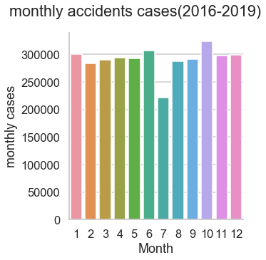
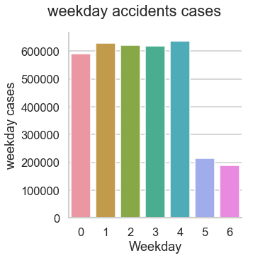
C. Number of Accidents by year, month and week:
There is a growing trend of year accidents cases
There were more cases during 8-12 months compared to other months, excluding the data from 2020 (because this is the season where the people in the USA travel more)
Number of accidents on a working day is much larger than those on weekend, as fewer people go out to work

Slide 10
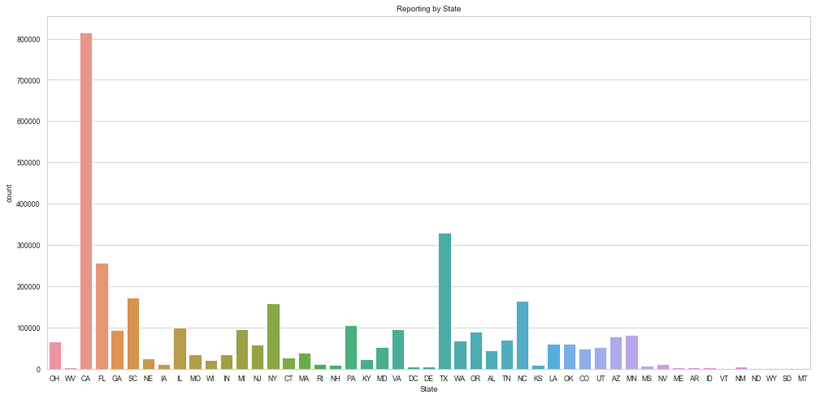
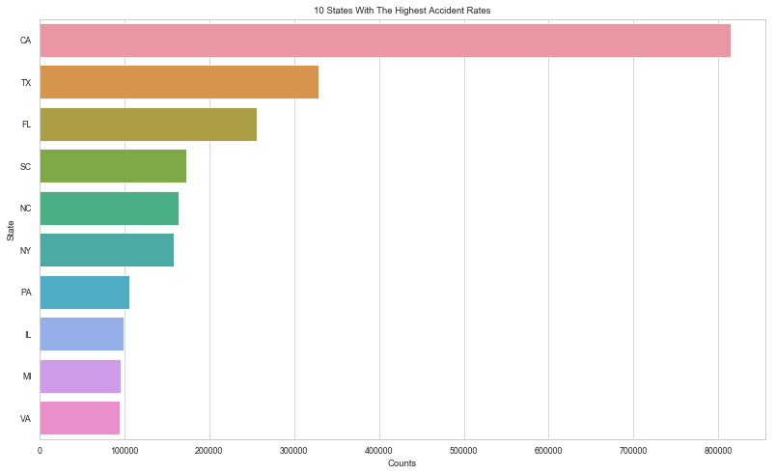
D. States and Cities with the highest number of accidents
By the above graphs, we can see that California and Texas have most accident rates

Slide 11
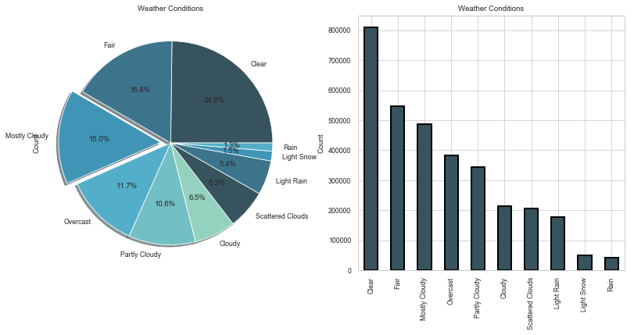
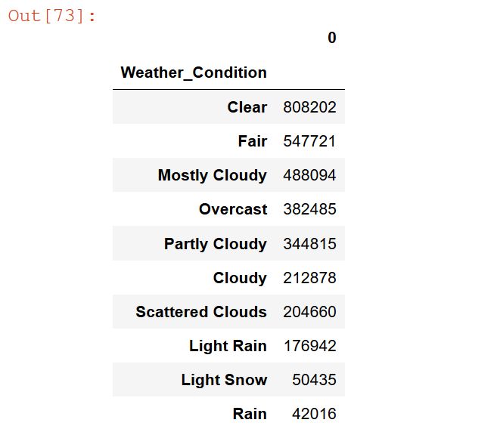
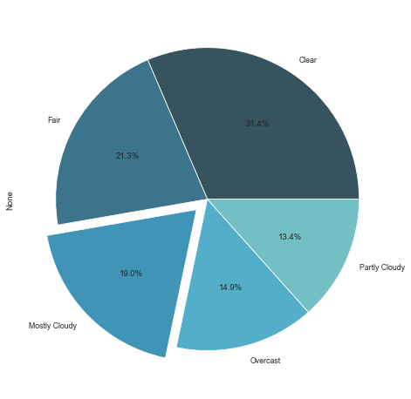
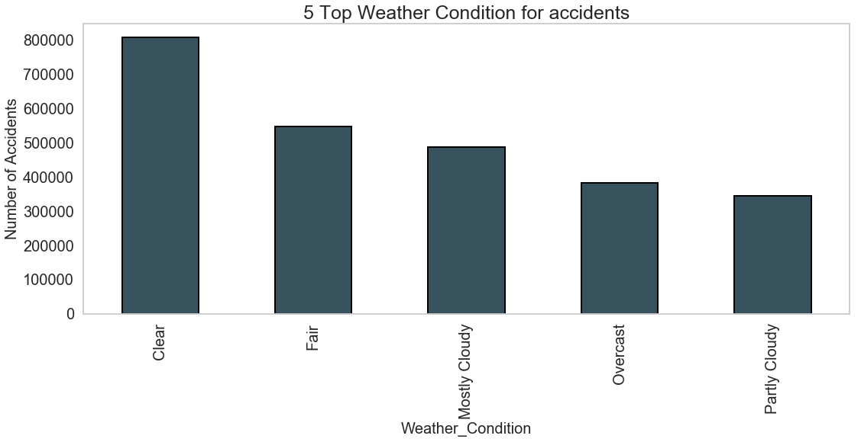
E. Weather conditions causing accidents:
Top 5 weather conditions
We can see the most accidents have occurred when the weather is clear, maybe people drive carefully when the weather is not good

Slide 12
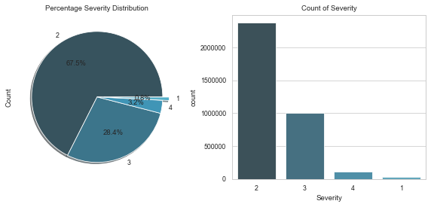
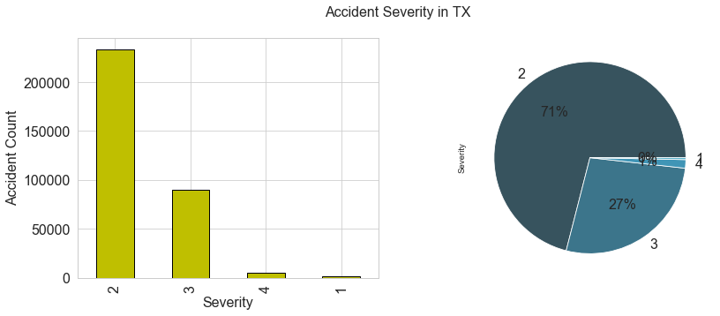
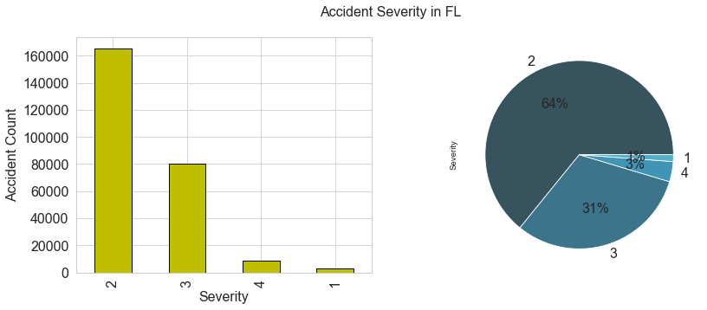
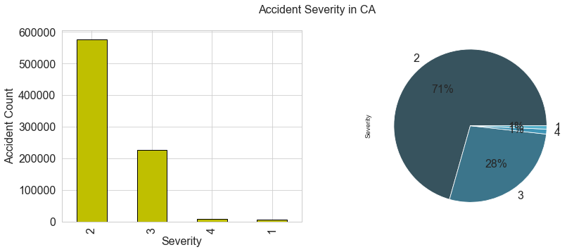
F. The severity of the accidents:
It tells the severity of the accident, a number between 0 and 4, where 0 indicates the least impact on the type of accident
1 indicates medium impact (fracture), similarly, 2 (handicap) and 3 indicates a significant impact (like death)
We igonore severity 0
Top 3 states accidents severity
1)Severity of accidents for state California
70% of accidents are of severity level 2
2) Severity of accidents for state Texas.71% of accidents are of severity level 2 and only 1% of severity level 2
3) Severity of accidents for state Florida:64% of accidents are of severity level 2 and only 3% of severity level 2 and 31% of level 3

Slide 13
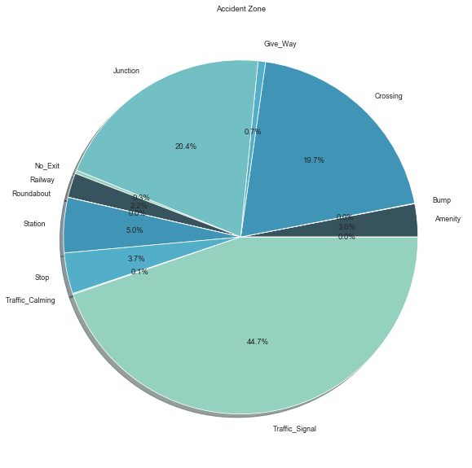
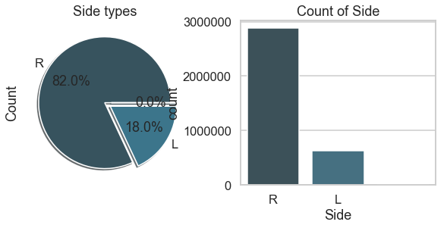
G. Accident Zones:
most accidents are during Traffic signal (44.7%), Junction (20.4%), Crossing (19.7%), etc. Surprisingly there are almost 0% accidents that have occurred during a bump
This graph suggests that more accidents happen on the right side.

Slide 14
Preprocessing
Handling null values
Label Encoding
Dimensionality reduction
Scaling & Normalization
Removed missing values for certain columns and rows
Updated with median and mode for few columns
Down sampling
Binning (in progress)
Label encoding to change categorical columns to numerical
One hot encoding for certain columns
Principal Component Analysis (PCA)
Standard scaling
Normalization
Parameter Tuning (Grid Search CV)

Slide 15
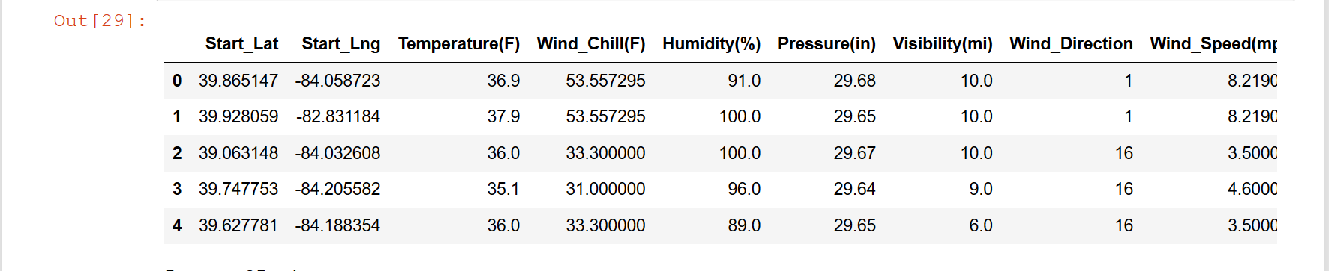
Dataset after pre-processing

Slide 16
Selected Features
Severity, Temperature, Windchill, Humidity, pressure, wind speed, Weather_condition,Start_Lat, Start_Lng, Amenity, Bump, Crossing, Give_Way, Junction, No_Exit, Railway, Roundabout, Station, Stop, Traffic_Calming, Traffic_Signal, Turning_Loop, Sunrise_Sunset

Slide 17
MODEL BUILDING
MODEL: Decision Tree, RandomForest, KNN, Logistic Regression
Target variable: Severity
Independent variable: Temperature, Windchill, Humidity, pressure, wind speed, Weather_condition,Start_Lat, Start_Lng, Amenity, Bump, Crossing, Give_Way, Junction, No_Exit, Railway, Roundabout, Station, Stop, Traffic_Calming, Traffic_Signal, Turning_Loop, Sunrise_Sunset

Slide 18
STEPS
1. Import the necessary libraries and the data set. The data was
Kaggale We will be predicting the severity level of the accidents .
2. Converting the categorical variables into dummy variables.
3. Splitting the data into train and test datasets, Test will 30% of
the original data frame.
4. After diving the dataset into train and test data with the help
of sklearn library we create our model.
5. Next, we pass the training dataset to the model and train our
model.
6. Now we can predict.

Slide 19
Evaluation
Accuracy Metrics: Accuracy score metrics for the test data is captured for all the models.

Slide 20
Experimental Results
S.no | Algorithms | Accuracy(%)
1. | Random Forest | 75.7%
2. | Decision Tree | 67.5%
3. | KNN | 71%
4. | Logistic Regression | 67%

Slide 21
Conclusion And Future Scope
The maximum accuracy score that we got is for Random Forest which is 75.7%.
We would like to explore advanced machine learning techniques such as ensemble methods, XGBoost, and Neural Networks to predict the severity of traffic on accidents in real-time.

Slide 22
References
Moosavi, Sobhan, Mohammad Hossein Samavatian, Srinivasan Parthasarathy, Radu Teodorescu, and Rajiv Ramnath. "Accident Risk Prediction based on Heterogeneous Sparse Data: New Dataset and Insights." arXiv preprint arXiv:1909.09638 (2019)
Chang, Li-Yen. "Analysis of freeway accident frequencies: negative binomial regression versus artificial neural network." Safety science 43.8 (2005): 541-557.
Ren, Honglei, You Song, Jingwen Wang, Yucheng Hu, and Jinzhi Lei. "A deep learning approach to the citywide traffic accident risk prediction." In 2018 21st International Conference on Intelligent Transportation Systems (ITSC), pp. 3346-3351. IEEE, 2018.
Yuan, Zhuoning, Xun Zhou, Tianbao Yang, James Tamerius, and Ricardo Mantilla. "Predicting traffic accidents through heterogeneous urban data: A case study." In 6th International Workshop on Urban Computing (UrbComp 2017). 2017.

Slide 23
Thank You

