Slide 1
DATA SCIENCE PROJECT
PRESENTED BY-GAYATRI . R . PURSWANI

Slide 2
PROJECT NAME-
NYC Shooting Incident Classification-
  Machine Learning for Fatal & Non-Fatal Incident Classification
  Technology: Python | Scikit-learn | Streamlit

Slide 3
agenda
Project Overview
Problem & Objectives
Dataset & Preprocessing
EDA & Feature Engineering
Machine Learning
Model Evaluation
Streamlit Application
Results & Future Scope

Slide 4
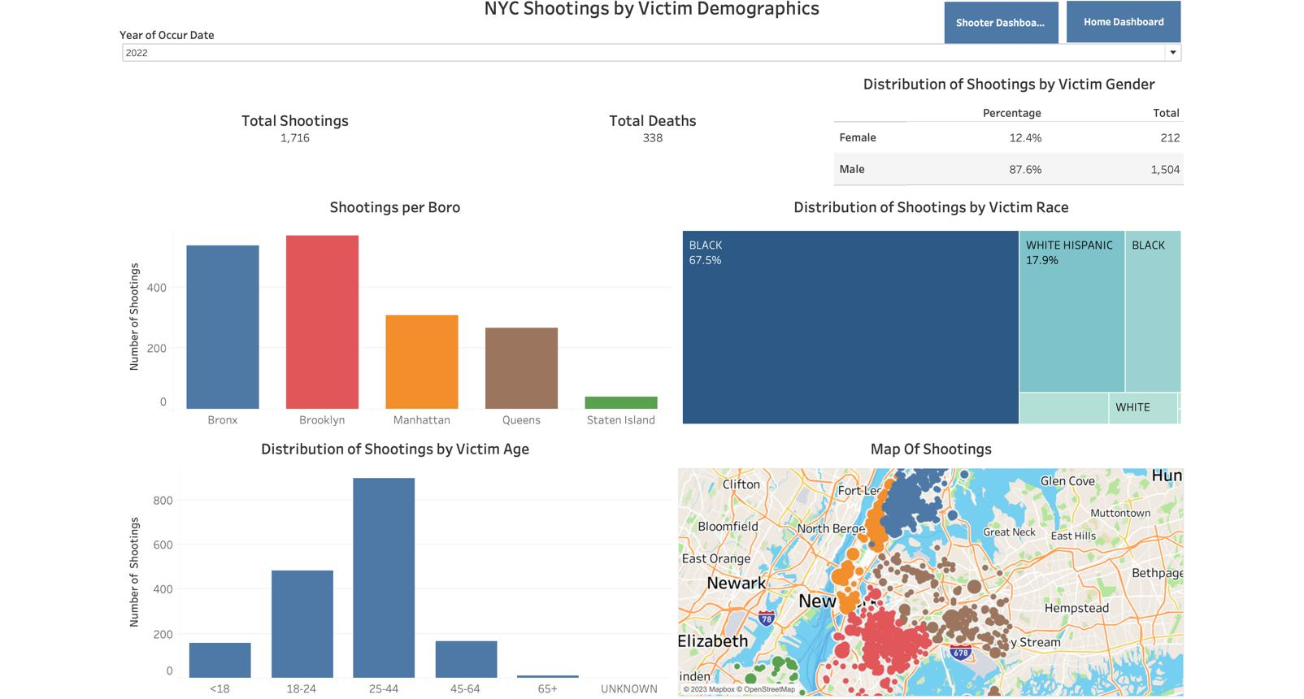
PROJECT OVERVIEW-
Machine learning project for classifying historical NYC shooting incidents.
Target variable: STATISTICAL_MURDER_FLAG
TRUE → Fatal / Murder Flag
FALSE → Non-Fatal
Uses temporal, geographical, victim and perpetrator characteristics.
Final model is integrated into an interactive Streamlit application.

Slide 5
Problem Statement
NYC shooting datasets contain thousands of incidents with multiple attributes.
Manual analysis of these attributes is difficult at scale.
Machine learning can learn patterns from historical incident data.
The project develops a classification pipeline to distinguish fatal and non-fatal incidents.

Slide 6
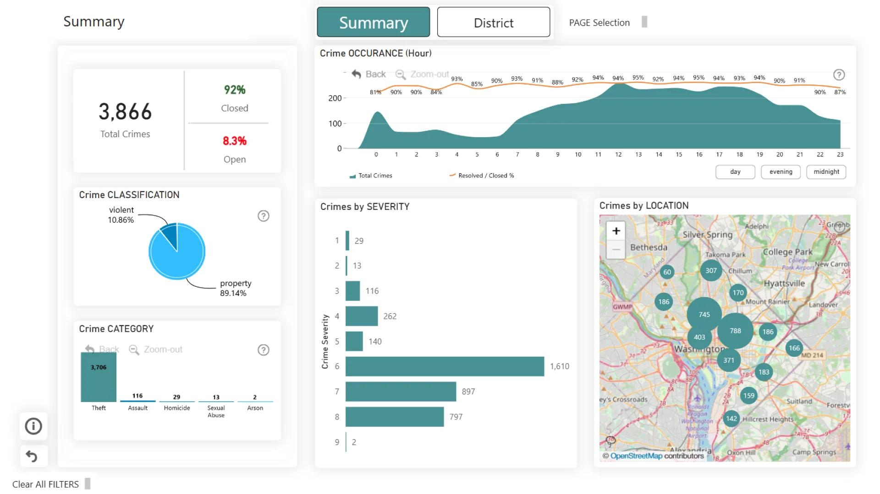
Project Objectives
Clean and preprocess the dataset
Perform exploratory data analysis
Engineer meaningful time-based features
Handle numerical and categorical variables
Train multiple classification models
Compare model performance
Analyze feature importance
Deploy the trained model using Streamlit

Slide 7
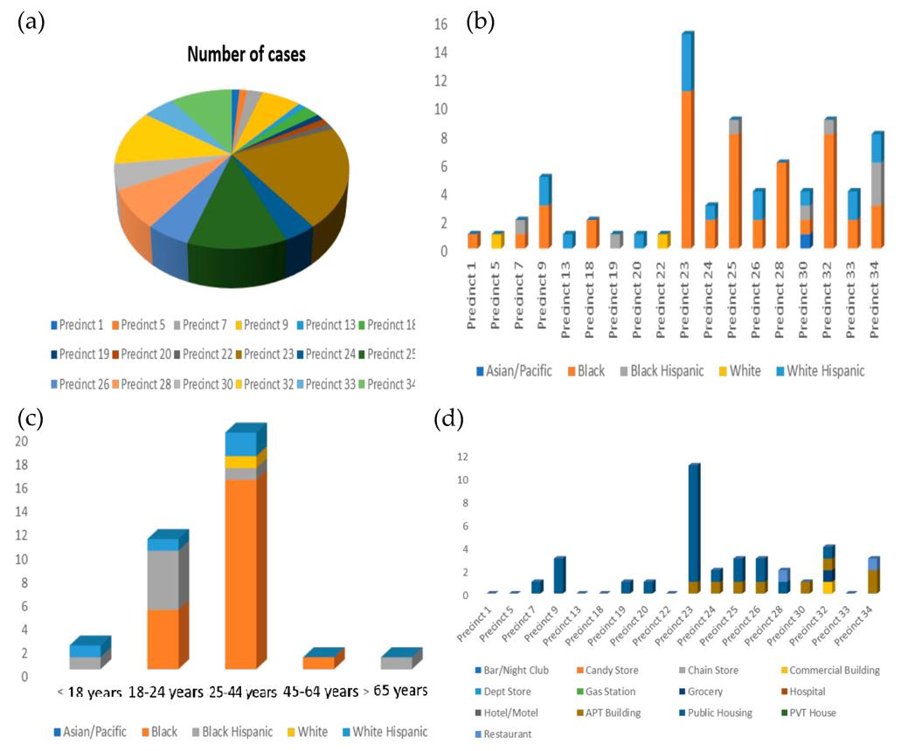
DATASET
Dataset: NYC Shooting Incident Data
Major feature groups:
Incident: INCIDENT_KEY
Date/Time: OCCUR_DATE, OCCUR_TIME
Location: BORO, PRECINCT, LOCATION_DESC
Victim: Age Group, Sex, Race
Perpetrator: Age Group, Sex, Race
Geographic: Latitude, Longitude, X/Y Coordinates
Target: STATISTICAL_MURDER_FLAG

Slide 8
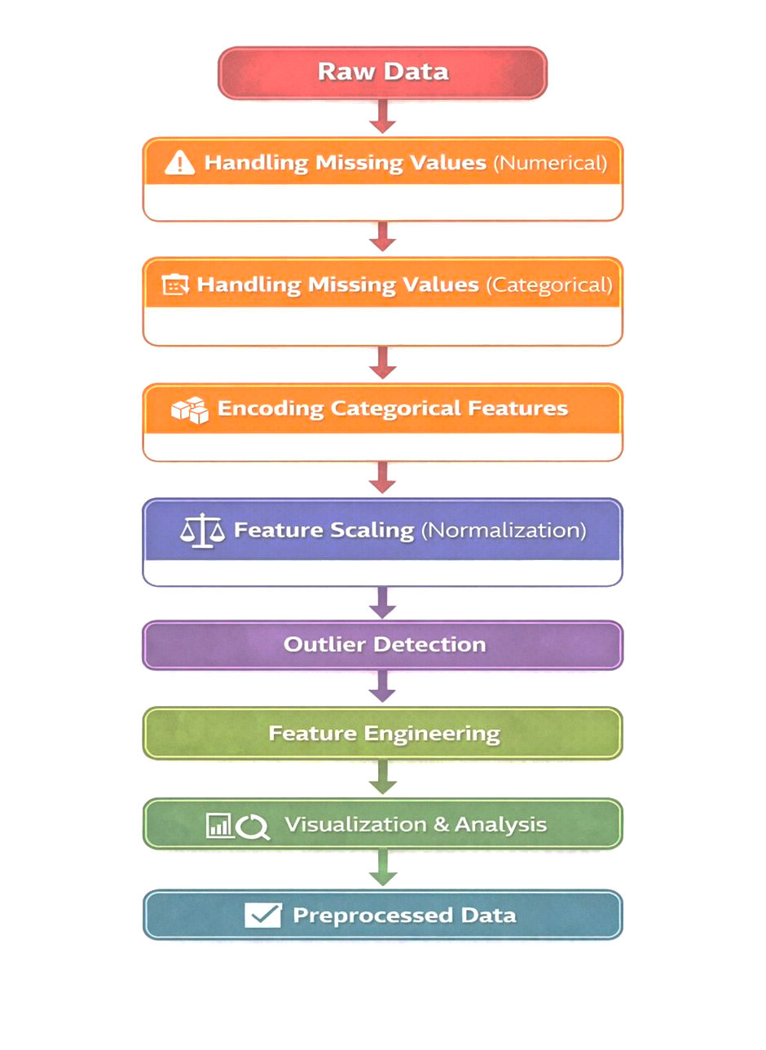
Data Preprocessing-
WORKFLOW

Slide 9
FEATURE ENGINEERING
Feature | Description | Purpose
YEAR | Year of the incident | Captures yearly patterns
MONTH | Month of the incident | Identifies seasonal patterns
DAY | Day of the month | Captures date-level patterns
HOUR | Hour of occurrence | Identifies time-of-day patterns
DAY_OF_WEEK | 0 = Monday to 6 = Sunday | Captures weekly patterns
IS_WEEKEND | 0 = Weekday, 1 = Weekend | Differentiates weekday and weekend incidents

Slide 10
Exploratory Data Analysis
EDA performed on:
Fatal vs Non-Fatal incidents
Borough-wise shooting distribution
Shooting incidents by hour
Victim age groups
Victim demographics
Perpetrator demographics
Geographic distribution
Temporal patterns

Slide 11
Machine Learning Models
Models considered:
Logistic Regression
Decision Tree
Random Forest
K-Nearest Neighbors
Support Vector Machine

Slide 12
WORKFLOW
TRAINING DATA
PREPROCESSING
MODEL TRAINING
VALIDATION
MODEL COMPARISON
BEST MODEL

Slide 13
Model Evaluation
Evaluation Metrics:
Accuracy
Precision
Recall
F1-Score

Slide 14
Feature Importance
Purpose:
Understand influential variables
Improve model interpretability
Identify important patterns
Explain model predictions

Slide 15
BEST MODEL
Best Performing Model
Model Selected: Random Forest Classifier

Slide 16
Results & Key Findings
Complete end-to-end ML pipeline developed.
Historical shooting data converted into ML-ready features.
Multiple classification algorithms evaluated.
Best trained model integrated into Streamlit.
User can enter incident characteristics.

Slide 17

FUTURE SCOPE
Real-time data integration
Interactive NYC incident maps
Advanced geospatial analysis
Automated model retraining
SHAP-based explainable AI
Model monitoring and drift det

Slide 18
Conclusion
Developed an end-to-end ML classification solution.
Performed data preprocessing and feature engineering.
Analyzed historical shooting patterns.
Compared machine learning classification approaches.
Integrated the trained model into Streamlit.
Created an interactive interface for model-based classification.

Slide 19
THANK YOU

