Slide 1
BLUESTOCK
BLUESTOCK
Mutual Fund Analytics
Capstone Project | Bluestock Fintech Data Analyst Internship
Prepared by: Puru Asthana
June 2026

Slide 2
Problem Statement & Objectives
Problem Statement
Objectives
The mutual fund industry generates large volumes of investment, portfolio, and performance data. Extracting meaningful insights is essential for investors, fund managers, and financial institutions.
1. Build an ETL pipeline
2. Clean & validate datasets
3. Exploratory data analysis
4. Compute performance metrics
5. Analyze investor behavior
6. Develop risk analytics
7. Build recommendation engine
8. Create interactive dashboard

Slide 3
Data Sources
10 comprehensive datasets powering the analytics pipeline
1
Fund Master
2
NAV History
Scheme codes, fund house, category
Daily NAV from 2022–2026
3
AUM by Fund House
4
Monthly SIP Inflows
Monthly AUM per AMC
SIP trend over time
5
Category Inflows
6
Industry Folio Count
Equity, debt, hybrid flows
Investor folio statistics
7
Scheme Performance
8
Investor Transactions
3yr/5yr returns, Sharpe, Alpha
SIP, Lumpsum, Redemption
9
Portfolio Holdings
10
Benchmark Indices
Sector & stock allocation
NIFTY50, NIFTY100 data

Slide 4
Project Architecture
1
2
3
4
5
6
7
8
9
Raw Data
ETL Pipeline
Data Cleaning
SQLite Database
EDA
Performance Analytics
Advanced Analytics
Power BI Dashboard
Final Report
End-to-end data analytics workflow from raw AMFI data to interactive dashboards

Slide 5
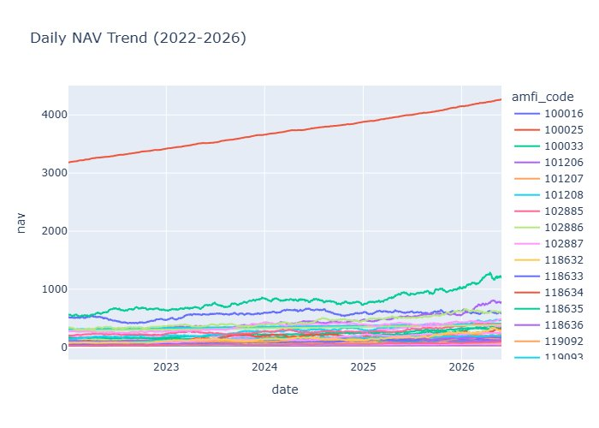
EDA Highlights — NAV Trends & AUM Growth
Key Findings
Industry AUM grew from ₹30L Cr (2022) to ₹65L Cr+ (2025)
Fund 100025 had the highest absolute NAV (~₹4,000+)
Strong long-term appreciation across all equity funds
Small cap funds showed highest NAV acceleration in 2025–26
Debt funds maintained stable, low-volatility NAV growth

Slide 6
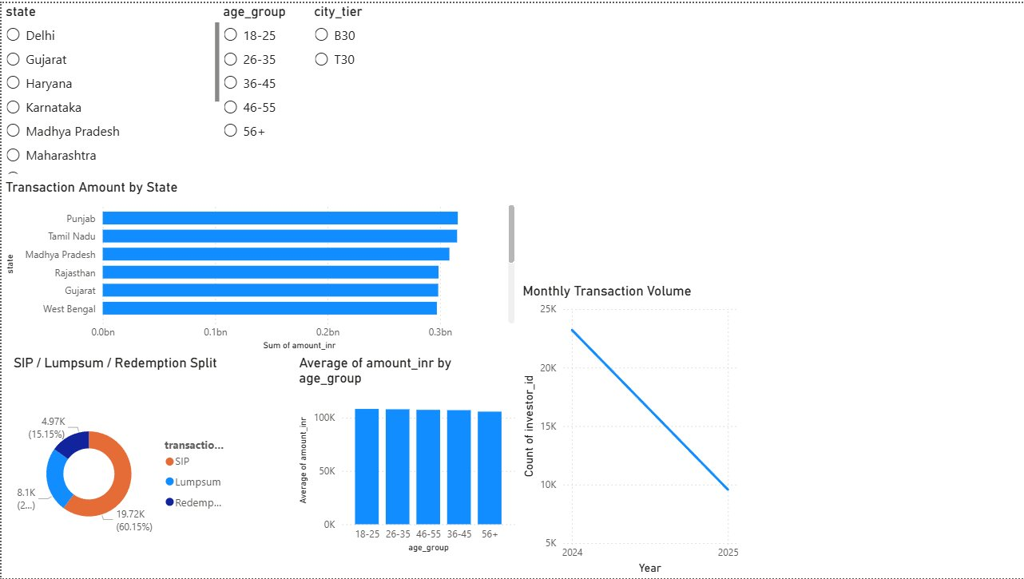
EDA Highlights — Investor & Category Analysis
Key Findings
SIP inflows account for 60.15% of transactions
Punjab & Tamil Nadu lead in transaction volumes
Avg. investment uniform (~₹1L) across age groups
Younger investors (18–35) drive SIP participation
Transaction volume peaked in 2024 with ~24K monthly

Slide 7
Performance Analytics — Fund Scorecard
Top 10 funds ranked by composite score
AMFI Code
CAGR
Sharpe
Alpha
Max DD
Score
120505
32.8%
1.18
29.3%
-18.2%
87.5
119598
32.4%
0.95
30.3%
-28.7%
82.6
149324
32.3%
0.95
30.1%
-31.2%
80.2
120843
30.9%
1.31
27.3%
-13.0%
79.0
100033
30.1%
1.09
27.2%
-16.2%
78.3
148567
30.9%
1.45
27.0%
-11.3%
77.8
148569
31.9%
1.23
28.3%
-16.4%
76.9
119094
28.2%
1.00
26.1%
-21.0%
74.8
119551
25.8%
1.21
23.2%
-15.0%
70.1
118632
24.0%
1.08
21.8%
-17.4%
70.1
Metrics: CAGR · Sharpe Ratio · Alpha · Beta · Max Drawdown · Expense Ratio · Sortino Ratio

Slide 8
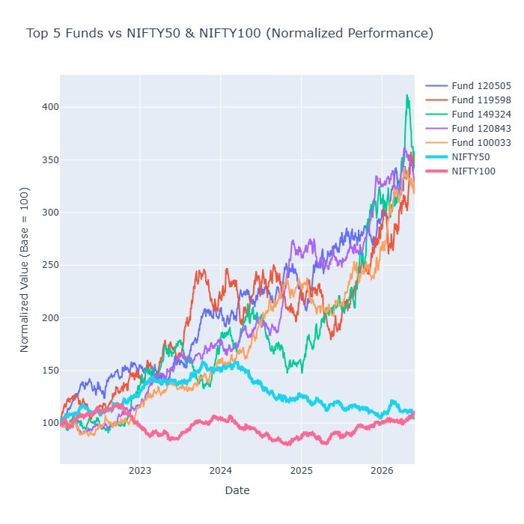
Performance Analytics — Benchmark Comparison
Key Findings
All top 5 funds outperformed NIFTY50 & NIFTY100
Fund 120505 achieved 3.2× growth vs NIFTY50's 1.1×
NIFTY100 underperformed even the indices over period
Fund 149324 showed spike to 4.1× in mid-2026
Rolling Sharpe identifies consistently stable performers

Slide 9
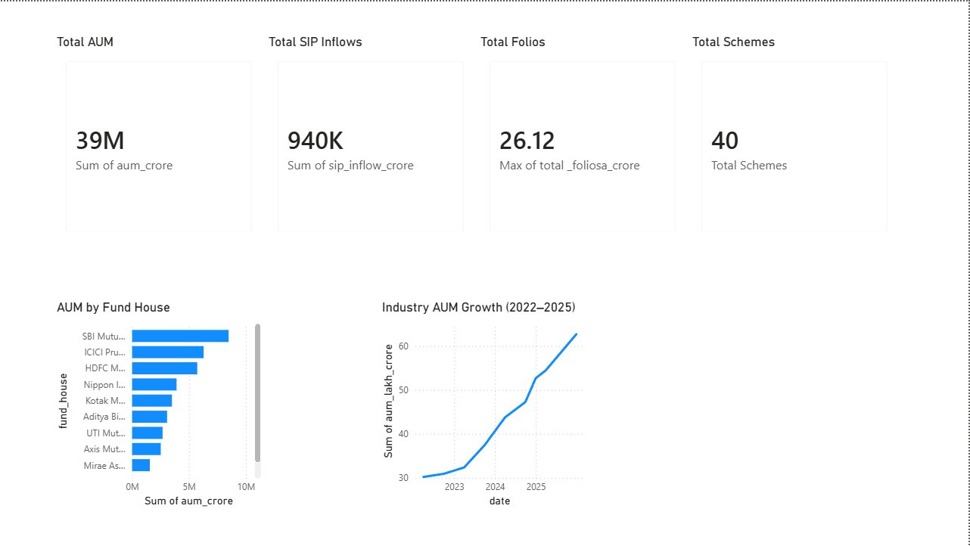
Dashboard — Industry Overview
Power BI Dashboard · Filters: Fund House | Category | Date Range

Slide 10
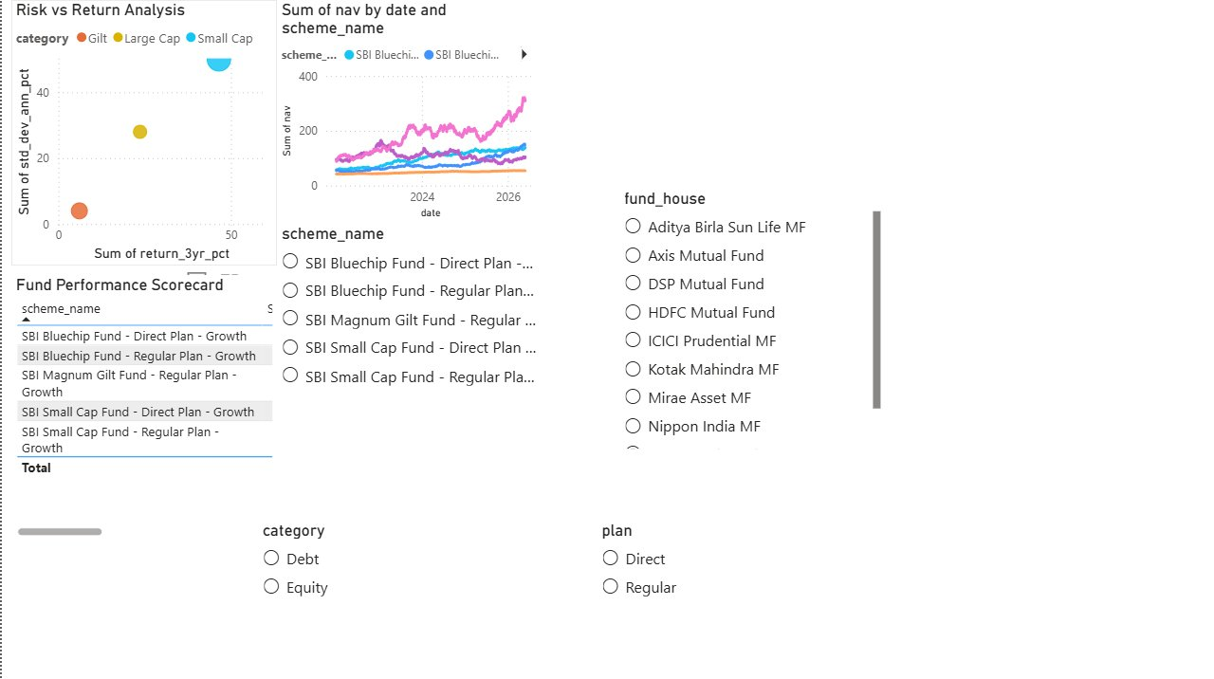
Dashboard — Fund Performance & Investor Analytics
Fund Performance
Investor Analytics
Fund filtering by category/plan
Risk vs return scatter
NAV trend tracking
Investor segmentation
SIP/Lumpsum split analysis
State-wise transaction mapping

Slide 11
Key Findings & Recommendations
Key Findings
Recommendations
1
Large-cap funds dominate industry assets with highest inflows
Diversify concentrated portfolios to reduce sector risk
2
SIP inflows reached record levels; 60%+ of all transactions
Monitor downside risk actively using Value-at-Risk (VaR) models
3
Top-performing funds consistently outperformed benchmarks by 2–3×
Improve investor retention through SIP continuity tracking
4
Investor participation increased significantly across all demographics
Expand data coverage to newer small/mid-cap schemes
5
Certain portfolios exhibit high sector concentration risk
Leverage ML for personalized fund recommendations

Slide 12
Thank You
Bluestock Mutual Fund Analytics
Puru Asthana
Bluestock Fintech · Data Analyst Intern · June 2026
GitHub: https://github.com/puruasthana20/bluestock_mf_capstone

