Slide 1
JOURNEY SCRAPBOOK
FOUNDATIONAL TRAINING
18-08-2023 to 25-08-2023
Purushottam Behera
Batch-16

Slide 2
Agenda week-1
Business Analysis
Agile methodology
DevOps
DBMS
Software Testing
Cloud Computing

Slide 3
Day – 1 (Introduction to business analysis )
Organizational Chart and the role of business of analysis.
CTO -> PMs (Product Managers)
PO (Project Owner)
Developers
QA (Quality Assurance)
BA (Business Analyst)
Designers
Network / Infrastructure engineer
BA does the following work:
Identify business needs
Gather and analyses requirement
Documenting the requirement (BRD, SRC, FSD)
SDLC Model ( Software Development Lifecycle )
Planning -> Define requirements -> Design -> Coding-> Testing -> Deployment -> Maintenance

Slide 4
Day – 1 ( Continued… )
Requirement analysis ( Functional and Non-functional )
Requirement Elicitation: Bridging the gap between idea and requirement through meetings, interviews, questionnaires, brainstorming, and prototyping sessions.
Requirement Management:
Gantt Charts
Critical Path Methos
WaterFall
Kanban
Scrum
Requirement Modelling:
Scenario-based
Class-based
Data-based
Requirement Traceability: To ensure business is tied to actual requirements and each requirement is tied to deliverable. i.e., Business goals -> detailed requirements -> test scripts - > system component
Waterfall VS Agile

Slide 5
Day – 2 (Agile methodology)
Agile principle
Agile Manifesto
Meetings in Agile – Sprint Planning, Daily Scrum meeting, Retrospective
Roles in Agile – Product owner , Scrum Master
Terminologies in Agile:
Scrum
Sprint
Increment of Done
Kanban

Slide 6
Day – 2 ( continued… )
Creation of user story, Epic, Task in Azure DevOps
Story point estimation
Sprint Board
Product Backlog and Sprint Backlog
Logging work
Report
BurnUp
BurnDown
Velocity chart
Capturing things in VSTS

Slide 7
Day-3 ( DevOps )
Intro to DevOps – Methodology to help develop application collaboratively between developers and operation people
DevOps Lifecycle – Continuous development, Continuous integration, Continuous testing, Continuous deployment, Continuous monitoring, Continuous feedback, Continuous operations
DevOps Tools:
Plan: Jira, Slack
Build: docker, terraform
SCM: Github, Gitlab
CI & CD: Jenkins, Aws, snyk
Monitoring: poingdom, dynatrace
DevOps Stages - Development, Quality Assurance, IT Operations

Slide 8
Day – 4 ( Database Management System )
Intro to Data and types of data: structured, semi-structured, unstructured.
Data can be stored in following ways:
Files ( json, xml, blob, optimized formats: parquet )
Database and its types ( relational, non-relational )
Different types of databases:
Relational databases
Object-oriented databases
Distributed databases
Data Warehouse
NoSQL databases

Slide 9
Day – 4 ( continued.. )
RDBMS Concepts (Table, Field, Record, Column, NULL, Constraints )
RDBMS Constants (NOT NULL, DEFAULT, UNIQUE, PRIMARY key, FOREIGN key, CHECK, INDEX)
Db Normalization : separate each entity into its own table
SQL (Structured Query Language):
DDL – CREATE, ALTER, DROP, RENAME
DCL – GRANT, DENY, REVOKE
DML – INSERT, UPDATE, DELETE
DQL – SELECT
TCL – COMMIT, ROLLBACK, SAVEPOINT
Object-Oriented database - PostgresSQL
SQL commands and concepts used:
INSERT, WHERE GROUP BY, HAVING clause
Subqueries
JOIN and its different types:
INNER JOIN
LEFT JOIN, RIGHT JOIN
SELF JOIN

Slide 10
Day – 4 ( continued.. )
Creating Table:
CREATE TABLE sales_data( first_name TEXT, last_name TEXT, email TEXT, city TEXT, mobile_no BIGINT, pincode INTEGER);
Inserting Data into the table:
INSERT INTO sales_data VALUES('Alice', 'Johnson', 'alice123@suu.com', 'USA', 9876543210, 345678);
INSERT INTO sales_data VALUES('Bob', 'Smith', 'bob456@suu.com', 'New York', 8765432109, 456789);
INSERT INTO sales_data VALUES('Charlie', 'Brown', 'charlie789@suu.com', 'Chicago', 7654321098, 567890);
INSERT INTO sales_data VALUES('David', 'Williams', 'david234@suu.com', 'Houston', 6543210987, 678901);
INSERT INTO sales_data VALUES('Eve', 'Miller', 'eve567@suu.com', 'Miami', 5432109876, 789012);
INSERT INTO sales_data VALUES('Frank', 'Davis', 'frank890@suu.com', 'New York', 4321098765, 890123);
INSERT INTO sales_data VALUES('Grace', 'Anderson', 'grace345@suu.com', 'Los Angeles', 3210987654, 901234);
INSERT INTO sales_data VALUES('Hank', 'Martinez', 'hank678@suu.com', 'Miami', 2109876543, 123456);
INSERT INTO sales_data VALUES('Ivy', 'Johnson', 'ivy901@suu.com', 'New York', 1098765432, 234567);
INSERT INTO sales_data VALUES('Jack', 'Brown', 'jack234@suu.com', 'USA', 9876543210, 345678);

Slide 11
Day – 4 ( continued.. )
Data fetching and manipulation:
SELECT first_name, last_name, city FROM sales_data WHERE city IN (‘USA’, ‘India');
SELECT first_name, last_name FROM sales_data WHERE first_name LIKE 'Bob’;
SELECT first_name, last_name, city FROM sales_data WHERE city=‘USA' OR city=‘India’;
SELECT first_name, last_name, pincode FROM sales_data WHERE pincode BETWEEN 300000 AND 500000;
SELECT product_name FROM sales_data WHERE sales_amount > 5000 GROUP BY product_name HAVING total_sales > 10 ORDER BY total_sales DESC;
UPDATE customer SET address='221B, Baker Street' WHERE customer_id =123;
DELETE FROM customer WHERE customer_id=123;
SELECT first_name, last_name FROM sales_data WHERE sales_order_id=(SELECT MIN(sales_order_id) from sales_data);
SELECT first_name, last_name FROM sales_data WHERE customer_id in (SELECT customer_id from sales_data WHERE city='USA’);

Slide 12
Day-5 ( Software Testing )
What is testing in software?
Bugs, defects and errors
Where testing fits in SDLC ?
Testing can be done in any stage i.e., right from requirements to maintenance.
Significance of software testing:
Reduce computer system dependency
Build defect free software
Detect variations from specification or expectation

Slide 13
Day-5 ( continued…)
STLC ( Software Test Life Cycle ) – stages in testing of software
Different phases in different:
Test strategy –> Test Plan -> Test Design -> Test Environment -> Test Execution -> Defect Reporting -> Test Closure
Deliverables based on phases:
Test Strategy Document -> Test Plan -> Test Scripts -> Test Environment -> Defect Reports -> Test Metrics and Closure Memo
Testing Triangle:
UI test
Integration test
Unit test

Slide 14
Day-5 ( continued…)
Unit testing – testing a small piece that can be logically isolated in a system
Unit testing tools – Junit, Mockito, Emma
Benefits:
Bugs are identified early
Integration of modules becomes easy
Makes design and documentation simple
Hands-on using Juint:
Writing test case
Understanding @Test, Setup, TearDown
Test execution and look for errors, exceptions, and isolations.

Slide 15
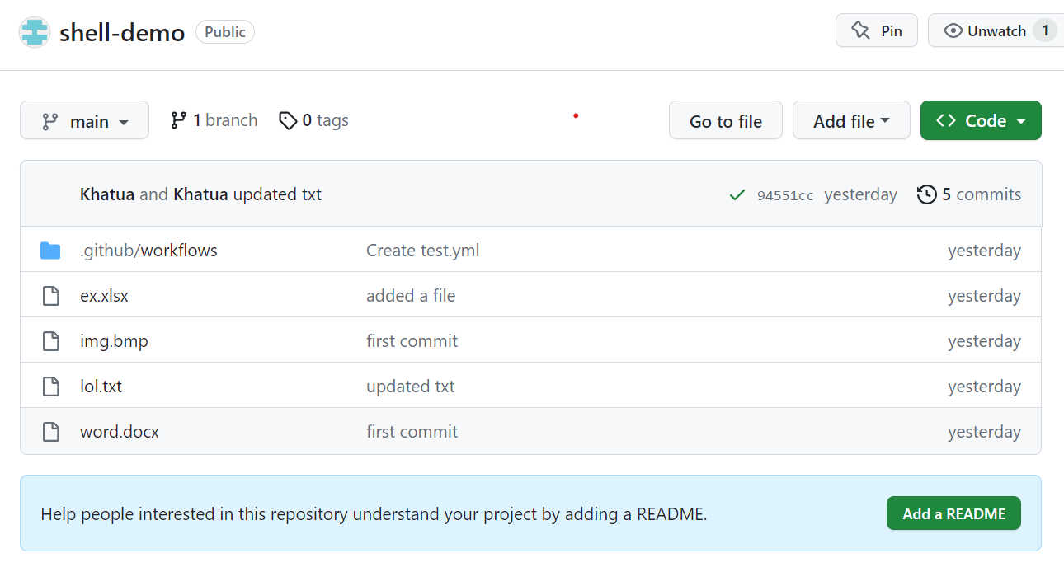
Day-5 ( Continued… )
Github Action – automation tool that helps to automate build, test and deployment pipeline
It can create and run a workflow that can build, test and deploy code on push, pull or issue event on a github repo.
Components of GitHub Actions:
Workflows – configurable automated process that run one or more jobs
Events – activity in a repo that triggers a workflow run
Jobs – A set of step that execute certain commands or script
Actions – custom application that performs a complex but repeated task
Runners – A server that runs the workflow on trigger event
GitHub provides Ubuntu Linux, Microsoft Windows , and MacOS runners to run workflow

Slide 16
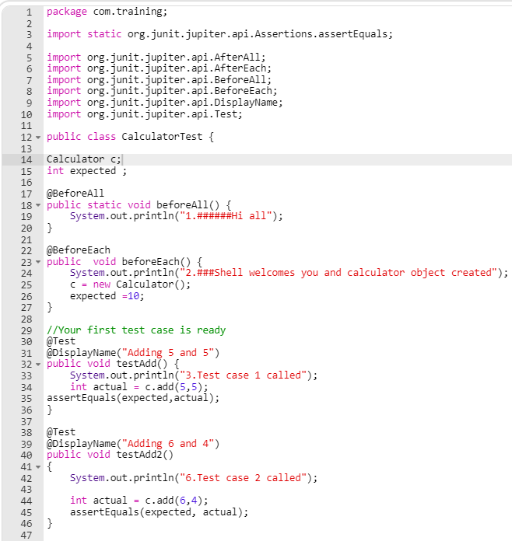
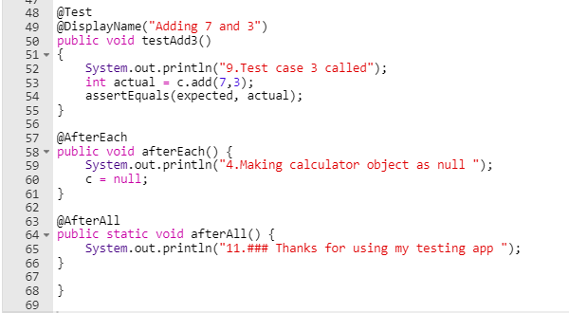
Day-5 ( continued…)
Tested the above code using Junit (Manual Testing).
Also tested it using Fitnesse (Automated testing).

Slide 17
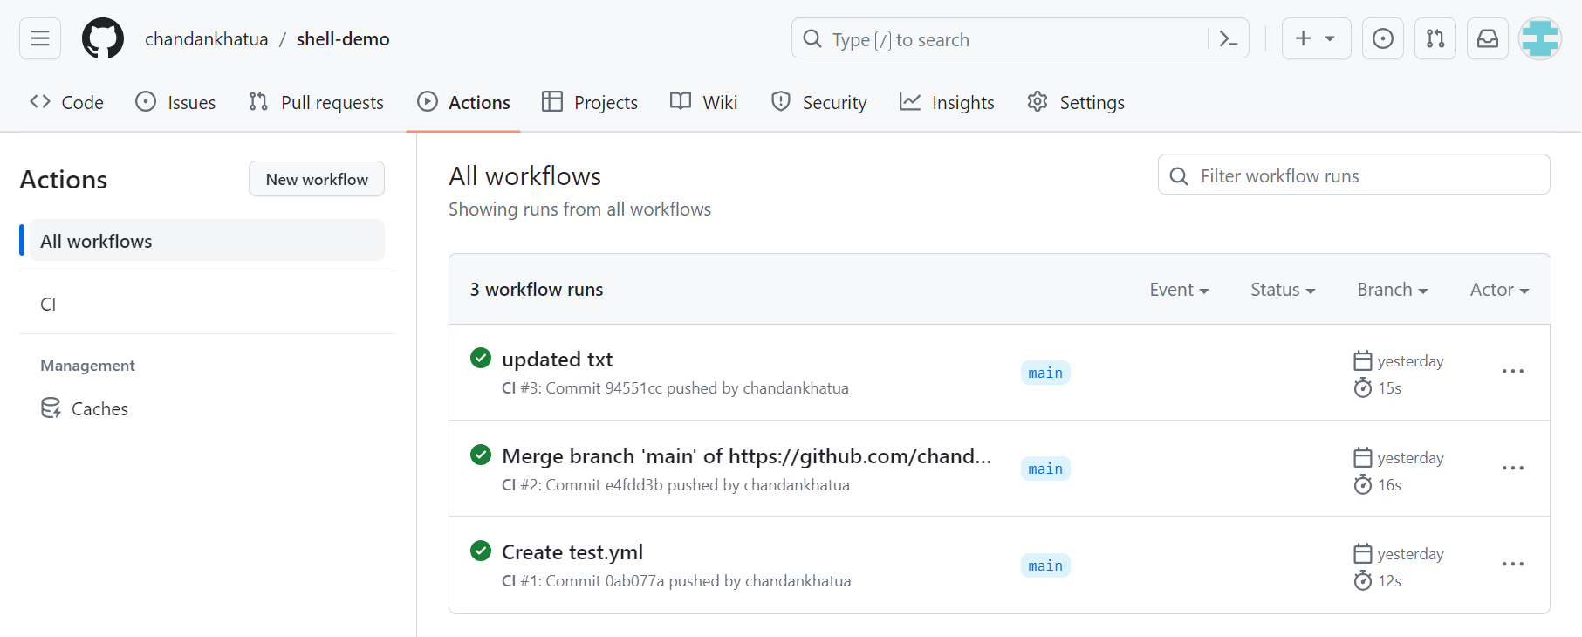
Day-5 ( Continued… )
Hands on Github Action: Implemented workflow that runs on push / pull activity on shell-demo repo

Slide 18
Day-6 ( Cloud computing )
Cloud computing refers to internet-based development and services
Shared pool of configurable computing resources
On demand network access
Provisioned by the service provider
Characteristics of Cloud computing
Large scale
Virtualization
Low-cost software
Geographic distribution
Advanced security
Cloud Service Models:
Software as a Service ( SaaS )
Platform as a Service ( PaaS )
Infrastructure as a Service ( IaaS )

Slide 19
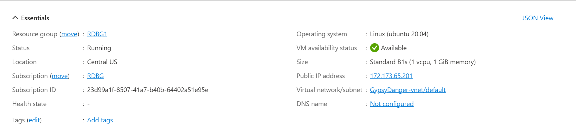
Day-6 ( Continued… )
Hands-on: Create a Virtual Machine in Azure

Slide 20
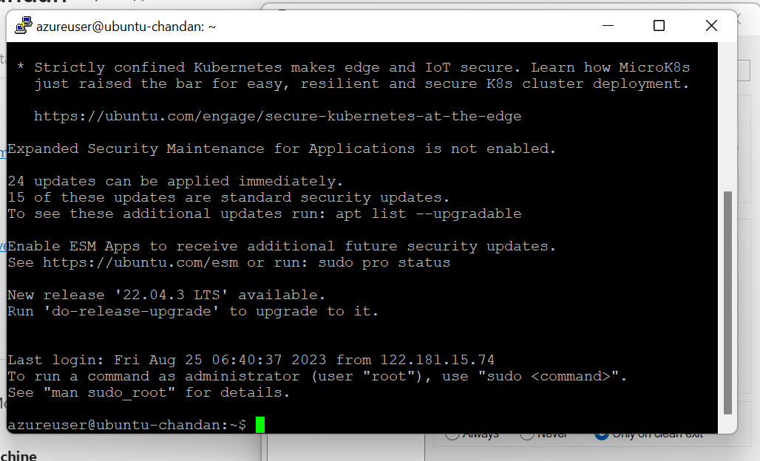
Day-6 ( Continued… )
We connected the VM through putty using the public IP address over SSH using a private key.
Also created a storage account to store a static html page and accessed it through a url provided by the Azure.
Lastly, implemented Azure web app to delploy a simple dynamic web page.

Slide 21
Thank you

