Slide 1
JOURNEY SCRAPBOOK
FOUNDATIONAL TRAINING
28-08-2023 to 01-09-2023
Purushottam Behera

Slide 2
Agenda week-2
Data Fundamentals
Big Data Fundamentals
Azure Fundamentals
Azure SQL

Slide 3
Day – 1 (Introduction to DBMS)
Data- collection of related data, produces meaningful information
Structured data (SQL, Oracle, Excel, Access)
Semi-Structured data (json, exml, paraquet)
Unstructured data (3D data contains facts & Dimensions)
Storing Of Data
File System
DBMS
- Attributes (collection of columns)
- Tuple (Collection of rows)
ACID property
Atomicity – The entire transaction takes place at once or does not happen at all.
Consistency- The database must be consistence before and after transactions.
Isolation- multiple transactions occur independently without interference
Durability – the changes of a successful transaction occur even if the system failure occurs

Slide 4
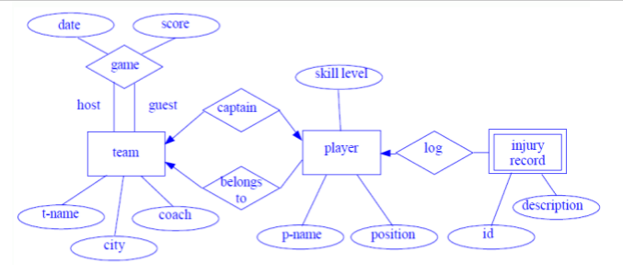
Day – 1 ( Continued… )
ER Diagram Case study
Suppose you are given the following requirements for a simple database for the National Hockey League (NHL):
The NHL has many teams,
Each team has a name, a city, a coach, a captain, and a set of players,
Each player belongs to only one team,
Each player has a name, a position (such as left-wing or goalie), a skill level, and a set of injury records,
A team captain is also a player,
A game is played between two teams (referred to as host_team and guest_team) and has a date (such as May 11th, 1999) and a score (such as 4 to 2).
Construct a clean and concise ER diagram for the NHL database.

Slide 5
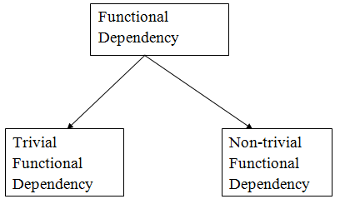
Day – 1 ( continued… )
Functional Dependency
a relationship that exists between two attributes. It typically exists between the primary key and non-key attribute within a table.
i. Trivial functional dependency
A → B has trivial functional dependency if B is a subset of A.
The following dependencies are also trivial like: A → A, B → B
Eg- {Employee_id, Employee_Name} → Employee_Id
ii. Non-trivial functional dependency
A → B has a non-trivial functional dependency if B is not a subset of A.
When A intersection B is NULL, then A → B is called as complete non-trivial.
Eg- ID → Name, Name → DOB

Slide 6
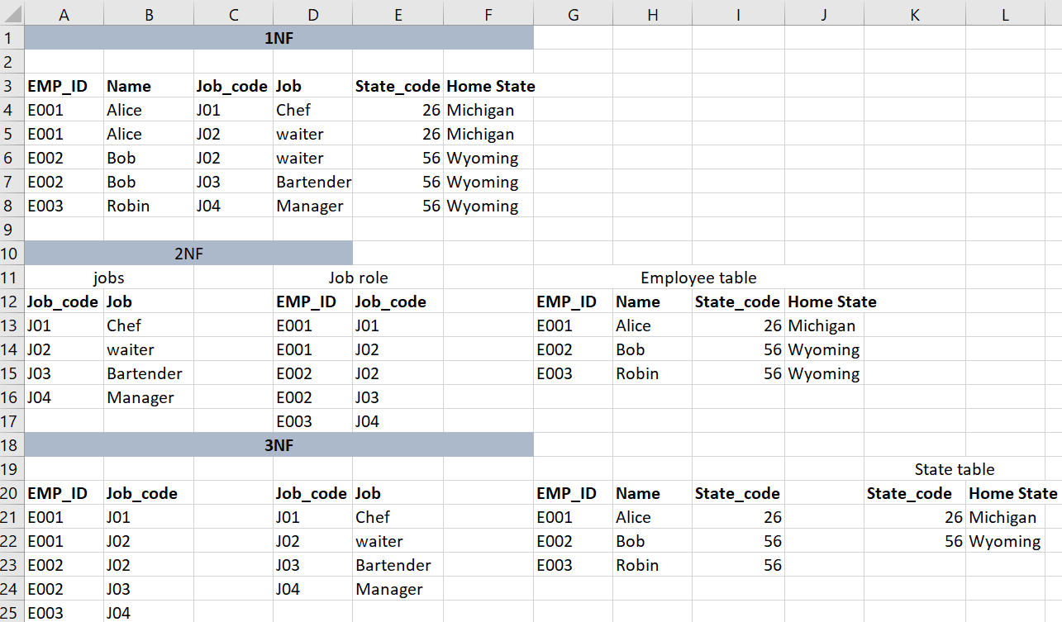
Day – 1 ( continued… )
Normalization

Slide 7
Day – 1 ( continued… )
Data Warehousing
A centralized store of business data for reporting and analysis
Architectures
Central Data warehouse
Departmental data marts
Hub and spoke

Slide 8
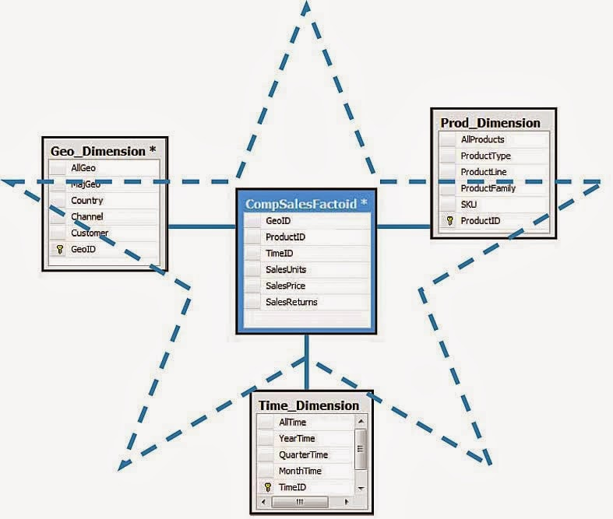
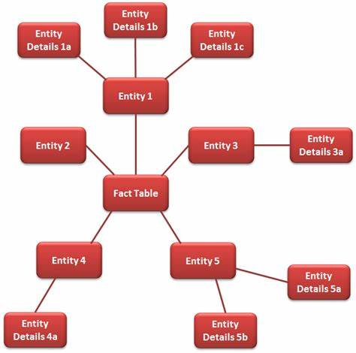
Day-3 (Big Data Fundamentals)
Transaction –
OLTP (online transaction process)
OLAP (online analytical process)
Schemas –
Star Schema
Snowflake schema
Types of fact table
Transactional fact table
Periodic snapshot fact table
Accumulating snapshot fact table
Star Schema
Snowflake Schema

Slide 9
Day – 3 ( continued… )
Big Data Hadoop
3 V's (volume, velocity, and variety) are three defining properties of big data
Volume refers to the amount of data, velocity refers to the speed of data processing, and variety refers to the number of types of data.
Scaling
Vertical Scaling [Scale up memory capacity]
Horizontal Scaling [Scale in - out] – adding machine
RAID- Randomized Access Independent Disk
RAID 0(striping), RAID 1(mirroring), RAID 5(Parity), RAID 1+0= 10(Striping+mirroring)

Slide 10
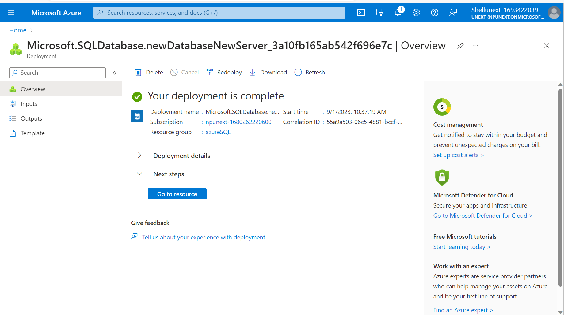
Day-4 (Azure Sql)

Slide 11
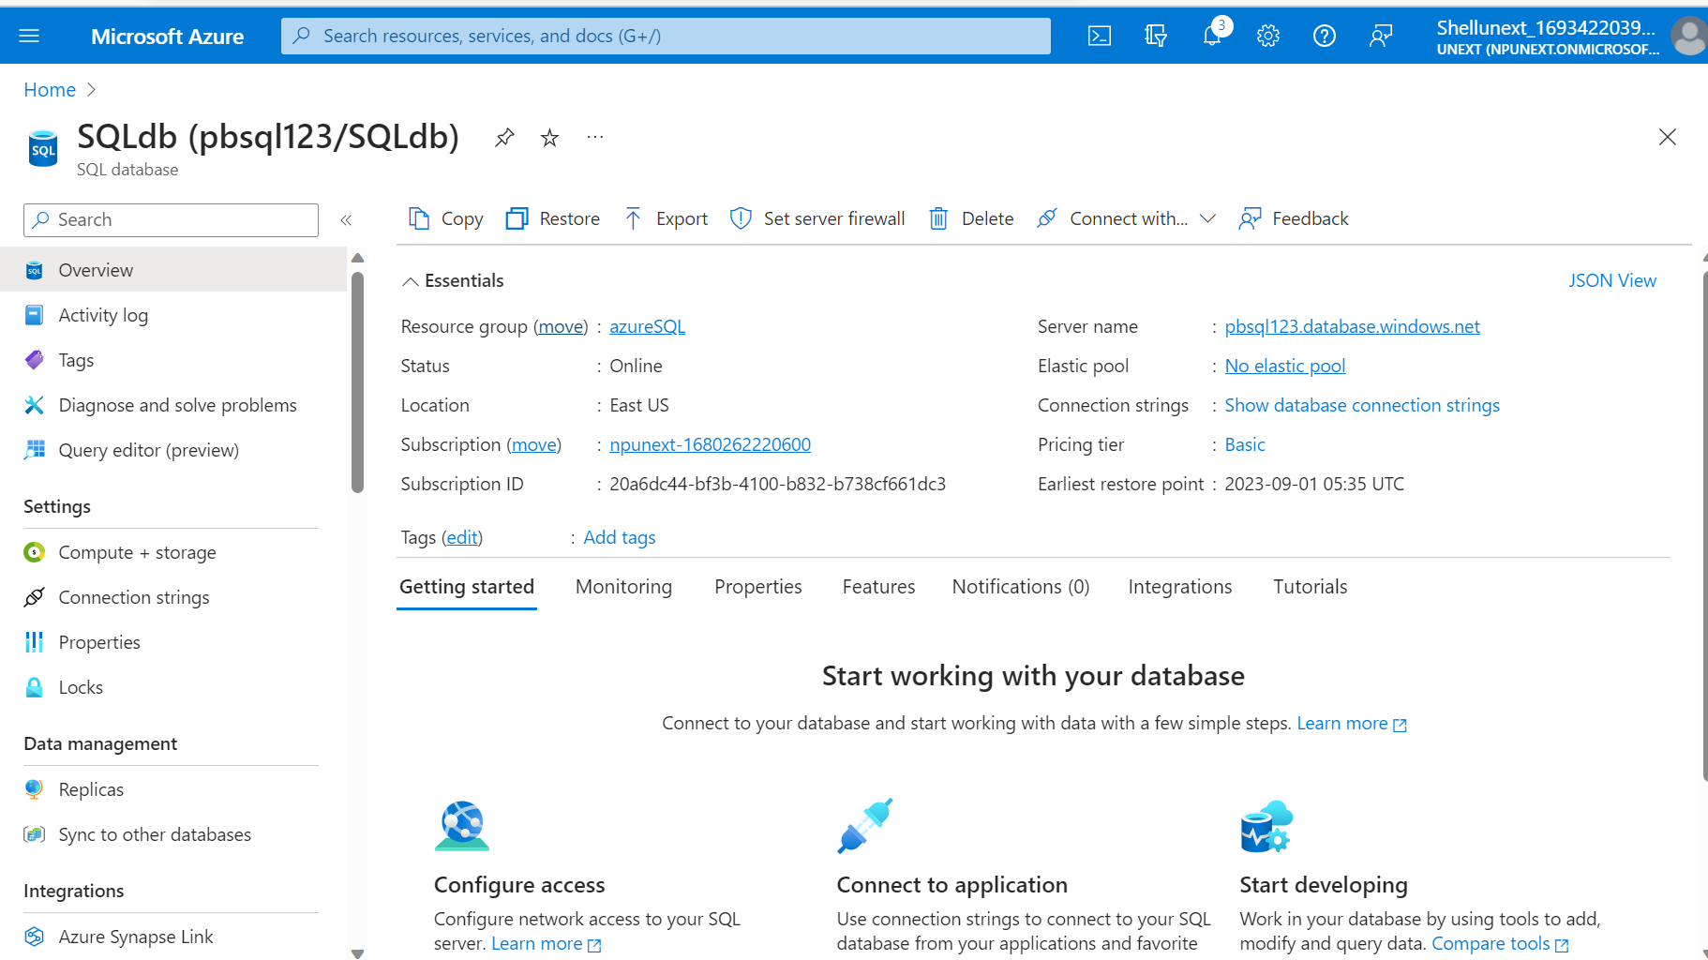
Day-4 ( continued…)

Slide 12
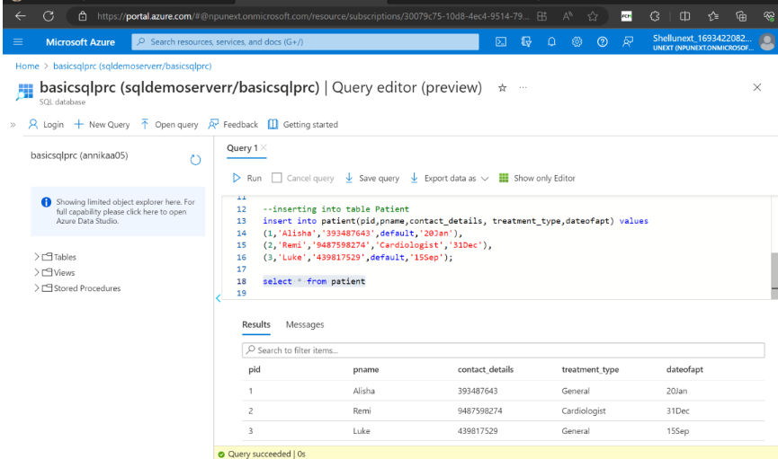
Day-4 ( continued…)

Slide 13
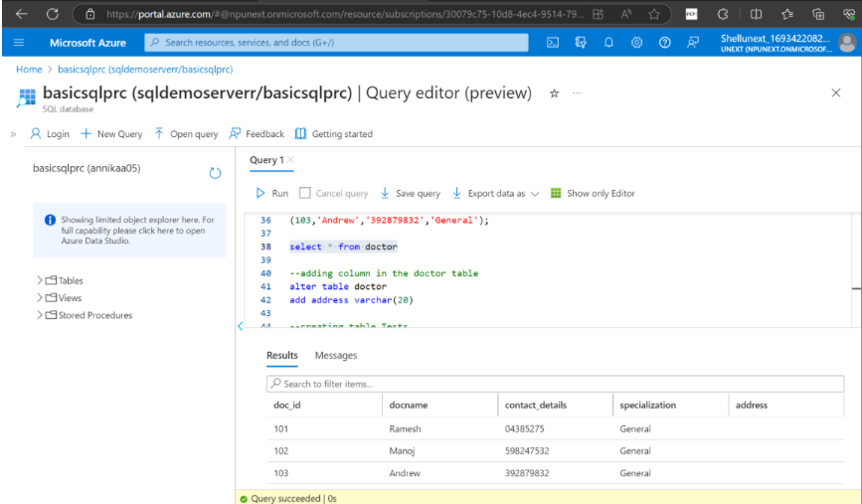
Day-4 ( continued…)

Slide 14
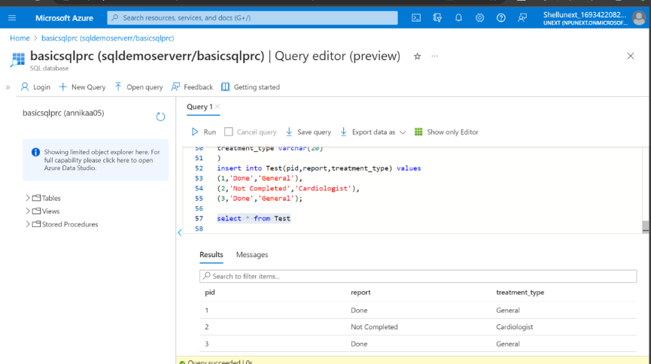
Day-4 ( continued…)

Slide 15
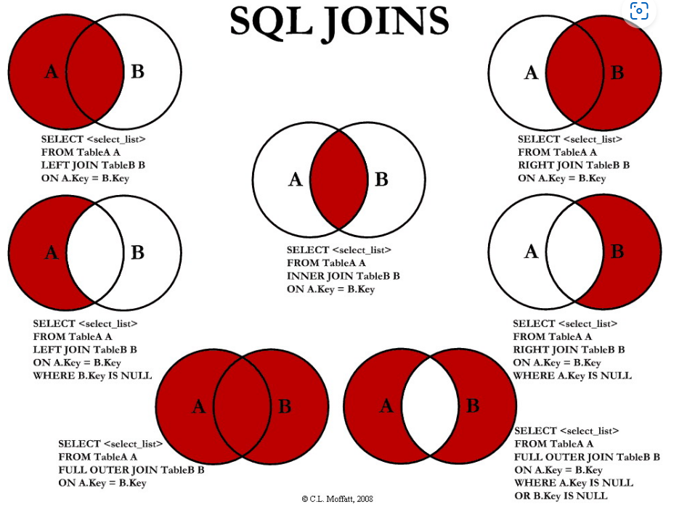
Day-5 ( continued…)
Join Concepts – Combine rows from multiple tables by specifying matching criteria
- Inner Join (Matching Data)
Outer Join
i. Left Outer join
ii. Right Outer join
iii. Full Outer join
Cross Join (T1 * T2)
Self Join

Slide 16
Day-5 ( continued…)
insert into emp values(1,'babjee', 'it', 7902, getdate(), 4000,0,70);
insert into emp values(2,'naveen', 'it', 7902, getdate(), 4000,0,70);
insert into dept values(60,'marketing', 'chennai');
select count(*) from emp
select empno, ename, sal, emp.deptno, dname, loc from emp
inner join dept on emp.deptno = dept.deptno
select empno, ename, sal, e.deptno, dname, loc from emp e
inner join dept d
on e.deptno = d.deptno
select empno, ename, sal, e.deptno, dname, loc from emp e
left join dept d
on e.deptno = d.deptno
select empno, ename, sal, e.deptno, dname, loc from emp e
right join dept d
on e.deptno = d.deptno
/* sub query */
select sal from emp where ename='smith'
select * from emp where sal > 800
select * from emp where sal > (select sal from emp where ename='smith')
select * from emp where sal > (select avg(sal) from emp)
select * from emp where sal = (select max(sal) from emp)
select * from dept where deptno in (select distinct deptno from emp)
select * from dept where deptno not in (select distinct deptno from emp)
/* co related sb queries */
select * from emp o where sal > (
select avg(sal) from emp i where o.deptno = i.deptno)

Slide 17
Day-5 ( continued…)
/* Rank vs denseRank
10000 1 1
9000 2 2
9000 2 2
8000 4 3
*/
select empno, ename, sal, rank() over(order by sal desc) as sal_rank from emp
select empno, ename, sal,deptno, rank() over(partition by deptno order by sal desc) as deptrank from emp
select empno, ename, sal,deptno, dense_rank() over(partition by deptno order by sal desc) as deptrank from emp
select row_number() over(partition by deptno order by empno) as slno, empno, ename from emp
select empno, ename, sal,lead(sal, 2) over(order by empno desc) as lead from emp
select empno, ename, sal,lag(sal, 2) over(order by empno desc) as lag from emp

