Slide 1
SWMM-VVWM Update
Successfully transferred SWMM outputs to VVWM
Both SWMM and VVWM are executing
Output Issue:
SWMM generated unreasonably large runoff (m3/s) and bifenthrin (ug/L) outputs

Slide 2
Solving the Problem
Compared bifenthrin (kg) that were inserted into SWMM to bifenthrin (kg) that was output from SWMM

Slide 3
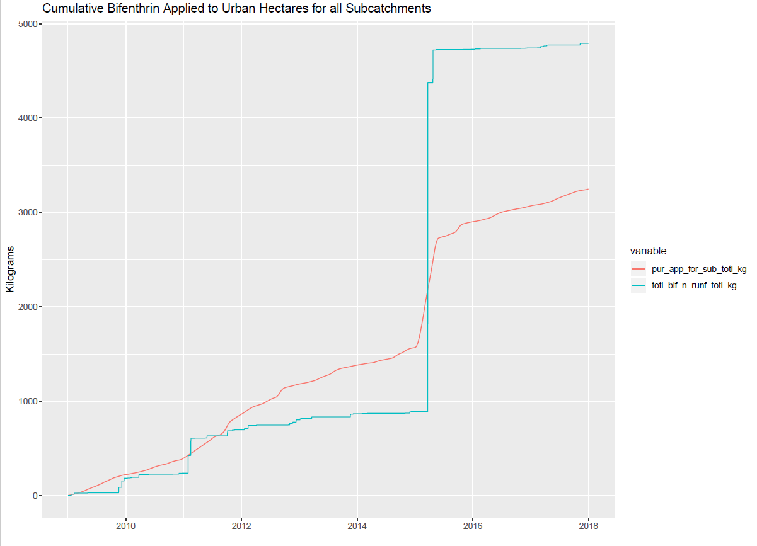
Total PUR Applications (kg), incorporated into SWMM process =>
Developed Land Area in Sub (ha) = Sub Area (ha) * Percent Developed Land in Sub
Application Incorporated for Sub (kg) = EXT App Rate (kgha) * Developed Land Area in Sub (ha)
=> Sum Across Subs, to get total watershed daily PUR applications incorporated into SWMM process
Bifenthrin in Runoff (kg), output =>
Total daily bifenthrin in runoff, in Sub (kg) = [SWMM Runoff output (m3/day) * SWMM Bifenthrin output (ug/m3) ] / 1e9
=> Sum Across Subs, to get total watershed’s daily bifenthrin in runoff that was output by SWMM

Slide 4
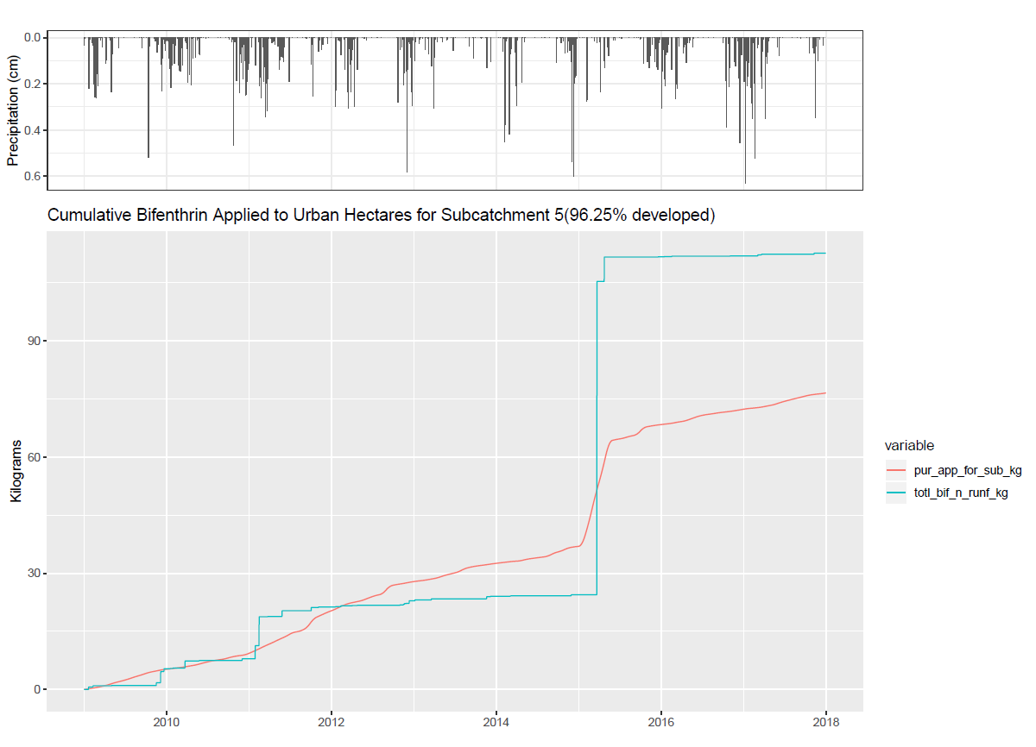

Slide 5
Possible Solutions
Increase SWMM reporting frequency to hourly (rather than daily)
Insert new application rate time series
No applications within 48hr buffer of rainfall
How to re-incorporate the applications that were removed?

