Slide 1
Population Models Python for Ecologists
Tao Hong, Tom Purucker, Jonathan Flaishans, Marcia Snyder
Ecological Society of America Workshop
Minneapolis, MN
hongtao510@gmail.com
August 3rd, 2013

Slide 2
Population models in Üntertool
Exponential
Logistic
Gompertz
Fox Surplus yield
Maximum Sustainable Yield
Yule-Furry
Feller-Arley
Leslie
Khoury
BeePop
HoPoMo
http://master.untertool.appspot.com/pop_index.html

Slide 3
Exponential Model
Mathematical equation
N₀ is the initial number of individuals
N_{t} is population size at t
r is intrinsic growth rate
t is duration
We have three inputs and one output

Slide 4
Code in Python (exp)
Define a function
1 def exponentialgrow(N_o , r, T):
2 index_set = np.arange(T+1) #How to do this in np.linspace?
#index_set = np.linspace(0,T,T+1)
3 x = np.zeros(len(index_set)) #create an array to hold the results
x[0] = N_o #initial condition
for t in index_set[1:]: #t starts at 0, ends at T
6 x[t] = N_o*np.exp(r*t)
return x
Call the defined function
>>>N_t=exponentialgrow(10, 0.4, 10)
>>>[ 10. 14.91824698 22.25540928 33.20116923 49.53032424
73.89056099 110.23176381 164.44646771 245.32530197 365.98234444
545.98150033]

Slide 5
It is your turn now!
Please code the logistic population model
N_{t} is population size at t
N_{t-1} is population size at t-1
K is population capacity
r₀ is max growth rate
t is simulation duration
We have four inputs and one output

Slide 6
Code in Python (logistic)
Define a function
def logisticgrow(N_o, T, r, K):
index_set = np.arange(T+1)
x = np.zeros(len(index_set))
x[0] = N_o
for t in index_set[1:]:
x[t] = x[t-1] + (r)*x[t-1]*(1 - x[t-1]/float(K))
return x
Call the defined function
>>>N_t=logisticgrow(10, 10, 0.4, 100)
>>>[ 10. 13.6 18.30016 24.28064058 31.63469878
40.28556162 49.90808037 59.90804657 69.51536903 77.99197051
84.85776886]
Why use float(K)?
Try 10/100
And 10/float(100)

Slide 7
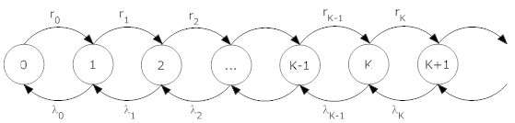
Feller-Arley (birth-death) Markov Process
No internal population structure and each individual can give birth and death with constant rates
N_{t}=N_{t-1}-1+N_{birth}-N_{death}
N_{birth} ~ binomial (N, P_{birth})
N_{death} ~ binomial (N, P_{death})
Let’s look at the code ‘population_modeling_bdp.py’

Slide 8
Monte Carlo Simulation
Wrap the code by a loop
Save results of each iteration
Loop begins
Call the defined function
function
Save results
Loop ends

Slide 9
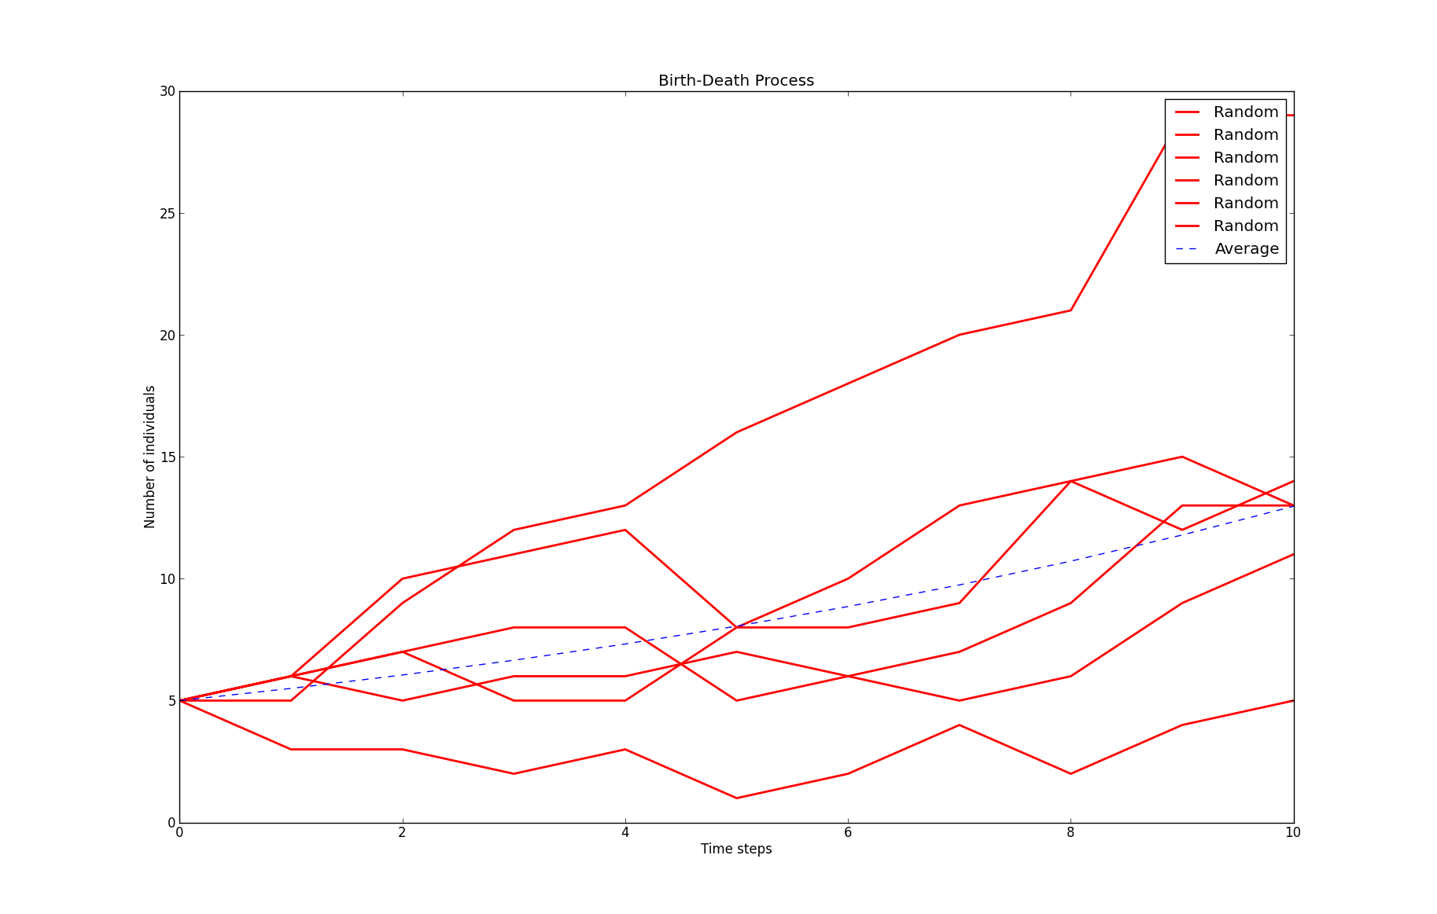
Plot Results
matplotlib, a library to illustrate your data

Slide 10
Leslie Model
for i in range(0, T):
n=np.dot(l_m, n_o)
n_o=n
n_f[:,i]=n.squeeze()
Let’s look at the script ‘population_modeling_lm.py’
Why squeeze?
Try n.ndim and n.squeeze().ndim

