Slide 1
Introduction to Programming with Python
Introduction, Variables, Operators, and Expressions
(Chapters 1 and 2)

Slide 2

Getting a Stranglehold on
Python is a general-purpose high-level programming language whose design philosophy emphasizes code readability.
Python aims to combine "remarkable power with very clear syntax”, and its standard library is large and comprehensive.
Libraries like NumPy, SciPy and Matplotlib allow Python to be used effectively in scientific computing.
Wikipedia

Slide 3
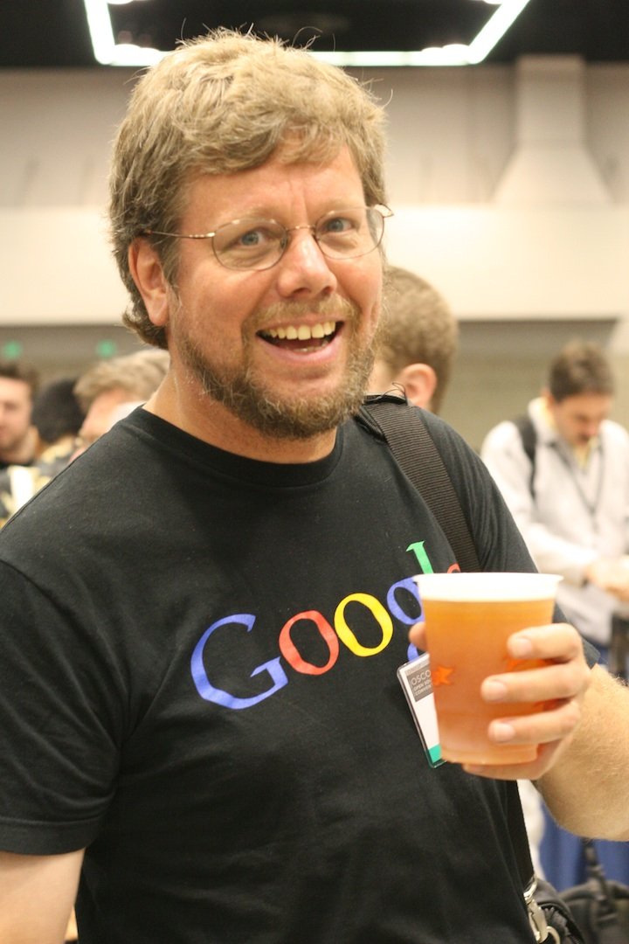
Getting a Stranglehold on
Python’s syntax has a clear layout based on whitespace (This does not mean tabulation!)
As a dynamic language, it is well suited as a scripting language, but easily can be used in an object-oriented fashion.
Can be used in conjunction with Java and C# using Jython and IronPython respectively.

Slide 4
Some Clear Python Code
import sys
z,x,y= "}{|}A|k{|kA|}=BE1)|BF}))|$}:~pI~/;@Go{H%{&A?|if }:~pJ"\ "IJ-1~#>=0:GoAG@HG;o{G;%-I&{?|m,kJ,j=C?;/@~o{~D:Gl[c]("\ ")?","G$p:%~;%~;el!]':p%break~;![':p%#<len(j):~%\n\t\t"\ "%if c=='%while o%\n%m[k]%+=1%\t%if not %c=j[o]%-=1%sy"\ "s.std%[0]*64000,0,0,open(sys.argv[1]).read()%if l.has"\ "_key(c)%in.read(%out.write(chr(%=1%,o".split('%'),"HG"\ "&%/~!#?}{;$@ABCDEFIJ”
for i in range(len(x)):z=z.replace(y[i],x[i])
z=z.split('|')
for o in range(9):
exec("def %c():\n\tglobal k,m,o,j\n\t%s\n"%(chr(97+o),z[o]))
l={'>':c,'<':d,'-': b,'+':a,',':e,'.':f,'[':g,']':h}
i()

Slide 5
How To Use Python
Interactive Interpreter:
Type python in terminal or python.exe
“>>>>” indicates ready for code input
Try this -- print "Hello, World!”
Print tells interpreter to print what is between quotes
Executable Python code:
hello_world.py, which is print “Hello, World!” in a simple text file.
Type python hello_world.py
Run code as executable script:
Add #!/usr/bin/python to first line of code
Make executable by typing chmod a+x hello_world_executable.py
Type ./hello_world_executable.py

Slide 6
Variables
One variable is set in a very simple manner:
x=3
Multiple variables are set in atleast 3 ways:
x,y,z = 1,2,3
x=y=5
The Right Way:
x=1
y=2
z=3
What about variables that hold text
x=“Hello,World!”
print x

Slide 7
So What is This Dynamic Typing thing
Notice this snippet from variables.py:
x="Hello, World!"
print x
p=x*y*z
print p
What does this print?
Wait! Java would scream at me like a 3 month old, for typing this what is happening?
Is it the order that matters? Try p=y*x*z or p=z*y*x
Mix three data types:
z=3.0
p=y*x*z
print p
Does addition/concatenation work?
p=x+y+z

Slide 8
Smooth Operators
+
Addition:
x=2.0
y=3
z=x+y
Concatenation:
p = "Hello, "
q = "World!"
r = p + q
-
Subtraction:
x=4
y=3
z=x-y
No such thing as reverse-concatenation:
p = "Hello, World!"
q = ", World"
r = p - q

Slide 9
Smooth Operators
*
Multiplication
x=2
y=3
z=x*3
Exponentials
z=x**y
Repetition (We saw this earlier)
/
Decimal Division
x=4.0
y=2
z=x/y
Modulo Division
x,y = 4,2
z=x/2
Note % operator returns remainder

Slide 10
Expressions
Mathematical
2 + 3
(2*3)
x + 1
x + y
Boolean
x or y
x and y
if (x == y)
not x
x != y
Strings
“Hello, World!”
“Hello,” + “World!”
Functional
print(x)
exit()

Slide 11
Statements (meaningful expressions)
Declarative
x = 1
x = “Hello, World!”
Expression statements
x = y + 1
x = y * z
x = floor(3.2)
Import statements
import math
import sound.effects.echo
import sound.effects.*
from math import floor

Slide 12
Primitives or Built-in Types
Integer
2, 3, 4
Float
2.0, 3.5
Boolean
True, False, 1, 0
String
“Hello, World!”
Tuples and Lists
x=(1,2,3)
x=Tuple(“wow”)
x=[2,3, “Hello”]

