Slide 1
Introduction to Programming with Python
Functions and Recursion

Slide 2
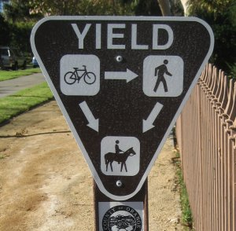
Review from Last Week
Conditionals
How would you code a function to decide who has right of way on a California Green Trail
def rightOfWay(you, it):
if it == “centaur”:
return “it”
elif you == “centaur”:
return “you”
elif it == “doing the robot”:
return “it”
else:
return “you”
Is this only way of doing this?

Slide 3
Review from Last Week
Loops
What is printed by the following code?
def whileLoopTest():
var0 = 0
while var0 < 100:
var0 += 1
if var0%2 == 0:
var0 += 3
print var0
Can we replicate this with a for loop?

Slide 4
Review from Last Week
Loops
What is printed by the following code?
def forLoopTest():
print 1
for var0 in range(1,26):
print var0*4 + 1
Not this is cosmetically similar, what makes the two loop types different?

Slide 5
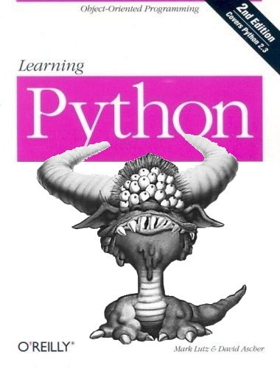
Now For Something a Little Different
Recursion
What if you are not going linearly through your data?
What if the solution to part of the problem informs/solves the whole problem?
What if you really like saying things like base case?

Slide 6
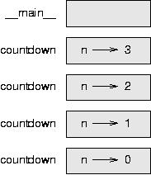
Recursion
Basically calling a function from within the same function.
Inputs to function should be different. (How? That is problem specific.)
Base case(s) tell the function to stop and return result.
For each recursive call, there is some additional memory kept.

Slide 7
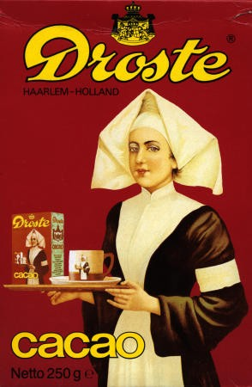
Recursion So Warm and Tasty!
def countdown(n):
if n == 0:
print "Blastoff!"
else:
print n
countdown(n-1)
Is this efficient?
Is it clear?

Slide 8
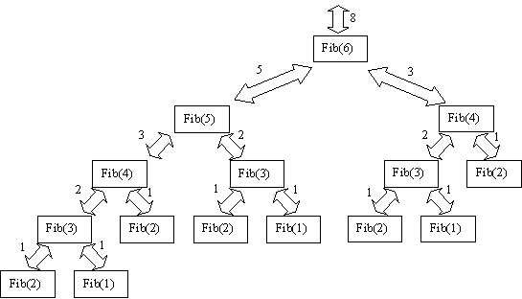
The Don’t Do This @ Home Kids
def fibonacci( n ): if n == 0 or n == 1: # base case print “*”
return n else:
# two recursive calls
print “*”
print “*” return fibonacci( n - 1 ) + fibonacci( n - 2 )
You can see that compared to iteration, which would only take 6 repetitions to get fib(6) this takes 8

Slide 9
Recursion problems
A not-so efficient factorial function
N!=N*(N-1)!
Base case:
0!=1
Fill in the blanks:
def rec_sum(list):
sum = __
for __ in list:
if type(element) == type([]):
sum += rec_sum(__)
else:
sum += sum + element
return __

Slide 10
Strings
Remember I said strings were built-in data types.
Not primitive though, this means they can be traversed as lists and have functions associated with them.
test = “hello”
print test[0]
test[0] = j No jello for your tonight!

Slide 11
Strings
def printStringVertically(word):
for index in range(0,len(word)):
print word[index]
Lets slice up a string
word = "Hello, World!"
print word[7:12]
print word[:5]
print word[7:]
print word[:]

Slide 12
Lists
Basic data structure that has numerous operations that can be used on it.
list = [0,1,2,3]
list.append(4)
list.extend(list)
list.insert(0,-1)
list.remove(-1)
list.pop(0)
list.count(1)
list.sort()
list.reverse()

Slide 13
List exercise
Create a function that prints all duplicate items in a list
Create a function that takes a list and returns the same list with no duplicates in reverse order.
Implement a stack like push, pop, and peek

