Slide 1
Python Development
Development Tools and Methodology

Slide 2
Basic Types of Development Tools
Interpretive Python mode
Basic text editing tools
Advanced text editing tools
Integrated Development Environments (IDEs)
No one tool is perfect for all developers or development tasks

Slide 3

The Worst Name for a Piece of Art

Slide 4
Interpretive Python Mode
A good way to learn simple mechanics of language
Test out APIs
Not especially well suited for development of functions, loops, and other advanced features of Python
Absolutely not how to do long term programming

Slide 5
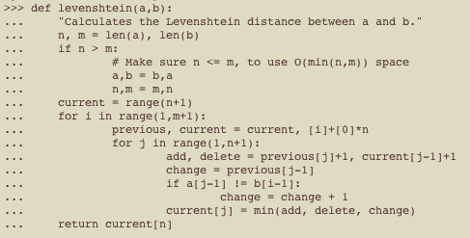
Implementing Levenshtein¹ Algorithm
Measures amount of edits needed to transformed on string to another.
¹^ В.И. Левенштейн (1965). "Двоичные коды с исправлением выпадений, вставок и замещений символов". Доклады Академий Наук СCCP 163 (4): 845–8. Appeared in English as: Levenshtein VI (1966). "Binary codes capable of correcting deletions, insertions, and reversals". Soviet Physics Doklady 10: 707–10.

Slide 6
Simple Text Editors
Think Notepad, Gedit, and nano
Easier to type lots of code and allows user to correct lines of code before interpreted.
No indication of whether code is correct until you save and type python filename.py
Code can be saved and run at later stage.

Slide 7
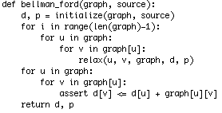
Bellman-Ford Algorithm
This algorithm measures distances between nodes in a directed and weighted graph. Oh and my man Djikstra’s solution makes this look like the guy who brought Boone’s Farm to the Judgement of Paris.

Slide 8
Advanced Text Editors
TextWrangler, BBEdit, vim, and emacs
Syntax highlighting, line numbers, and ability to execute files as scripts allow user to develop more entailed code and run scripts in situ
Little or no idea of objects, classes external to scripts, and code completion make large scale development less intuitive

Slide 9
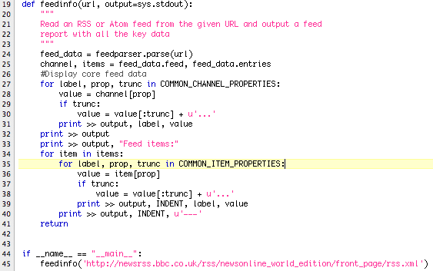
Using an RSS feeder library
FeedParser is a RSS and Atom Feeder that everybody should use.

Slide 10
Et tu Brute? Beware the IDEs of March
IDLE, Pydev (Eclipse), Komodo
Variety of menus and windows that provide user-tailored environment
Class and Function browsing, syntax error notification, external library navigation, introspection, and code debugging make this the environment of choice for large projects

Slide 11
How to install python module
Download python code and uncompress python from site, let’s say for feedparser from here.
In terminal in folder that holds python code, type sudo python setup.py.
This installs code into default python module folder
Include module code by typing
import feedparser

