Slide 1


Simulation
www.neptuneandco.com

Slide 2
Presentation Outline
Probability Distributions
Random Number Generators
Multivariate Sampling
Simulation vs Monte Carlo Integration

Slide 3
Named Distributions
Most common probability distributions are available in base R (stats package)
Virtually any “named” distribution is available in some R package – less common ones appear in contributed packages
Almost all follow the same function naming conventions

Slide 4
d, p, q, r
Evaluate the probability density function (pdf/pmf) of a distribution
dNAME( x, … )
Evaluate the cumulative distribution function (CDF) of a distribution
pNAME( x, … )
Evaluate the inverse cumulative distribution function of a distribution
qNAME( x, … )
Generate random variates from a distribution
rNAME( n, … )

Slide 5
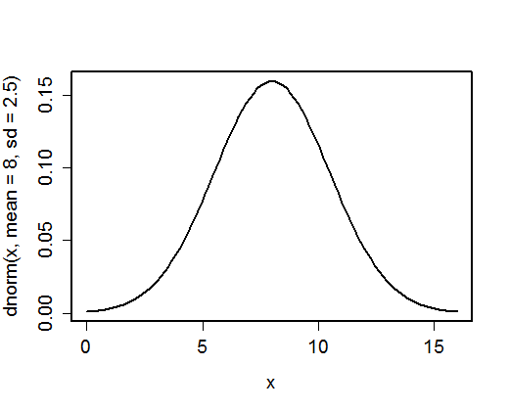
Example – Normal Distribution
curve( dnorm( x, mean=8, sd=2.5 ), from=0, to=16 )

Slide 6
Probability Density Function
Describes the relative likelihood of a value that the random variable could take
Normalized to integrate (or sum) to 1
Often used in statistical computations to assess the likelihood of a sampled value
Likelihood function – for i.i.d. samples, product of density functions
Useful option when computing likelihoods:
log=TRUE
dnorm( 44, mean=8, sd=2.5, log=TRUE )
[1] -105.5152

Slide 7
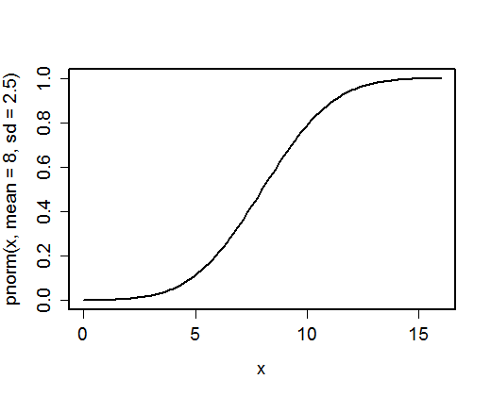
Example – Normal Distribution
curve( pnorm( x, mean=8, sd=2.5 ), from=0, to=16 )

Slide 8
Cumulative Distribution Function
Curve describing the probability of a random variable being lower that a given value
F(x) = Prob( X ≤ x )
Often used in statistics to compute p-values
Also used for likelihood functions when data values are censored (e.g. detection limits)
Useful options: log.p=TRUE
lower.tail=FALSE [ Prob( X ≥ x ) ]
pnorm( 44, mean=8, sd=2.5, log.p=TRUE, lower.tail=FALSE )
[1] -107.2709

Slide 9
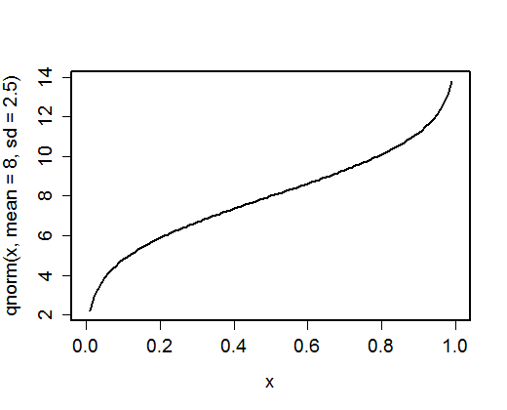
Example – Normal Distribution
curve( qnorm( x, mean=8, sd=2.5 ), from=0, to=1 )

Slide 10
Inverse CDF
Also known as the quantile function
Q(x) = F⁻¹(x)
Often used in statistics to compute critical values for a test statistic
E.g. qnorm( 0.95 ) for an upper 95% bound
Probability Integral Transform (coming soon)
Useful options: log.p=TRUE
lower.tail=FALSE
qnorm( 1e-3, mean=8, sd=2.5, lower.tail=FALSE )
[1] 19.88356

Slide 11
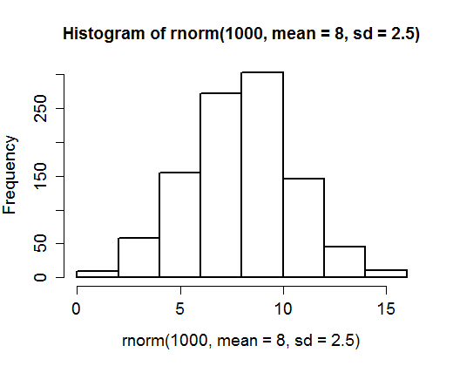
Example – Normal Distribution
hist(rnorm( 1000, mean=8, sd=2.5 ))

Slide 12
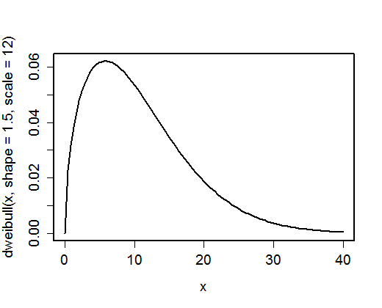
Example – Weibull Distribution
curve( dweibull( x, shape=1.5, scale=12 ), from=0, to=40 )

Slide 13
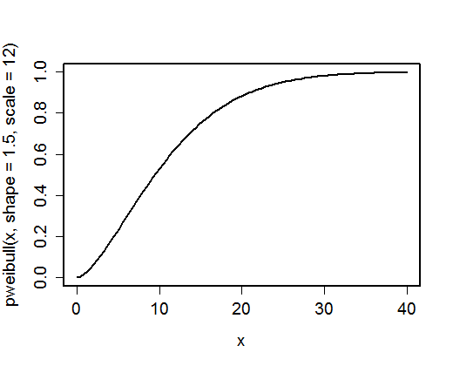
Example – Weibull Distribution
curve( pweibull( x, shape=1.5, scale=12 ), from=0, to=40 )

Slide 14
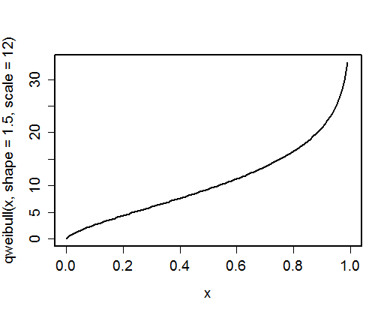
Example – Weibull Distribution
curve( qweibull( x, shape=1.5, scale=12 ), from=0, to=1 )

Slide 15
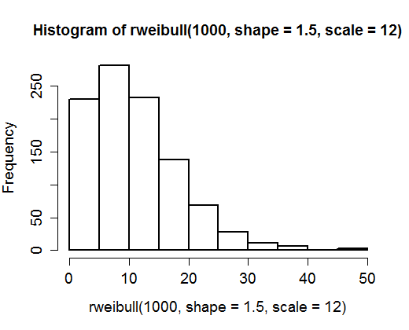
Example – Weibull Distribution
hist( rweibull( 1000, shape=1.5, scale=12 ) )

Slide 16
Common Distributions
Continuous Distributions
Beta: beta [shape1, shape2]
Chi-squared: chisq [df, ncp]
Exponential: exp [rate]
(Snedecor’s) F: f [df1 (num.), df2 (den.)]
Gamma: gamma [shape, rate (or scale)]
Mean = shape / rate = shape * scale
Logistic: logis [location, scale]
Lognormal: lnorm [meanlog, sdlog]
Normal (Gaussian): norm [mean, sd]

Slide 17
Common Distributions (cont’d)
(Student’s t): t [df, ncp]
Uniform: unif [min, max]
Weibull: weibull [shape, scale]
Discrete distributions
Binomial: binom [size, prob]
Geometric: geom [prob] (min value=0)
Hypergeometric: hyper [n, m, k]
Negative Binomial: nbinom [size, prob or mu]
Poisson: pois [lambda]
Multinomial: unif [size, probs] (r and d only)

Slide 18
Discrete Sampling
If you wish to pick from a discrete set of values with specified probabilities:
sample( x, n, prob=p, replace=TRUE )
## samples n values from the vector x
## chosen with probability proportional
## to p
sample( letters[1:5], 8, prob=1/(1:5), replace=TRUE )
[1] "e" "a" "a" "d" "b" "b" "a" "c"
By default, prob = 1/length(x) – all values of x equally likely

Slide 19
Sampling without Replacement
Does not allow the same value to be chosen more than once
Useful for subsampling:
sample( letters, 5, replace=FALSE )
[1] "m" "x" "h" "z" "s"
Or for randomizing the order of a vector:
sample( letters, 26, replace=FALSE )
[1] "p" "e" "f" "q" "l" "s" "i" "u" "x" "a" "z" "m" "c" "v" "d" "r" "g" "j" "y" "k" "b" "o" "w" "n" "t" "h"

Slide 20
Randomization
Commonly desirable to randomize the order of runs in an experiment
Exper
Temp Flow Species
1 60 100 A
2 75 100 A
3 60 200 A
4 75 200 A
5 60 300 A
6 75 300 A
7 60 100 B
8 75 100 B
9 60 200 B
10 75 200 B
11 60 300 B
12 75 300 B
Exper[ sample( nrow(Exper) ), ]
Temp Flow Species
11 60 300 B
4 75 200 A
12 75 300 B
8 75 100 B
9 60 200 B
10 75 200 B
3 60 200 A
5 60 300 A
6 75 300 A
2 75 100 A
1 60 100 A
7 60 100 B

Slide 21
Random Number Generators
Pseudo-random numbers: a re-ordered sequence of integers on some range 1, 2, …, M
Intended to “act” random
Several options for R:
Default: Mersenne-Twister
Knuth-TAOCP, Knuth-TAOCP-2002, L'Ecuyer-CMRG Marsaglia-Multicarry, Super-Duper, Wichmann-Hill
RNGKind(kind="…")#sets the RNG-type
Parallel RNGs available in contributed packages

Slide 22
Replicating Results
.Random.seed is an object storing the current random number state
It can be stored to replicate simulation
tmp <- .Random.seed
rnorm( 5 )
[1] -0.05159343 1.10103229 0.83087681 0.61118627 1.70408828
.Random.seed <- tmp
rnorm( 5 )
[1] -0.05159343 1.10103229 0.83087681 0.61118627 1.70408828

Slide 23
Initializing the RNG
The simple way to initialize the RNG is:
set.seed( someinteger )
This initializes the random number seed with a single value, even when the random number generator requires a complicated seed vector
Gives the same results from computer to computer
set.seed( 123 ); rnorm( 5 )
[1] -0.56047565 -0.23017749 1.55870831 0.07050839 0.12928774

Slide 24
Probability Integral Transform
If U is a uniform random variable on (0,1), then X = F⁻¹(U) is a r.v. with CDF F.
If inverse CDF function exists in R:
Generate N uniform(0,1) random variates.
Compute the inverse CDF evaluated at those points.
E.g., to get gamma r.v.s, could use:
u = runif( 10 )
x = qgamma( u, shape=2, rate=0.2 )
Better to use r algorithm where available

Slide 25
Multivariate Sampling
If independent, just generate separately
If directionally dependent, generate sequentially:
Generate X from its distribution.
Generate Y with parameters of Y varying according to the values of X.
True multivariate distributions quite limited in base R (and generally)
Multivariate normal:
MASS::mvrnorm( n, mu, Sigma )
For vector mu and covariance matrix Sigma

Slide 26
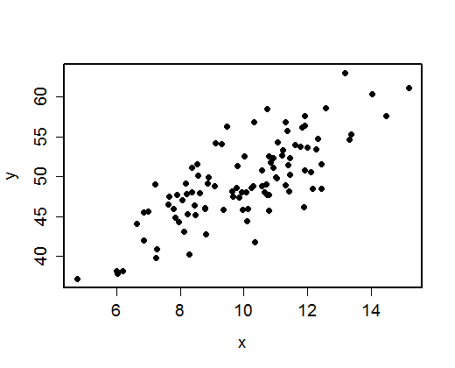
Multivariate Normal
xy = MASS::mvrnorm( 100, c(10,50), matrix( c(4,7,7,25), ncol=2 ) )
plot( xy, xlab="x", ylab="y" )

Slide 27
Structural Multivariate
Example: Regression-style relation Y = 3.2 + 5 X + e
x <- rnorm( 100, 5, 2 )
y <- rnorm( 100, 3.2 + 5*x, 1.5 )
Example: More general parameter relations
x <- rlnorm( 100, 1, 0.5 )
y <- rlnorm( 100, 2, 0.3 )
z <- rgamma( 100, shape=0.5*x, rate=x/y )

Slide 28
Inducing Correlation
Inducing correlation amongst r.v.s is generally difficult outside of multivariate normals
Common (imperfect) approach for correlating non-normals
Simulate multivariate normals X with desired correlations amongst variables.
For each variable, evaluate normal CDF: U_{i}=Φ(X_{i}).
Use the probability integral transform to convert U_{i} to desired distribution: Y=F⁻¹(U_{i}).
Preserves rank-correlation, but not correlation

Slide 29
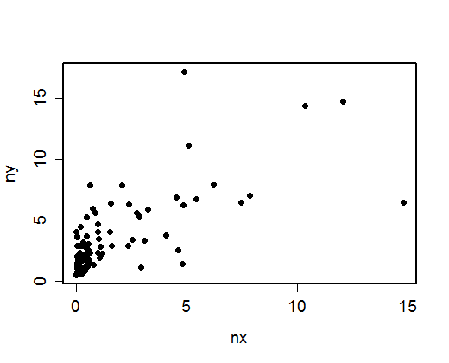
Inducing Correlation Example
x <- MASS::mvrnorm( 100, c(0,0), matrix( c(1,0.7,0.7,1), ncol=2 ) )
u <- pnorm( x )
nx <- qgamma( u[,1], shape=0.5, rate=0.3 )
ny <- qlnorm( u[,2], meanlog=1, sdlog=0.75 )

Slide 30
Simulation vs Monte Carlo Integration
Simulation
Goal is to replicate sampling variability
Want to explore effect of randomness on process
Inference of interest may be in ranges or extremes as well as typical or average behavior
Monte Carlo Integration
Randomness present but is a “nuisance”
Inference of interest is an average (of some sort)
Interested in ensuring “coverage” of parameter space

Slide 31
Monte Carlo Integration
Want to estimate a quantity of the form:
where f(x) is a probability density function.
Simulate N random variates – x₁, x₂, x₃, …, x_{N} – from the distribution corresponding to f(x).
Estimate the quantity of interest:
Standard error of estimate:

Slide 32
Simple MC Integration Example
Suppose you want an estimate of the average of e^{X} where X is normal( 0, 1 ) [Truth = 1.64]
Simulate 4 X values and compute:
mean( exp( rnorm( 4 ) ) )
[1] 1.774846
mean( exp( rnorm( 4 ) ) )
[1] 2.744466
mean( exp( rnorm( 4 ) ) )
[1] 0.5896753
Close enough?

Slide 33
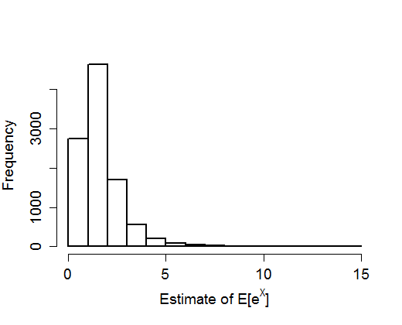
MC Integration Example (cont’d)
Repeating the experiment of using just 4 samples, the distribution of estimates:

Slide 34
A quantile approximation
If you can use just 4 points, better to use evenly spaced quantiles?
Using the 20th, 40th, 60th, and 80th percentiles:
tmp = qnorm( c(0.2, 0.4, 0.6, 0.8) )
mean( exp( tmp ) )
[1] 1.203916
Not perfect. At least known likely not to be eggregiously off.

Slide 35
Quasi-random Numbers
Number sequences that are low discrepancy
i.e. the sorted sequence has minimal gaps
i.e. never get several high numbers in a row
Often better for Monte Carlo integration
Current algorithms not great for high dimension (d > 7)
Available from the GNU scientific library package (gsl)
q <- gsl::qrng_alloc( dim=1, type= "sobol" )
gsl::qrng_get( 10 )

Slide 36
Latin Hypercube Sampling
A hybrid pseudo/quasi-random sample for multiple dimensions
Various levels of sophistication with respect to dimensionality
Of primary use when total # of computer runs is small compared to dimensionality of random inputs
Various LHS exist in R: package lhs has fundamental algorithms
lhs::randomLHS( n, k )
## n,k = number of samples, dimensions
Generates uniforms – probability integral transform

