Slide 1


Advance graphics
Matt Pocernich
www.neptuneandco.com

Slide 2
Outline
Advanced usage of base plot functions
Setting options with par
File formats – saving files
Format for publication
Best practices
ggplot
Components
Usage
Examples

Slide 3
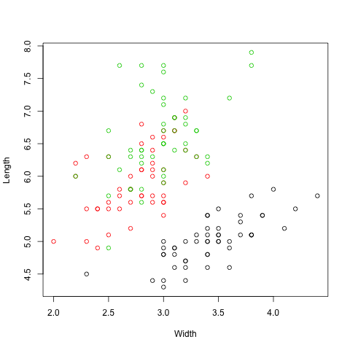
Image with default settings
Issues
Size
Space in margins
Grainy
Points faint
Lines faint
y-axis labels

Slide 4
Different graphics styles are needed for different purposes
Presentations
Thicker lines, bolder points
Saying “You probably can’t see this ….” = “I am too lazy to make a figure appropriate for presentations”
Reports
Collaborators? What software do they use?
Printed material requires higher resolution than electronic media.
Journals
Style defined by journal
Commonly thinner lines, color restrictions, restricted widths, fonts, etc.

Slide 5
Improving a basic plot
Eliminate white space
Rotate axis labels
Make lines thicker
Add text to corner as required by journal

Slide 6
par() Setting graphical parameters
Commonly set values
mfrow= c(nrows, ncol) # multiple plots
mar = c( bottom, left, top, right) # margins
par() # returns all parameter of an open plot.
par("usr") ## returns coordinates of print region
par settings effect all subsequent plots until graphics window or file is closed.

Slide 7
Common par options
cex- character expansion
governs text or points
lwd – line weight
lwd = 1 are in pixels or points or 1/96 inch.
usr (user coordinates)/ plt( proportion of figure region)
mar = margin in relative units

Slide 8
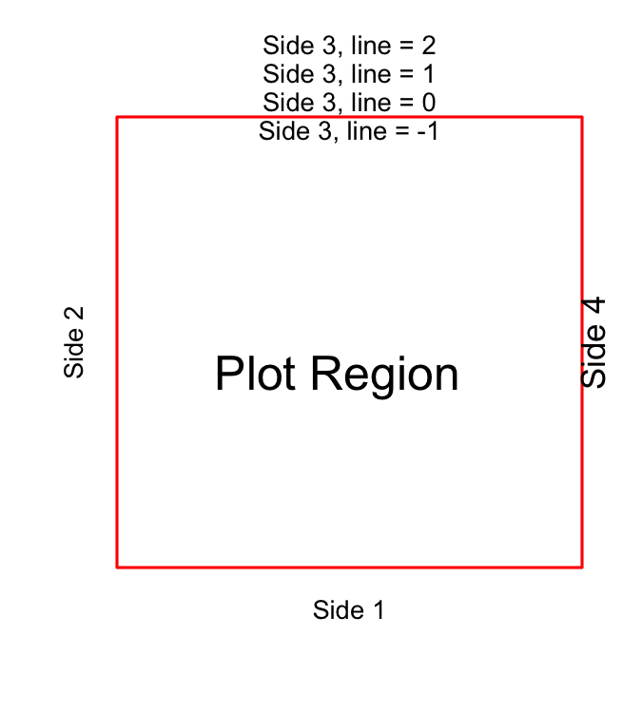
Plot Region Coordinates
par(mar = c(5,5,4,1) ) control margins in relative line units
arguments in mar follow c(bottom, left side, top, right side)
mtext used to add margin labels
par(‘usr’) returns the coordinates of the plot region
Part A: Improving Base Plots
file = graphics.R

Slide 9
Types of graphic file formats
Vector graphics – pdf, postscript, wmf
Resolution is not an issue/option
Lines and points created from code
Become very large with many points
May correctly reshape
Raster – jpeg, png, bitmap
Resolution is an issue
Potential issues rescaling
Used to store images

Slide 10
Figure Storage Formats
pdf, and eps (encapsulated postscript)
Scalable and very clean
By default, use locally stored fonts.
Difficult to use with some version of Word
pdf files hold multiple pages of figures
jpeg, bitmap, png
wmf (windows metafile)
Won’t work on a Mac OS

Slide 11
Graphics Terms
resolution (res) in pixels per inch
pixel - a single point on a display device
pointsize
approximately 1/72” – a distance
– points are not pixels
font – basically, normal, bold, italic, …
family ( font family) Courier, Hevletica, …
units = “in”, “cm”, “px”

Slide 12
Png and jpeg files
Dimensions of png and jpeg files
Default resolution taken from OS or defaults to 72 ppi
Default height and width = 480 pixels ~ 6 inches at 72 ppi
If units are changed to inches or cm, resolution must be specified
args(png)
function (filename = "Rplot%03d.png", width = 480, height = 480, units = "px", pointsize = 12, bg = "white", res = NA, …)

Slide 13
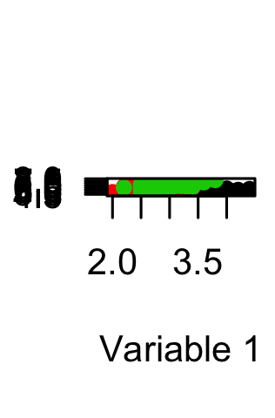
A troubled image. Why?
png(”test.png",
pointsize = 10, res = 300)
plot(…)
dev.off()

Slide 14
pdf and postscript
args(pdf)
function (file = ifelse(onefile, "Rplots.pdf", "Rplot%03d.pdf"), width, height, onefile, family, title, fonts, version, paper, encoding, bg, fg, pointsize, colormodel)
Many options take values from the local system.
ps.options() ### returns systems values
Part B: Graphic File Options
file = graphics.R
Notes:
Check for Windows alternative to ps.option()

Slide 15
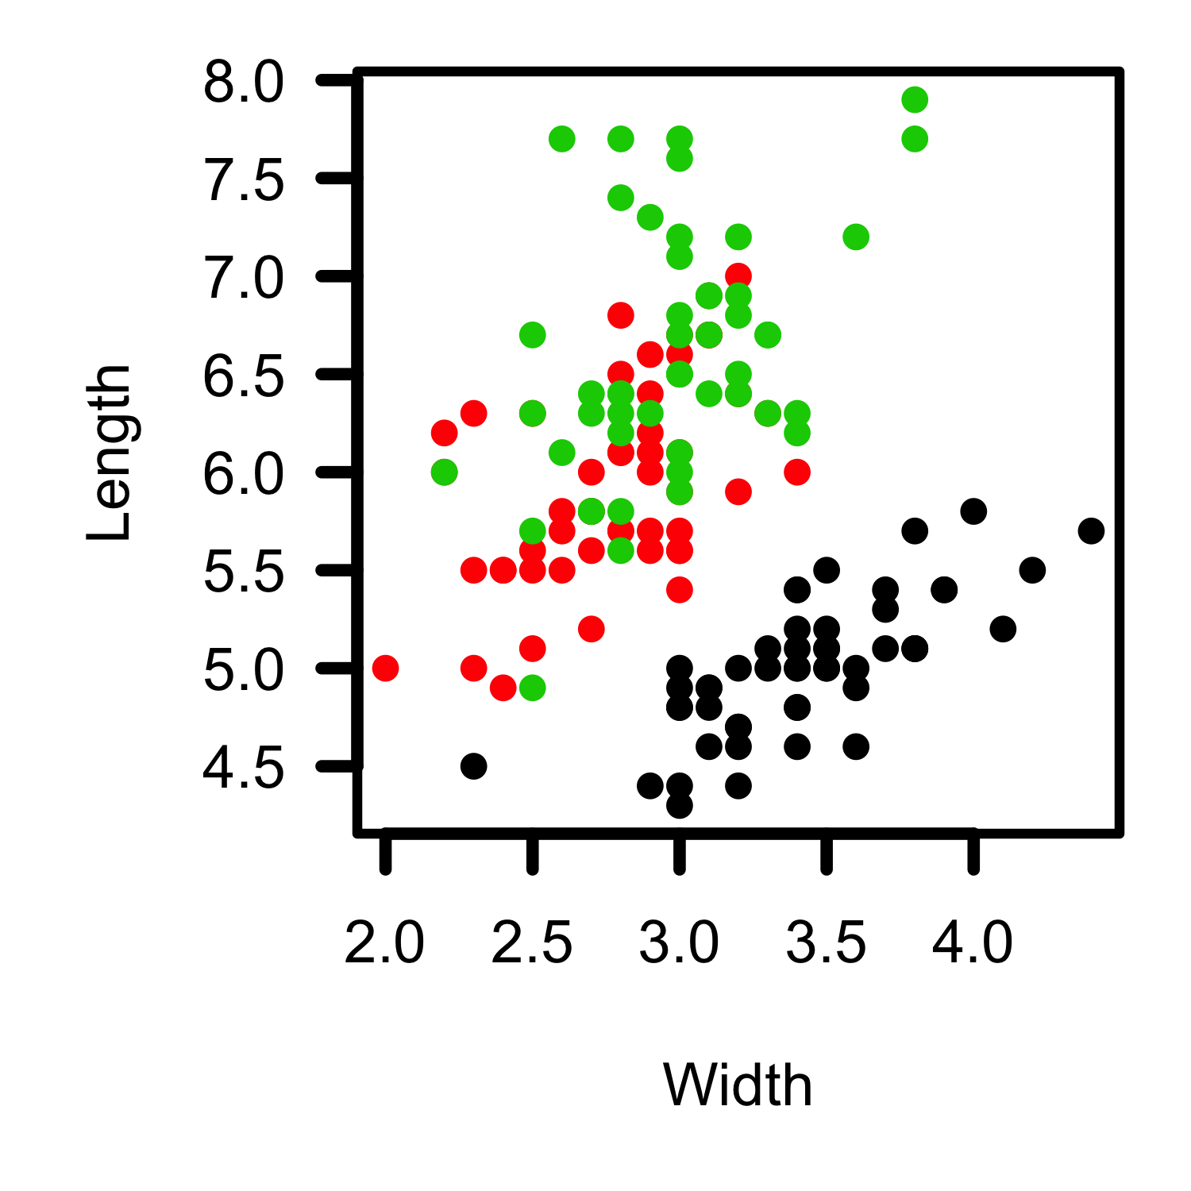
Show polished slide and what it takes to get there
png("test5.png", res = 300, units = "in", width = 5, height = 5)
par(mar = c(5,5,1,1), cex = 1.5, lwd = 4,
las = 1)
plot(iris$Sepal.Width, iris$Sepal.Length, col = as.factor(iris$Species) ,
xlab = "Width", ylab = "Length", axes = FALSE, pch = 16)
box()
axis(1, lwd = 5):axis(2, lwd = 5)
dev.off()

Slide 16
Example of Journal Criteria Nature: Select Critera
Full colour artwork should be provided in CMYK format
All text should be in a sans-serif typeface, preferably Helvetica or Arial
Nature’s standard figure sizes are 89 mm (single column) and 183 mm (double column).
Do not rasterize line art or text in submitted figures
It is best to prepare artwork so that when reduced to one of these sizes, the letters and symbols will be no smaller than 8 points.

Slide 17
Colors and Embedded Fonts
RGB – Red, Green Blue
Digital media such as computer screens
Millions of colors
CMYK - Cyan, Magenta, Yellow, and Key
Print Media
Thousands of colors
See embedFonts or use
and graphics software
Part C: Journal Publications
file = graphics.R

Slide 18
Best Practices
Make figures the dimensions of the final product!
Printed material requires higher resolution than screens
Caution (awareness?) when sharing figures between different operating systems and software
Strictly working within a Windows .wmf are nice
Cannot be opened with on a Mac

Slide 19
More Best Practices
Plotting lots of points? Use a raster format
EPS and WMF files store information on points whether you can see them or not.
eps or pdf are vector based and are very sharp.
Develop and save style sheets for different uses and media.
ggplot allows this with theme and opts

Slide 20
End of Part 1

Slide 21
ggplot2 Elegant Graphics for Data Analysis by Hadley Wickham
gg = grammar of graphics
Based on concepts outlined in Grammar of Graphics (Wilkison, 2008).
Different from base plot function
Good documentation and mailing list
Pro: succinct code
Con: There is a learning curve.
Similar syntax to lattice
New packages such as ggmap expand capabilities.

Slide 22
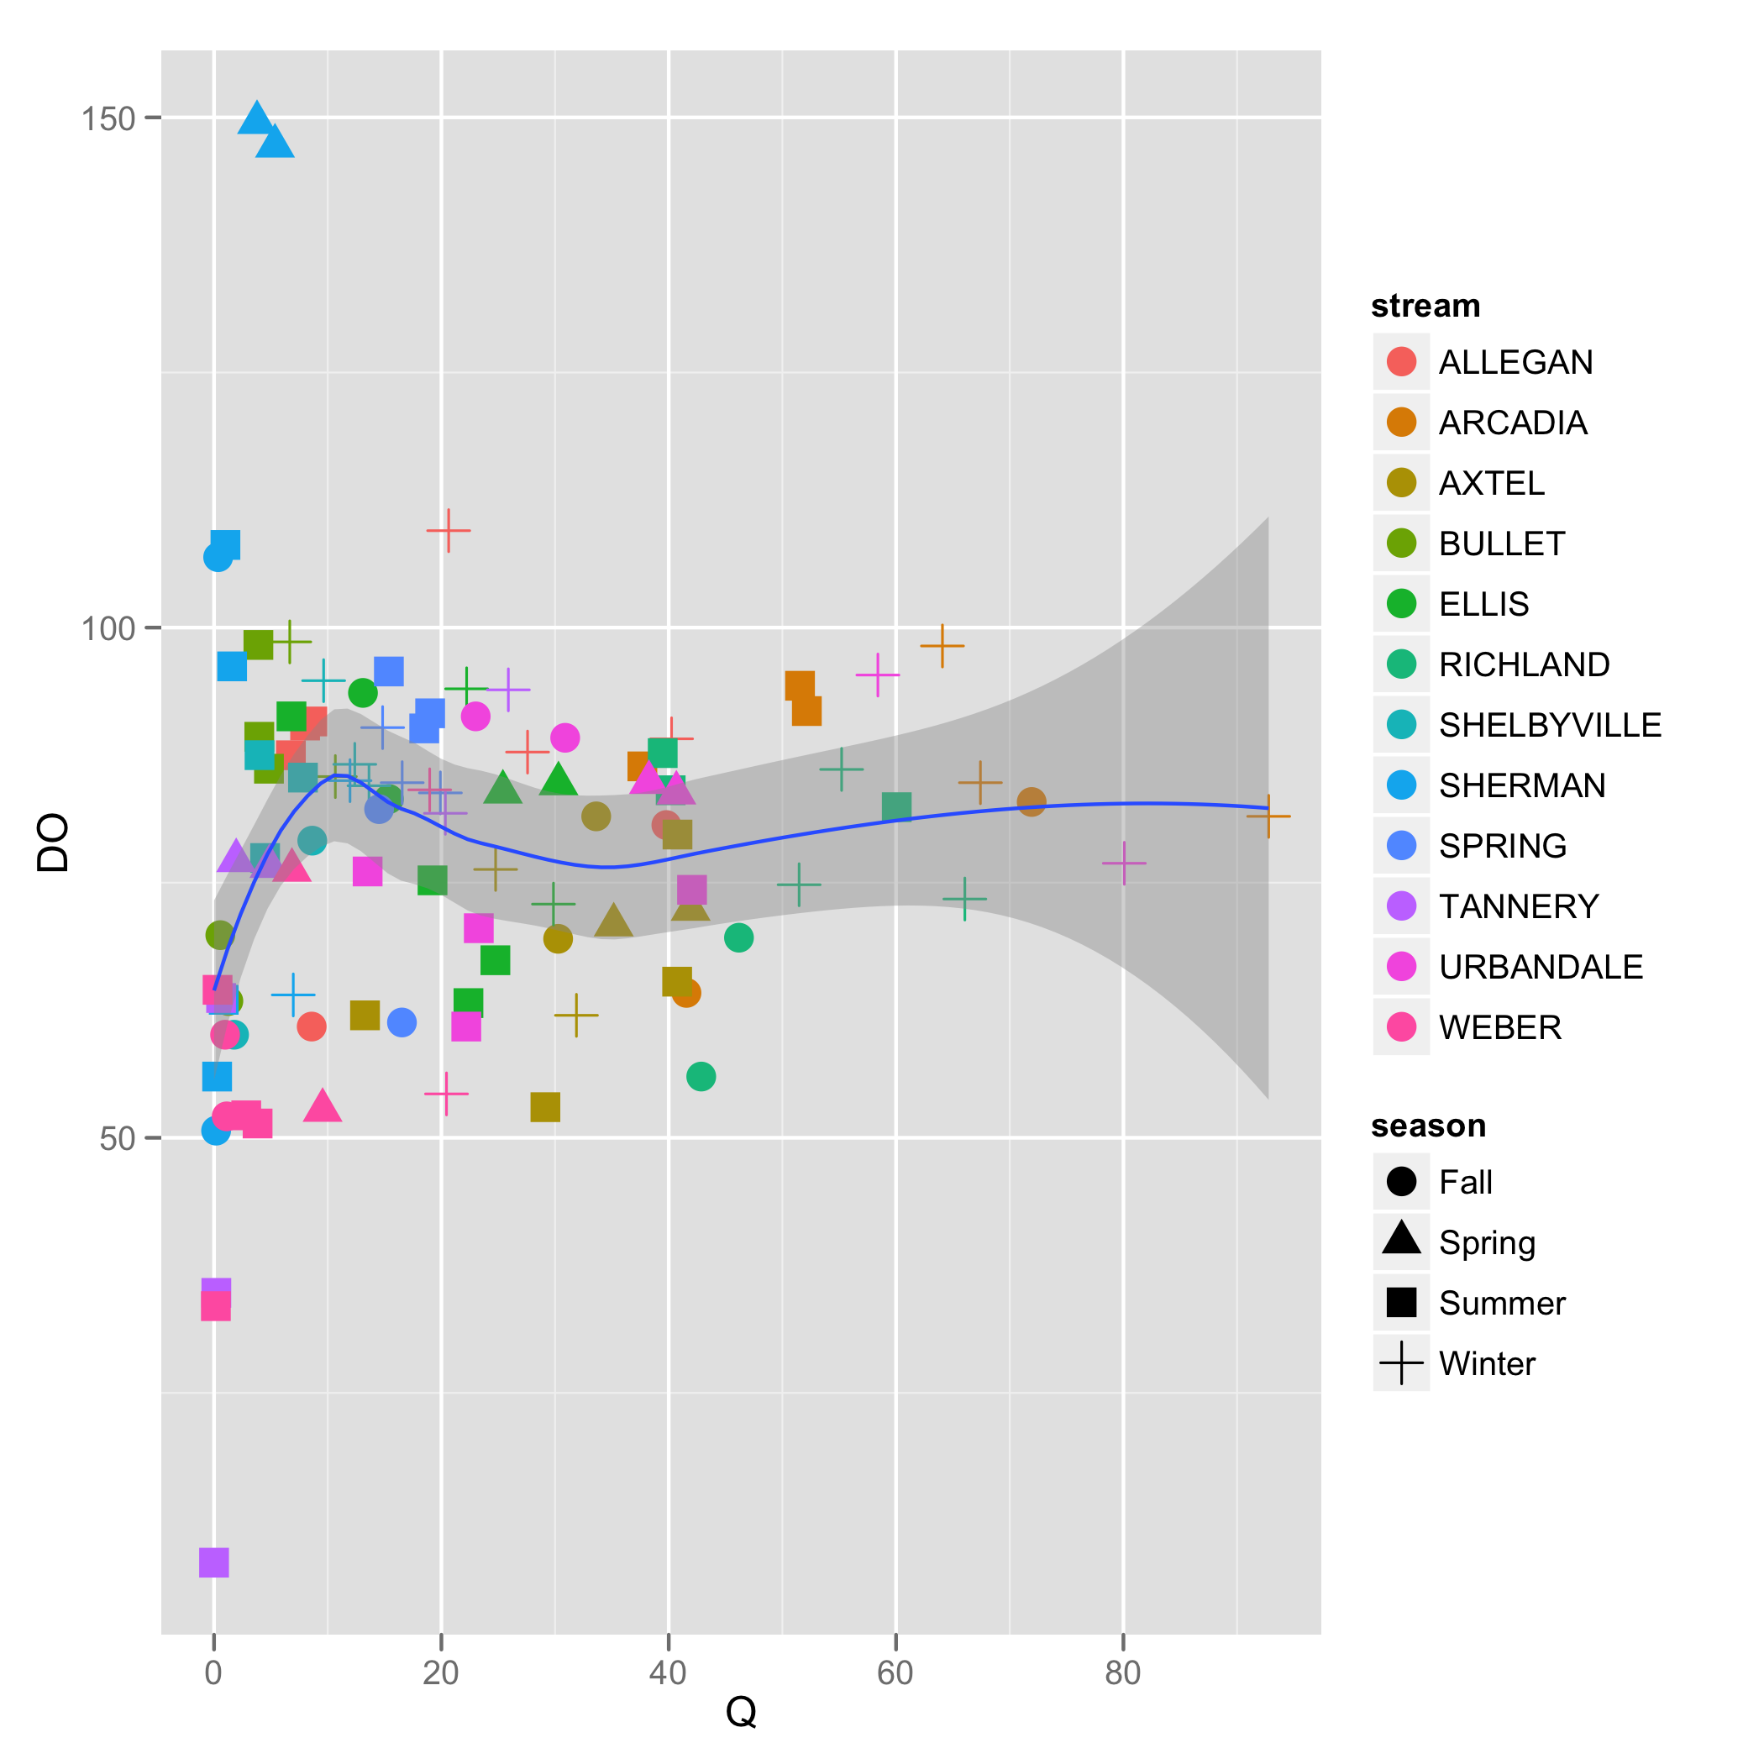
An Example
> head(streamDat)
stream season date Q DO NO3 NH4 TDOC Temp.C
1 ALLEGAN Spring 03/31/04 22.19 NA 2.54 20.19 3.50 11.80
2 ALLEGAN Spring 04/30/04 11.26 NA 1.40 11.59 3.89 16.40
3 ALLEGAN Spring 05/27/04 36.95 NA 2.29 50.33 4.71 14.50
4 ALLEGAN Summer 06/30/04 8.64 90.80 1.72 26.21 2.36 18.64
ggplot( data = streamDat,
aes( x = Q, y = DO) ) +
geom_point( aes(col = stream,
shape = season), size = 2) + geom_smooth()

Slide 23
Components of a ggplot
data – requires a strict data.frame format
geom – graphics – points, lines, etc.
stats- statistical summary (optional)
scales-maps data to aesthetic space
coord-maps data to plot region
facet – subset data
Part D: ggplot2
file = graphics.R

Slide 24
data
Data must be in a data.frame
Data often is needed in a tall format. See reshape2 package
Typical syntax
p <- ggplot(data, aes(x ,y))
x and y are column names
Names need not be in quotes – a thoughtful convenience
By itself, this code doesn’t return or produce anything

Slide 25
geom layer
Common objects are boxplots, points and lines (geom_boxplot, geom_lines, geom_point)
Depending on the type, may reasonable include aesethics
May contain groups
p + geom_point(
aes(col = stream, shape = season),
size = 2)

Slide 26
Assigning aesthetics for points
… + geom_point(
aes(col = stream, shape = season),
size = 2)

Slide 27
stats layer
stats_smooth
defaults to loess line
method = “lm” provides linear fit
group provides separate summary of each group
se = TRUE (default) displays confidence intervals

Slide 28
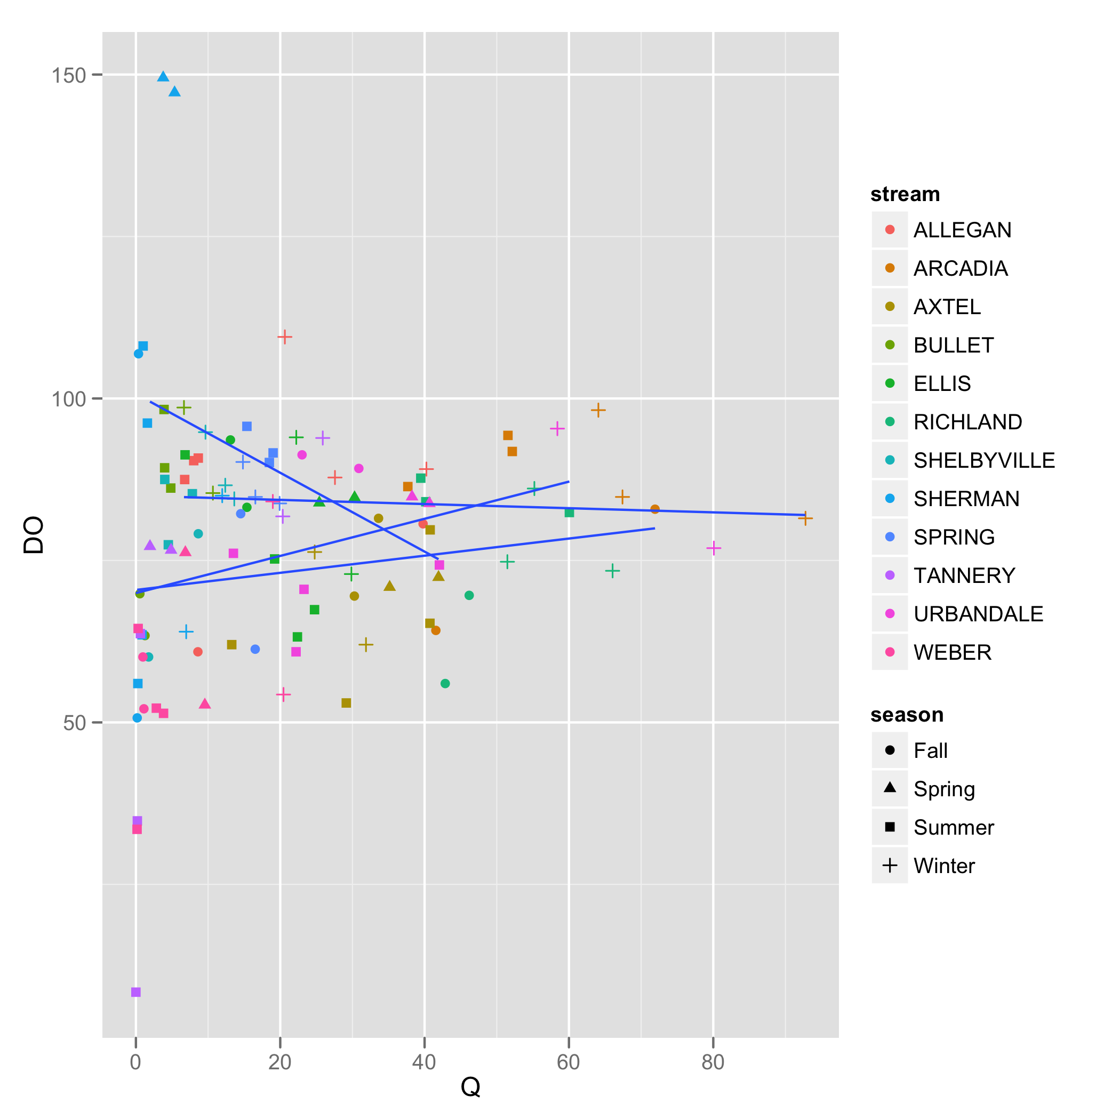
An illustration of stats_smooth
…+ stats_smooth()
Defaults to loess with standard error
Equivalent to geom_smooth()
… + stats_smooth(method = “lm”, se = FALSE)
Linear model without band
… + stats_smooth(aes(group = season), method= “lm”, se = FALSE)
Same as previous, but separate line for each season.
A separate line is created for all aesthetics which are factors

Slide 29
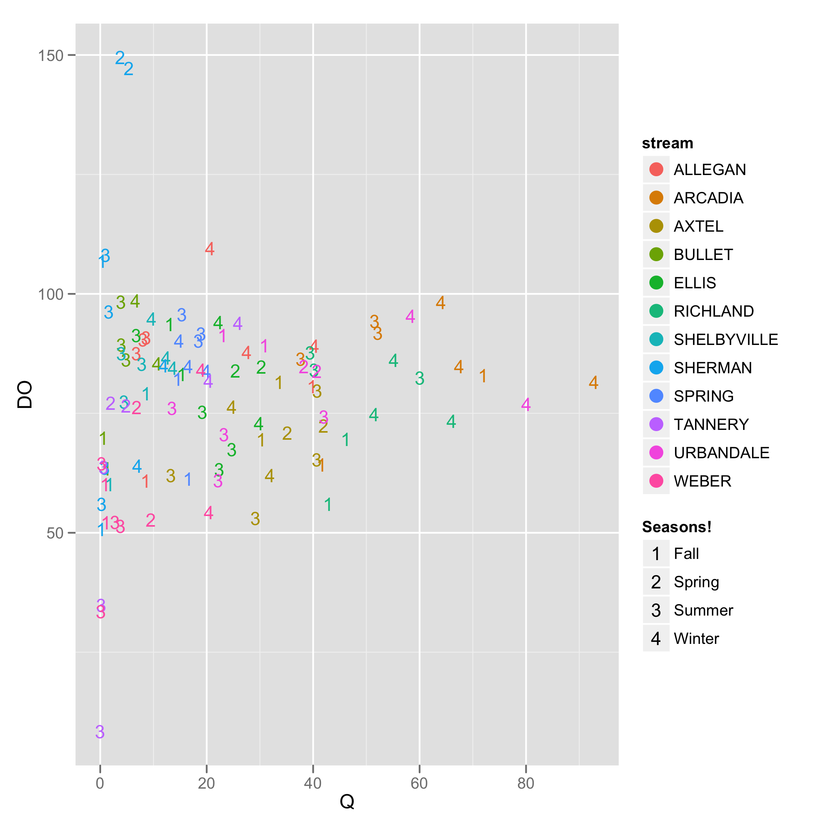
Illustration of the use of scale
Change symbols on plot
Specify shape and color values
Change names used in labels or legend.
scale_shape_manual(values = c("1", "2", "3", "4" ) )+ symbol choice scale_shape_discrete(name = "Seasons !")

Slide 30
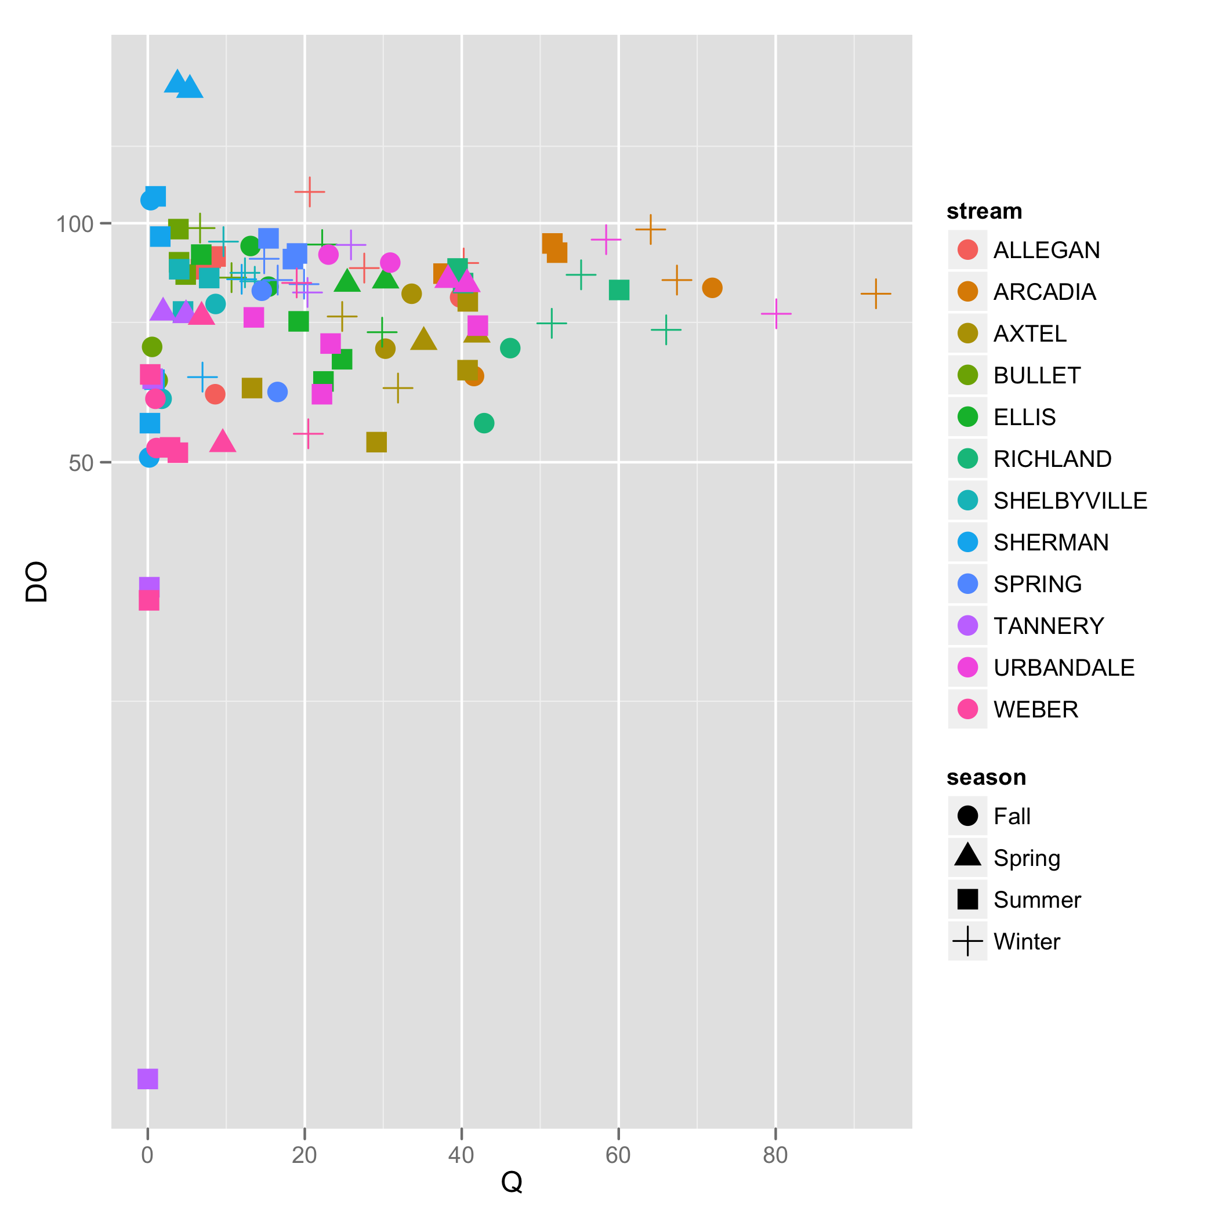
Coordinates
p + geom_point( aes(col = stream, shape = season), size = 4) +
coord_trans(y = "log")
The difference between transforming the scales and transforming the coordinate system is that scale transformation occurs BEFORE statistics, and coordinate transformation afterwards.

Slide 31
themes
Control formatting by setting themes options.
Can be saved for reuse on other plots.
“Theme elements can inherit properties from other theme elements. For example, axis.title.x inherits from axis.title, which in turn inherits from text. “

Slide 32
ggplot resources
Wickham, 2009 provides good overview and conceptual explanation. Not the greatest reference.
Package help pages are weak.
Online help pages good with examples (http://docs.ggplot2.org/current/).
Links to mailing list – archived and searchable
r-bloggers.com and stackoverflow.com

