Slide 1


Generalized Linear Models
www.neptuneandco.com

Slide 2
Presentation Outline
Why GLM?
A look at the GLM structure
Logistic Regression
Poisson Regression

Slide 3
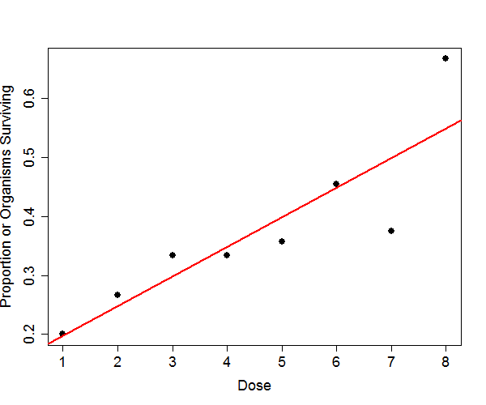
Good Linear Regression Fit?

Slide 4
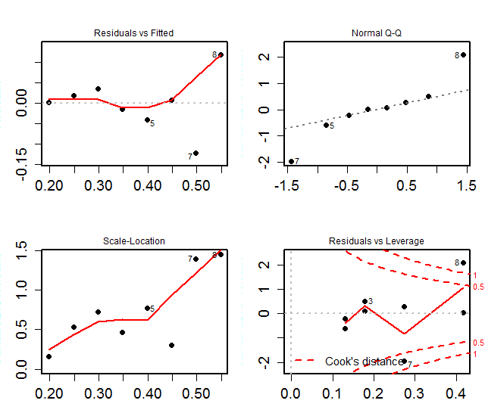
Diagnostic Plots for Fit

Slide 5
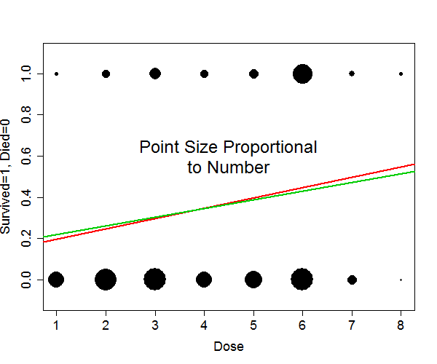
Same Data: Different Depiction
Green line shows new least squares fit

Slide 6
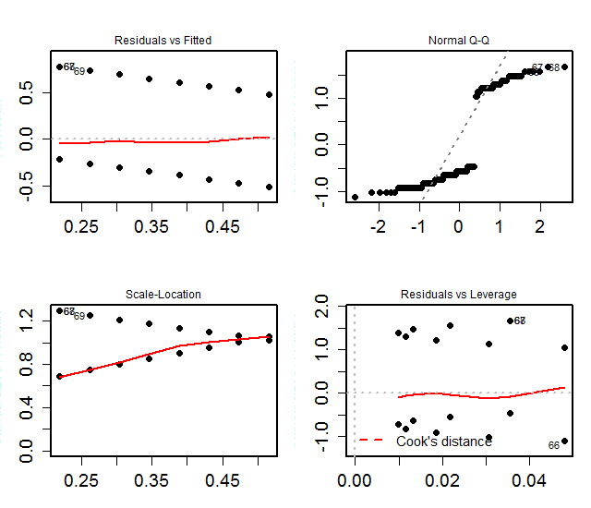
Diagnostics Better?

Slide 7
Linear Regression Model
Model form:
Y_{j} = μ(X_{j}) + ε_{j}
= β₀ + β₁·X_{1,j} + β₁·X_{1,j} + … + β_{k}·X_{k,j} + ε_{j}
Assumptions
X_{j}’s are fixed and known
ε_{j}’s are independent and identically distributed:
ε_{j} ~ Normal( 0, σ² )
Implication:
Y_{j}’s are independent and normally distributed:
Y_{j} ~ Normal( μ(X_{j}), σ² )

Slide 8
Why Least Squares?
Under assumptions on previous slide, the least squares line is equivalent to the maximum likelihood estimate for the β’s.
That is, the β’s (and σ) values that make the observed data most “probable” under the normal probability model
Convenient (particularly computationally)
Other probability models … less convenient, but maximum likelihood still preferred, statistically

Slide 9
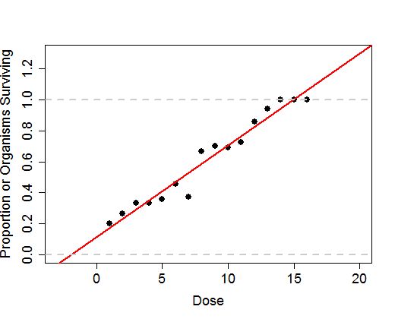
Other Issues with Least Squares
Regression estimate <0? >1?
Variation at Dose =9 vs Dose = 15?

Slide 10
Generalized Linear Model
Formulation:
g[μ(X_{j})] = β₀ + β₁·X_{1,j} + β₁·X_{1,j} + … + β_{k}·X_{k,j}
Same as linear regression if g(μ)= μ.
The function g is known as the link function
Depending on the probability distribution for the observed data Y, particular link functions lead to tractable computational models
I.e., where an iteratively weighted least squares approach can be used to maximize the likelihood function
Still not guaranteed to converge (depending on data support)

Slide 11
Canonical Link Functions
Binomial (Bernoulli): g(μ) = logit(μ) = ln(μ/(1- μ))
Poisson: g(μ) = ln(μ)
Normal: g(μ) = μ
For lognormal: g(μ) = ln(μ)
Gamma: g(μ) = 1/μ
Other link functions sometimes used (such as probit for binomial: g(μ) = Φ⁻¹(μ) )
Canonical forms have some nice statistical and computational properties

Slide 12
Fitting a GLM in R
Basic call:
glm( formula = y ~ x1 + x2 + …,
data=…, family=… )
Formulas follow same conventions as lm
response ~ predictor1 + predictor2 + …
family : specifies the probability distribution of the response variable and the link function to use

Slide 13
Logistic Regression
Response variable is Bernoulli:
Yes/No, Lived/Died, Success/Failure, 1/0, etc.
Binomial – effectively repeated Bernoulli’s
Inputs to R handled slightly differently
Y_{j} has probability μ_{j} of “success” and:
θ_{j} – “log-odds” – to convert back to probability:

Slide 14
Logistic Regression Call
If response data y is stored as a Bernoulli
(a numeric vector of 0’s and 1’s):
glm( y ~ x1, family=binomial)
Equivalent to:
glm( y ~ x1,
family=binomial(link="logit"))
(Canonical link is the default in most cases)

Slide 15
GLM Output
summary( logitmod2 )
Deviance Residuals:
Min 1Q Median 3Q Max
-2.0856 -0.7825 0.3659 0.6527 1.9078
Coefficients:
Estimate Std. Error z value Pr(>|z|)
(Intercept) -1.95109 0.35547 -5.489 4.05e-08 ***
newdose2 0.30809 0.04365 7.059 1.68e-12 ***
Null deviance: 283.83 on 211 degrees of freedom
Residual deviance: 212.45 on 210 degrees of freedom
AIC: 216.45
Number of Fisher Scoring iterations: 4

Slide 16
Logistic Regression Call
If response data y is stored as binomial:
(possibly more than one trial per covariate level)
The response variable is a matrix, with column one being the number of “successes” and column two being the number of “failures”
glm( cbind(numsucc, numfail) ~ x1, family=binomial)
Model fits are equivalent
Some output from the model treated differently

Slide 17
Interpreting Coefficients
In terms of log-odds …
Intercept term is log-odds when covariates are 0
Other terms are increase in log-odds due to a unit increase in the covariate
In terms of probabilities …
Intercept term can be converted to a probability directly. Probability of “success” when covariates are 0:
Other terms can only be interpreted in context
Change in probability can only be stated in terms of the “starting” probability

Slide 18
Fitted Values
Can compute fitted values directly from coefficients, but typically easier to use R’s built-in functions
To retrieve fitted values for input data:
fitted( logitmod )
Returns values in response variable space (probability)
To retrieve estimates for a different set of covariate values:
In response space (probabilities):
predict( logitmod, new.data=data.frame( … ), link="response", se.fit=TRUE )
In link space (log-odds)
predict( logitmod, new.data=data.frame( … ), link="link", se.fit=TRUE )

Slide 19
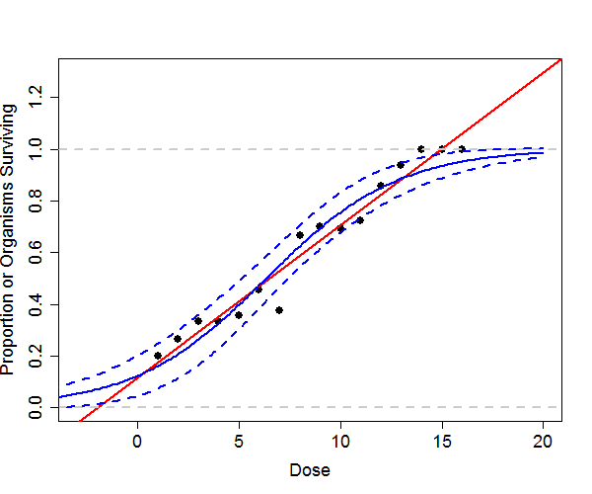
Predicted Values in Response Space
Dashed lines are fits +/- 2 standard errors

Slide 20
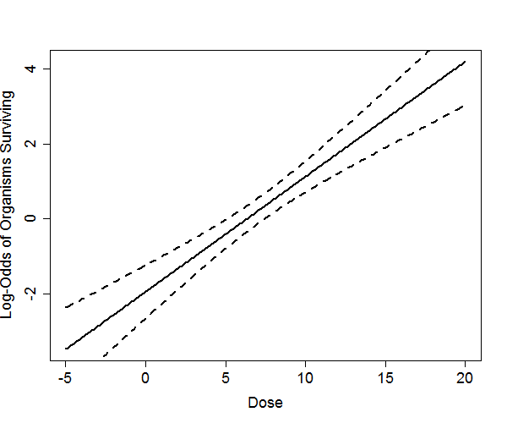
Predicted Values in Link Space
Dashed lines are fits +/- 2 standard errors

Slide 21
Residuals in a GLM
Pearson residuals:
Typically the only type used for LMs
Deviance residuals:
These are “standardized”
Values larger than 2 in absolute value are large
Under certain conditions, the distribution of the deviance residuals will be approximately standard normal

Slide 22
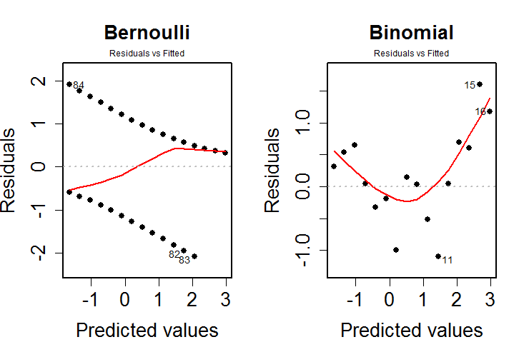
Diagnostics: Residuals vs Fitted

Slide 23
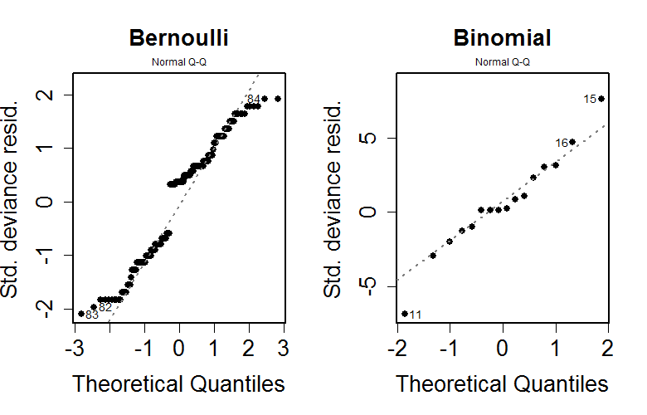
Diagnostics: Q-Q Plots

Slide 24
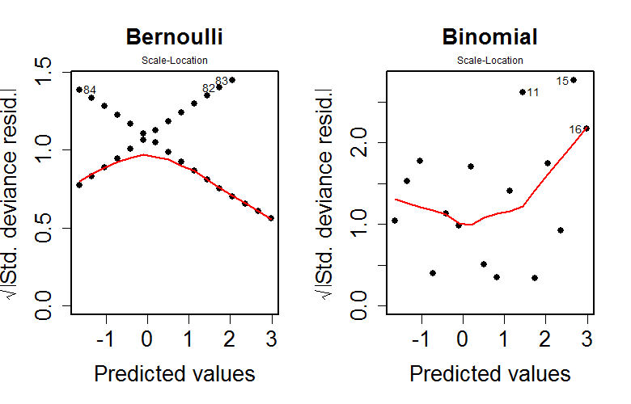
Diagnostics: Scale-Location

Slide 25
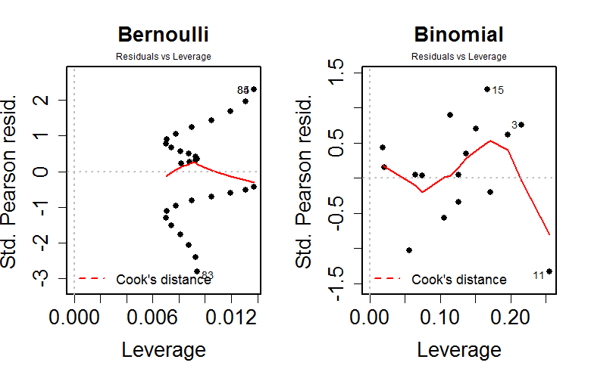
Diagnostics: Residuals vs Leverage

Slide 26
Poisson Regression
Poisson distribution often used to model count data
E.g., # per unit time, area, volume, or mass
Only non-negative integer values are possible
Variation increases with the mean
Mean = Variance = Std. Dev.²
Distribution is approximated well by normal, when mean is high enough
In regression, the mean can vary greatly depending on covariates

Slide 27
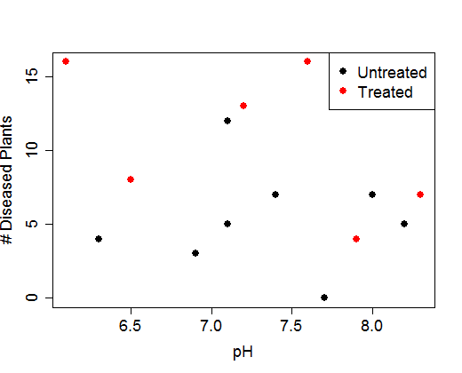
Some Count Data
Number of diseased plants for 14 plots of land

Slide 28
Fitting a Poisson Regression Model
pmod <- glm( Count ~ pH + Treatment, data=fd, family=poisson ) ##link="log"
Estimate Std. Error z value Pr(>|z|)
(Intercept) 3.1592 1.0087 3.132 0.001737 **
pH -0.2023 0.1372 -1.475 0.140289
TreatmentYes 0.6658 0.1979 3.364 0.000767 ***
anova( pmod, test="Chisq" )
Df Deviance Resid. Df Resid. Dev Pr(>Chi)
NULL 13 44.505
pH 1 2.962 12 41.543 0.0852418 .
Treatment 1 11.601 11 29.943 0.0006592 ***

Slide 29
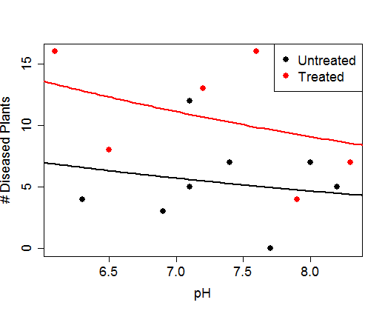
Fitted Values
Units of Mean?
Mean is a rate, counts per what?

Slide 30
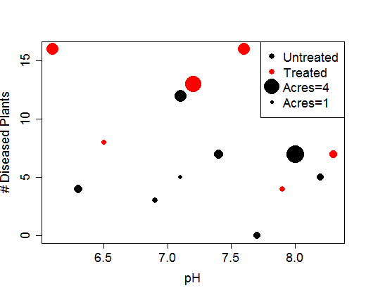
Plot with Relevant Unit
Better to model rate per acre?

Slide 31
Converting to Relevant Unit
Mean for Y_{j} = Acres_{j} * Mean Rate_{j}/acre

Slide 32
Fitting in Alternate Units
pmod2 <- glm( Count ~ pH + Treatment, data=fd,family=poisson, offset=log(Acres))
Estimate Std. Error z value Pr(>|z|)
(Intercept) 2.3490 1.0460 2.246 0.02472 *
pH -0.2063 0.1410 -1.463 0.14339
TreatmentYes 0.5509 0.2002 2.752 0.00592 **
anova( pmod2, test="Chisq" )
Df Deviance Resid. Df Resid. Dev Pr(>Chi)
NULL 13 28.063
pH 1 3.7900 12 24.273 0.051561 .
Treatment 1 7.7354 11 16.538 0.005415 **

Slide 33
Other GLMs
The gamma distribution can be viewed as the continuous version of the Poisson distribution
Gamma GLM, however, has constant coefficient of variation
Warning: not all fitted values are valid
The lognormal and gamma distributions might appear similar
The tail behavior can be quite different, however
Why use lognormal GLM when you could just log your response variable and use LM?
Statistical issues with back-transform handled
AIC and log-likelihood computes correctly

Slide 34
AIC Weights
Akaike Information Criterion (AIC) provides a measure of fit for a model
-2 log-likelihood + 2 times number of parameters
Lower AIC means better fit
The +2p is a penalty term – helps deter over-fitting
Scale of AIC is not interpretable, only useful in comparing fit of different models to the same data
The exact same data – problematic if, e.g., some models leave out data due to NAs

Slide 35
Akaike Weights
Consider k different models fit to the same data
Let A₁, A₂, …, A_{k} be the associated AICs
The AIC weights are computed as:
A pseudo-Bayesian interpretation:
The posterior probability of the model, given a roughly uniform prior across the models

Slide 36
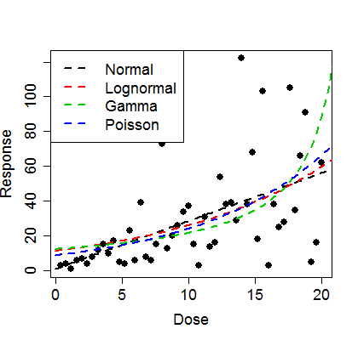
Example AIC Weights
Four models fit to one data set
AICs <- c( AIC(normmod),
AIC(lnormmod), AIC(gammod),
AIC(poismod) )
omegas <- AICs - min(AICs)
AICweights <- exp(-omegas) /
sum(exp(-omegas))
AICweights
Normal Lognormal
1.762210e-19 2.019747e-20
Gamma Poisson
1.000000e+00 6.042583e-266

Slide 37
Overdispersed Models
The relationship between the mean and the variance for the binomial and Poisson models can lead to poor fit for real data
Often, the underlying mean is not quite constant across the sampling units
Overdispersed models allow for larger than usual variation relative to the mean
family=quasibinomial or quasipoisson
Some model statistics are not well-defined, however, such as AIC

