Slide 1


Spatial Objects and Analysis in R
www.neptuneandco.com

Slide 2
Presentation Outline
Types of spatial data
Spatial data, maps and GIS
Import/Export
Sharing data with GIS applications
Visualization
Basic analyses

Slide 3
R and GIS Software
R is useful for manipulating, visualizing, and analyzing spatial data.
A comprehensive Geographical Information System (GIS) would also have a database to store the data.
There is overlap!
Database
GIS Programs
R

Slide 4
R Spatial Packages
Around 100 packages in the CRAN ‘spatial’ task view:
http://cran.r-project.org/web/views/Spatial.html
We can’t cover them all; we’ll cover ‘sp’ mostly and a bit of ‘gstat’, ‘maptools’ and ‘shapefiles’

Slide 5
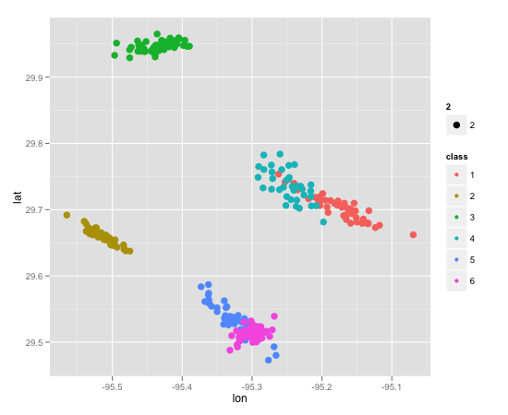
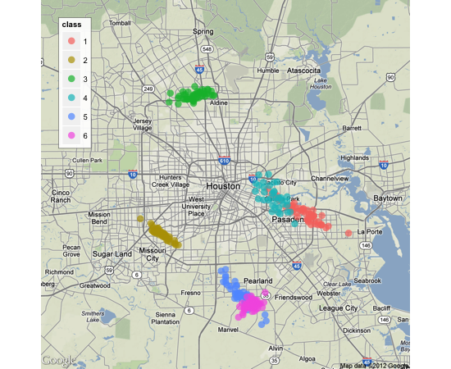
Spatial data vs. Maps
Spatial Data
Map

Slide 6
Spatial Data and Maps
Spatial Data
Minimally, only requires an x and y coordinates and a way to measure distances between points.
Often a scatterplot is a perfectly acceptable tool for presenting and analyzing spatial data
Maps
Requires the x and y data be coordinates which relate to an external reference.
Integrating with other maps and sources requires precision.

Slide 7
Types of Spatial Data
Pure spatial data
Have coordinates and a reference system
Only concerns ‘where’ things are
Points, lines, polygons, grids
Spatial attributes
Information paired with each of the locations above
e.g., total Nitrogen in a stream sample at a specified location.

Slide 8
GIS = Maps + Data
GIS datasets strongly combine spatial information and data. (eg. locations of wells + sample results.)
A common form of data from GIS is a layer. A layer usually refers to a set of files, minimally with data, shapes and projection information.
In R, one may want to access the data and use map information from the file to enhance figures.

Slide 9
Structure of a shapefile
Mandatory Components
.shp – geometeries of points, polygons and lines
.shx – index of shapes – binary format.
.dbf – data associated with shapes. Can be read with other programs like open office or some versions of Excel.
Optional
.prj – defines projection in standardized terms.
GEOGCS["GCS_North_American_1983",DATUM["D_North_American_1983",SPHEROID["GRS_1980",6378137.0,298.257222101]],PRIMEM["Greenwich",0.0],UNIT["Degree",0.0174532925199433]]

Slide 10
Projections
Accurately specifying with a coordinate reference system (CRS) is key to accurately using maps.
R uses proj4strings
Proj4 is a list maintained by the Cartographic Projection Library
ESPG – is a list maintained by European Petroleum Survey Group and accessible via the package rgdal.
Common projections
Google : "+proj=longlat +ellps=WGS84“
Other example " +proj=utm +zone=11 +ellps=WGS84 +datum=WGS84 +units=ft +no_defs +towgs84=0,0,0"

Slide 11
Directly reading a shapefile
readShapeSpatial
Requires name of shapefile
Assumes and requires that there will be files named with suffices of .shp, .shx and .dbf
If projection (proj4) string is not specified, it will be assigned.
writeShapeSpatial
Requires a spatial[point or polygon]dataframe
A shapefile name.

Slide 12
sp Class of Object
~ A complicated list, with ‘slots’ for information
Combines information about projection and data with lines, points, grids, pixels and polygons
Allows data manipulation by spatial feature. Includes transformations, subsetting, assignments to polygons
S4 Class of object (more in session 6)

Slide 13
Components of a SpatialPointsDataFrame
From: Bivand et al, 2008

Slide 14
Importing GIS Data Into R
Layer exported from GIS:
Accessing all or part of a layer:
file.shp – shape file of vector data. May contain points, lines or polygons.
file.dbf – database file. Contains attribute data associated with shapes.
file.prj – projection file. Describes the projection used in the coordinates.
library(maptools)
getinfo.shape(“file.shp”)
readShapeSpatial(“file”)
read.dbf(“file.dbf”)
read.shp(“file.shp”)

Slide 15
Exporting Spatial Data From R
Several ways within ‘shapefiles’ package
write.xxx() functions for .shp, .dbf, .shx files individualls
write.shapefile() does it all at once
maptools function
writeSpatialShape

Slide 16
Visualization
Many ways to visualize spatial data
Basic plot with points
Points and lines for reference
Points, lines and polygons
Contours (predicted or actual)
Heat or intensity map
Bubble plot
Color-coded map by region or polygon
etc.
We’ll show you a few…

Slide 17
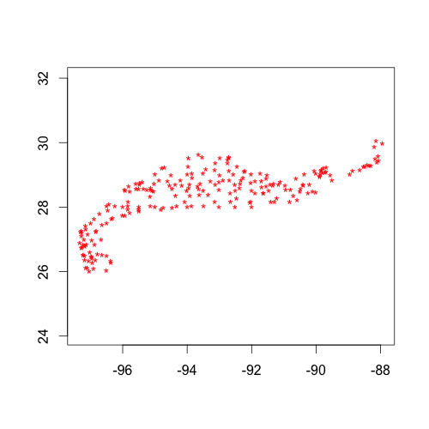
Visualization: Basic Plots
A plot with just points:

Slide 18
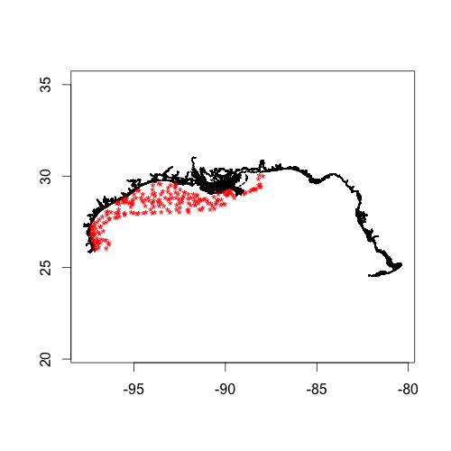
Visualization: Basic Plots
A plot with points and reference lines:

Slide 19

Visualization: Basic Plots
Points, lines, polygon:

Slide 20
Exercises
Take 20 minutes to do Exercises 1 - 2.

Slide 21
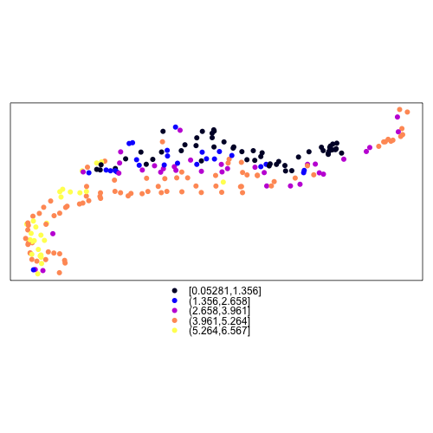
Visualization: spplot()
In addition to plot(), the ‘sp’ package has a function spplot() which is highly customizable.

Slide 22
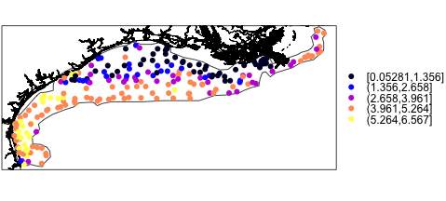
Visualization: spplot()
Can add layers (lines, polygons, other points) and change legend location.

Slide 23
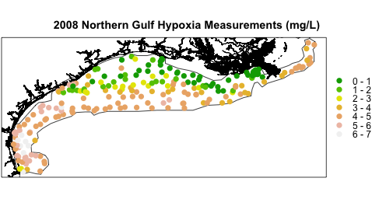
Visualization: spplot()
Can also modify the legend, add title, change color scale, specify breakpoints, etc.

Slide 24
Types of spatial analysis
Spatial point process data
Location is the event of interest. Epidemics, crime, species
Geostatistical data
Location of samples are random – the measurements are of interest
Ore exploration, air quality, weather samples
Lattice data
Observed within polygons
Census data, county health data
Absolute difference less relevant. Neighbors more relevant.
(Groupings by Noel Cressie)

Slide 25
Focusing on geostatistical
Common tasks
Interpolate – produce estimates for areas not measured
Quantify spatial correlation
Identify anomalies
Predict

Slide 26
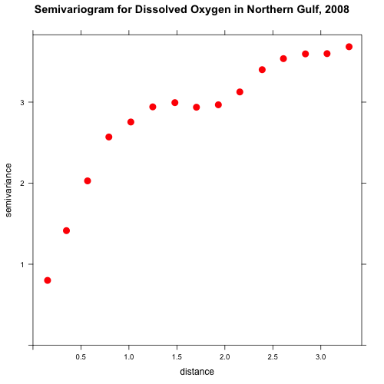
Basic Analyses
A variogram is a natural place to start

Slide 27
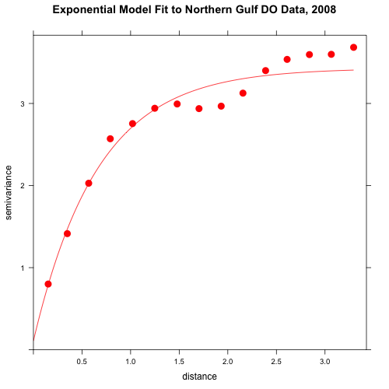
Basic Analyses
Can fit a covariance model to the data:

Slide 28
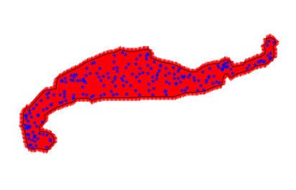
Basic Analyses
Kriging is straightforward with the ‘gstat’ package – it plays well with ‘sp’.
Need a ‘new’ set of points – use spsample()
SpatialPixelsDataFrame gives a heat map when used with spplot()

Slide 29
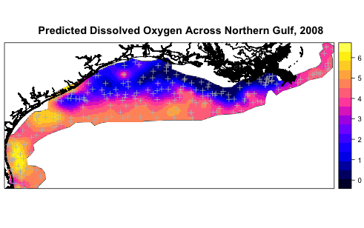
Basic Analyses
Heat map of predicted values across Gulf:

Slide 30
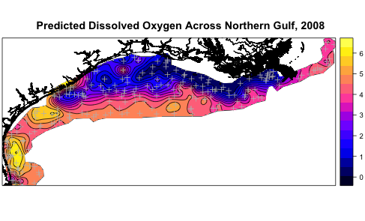
Basic Analyses
Heat map with contours:

Slide 31
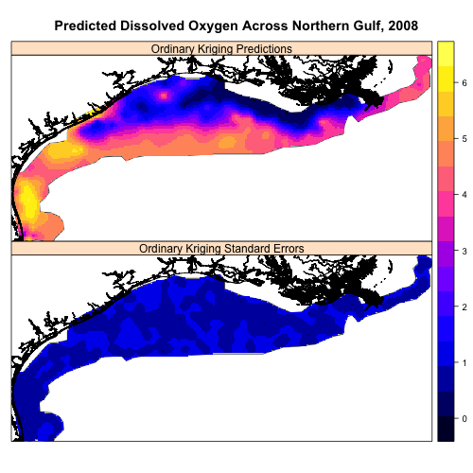
Basic Analyses
Kriged values and standard errors:

Slide 32
Other Resources
Applied Spatial Data Analysis in R. Bivand, et. al. : great applied book
Several galleries of graphics online using ‘sp’ and other tools. E.g.:
http://r-spatial.sourceforge.net/gallery/
http://casoilresource.lawr.ucdavis.edu/drupal/book/export/html/519

Slide 33
Other Resources
Take 20 minutes to do Exercises 3 - 5.

