Slide 1


Dealing with Correlation
www.neptuneandco.com

Slide 2
Presentation Outline
Why Correlation Matters
Spatial and Temporal Correlation Examples
Regression with Correlated Errors

Slide 3
Why Does Correlation Matter?
Samples might have ‘shared’ information across space or time.
Power of inference could be affected.
In particular, p-values might be wrong (*gasp*)!

Slide 4
Correlation Example
Simulate lots of samples of random multivariate normal data.
Test whether the mean is significantly different from the specified mean; find a p-value for the test.
Perform simulation with pairwise correlation of 0 and 0.2, compare results.

Slide 5
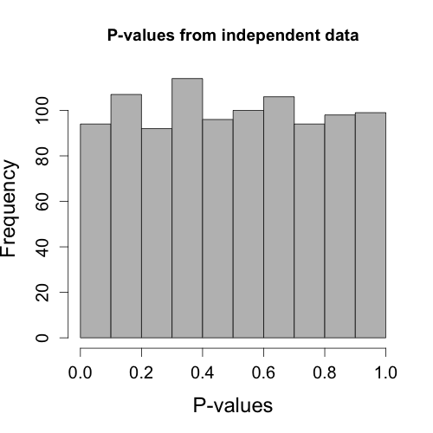
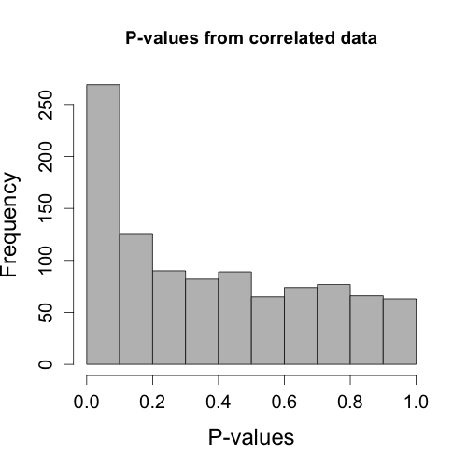
Simulation Results

Slide 6
Correlation Example Explained
So why such a drastic difference in the histograms?
‘Significant differences’ in large percentage of simulations with correlated data.
Standard error estimates are too small in t-test, leading to narrow confidence intervals.
Running tests without accounting for correlation leads to misleading results!

Slide 7
Correlation Concepts
When data are independent, they have completely unrelated information content
What are some examples where data may have related information content across space and/or time?

Slide 8
Correlations in Space/Time
Sea surface temperatures or water levels vary with time.
e.g., El Nino-Southern Oscillation (ENSO)
Water quality measurements within a stream might be correlated among several sampling locations.
e.g., total Nitrogen, dissolved Oxygen
Percent forest cover across units in a management landscape are likely related spatially (similar patchiness) and temporally (deforestation trend)

Slide 9
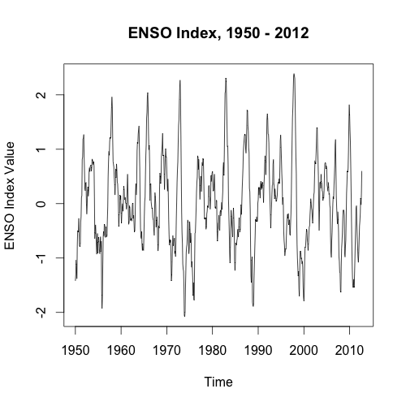
Temporal Correlation - ENSO Index
Is there correlation here?

Slide 10
Checking For Correlation
With a time series, individual values may be correlated with previous values.
Can plot auto-correlation function (ACF) and partial auto-correlation function (PACF).
The statistics here aren’t vital; they are used to recognize patterns.

Slide 11
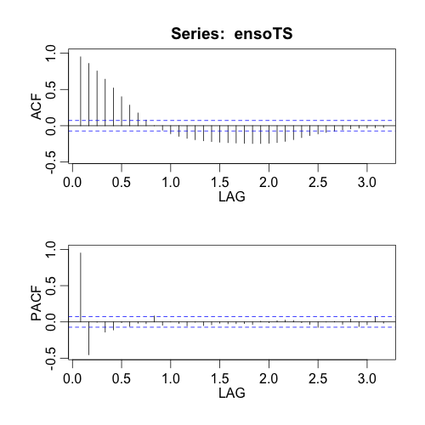
ACF and PACF for ENSO Index

Slide 12
ENSO Index Continued
How to deal with the correlation from the ACF and PACF?
Variety of time-series models available.
Basic regression models shown later.
Important Note: Correlation among response variable values isn’t necessarily a bad thing; it may be explained thoroughly by covariates.

Slide 13
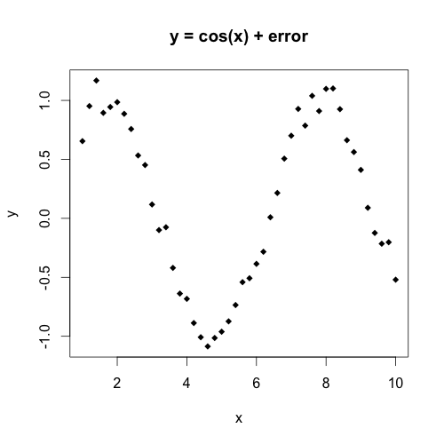
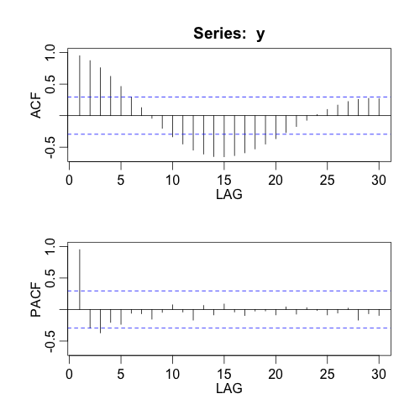
Example
A mathematical function can mostly explain this series, so the correlation isn’t a big deal.

Slide 14
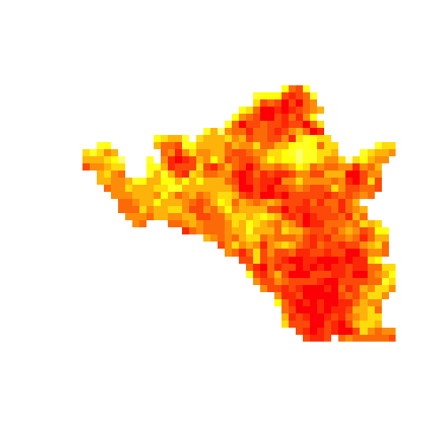
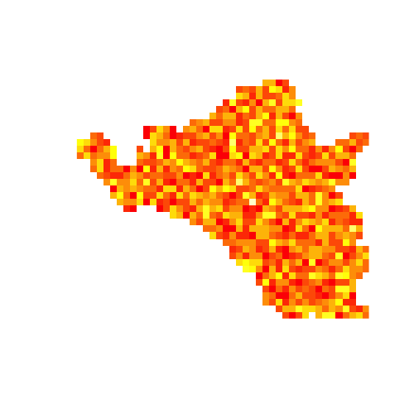
Spatial Correlation – Yukon Fire
Correlated
Random
Normalized Burn Ratio (NBR) Post-Fire

Slide 15
Checking For Correlation
With a spatial problem, an initial heat map might show obvious correlation
Can use a (semi)variogram as well

Slide 16
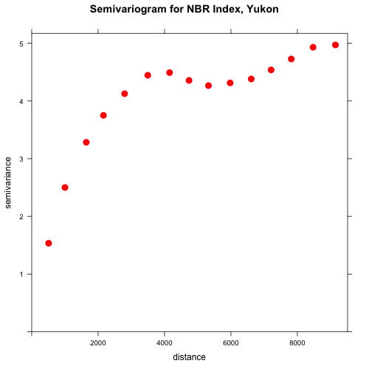
Semivariogram for Yukon Fire
If there were no spatial correlation, this would be a flat horizontal line at the approximate value of the variance.

Slide 17
Exercises 1 - 3
Take 20 minutes to do Exercises 1 - 3.

Slide 18
Modeling Correlation
Lots of methods for handling correlation, both spatial and temporal. Bayesian and classical methods for both.
Regression methods are fairly standard, and are easily fit in R.

Slide 19
Modeling Example
NOAA month-long time series of atmospheric/meteorological variables from Fort Pulaski, GA.
Variables include Date, Time, Wind Speed, Wind Direction, Wind Gust, Air Temperature, Water Surface Temperature, Barometric Pressure

Slide 20
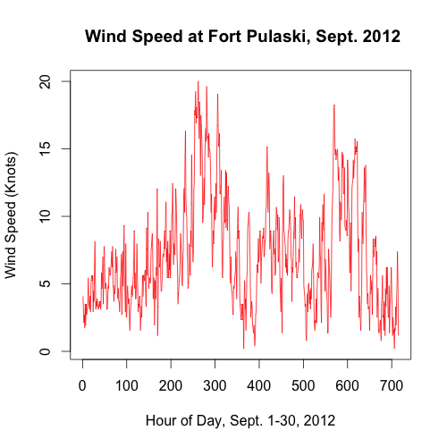
Modeling Example
Is there correlation here?

Slide 21
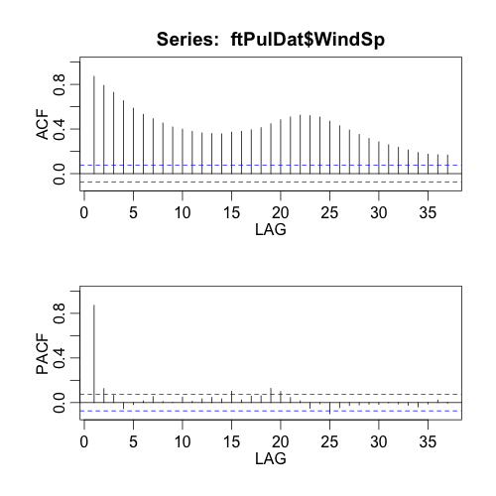
Modeling Example

Slide 22
Modeling Example
Check for other variables that might explain some of the signal.
Wind Gust seems linearly correlated, but might be essentially the same information.
Barometric Pressure seems related in a curvilinear manner, and makes some physical sense.
Wind Direction seems slightly correlated.

Slide 23
Modeling Example
Fit a few regression models.
Model 1: WindSp vs. BaroPr
Model 2: WindSp vs. 2nd-degree polynomial with BaroPr, WindDr.
See R code “Part 4” for model-building.

Slide 24
Modeling Example
‘Best’ model has centered BaroPr and (BaroPr)^2 variables, and WindDr.
Autocorrelation still exists in the residuals.
Fit model with an AR(1) structure.
Look at the regression coefficient estimates and standard errors with and without the AR(1) structure.

Slide 25
Modeling Example
Multiple Linear Regression Coefficient Results:
AR(1) Coefficient Results
Estimate Std. Error t-value Pr(>|t|)
(Intercept) 8.741739 0.240544 36.342 < 2e-16
poly(BaroPr, 2)1 30.274981 3.551185 8.525 < 2e-16
poly(BaroPr, 2)2 46.046676 3.143682 14.647 < 2e-16
WindDr -0.009728 0.001332 -7.301 7.67e-13
Estimate Std.Error t-value p-value
(Intercept) 7.33492 0.422578 17.357560 0.0000
poly(BaroPr, 2)1 34.75941 9.247625 3.758740 0.0002
poly(BaroPr, 2)2 29.66282 7.432732 3.990837 0.0001
WindDr -0.00123 0.001048 -1.175310 0.2403

Slide 26
Summary
Accounting for correlation can make a big difference in modeling.
Lots of methods in R for including correlation in analyses.

Slide 27
Exercises 4 and 5
Take 20 minutes to do Exercises 4 - 5.

