Slide 1
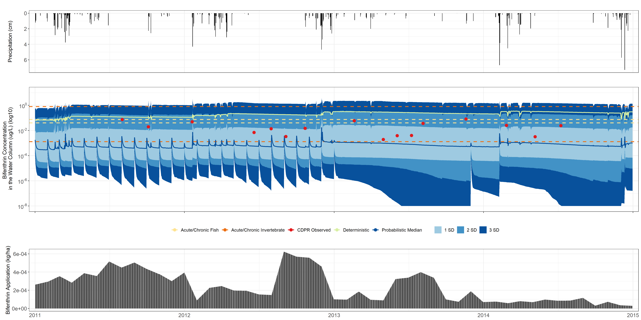
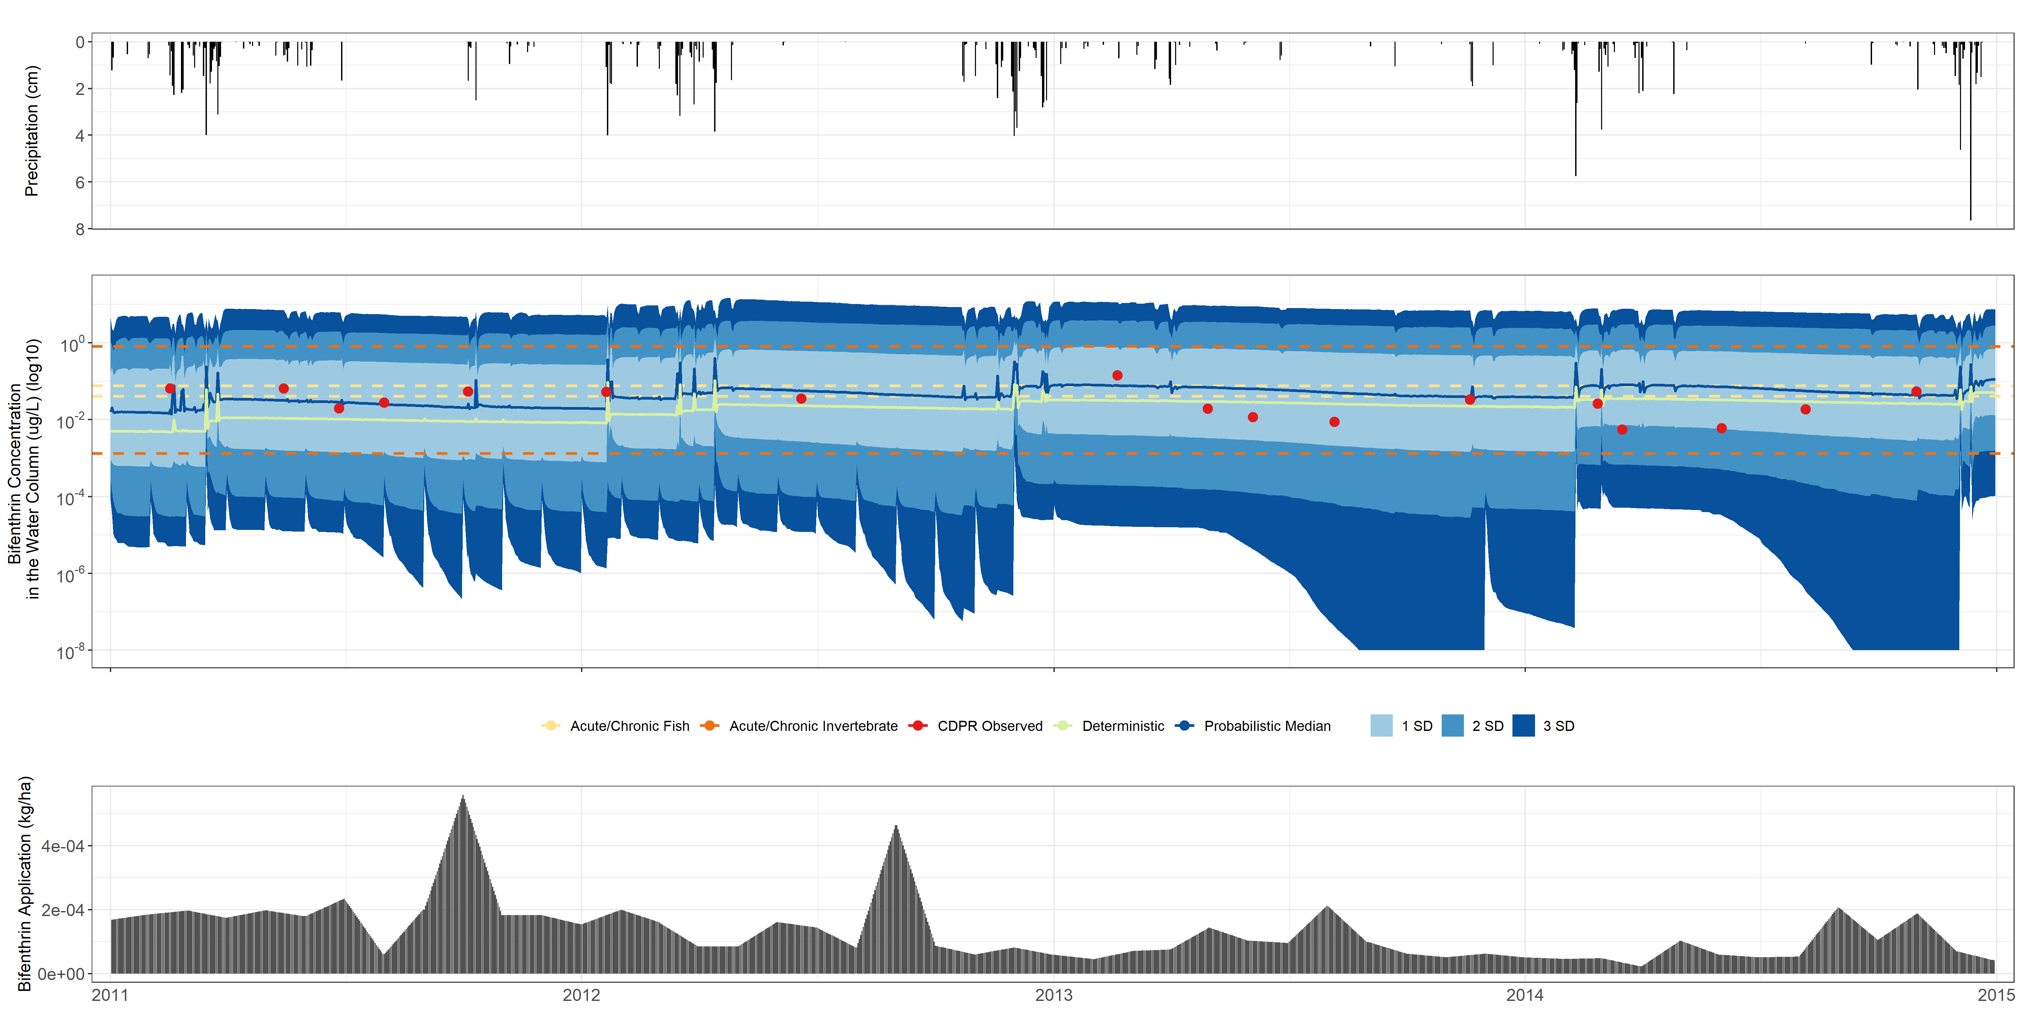
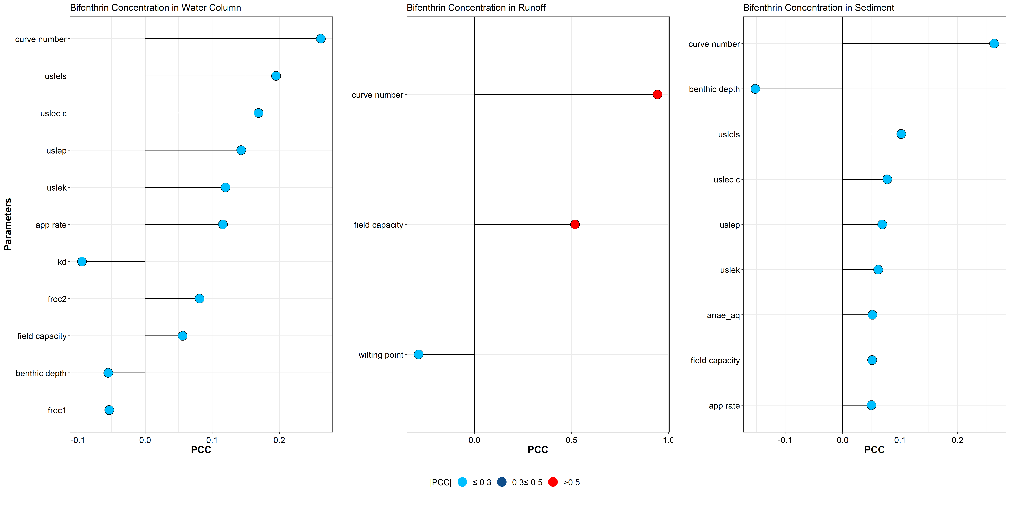
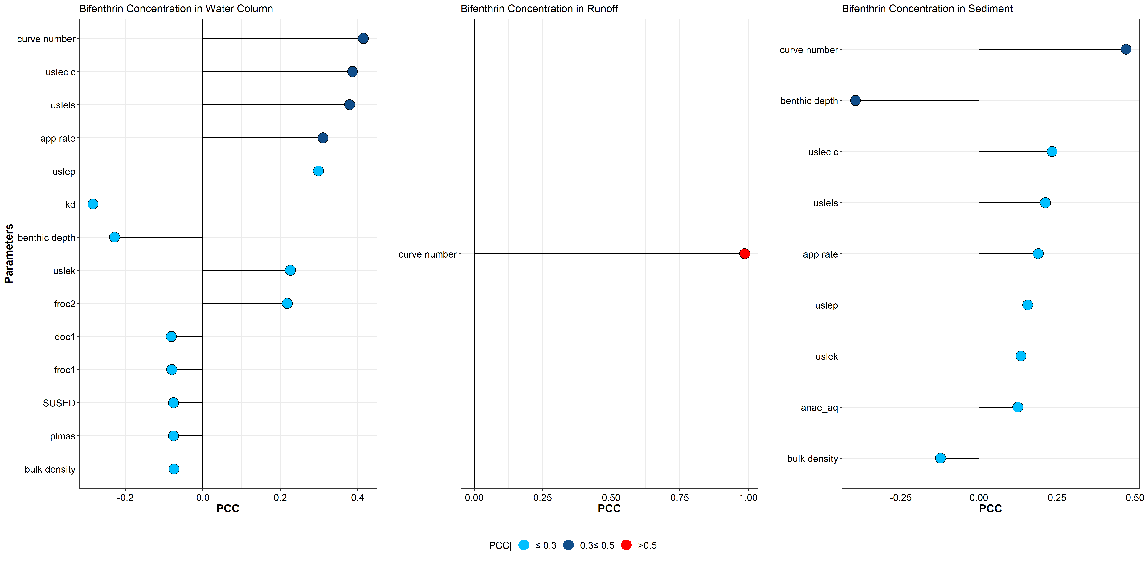
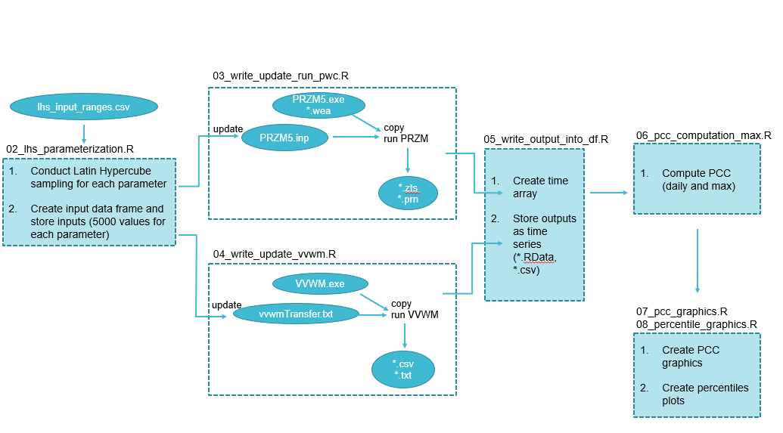
Sensitivity Analysis and Model Evaluation of Bifenthrin Surface Water Concentrations from California Urban Runoff
Emma A. Chelsvig¹ and S. Thomas Purucker²
¹ORISE at U.S. EPA; ²U.S EPA ORD
Emma A. Chelsvig | echelsvig@gmail.com | +1 217-371-5299
Introduction
Results
Aquatic species in the Sacramento-San Joaquin Delta are negatively impacted by urban runoff.
Bifenthrin, a pyrethroid commonly used in urban settings, is a major contributor to pyrethroid presence in urban runoff, particularly following rainfall events.
We employed deterministic and probabilistic approaches to simulate urban runoff concentrations with PWC and conducted a sensitivity analysis to identify sensitive inputs with respect to model output variability.
Folsom, California (FOL002)
Roseville, California (PGC010)
The deterministic simulation is more conservative than the probabilistic median in FOL002, but less conservative in PGC010.
The observed concentrations are within ±2 SD of the modeled concentrations.
We see surges in the modeled bifenthrin concentrations following rainfall events.
Methods
A deterministic simulation was performed to provide a single concentration estimate.
Probabilistic Workflow
The runoff curve number is sensitive to model output, particularly to the bifenthrin concentration in runoff
Other sensitive inputs include benthic depth, field capacity, and application rate.
Discussion & Conclusions
…
…
…
…
…
We used Latin Hypercube Sampling to uniformly and randomly draw input variables from their distributions 5,000 times to propagate variability and yield 5,000 unique model outputs.
Partial Correlation Coefficients (PCC) were computed as the primary sensitivity analysis metric.
Disclaimer: The views expressed in this poster are those of the authors and do not necessarily represent the views or
policies of the U.S. Environmental Protection Agency.

