Slide 1
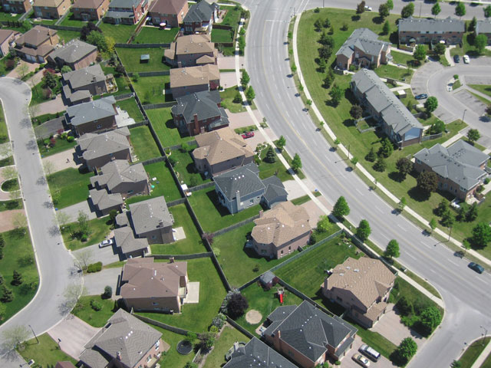
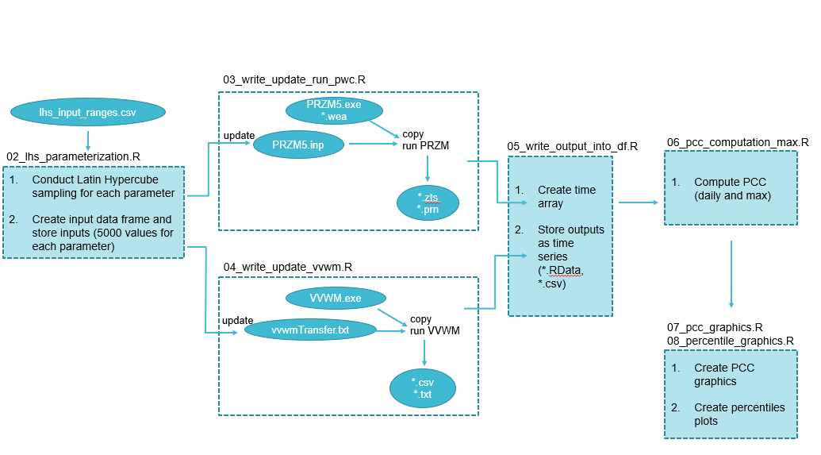
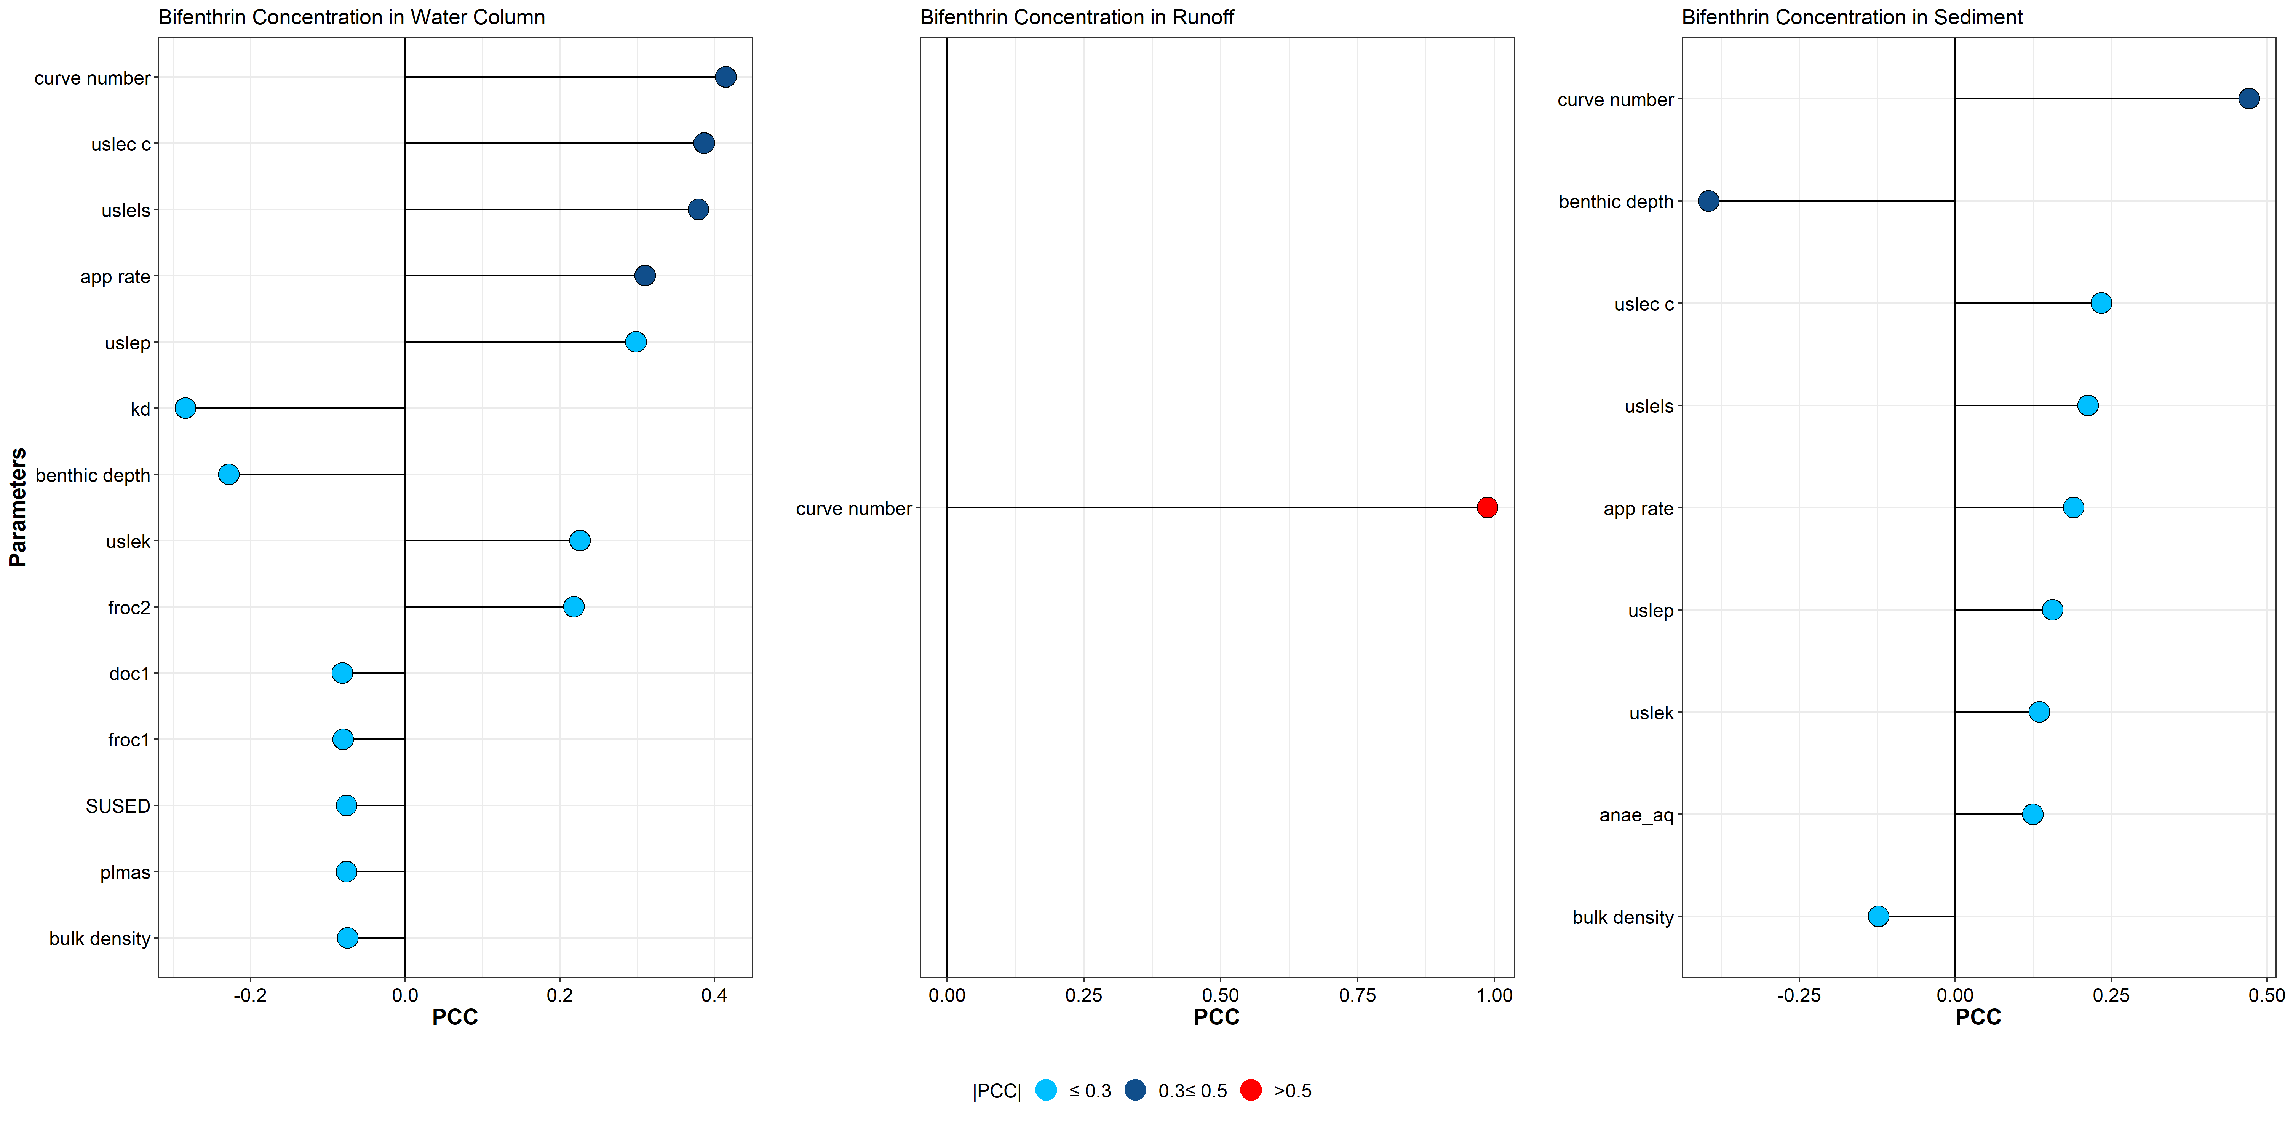
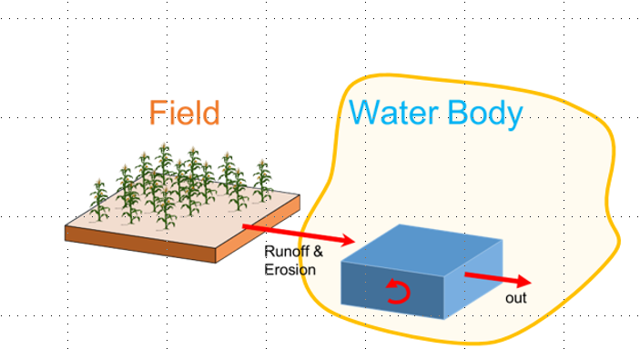
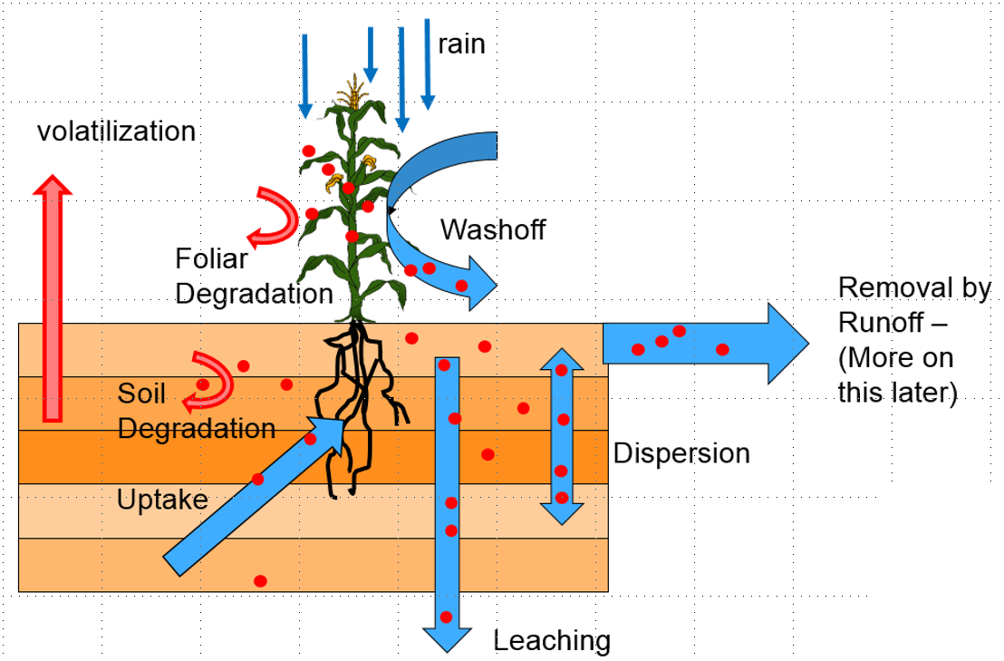
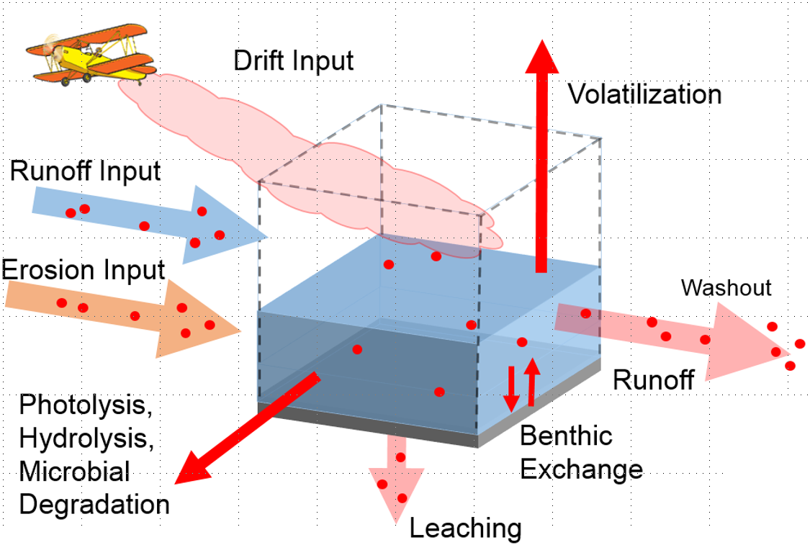
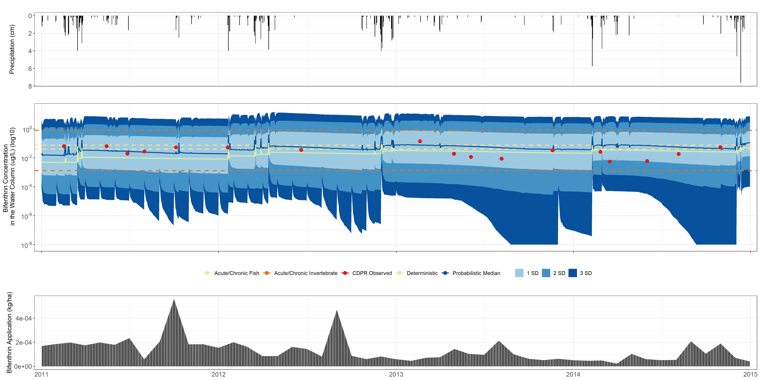
Sensitivity Analysis and Model Evaluation of Bifenthrin Surface Water Concentrations from California Urban Runoff
Emma A. Chelsvig¹ and S. Thomas Purucker²
¹ORISE at U.S. EPA; ²U.S EPA ORD
Emma A. Chelsvig | echelsvig@gmail.com | +1 217-371-5299
Introduction
Methods
Results (cont.)
Aquatic species in the Sacramento-San Joaquin Delta are negatively impacted by urban runoff.
Bifenthrin, a pyrethroid commonly used in urban settings, is a major contributor to pyrethroid presence in urban runoff, particularly following rainfall events.
We employed deterministic and probabilistic approaches to simulate urban runoff concentrations at storm drain outfalls in Northern California with PWC and conducted a sensitivity analysis to identify sensitive inputs with respect to model output variability.
A deterministic simulation was performed to provide a single concentration estimate.
We then used Latin Hypercube Sampling to uniformly and randomly draw input variables from their pre-determined distributions 5,000 times to propagate variability and yield 5,000 unique model outputs (Figure 2).
PCC ranges from -1 to +1 and measures the strength of the linear relationship between model output and input.
The runoff curve number is sensitive to model output, particularly to the bifenthrin concentration in runoff.
Other sensitive inputs include benthic depth, USLE parameters, and application rate.
Model Overview
Figure 2
Figure 4
The US EPA Pesticide Water Calculator (PWC) estimates water body pesticide concentrations resulting from land applications. It pairs two simulation engines: the Pesticide Root Zone Model (PRZM) and the Variable Volume Waterbody Model (VVWM).
Partial Correlation Coefficients (PCC) were computed as the primary sensitivity analysis metric.
Discussion & Conclusions
Results
In general, PWC performed well in simulating bifenthrin concentrations in the water column at the observed storm drain outfalls.
Runoff curve number is highly sensitive to bifenthrin concentration in the water column, runoff, and sediment. High curve numbers correspond to rainfall acting as runoff with minimal soil absorption, while lower curve numbers correspond to the soil’s increased ability to retain rainfall. Curve number is crucial to consider in urban modeling where there are impervious and pervious surfaces present.
The sensitivity of the USLE parameters indicate that soil erosion could be a prominent driver of pesticide transport.
Figures 3 and 4 show results for the Pleasant Grove Creek watershed storm drain outfall.
PRZM
VVWM
Figure 1
Figure 3
PRZM, a hydrologic model, simulates transport of pesticide leachate from the root zone through the soil. Vertical water movement is based on the tipping bucket concept: water movement is always downward and occurs when a soil compartment is at capacity. ¹
VVWM estimates pesticide fate, transport, exposure, and persistence in the receiving water body. ²
The observed concentrations are within ±2 SD of the modeled concentrations.
Rain events appear to have a strong impact on modeled outputs as shown from surges in modeled bifenthrin concentrations following rain events.
Simulations were also conducted for the Folsom watershed storm drain outfall in Folsom, CA. Results were similar to those displayed, however, the deterministic simulation was more conservative than the probabilistic median.
Acknowledgements
This research was supported in part by an appointment to the Research Participation Program for the U.S. Environmental Protection Agency, Office of Research and Development, administered by the Oak Ridge Institute for Science and Education through an interagency agreement between the U.S. Department of Energy and EPA.
References
Young, D. F., and Fry, M. M., (2016), PRZM5, A Model for Predicting Pesticides in Runoff, Erosion, and Leachate, Revision A. (https://www.epa.gov/pesticide-science-and-assessing-pesticide-risks/models-pesticide-risk-assessment, accessed 8/2020).
Young, D. F. (2014). The Variable Volume Water Model. Washington, DC: U.S. Environmental Protection Agency, Office of Pesticide Programs. (https://www.researchgate.net/publication/270565226_The_Variable_Volume_Water_Mode, accessed 8/2020)
Disclaimer: The views expressed in this poster are those of the authors and do not necessarily present the views or policies of the U.S. Environmental Protection Agency.

