Slide 1
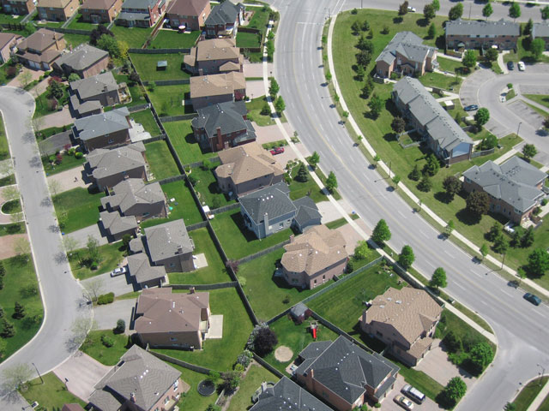
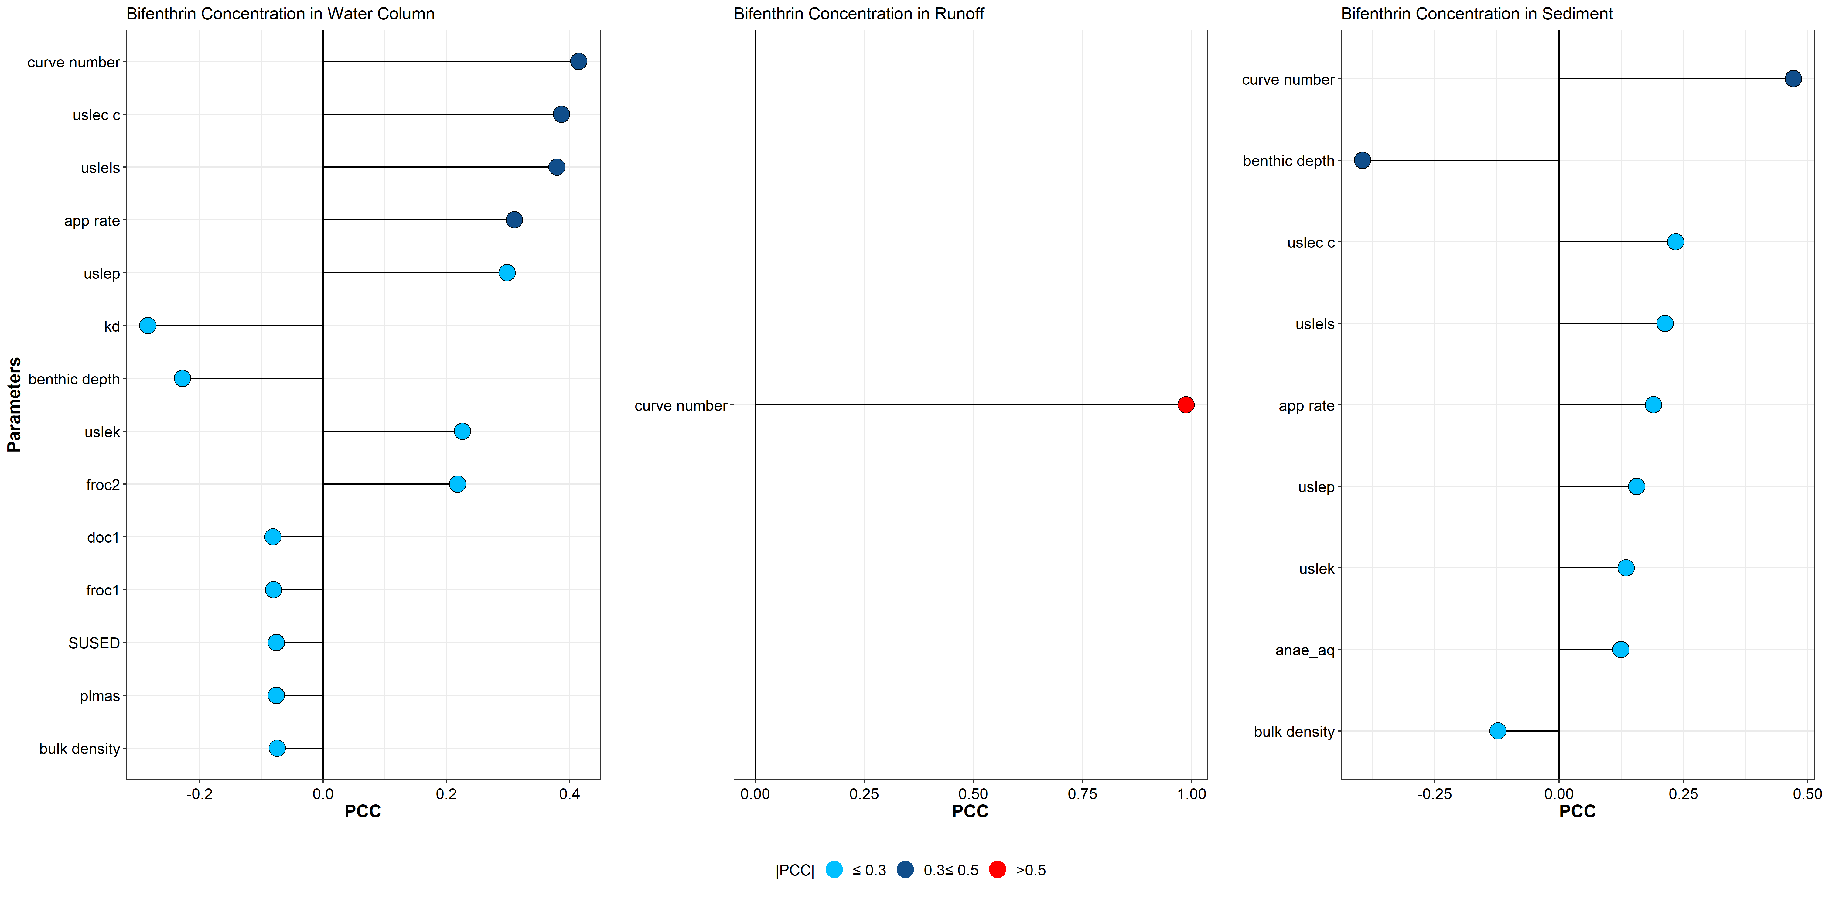
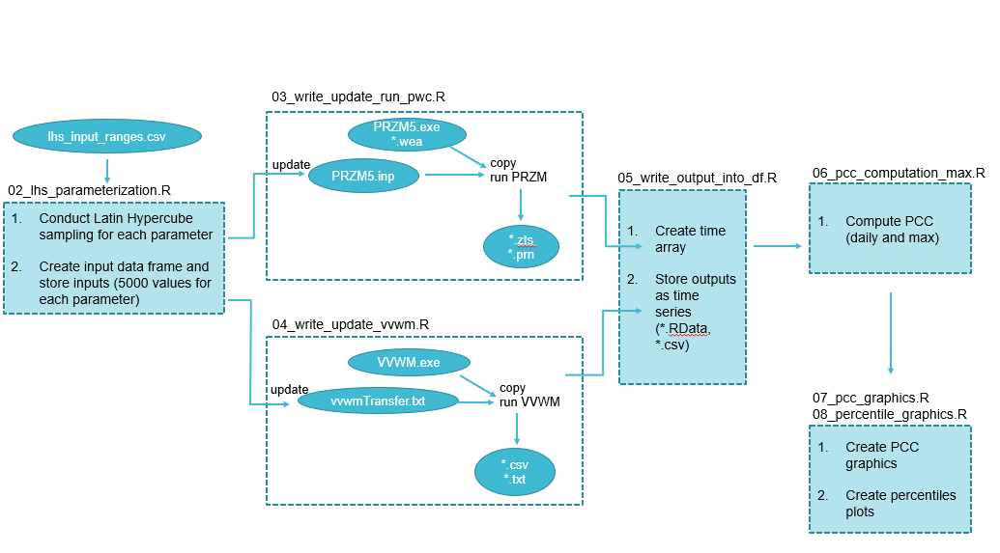
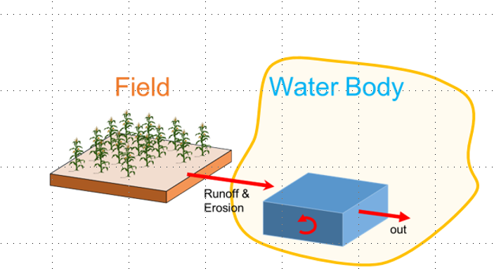
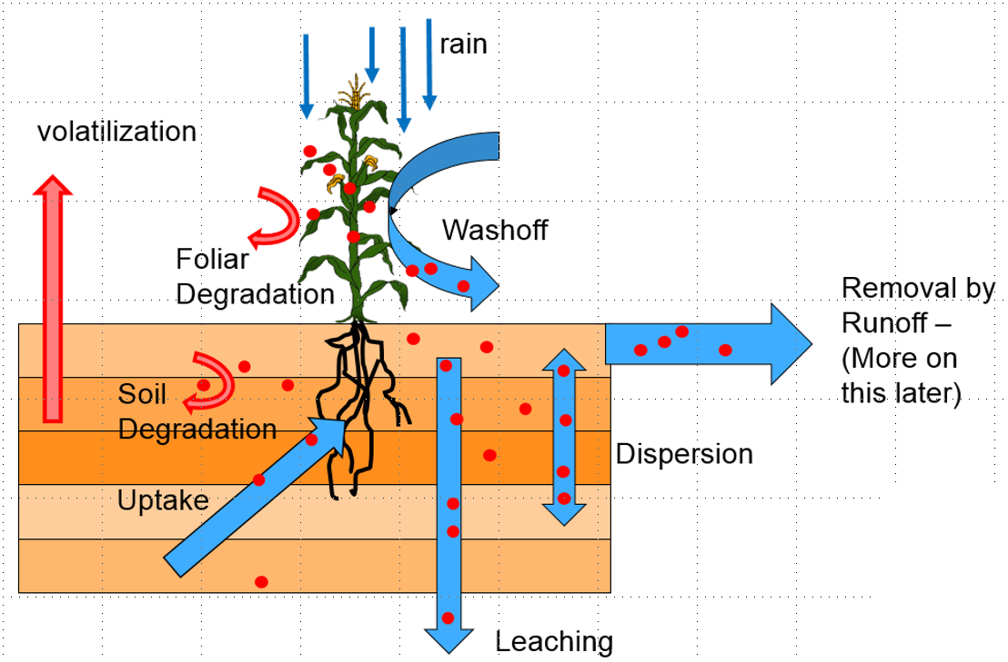
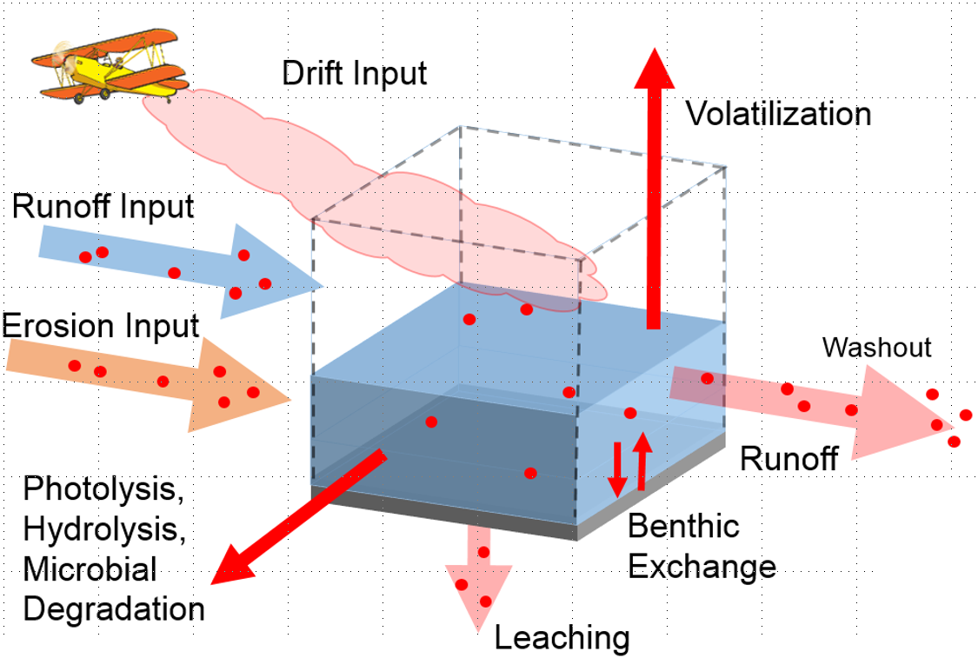
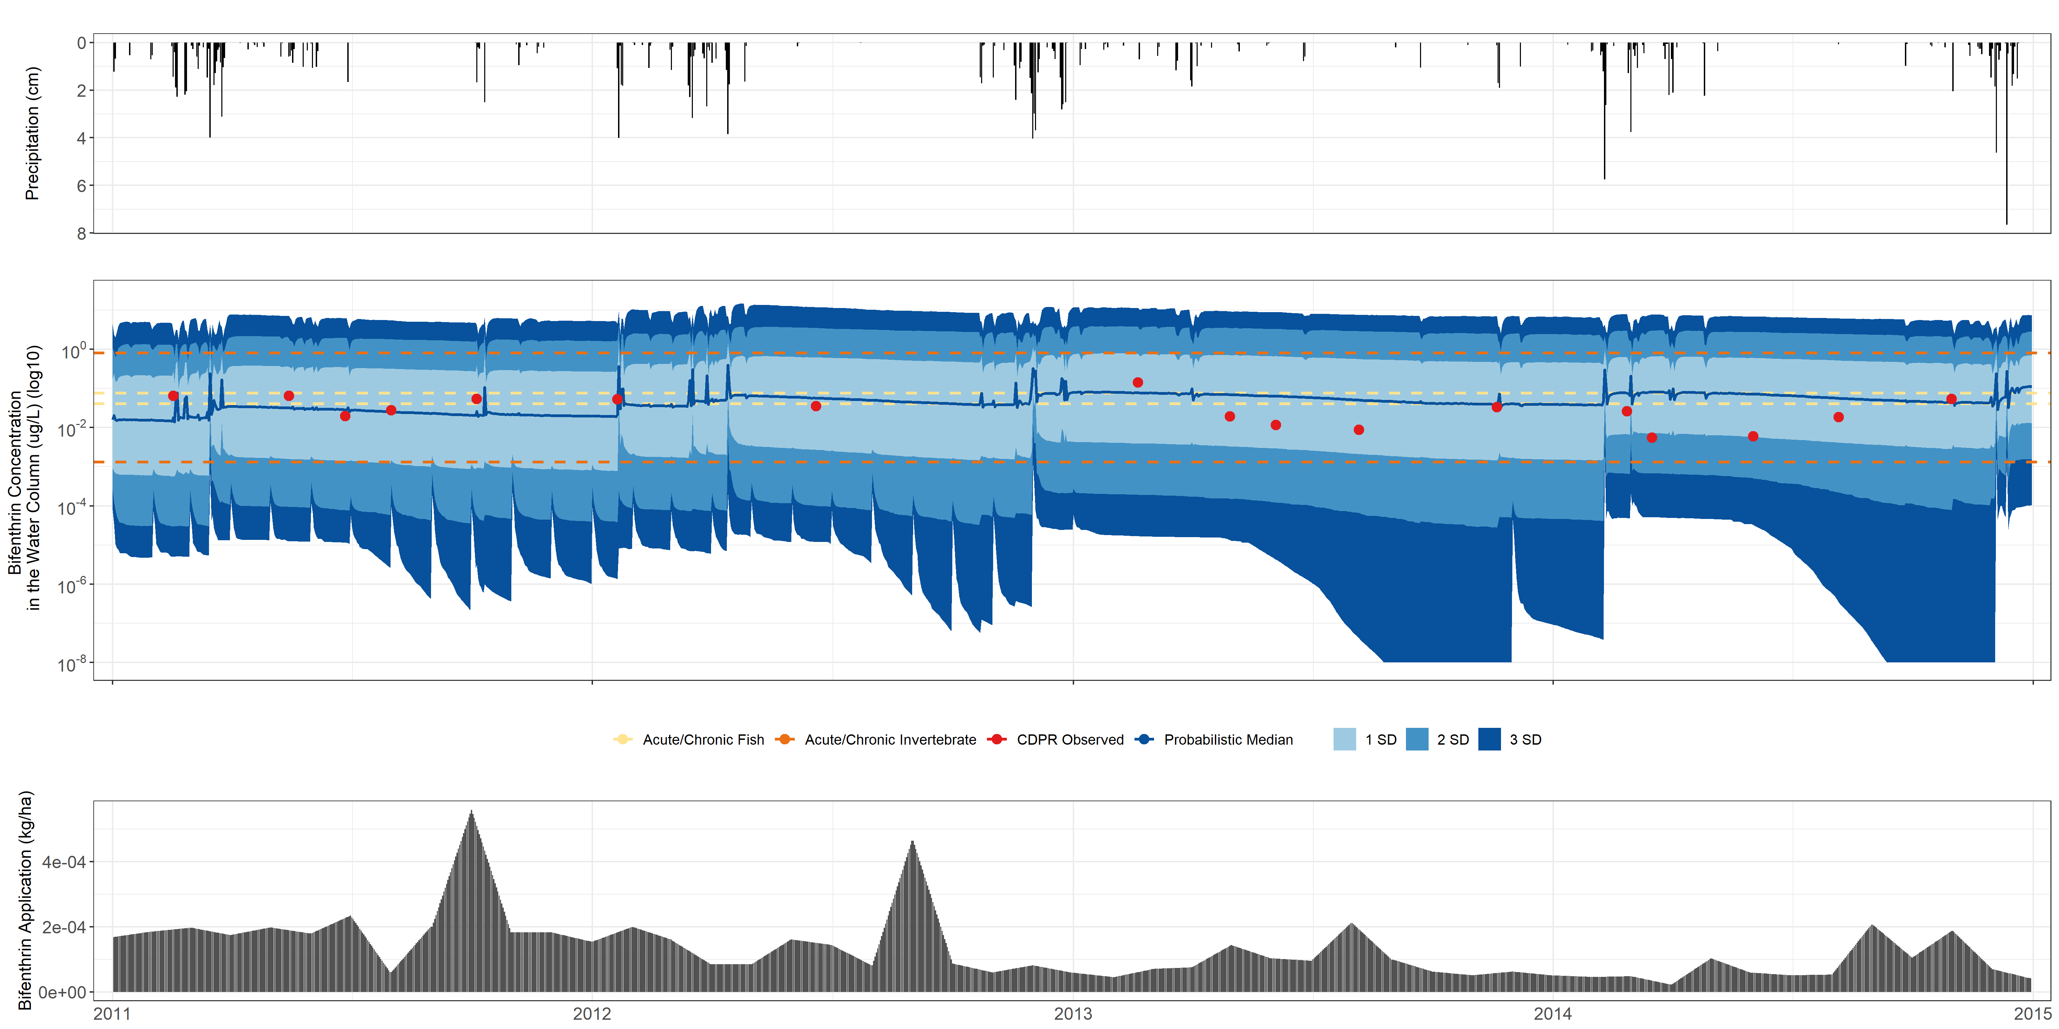
Sensitivity Analysis and Model Evaluation of Bifenthrin Surface Water Concentrations from California Urban Runoff
Emma A. Chelsvig¹ and S. Thomas Purucker²
¹ORISE at U.S. EPA; ²U.S EPA ORD
Emma A. Chelsvig | echelsvig@gmail.com | +1 217-371-5299
Introduction
Methods
Results (cont.)
Aquatic species in the Sacramento-San Joaquin Delta are negatively impacted by urban runoff.
Bifenthrin, a pyrethroid commonly used in urban settings, is a major contributor to pyrethroid presence in urban runoff, particularly following rainfall events.
We employed a probabilistic approach to simulate urban runoff concentrations at storm drain outfalls in Northern California with PWC and conducted a sensitivity analysis to identify sensitive inputs with respect to model output variability.
We used Latin Hypercube Sampling to uniformly and randomly draw 38 PWC input variables from their pre-determined distributions 5,000 times. This allowed us to propagate variability and yield 5,000 unique model outputs (Figure 2).
A Partial Correlation Coefficient (PCC) was computed for each of the 38 input variables to be used as the sensitivity analysis metric. This approach is based off methodology presented in Sinnathamby et al. 2020.³
PCC ranges from -1 to +1 and measures the strength of the linear relationship between model output and input.
The runoff curve number is sensitive to model output, particularly to the bifenthrin concentration in runoff. Other sensitive inputs include benthic depth, USLE parameters, and application rate.
Model Overview
Figure 4. Sensitive input parameters to water column bifenthrin concentration include curve number (.41), USLE C (.39), USLES (.38), and application rate (.31). Curve number was again highly sensitive to runoff concentration (.98) and sediment concentration (.47). Benthic depth was also sensitive to sediment concentration (-.40).
The US EPA Pesticide Water Calculator (PWC) estimates water body pesticide concentrations resulting from land applications. It pairs two simulation engines: the Pesticide Root Zone Model (PRZM) and the Variable Volume Waterbody Model (VVWM).
Figure 2. After sampling 5,000 unique input variable combinations, PRZM and VVWM input files were rewritten and executed 5,000 times to produce 5,000 unique model outputs. All simulation outputs were consolidated into an array prior to conducting the sensitivity analysis and constructing the plots. Scripts and supplementary data are found at : https://github.com/puruckertom/yuan_urban_pesticides.
Discussion & Conclusions
The PWC produced simulation results for our urban northern California watershed that were consistent with observed field data.
Runoff curve number was highly sensitive to model outputs, as were application rate, benthic depth, and the universal soil loss equation (USLE) parameters. This suggests runoff and soil erosion may be central variables involved in the transport and fate of pesticide concentrations in urban environments.
Improving distributions and point-estimates for these sensitive variables have the potential to improve model accuracy and resulting output-based decisions.
Results
The Monte Carlo percentile estimates of bifenthrin concentration in the water column are shown in Figure 3.
Observed concentrations (n=17) are within ±2 SD of the modeled concentrations. Several observed concentrations are above the acute benchmarks for fish and invertebrates (35% and 100%, respectively).
Rainfall events appear to have a strong impact on modeled outputs as shown from surges in modeled bifenthrin concentrations following rainfall events.
PRZM
VVWM
Figure 1. PRZM uses multiple years of rainfall data to cover year-to-year variability in runoff. It also predicts daily edge-of-field pesticide loadings in dissolved (in runoff) and absorbed (sorbed to sediment) forms. These outputs are then handed to VVWM.
Acknowledgements
PRZM, a hydrologic model, simulates transport of pesticide leachate from the root zone through the soil. Vertical water movement is based on the tipping bucket concept: water movement is always downward and occurs when a soil compartment is at capacity. ¹
VVWM estimates pesticide fate, transport, exposure, and persistence in the receiving water body. ²
This research was supported in part by an appointment to the Research Participation Program for the U.S. Environmental Protection Agency, Office of Research and Development, administered by the Oak Ridge Institute for Science and Education through an interagency agreement between the U.S. Department of Energy and EPA.
References
Young, D. F., and Fry, M. M. (2016), PRZM5, A Model for Predicting Pesticides in Runoff, Erosion, and Leachate, Revision A. (https://www.epa.gov/pesticide-science-and-assessing-pesticide-risks/models-pesticide-risk-assessment, accessed 8/2020).
Young, D. F. (2014). The Variable Volume Water Model. Washington, DC: U.S. Environmental Protection Agency, Office of Pesticide Programs. (https://www.researchgate.net/publication/270565226_The_Variable_Volume_Water_Mode, accessed 8/2020)
Sinnathamby, S., Minucci, J., Denton, D., Raimondo, S., Oliver, L., Yuan, Y., Young, D., Hook, J., Pitchford, A., Waits, E., Purucker, S.T. (2020). A sensitivity analysis of pesticide concentrations in California Central Valley vernal pools. Environmental Pollution. 257(2020).
Figure 3. Ninety-four percent (n=17) of the observed concentrations are within ±1 SD, and one-hundred percent of the observed concentrations are within ±2 SD of the probabilistic modeled concentrations.
Disclaimer: The views expressed in this poster are those of the authors and do not necessarily present the views or policies of the U.S. Environmental Protection Agency.

