Slide 1
Objective
Employ deterministic and probabilistic approaches to simulate bifenthrin concentration in urban runoff
Pesticide Water Calculator (PWC = PRZM + VVWM)
Identify sensitive input parameters with respect to model output

Slide 2
Background
Frederick Ayivi and Yongping Yuan begin study, 2016
Analysis focused on a single model simulation
Did not complete before leaving ORISE
Tom Purucker and Emma Chelsvig join, 12/2019
Incorporate probabilistic simulations and a sensitivity analysis
Many other changes were made to resolve inaccurate or unsuitable methodology

Slide 3
In-Depth Project Details
Now please view the PowerPoint presentation located in the repo (yuan_urban_pesticides/outputs/presentation_06_23_20.pptx) while reading the corresponding presentation notes located in the Google Drive folder (Chelsvig Yuan et al Presentation Notes)
This provides a summary of the project (background, methods, results)
Note: changes have been made to the project since this presentation was given, so the results/figures are not the most up-to-date

Slide 4
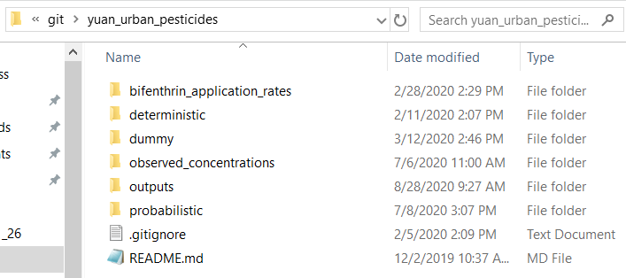
Folder Organization
The following slides discuss and explain the folder organization and the files within them.

Slide 5
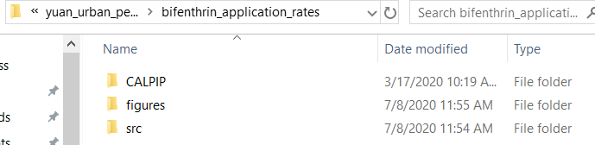
/CALPIP/
Raw CALPIP PUR data for application rates. Each county’s raw apps are located in their respective folder
Files of Importance:
output_for_pwc_with_ma_folsom.txt
output_for_pwc_with_ma_pgc.txt
The above files were manually copy-paste in the PRZM input files (Record C2) for the respective outfall location.
/figures/
Figures of application rates
/src/
Scripts to clean and compile the application rates in the necessary format
Read to understand methodology

Slide 6
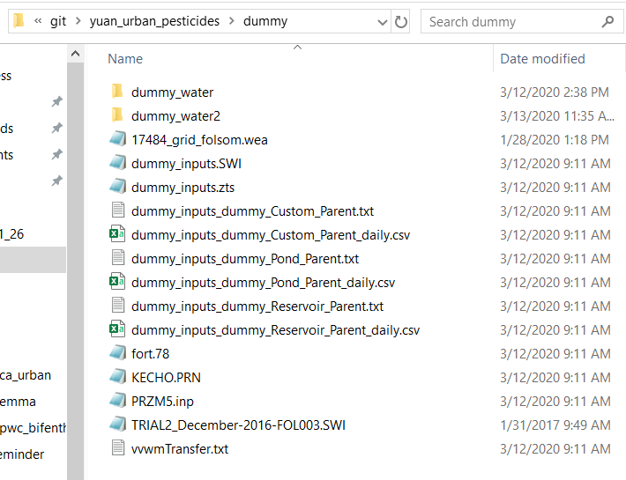
/dummy/
Test runs when I was trying to figure out issues

Slide 7
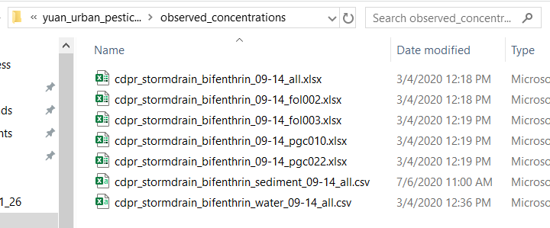
Observed concentrations from CDPR (provided by Dr. Ensminger, email correspondence)
File names explain the contents

Slide 8
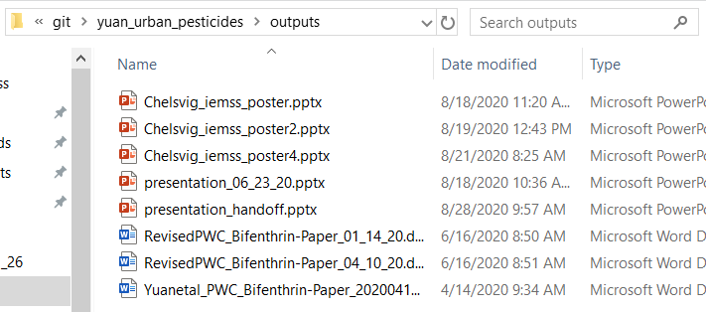
Final project outputs
Chelsvig_iemss_poster4.pptx (finalized version for IEMSS 2020 virtual conference)
presentation_06_23_20.pptx (view with Google Drive notes if you haven’t already)
None of the manuscripts (Microsoft Word docs) are the most up-to-date version. Ask Dr. Tom Purucker for up-to-date version.

Slide 9
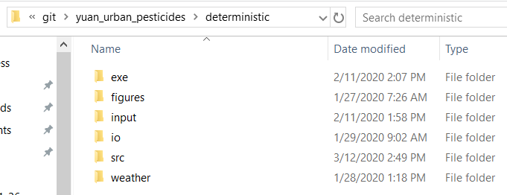
← All Files of Importance
/exe/
executables
/input/
The deterministic runs are split into the respective outfall’s folder. The next slide goes through the FOL002 as an example.
/io/
Final outputs grabbed from each outfall’s respective PWC output files
/src/
Scripts to run the deterministic for each outfall. Script 02a corresponds to FOL002, 02b corresponds to FOL003, etc.
/weather/
Weather files
17484_grid_folsom.wea is for FOL002 and FOL003
17719_grid_roseville.wea is for PGC010 and PGC022

Slide 10
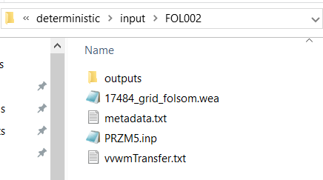
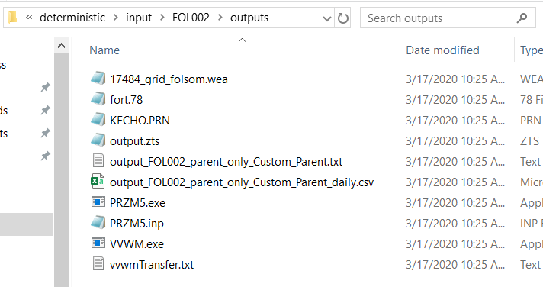
← All Files of Importance →
All relevant inputs/outputs for this run are located here
.wea = weather file
Fort.78 and KECHO.PRN are files that just get generated with the PWC process
output.zts, vvwmTransfer.txt, and .wea are required inputs for VVWM
output.txt and output.csv are the final outputs from PWC
metadata.txt
Provides useful summary of the files
PRZM5.inp
Initial input file for PWC…the outputs of this get translated to VVWM in the form of the output.zts
vvwmTransfer.txt
VVWM transfer file (1 of 3 required files for VVWM to run)

Slide 11
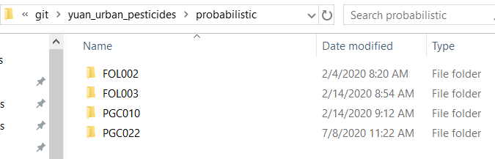
The following sides go over the FOL002 probabilistic folder as an example

Slide 12
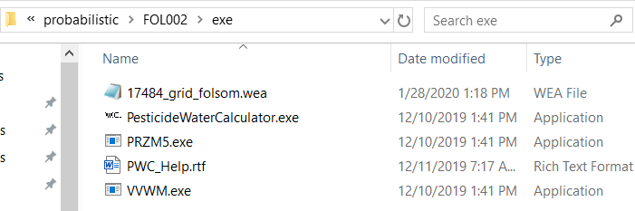
Executables, PWC manual, .wea weather file for this outfall

Slide 13
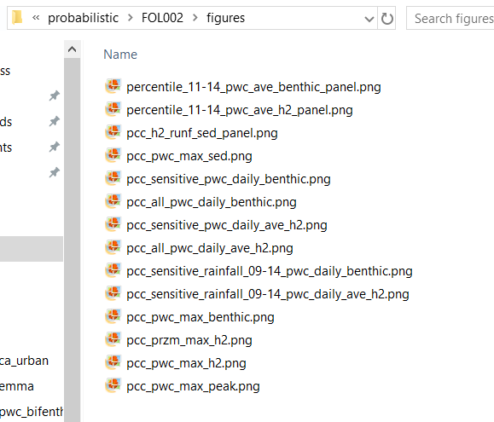
Final output figures
Files of Importance:
The three files with _panel.png

Slide 14
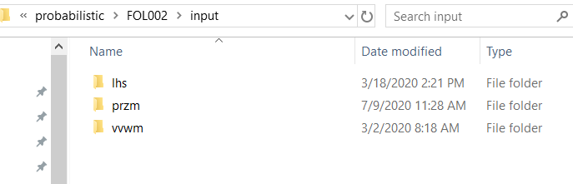
← All Files of Importance
/lhs/
Contains lhs parameter ranges
/przm/
Contains the PRZM side of things
Read metadata
/vvwm/
Contains the VVWM side of things
Read metadata
*when run in full, there will be nsims input_# folders within these folders that contain that respective run’s input/output files

Slide 15
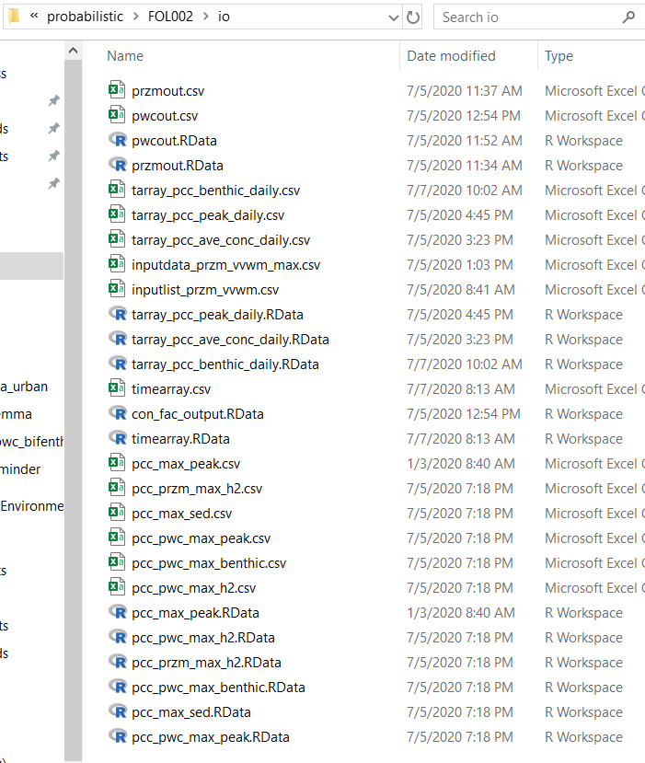
Files created during the process
Compiled all nsims inputs/outputs into single arrays

Slide 16
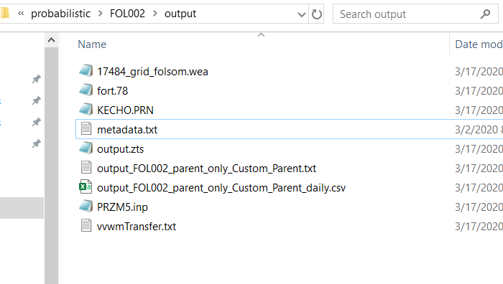
Base files, copy-paste from the deterministic simulation

Slide 17
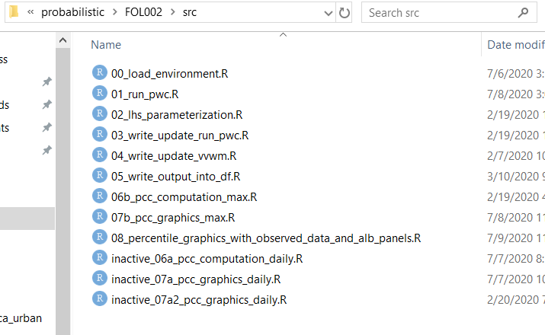
Files of Importance
Read through these to get a better sense of the process (where files are coming from, where they are stored, how they are incorporated into the overall process)
This process isn’t perfectly streamlined and there are duplicate files located in different locations…when in doubt, always refer to the scripts to see which file is actually being used!

Slide 18
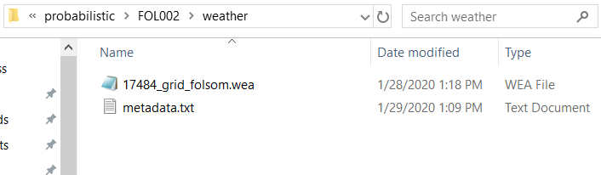
Weather file

Slide 19
Contact Information
If you have any questions, please contact me at echelsvig@gmail.com

