Slide 1
MPP
PROJECT PRESENTATION
Team Member
Purushottam Prajapati
Sally Haddad
Maher Gerges

Slide 2
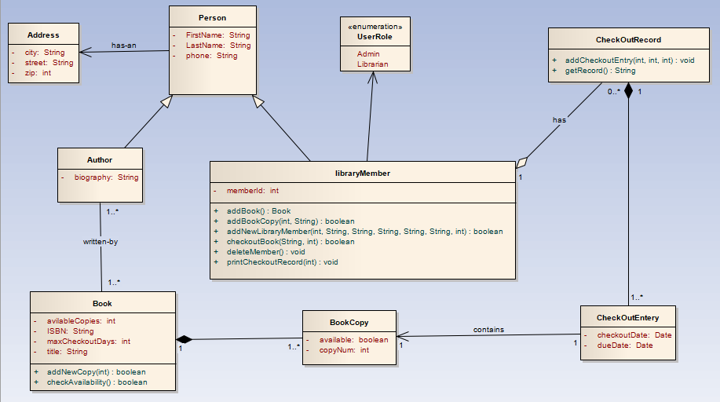
Class Diagram

Slide 3
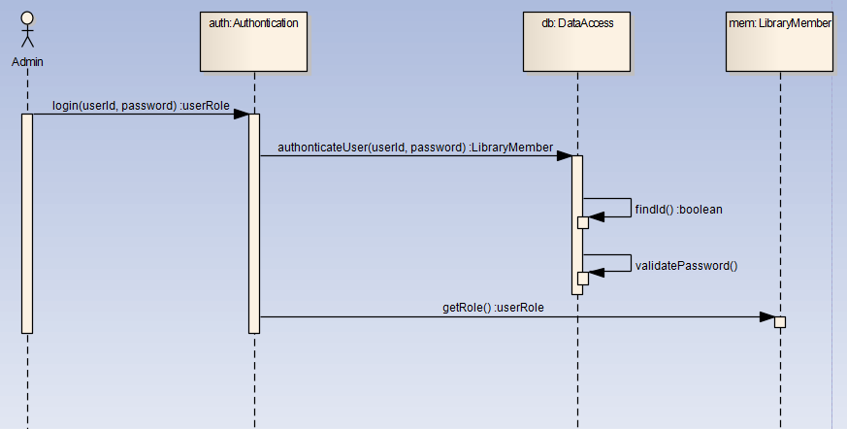
Sequence - Login

Slide 4
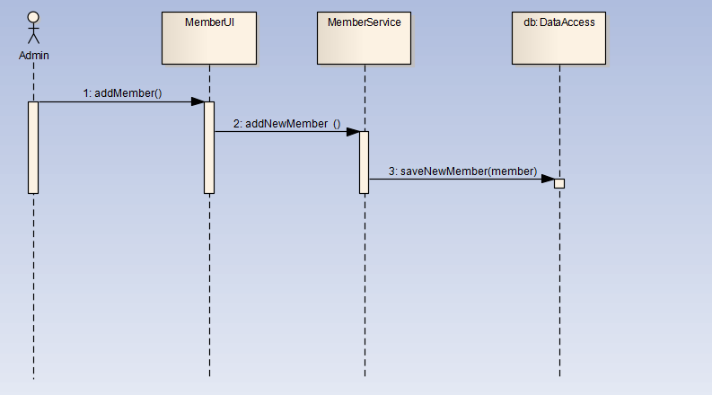
Sequence – Add Member

Slide 5
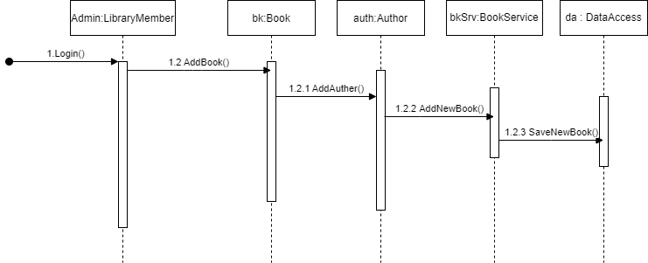
Sequence – Add book

Slide 6
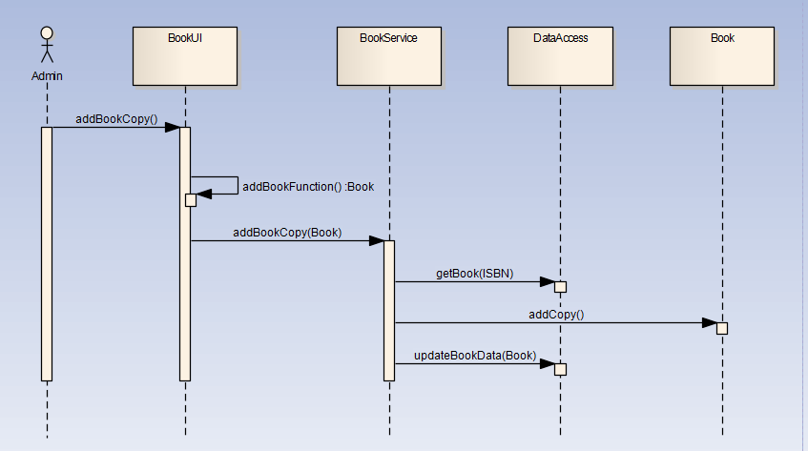
Sequence – Add Book Copy

Slide 7
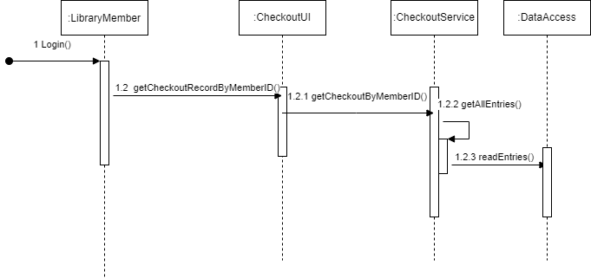
Sequence – Add Checkout

