Slide 1

PSPCL ERP
Implementation
Organization: AWC Software Pvt. Ltd.
Start Date: 3rd February, 2025
End Date: 30th June, 2025
Mentor:
Mr. Rahul Kumar Kushwah (Business Analyst, AWC Software)
Project Semester 2025
Computer Science and Engineering Department Thapar Institute of Engineering and Technology

Slide 2

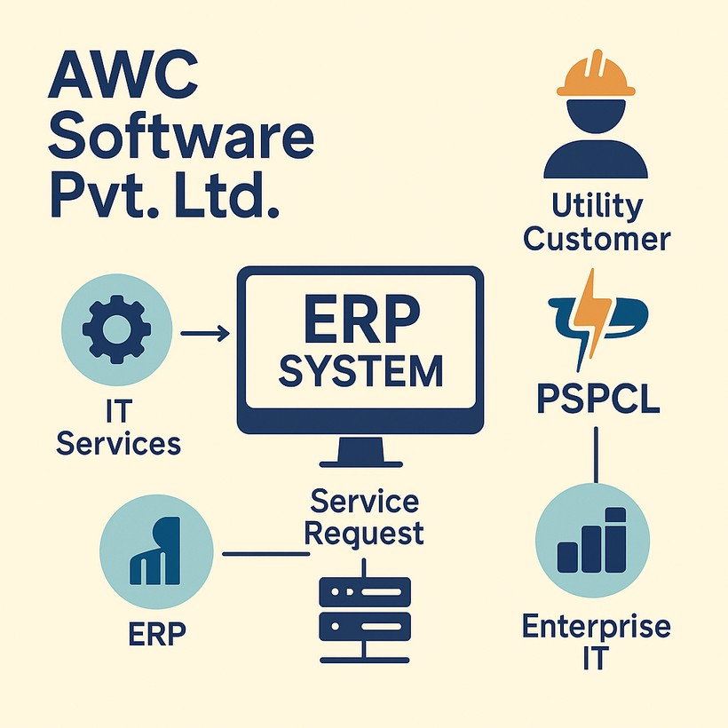
ABOUT AWC SOFTWARE
Trusted IT services and consulting firm.
Certified Oracle Gold Partner, Microsoft Partner, and Salesforce Partner.
Gold
Specialized in ERP, CRM, cloud infrastructure, and system integration solutions.
Proven experience delivering
digital sector
transformation for public and private
clients, including PSPCL.

Slide 3
PROJECT BACKGROUND
📌 Context:
PSPCL manages procurement and return of materials using Oracle ERP modules like Store Requisition (SR) and Store Return Warrant (SRW).
Manual issue tracking created delays and confusion in addressing bugs related to these forms and workflows.
🎯 Problem:
No centralized system to manage and monitor bug reports across the ERP modules.
Difficult to track which issues were pending, resolved, or reopened — especially for PSPCL’s SR/SRW-related requests.
✅ Objective:
Integrate a bug tracking system (Mantis Bug Tracker) to streamline how PSPCL logs issues and AWC resolves them. Support smoother resolution flow and improve the transparency of issue status.

Slide 4
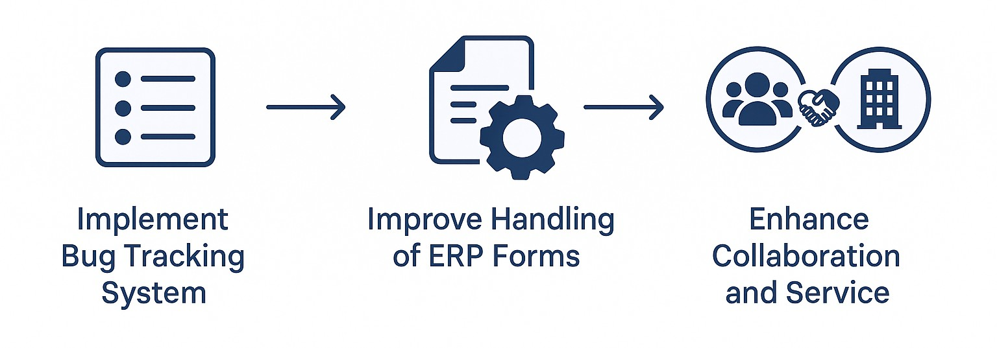
PROJECT SCOPE & UTILITY
Develop and customize a bug tracking system (MantisBT) to streamline issue logging and resolution for PSPCL’s ERP modules.
To improve the handling of SR and SRW forms, enabling better collaboration between PSPCL and AWC for faster and more reliable service.

Slide 5
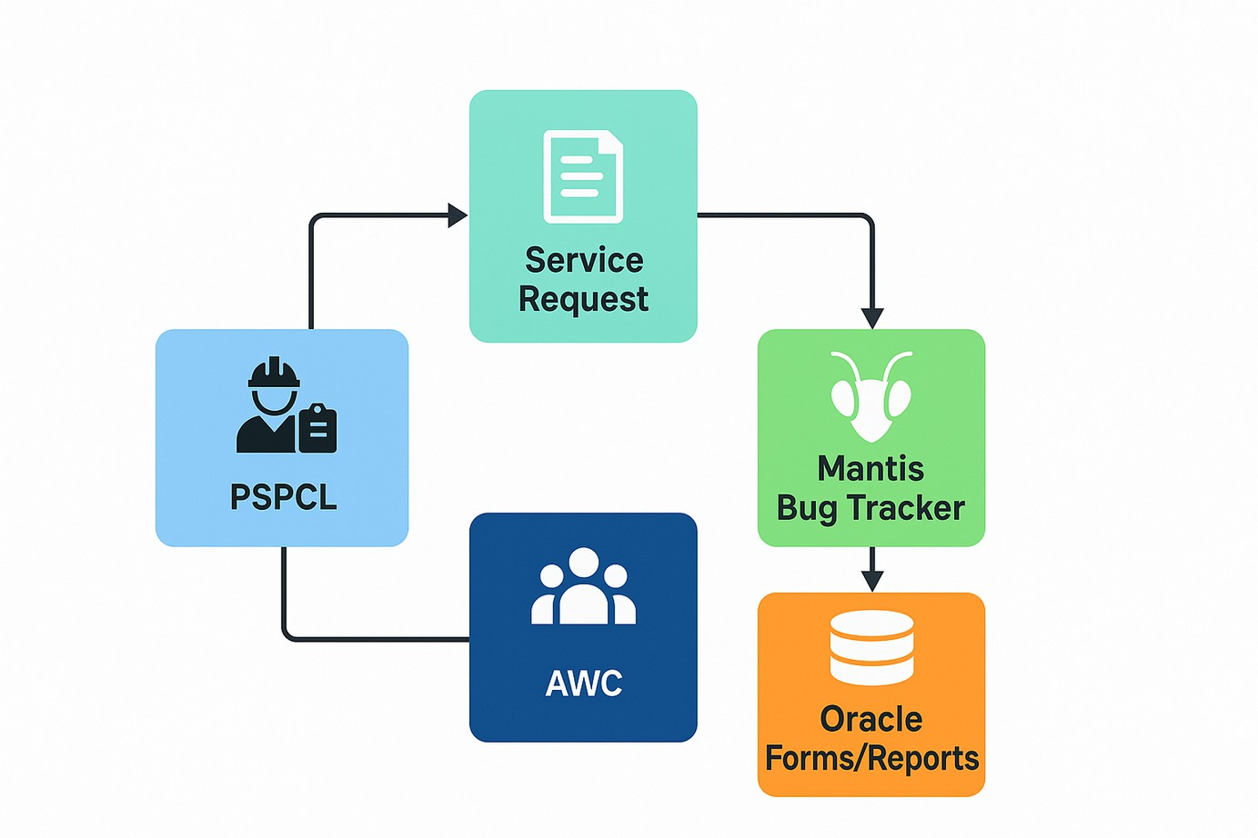
PROJECT ARCHITECTURE

Slide 6




TECHNIQUES AND TOOLS USED
Bug Tracker: MantisBT (PHP, MySQL-based)
ERP Tools: Oracle Forms, SR/SRW Forms Development: PHP, HTML, plugin customization Others: ChatGPT, testing tools

Slide 7
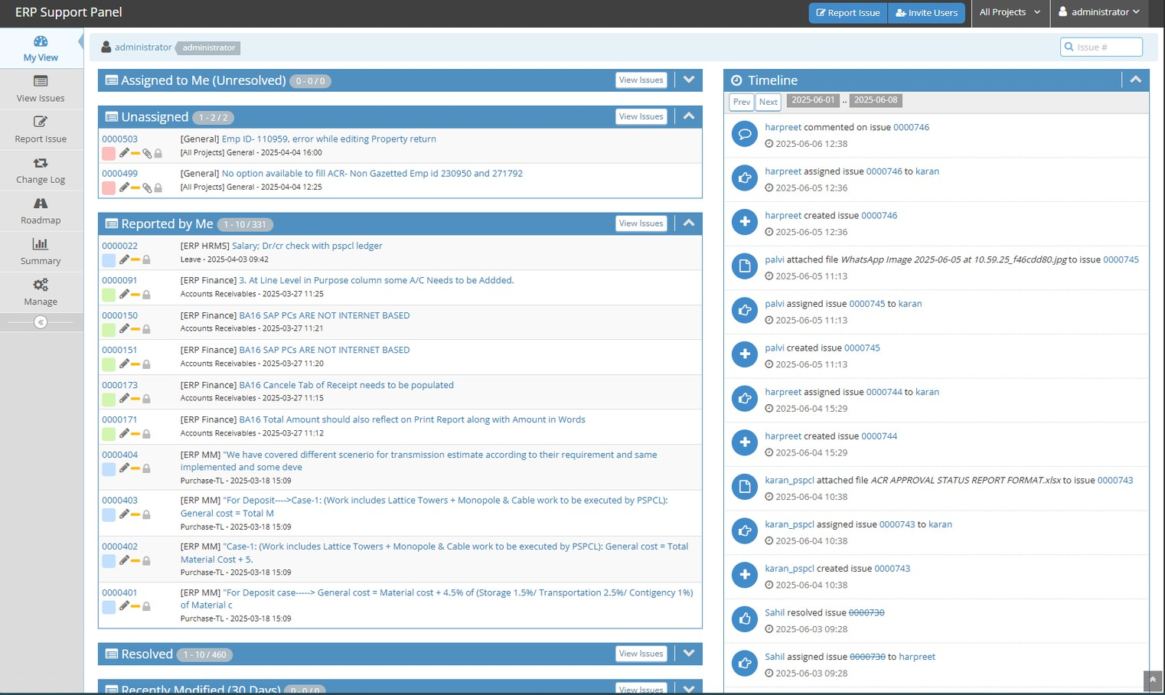
P R O J E C T S N A P S H O T S
MANTIS DASHBOARD

Slide 8
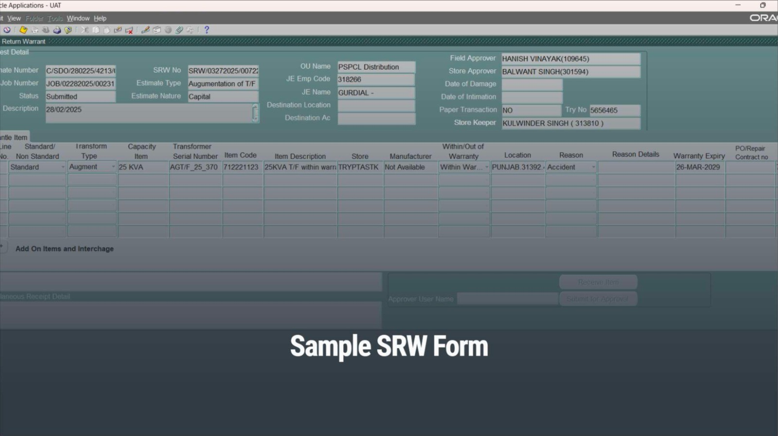
P R O J E C T S N A P S H O T S

Slide 9
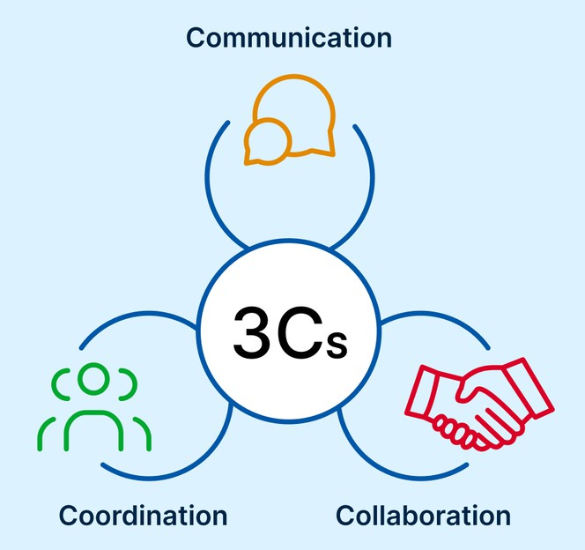
PROFESSIONAL & TECHNICAL LEARNING
⚙ Technical Learning
Understood the complete bug lifecycle using MantisBT
Gained hands-on experience in customizing open-source tools (PHP, MySQL) Explored Oracle ERP modules — specifically SR and SRW workflows
💼 Professional Growth
Learned to collaborate with cross-functional teams
Improved ability to analyze, prioritize, and structure issues in a live enterprise environment

Slide 10
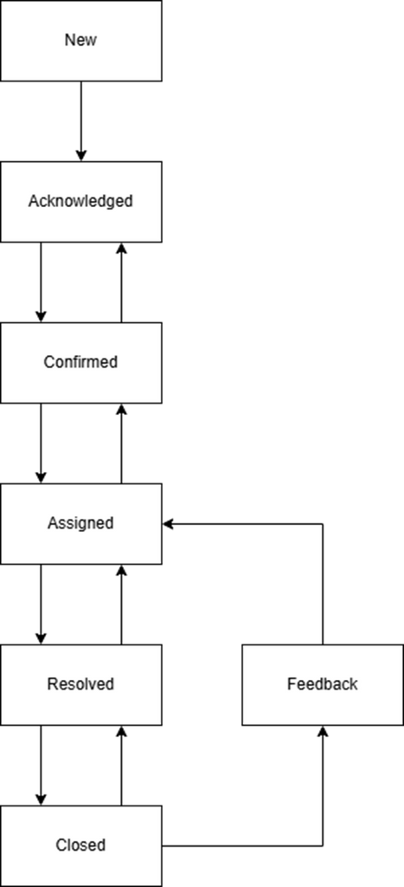
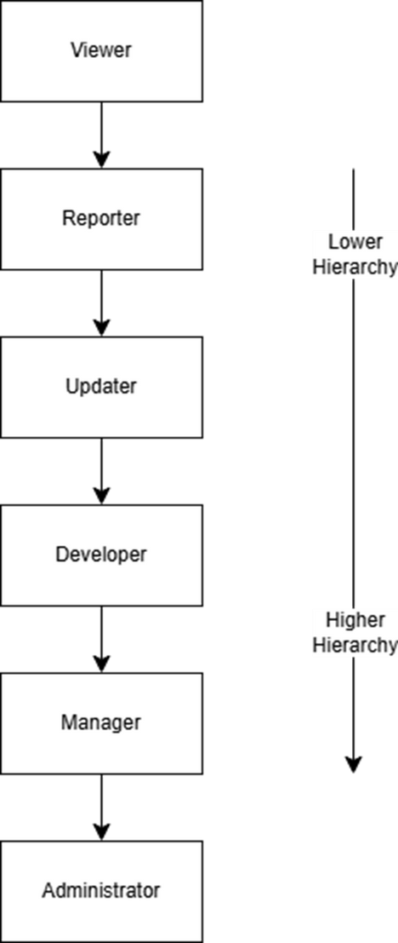
I S S U E L I F E C Y C L E & U S E R H I E R A R C H Y

Slide 11
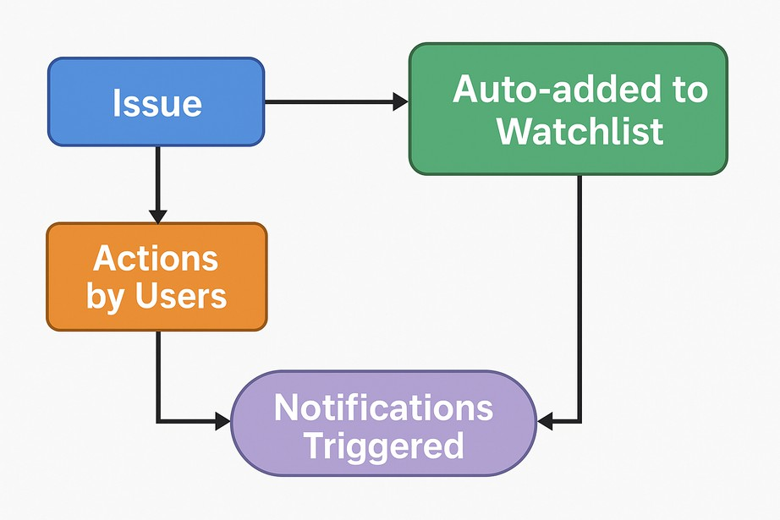
AUTO-WATCHLIST PLUGIN
🔌 Custom Plugin: Auto-Watchlist
Created a plugin that automatically adds all users involved in an issue's lifecycle (reporter, assignee, updater, etc.) to the issue’s watchlist.
Used MantisBT plugin hooks and PHP scripting to dynamically track user roles and manage watchlist logic.

Slide 12
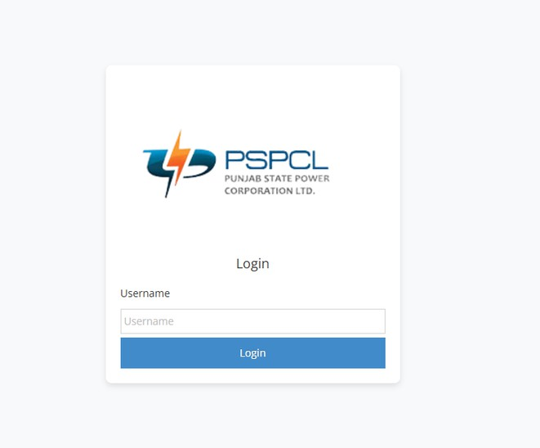
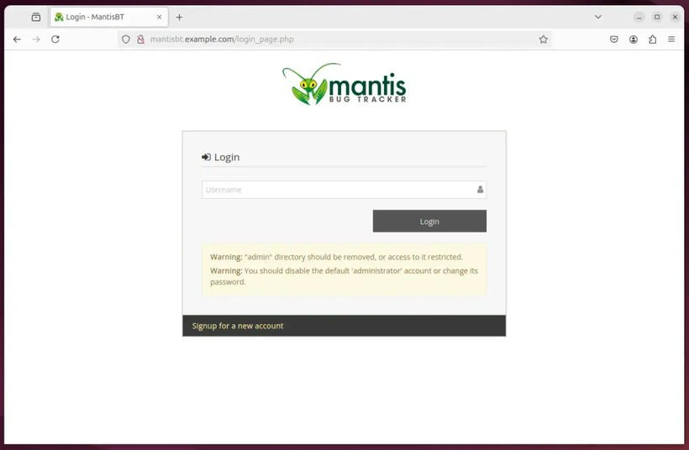
UI IMPROVEMENTS
🎨 UI Enhancements
Redesigned Login and Signup pages in Mantis with the required design.
Applied improvements in form alignment, responsive layout, and input clarity using HTML & CSS. Focused on making the interface more accessible and user-friendly.

Slide 13
KEY HIGHLIGHTS
✅ Hands-on Experience with Mantis Bug Tracker
Managed real-time issue lifecycle and implemented a custom auto-watchlist plugin
✅ UI Enhancements in a Live System
Improved login and signup pages for better usability and accessibility
✅ Worked on Oracle ERP Modules (SR/SRW)
Understood and supported real workflows in inventory management
✅ Technical Exposure
PHP, MySQL, Oracle Forms, plugin architecture, and client collaboration

Slide 14
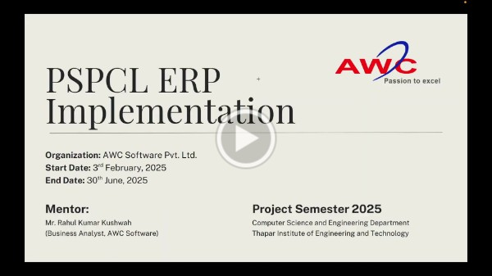
PROJECT VIDEO
HTTPS://DRIVE.GOOGLE.COM/FILE/D/1DCPTUP4QZ8A8_1 V0RYFAST_1-XRRXZFG/VIEW?USP=DRIVE_LINK

Slide 15
FEEDBACK
Project Semester Experience
The internship allowed me to apply my technical knowledge in a practical, enterprise-level environment.
I gained hands-on experience with bug tracking systems, plugin development, and ERP module workflows. This opportunity helped me grow in terms of problem-solving, collaboration, and tool expertise.
Faculty Guidance
Faculty provided meaningful support in terms of project expectations and documentation standards. Their insights helped me better structure my technical work and align it with academic objectives.
I am thankful for their encouragement throughout the internship period.

Slide 16
Thank you!

