Slide 1
RAG for Confluence

Slide 2
Agenda
What is RAG
RAG Accuracy
RAG Use cases
Agentic RAG for Confluence – Index creation
Agentic RAG for Confluence - Ingestion
Agentic RAG for Confluence - Querying

Slide 3
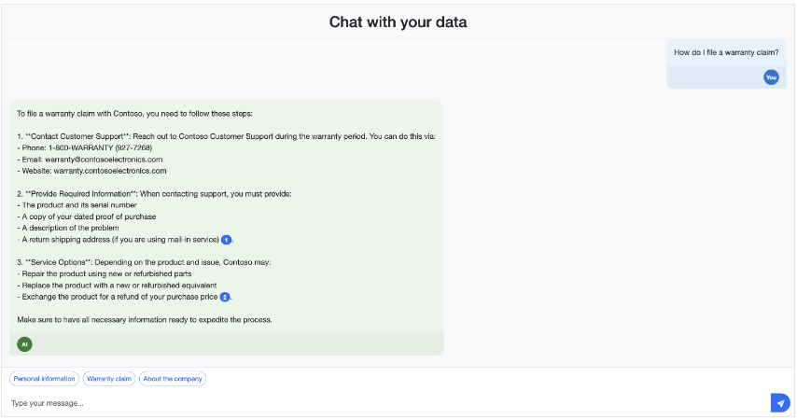
What is RAG

Slide 4
What is RAG (Continued)
Data Sources
Confluence
User Query
Vector DB
Files (PDF,…)
Context
UI
App Server
User Query + System Prompt +
Context
Response
LLM
System Prompt ex: You are a helpful assistant. Answer the user's question using ONLY the context provided below.

Slide 5
RAG Accuracy
Answers/Information provided by an Agentic system using RAG may not be 100% correct
It needs to be reviewed before finalizing
Can be treated as an Assistant
This behaviour is even after doing everything needed to reduce hallucinations,…
Notes:
85-95% accuracy can be achieved

Slide 6
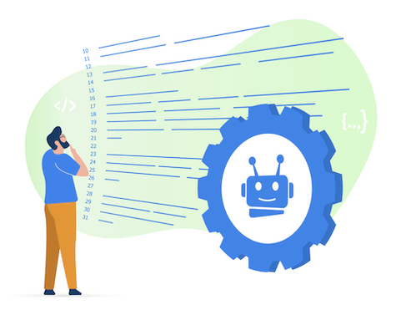
RAG Use cases – User story generator
Business Analyst can ask the Bot to generate User story for the details that they provide as input
Bot retrieves the Confluence content stored in Vector DB. Generates user story
BA can review the user story generated, refine the content manually and finalize it

Slide 7

RAG Use cases – Customer Support
User writes an email enquiring about the details of a Product to Customer support, who in turn uses the Bot
Bot retrieves the answer based on the content stored in its Vector DB. Also, provides reference document names ie citation from where the contents were fetched. (Vector DB to have the content of different data sources like Product specification PDFs of various Products,…)
Customer support person reviews the details fetched, refines the content manually if needed and responds back to User

Slide 8
Agentic RAG for Confluence – Index creation
# For text chunks: plain paragraph text.
# For table chunks: Markdown-serialised table (preserves structure for BM25).
SearchableField(
name="content",
type=SearchFieldDataType.String,
analyzer_name="en.microsoft",
retrievable=True,
),
# ── Chunk classification # "text" or "table" — enables filtered retrieval and prompt rendering.
SimpleField(
name="chunk_type",
type=SearchFieldDataType.String,
),
# ── Vector field
SearchField(
name="content_vector",
type=SearchFieldDataType.Collection(SearchFieldDataType.Single),
searchable=True,
vector_search_dimensions=VECTOR_DIMS,
vector_search_profile_name="hnsw-profile",
),

Slide 9
Agentic RAG for Confluence - Ingestion
Embedding
model
Structure aware chunking
Metadata
+
Confluence
Page
Document
{ }
atlassian-python-api
Docling
Parser
Table
Chunking
Vector
chunk
url
JSON
Text (Paragraph, List,…)
Chunking
Vector
Document
{ }
chunk
+
Metadata
-This setup is for Hybrid search. ie
Free text search: exact terms, keywords, IDs
+
Vector search: semantic match ie conceptually related
-Don’t split a table across chunks unless it is very large
-Metadata refers to pageTitle, section heading,…
-Document object should have the same fields as that of the index created
Azure AI Search
(Custom Index)

Slide 10
Agentic RAG for Confluence - Querying
Embedding model
User Query
Vectors
Azure AI Search
User Query + Vectors
UI
App Server
Top-K documents + citation
User Query + System Prompt + (Top-K documents + citation) + Conversation history
Generator
LLM
Response from Gen LLM
(sentence with citation)
Session Id+
User Query +
Response from Judge LLM
Response from Gen LLM + (Top-K documents + citation)
Response from Judge LLM
Judge LLM (Evaluation:
LLM as Judge)
DB
(for conversation history)

Slide 11
Thank you

