Slide 1
Social Distancing Detection
DPR - Detailed Project Report
By puru Sharma

Slide 2
Objective:
The main purpose of the Social Distancing Detection System is to enable the process of automating the task of monitoring social distancing using surveillance video.
Since there are no proper vaccines available for covid-19 complete prevention, social distancing is the only feasible approach to fight against this pandemic.

Slide 3
Benefits:
Avoids the spread of infectious diseases like Covid caused by Corona-virus.
Automates the process of alerting the people about social distance in congestion areas like malls, hotels, restaurants.
Using CCTV cameras installed at hospital premises, health authorities can track if visitors, patients or health workers are maintaining a distance or not. If somebody is found violating the distancing, alerts will be sent to the concerned authorities to take action.
Using a social distancing AI app, schools can manage social distancing efficiently. If students or teachers are found violating the distancing within school premises, an alert is raised and notification is sent to concerned authorities.

Slide 4
Social Distancing Detection System
The rampant coronavirus disease 2019 (COVID-19) has brought global crisis with its deadly spread to more than 180 countries, and about 3,519,901 confirmed cases along with 247,630 deaths globally as on May 4, 2020. The absence of any active therapeutic agents and the lack of immunity against COVID19 increases the vulnerability of the population. Since there are no proper vaccines available for complete prevention, social distancing is the only feasible approach to fight against this pandemic.
Motivated by this notion, this system proposes a deep learning based framework for automating the task of monitoring social distancing using surveillance video. The proposed framework utilizes the YOLO v3 object detection model to segregate humans from the background and Deepsort approach to track the identified people with the help of bounding boxes and assigned IDs. The results of the YOLO v3 model are further compared with other popular state-of-the-art models, e.g. faster region-based CNN (convolution neural network) and single shot detector (SSD) in terms of mean average precision (mAP), frames per second (FPS) and loss values defined by object classification and localization. To detect the distance between persons we use Euclidean Distance. Later, the pairwise vectorized L2 norm is computed based on the three-dimensional feature space obtained by using the centroid coordinates and dimensions of the bounding box. The violation index term is proposed to quantize the non adoption of social distancing protocol. From the experimental analysis, it is observed that the YOLO v3 with Deepsort tracking scheme displayed best results with balanced mAP and FPS score to monitor the social distancing in real-time.

Slide 5
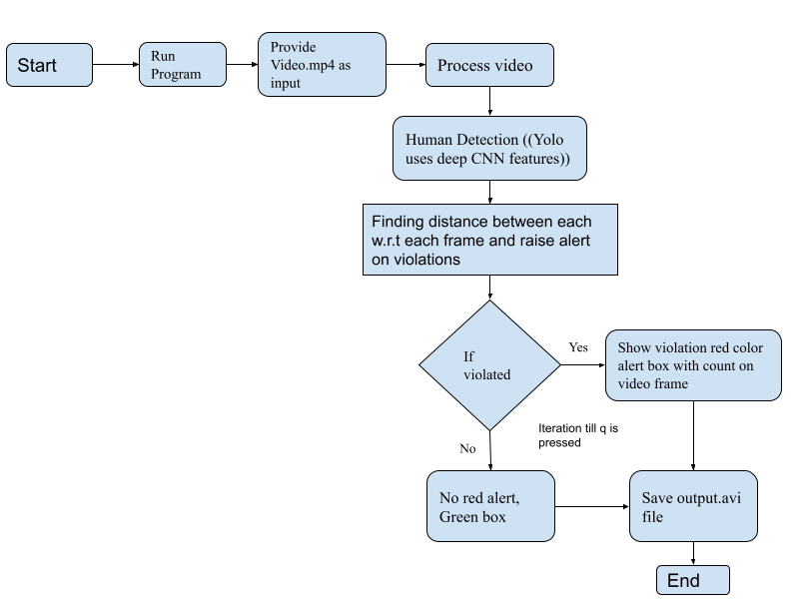
Architecture

Slide 6
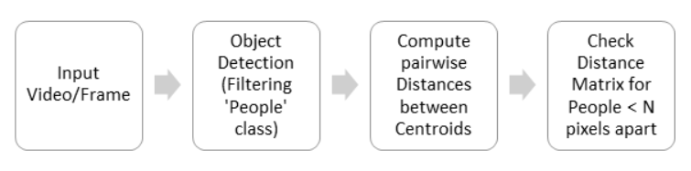
The steps to build a social distancing detector :
The steps to build a social distancing detector include:
Apply object detection to detect all people (and only people) in a video stream.
Compute the pairwise distances between all detected people.
Based on these distances, check to see if any two people are less than N pixels apart
This social distancing detector implementation will rely on pixel distances, which won’t necessarily be as accurate.

Slide 7
Applications of Social Distance Detection System
Airports
Social Distancing AI App can be used at airports to identify if people are maintaining social distance or not. Multiple IP cameras installed at the airport can capture people standing in close proximity and logs are kept in a system. The app triggers the voice alerts and sends notifications to the concerned authorities.
Hospitals
Hospitals can use social distancing app to monitor if people are adhering to social distancing or not. Using CCTV cameras installed at hospital premises, health authorities can track if visitors, patients or health workers are maintaining a distance or not. If somebody is found violating the distancing, alerts will be sent to the concerned authorities to take action.
Offices
The risk of COVID-19 will be not be ending soon; therefore, offices after the lockdown can use this app to ensure that social distancing is maintained until the risk of COVID-19 does not go away. Offices can add face data of their employees and if anyone is found not following distance can receive an alert or notification.

Slide 8
Applications of Social Distance Detection System…
Manufacturing plants
Social distancing alert device can be used in manufacturing plants to prevent workers from the risk of infection. IP or CCTV cameras installed at the plants would capture and identify if workers are found in close contact with each other. Notification alerts will be sent to the concerned workers and their authorities.
Retail shops
Retail stores can use the social distancing AI app to ensure that visitors maintain a specific distance from each other. Cameras connected to the app would track the in-store activity and trigger voice alert to aware people..
Metro Stations
Metro stations are considered as the most crowded places where the social distancing AI app can help reduce the risk of COVID-19 by alerting people and concerned authorities. Cameras installed at metro stations can use the capability of AI to track the movement of people and find if everyone is maintaining the social distance or not.

Slide 9
Conclusion
The Social Distancing Detection system proposes an efficient real-time deep learning based framework to automate the process of monitoring the social distancing via object detection and tracking approaches, where each individual is identified in the real-time with the help of bounding boxes. The generated bounding boxes aid in identifying the clusters or groups of people satisfying the closeness property computed with the help of pairwise vectorized approach. The number of violations are confirmed by computing the number of groups formed and violation index term computed as the ratio of the number of people to the number of groups.
The extensive trials were conducted with popular state-of-the-art object detection models: Faster RCNN, SSD, and YOLO v3, where YOLO v3 illustrated the efficient performance with balanced FPS and mAP score. Since this approach is highly sensitive to the spatial location of the camera, the same approach can be fine tuned to better adjust with the corresponding field of view.

Slide 10
Q & A:
What is Yolo v3?
- YOLOv3 (You Only Look Once, Version 3) is a real-time object detection algorithm that identifies specific objects in videos, live feeds, or images. YOLO uses features learned by a deep convolutional neural network to detect an object.
What is Euclidean Distance?
- Euclidean Distance represents the shortest distance between two points. Most machine learning algorithms including K-Means use this distance metric to measure the similarity between observations.
What is Opencv ?
- OpenCV (Open Source Computer Vision Library) is an open source computer vision and machine learning software library.
What is social distance detection ?
- The detection tool was developed to alert people to maintain a safe distance with each other by
evaluating a video feed.

