Slide 1

Chinook Music Store
SQL Data Analysis & Business Insights
Submitted by: Purushotam Kumar
August, 2026

Slide 2
Problem Statement
You are hired as a data analyst at Chinook, and your objective is to analyze music record sales data to gain insights and make recommendations for the company's strategy in the physical music market.

Slide 3
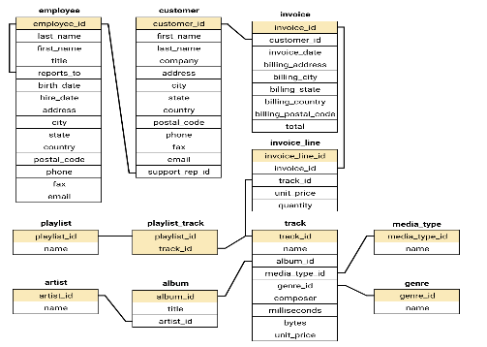
Database Schema

Slide 4
Data description
customer:
customer_id: Unique identifier assigned to each customer.
first_name: The given name or first name of a customer.
last_name: The surname or family name of a customer.
company: The name of the company associated with a customer.
address: The street address of a customer's location.
city: The city where a customer is located.
state: The state or province where a customer is located.
country: The country where a customer is located.
postal_code: The postal or zip code of a customer's address.
phone: The phone number of a customer.
fax: The fax number associated with a customer.
email: The email address of a customer.
support_rep_id: The employee ID of the support representative assigned to a customer.
invoice:
invoice_id: Unique identifier assigned to each invoice.
customer_id: The customer ID associated with the invoice.
invoice_date: The date when the invoice was generated or issued.
billing_address: The street address used for billing purposes.
billing_city: The city used for billing purposes.
billing_state: The state or province used for billing purposes.
billing_country: The country used for billing purposes.
billing_postal_code: The postal or zip code used for billing purposes.
total: The total amount due on the invoice.

Slide 5
Data description
invoice:
invoice_id: Unique identifier assigned to each invoice.
customer_id: The customer ID associated with the invoice.
invoice_date: The date when the invoice was generated or issued.
billing_address: The street address used for billing purposes.
billing_city: The city used for billing purposes.
billing_state: The state or province used for billing purposes.
billing_country: The country used for billing purposes.
billing_postal_code: The postal or zip code used for billing purposes.
total: The total amount due on the invoice.
invoice_line:
invoice_line_id: Unique identifier assigned to each line item on an invoice.
invoice_id: The invoice ID to which the line item belongs.
track_id: The ID of the track or product included in the line item.
unit_price: The price per unit for the line item.
quantity: The quantity of units for the line item.
playlist:
playlist_id: Unique identifier assigned to each playlist.
name: The name or title of the playlist.
playlist_track:
playlist_id: The ID of the playlist to which the track belongs.
track_id: The ID of the track included in the playlist.
track:
track_id: Unique identifier assigned to each track or song.
name: The title or name of the track.
album_id: The ID of the album to which the track belongs.
media_type_id: The ID of the media type associated with the track.
genre_id: The ID of the genre associated with the track.
composer: The name of the composer or artist who composed the track.
milliseconds: The duration of the track in milliseconds.
bytes: The file size of the track in bytes.
unit_price: The price per unit for the track.

Slide 6
Data description
album:
album_id: Unique identifier assigned to each album.
title: The title or name of the album.
artist_id: The ID of the artist associated with the album.
artist:
artist_id: Unique identifier assigned to each artist.
name: The name of the artist.
media_type:
media_type_id: Unique identifier assigned to each media type.
name: The name or description of the media type (e.g., MPEG audio file, AAC audio file).
genre:
genre_id: Unique identifier assigned to each genre.
name: The name or description of the genre (e.g., rock, pop, classical).

Slide 7
About the Dataset
11
59
614
3,503
Tables in Database
Total Customers
Total Invoices
Total Tracks
Key Tables & Relationships
▸
customer — 59 rows — customer location and contact info
▸
track / album / artist — 3503 tracks across 347 albums and 275 artists
▸
invoice — 614 rows — billing details and invoice totals
▸
genre / media_type — 25 genres and 5 media types
▸
invoice_line — 2240 rows — individual track purchases

Slide 8
Q1 — Data Quality Check
Checking for NULL values and duplicate records before any analysis
NULL Values Found
Duplicates Found
○ customer.company → 49 out of 59 are NULL
○ invoice_line → 6 duplicate entries found
○ customer.fax → 47 out of 59 are NULL
○ track table → same name in same album
○ track.composer → 978 out of 3503 are NULL
○ customer emails → no duplicates (clean)
○ invoice.billing_state → NULL for some countries
○ employee data → fully clean
How These Were Handled
NULLs in fax, phone, and company are optional fields — retained as-is. 978 NULL composers in the track table is a data gap worth noting. Duplicate invoice_line entries should be cleaned by keeping the lowest invoice_line_id.

Slide 9
Q2 — Top Tracks & Artists in the USA
Filtered by billing_country = 'USA' — revenue and units sold
Insights:
The Doors is the top-selling artist in the USA, with 8 units sold, followed by Cake (6) and Amy Winehouse (5).
“War Pigs” is the top-performing track, generating the highest revenue/value at 6, followed by “You Know My Name (Look Up the Number)” at 5.
Sales are relatively concentrated among a few top performers—The Doors leads artists, while most other artists and tracks fall in the 3–5 unit range, indicating moderate variation in popularity.

Slide 10
Q4 — Revenue by Country
Total invoices and revenue grouped by billing country
Insights:
USA is the largest revenue-generating market, contributing $1,040.49, significantly higher than every other country.
Canada and France are the next strongest markets, generating $535.59 and $389.07, respectively, showing strong revenue performance in North America and Europe.
Revenue is highly concentrated in a few countries — the USA, Canada, Brazil, France, and Germany together generate a substantial share of total revenue, while most other countries contribute comparatively smaller amounts.

Slide 11
Q5 — Top 5 Customers per Country
RANK() window function partitioned by country — revenue leaders by region
Country | Rank | Customer Name | Total Spent
Brazil | 1 | LuÃ­s GonÃ§alves | 108.9
Czech republic | 1 | FrantiÅ¡ek WichterlovÃ¡ | 144.54
Czech Republic | 1 | Helena HolÃ½ | 128.7
India | 1 | Manoj Pareek | 111.87
Ireland | 1 | Hugh O'Reilly | 114.84
Insights:
František Wichterlová is the highest-spending customer, ranking #1 in the Czech Republic with $144.54 in total spending.
The Czech Republic shows the strongest customer spending among the listed countries, with its top two customers spending $144.54 and $128.70, indicating multiple high-value customers.
Top customers vary significantly across countries, with Manoj Pareek (India) at $111.87, Hugh O'Reilly (Ireland) at $114.84, and Luís Gonçalves (Brazil) at $108.90, showing strong individual customer value across different markets.

Slide 12
Q8 — Customer Churn Rate
Customers with no purchase in the 3 months before dataset end date (Dec 2013)
59
38
Total Customers
Churned
21
64%
Still Active
Churn Rate
What This Means
64% churn is high but expected for a historical dataset. Re-engagement campaigns targeting the 38 churned customers via email is the immediate action.

Slide 13
Q7 — Customer Purchasing Behavior
Frequency, basket size, average order value — across all 59 customers
Key Insights:
František Wichterlová is the highest-spending customer with 1,683 in total purchases.
Purchase frequency and customer value are not always directly related, as frequent buyers can still have lower total spending.
The top customers contribute substantially more revenue, making high-value customer retention an important business opportunity.

Slide 14
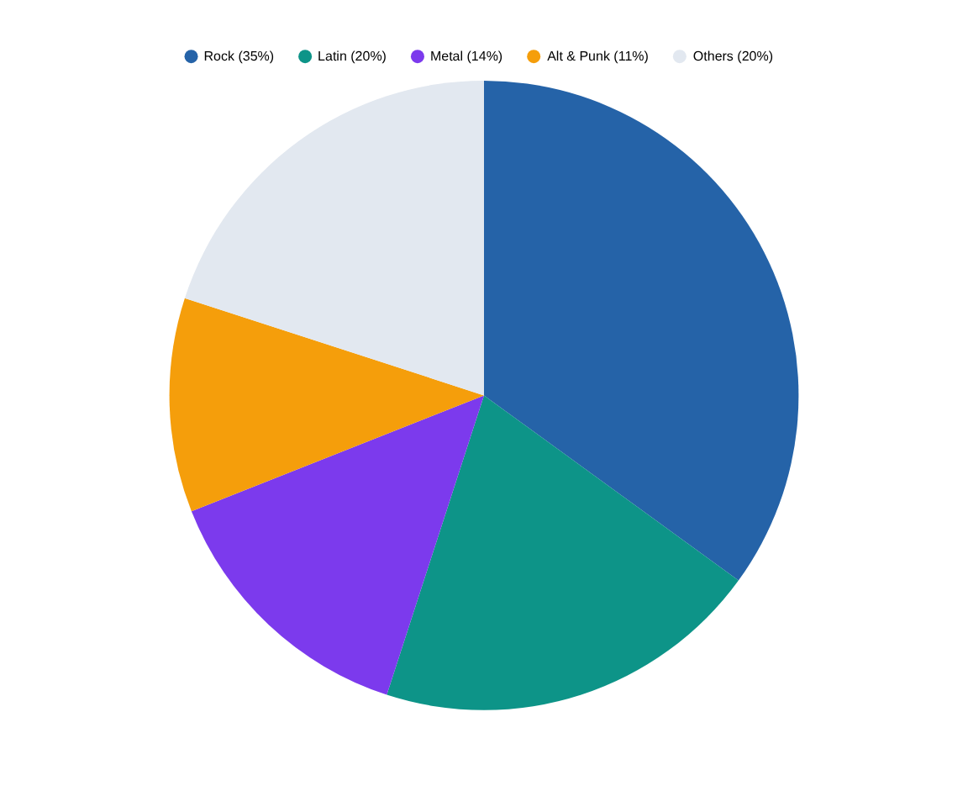
Q9 & Q11 — Genre Performance in USA
Revenue percentage and ranking of all genres in the USA market
Genre Leaderboard — USA
1
Rock
$157.43
2
Latin
$90.09
3
Metal
$63.36
4
Alt & Punk
$49.50
5
Jazz
$21.78
Insight: Rock + Latin + Metal together = 69% of all USA sales. New label albums in these 3 genres should be the top advertising priority.

Slide 15
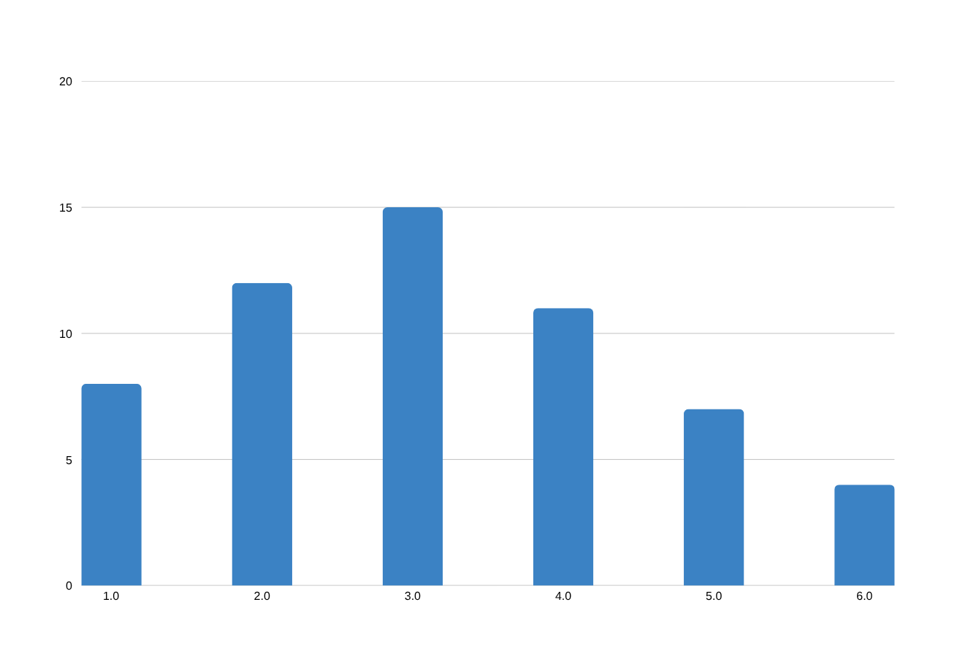
Q10 — Customers with Diverse Genre Taste
Customers who purchased tracks from 3 or more different genres
Why This Matters
✓ Multi-genre buyers have higher total spend
✓ More receptive to cross-sell recommendations
✓ Ideal for bundle offers across genres
✓ Best candidates for loyalty programs
✓ Higher customer lifetime value overall
Insight: Customers buying 5+ genres are Chinook's highest engagement tier. A loyalty program rewarding genre diversity could significantly boost retention and CLV.

Slide 16
Key Recommendations for Chinook
Based on analysis of sales data, customer behavior, and genre performance
01
Promote Rock, Latin & Metal in USA
04
Target Single-Customer Countries
These 3 genres = 69% of USA revenue. New albums in these genres should get the highest advertising priority and budget allocation.
Argentina, Austria, Australia each have 1 customer who spends well. Focused regional campaigns in these markets could unlock significant new revenue.
02
Re-engage 38 Churned Customers
05
Introduce Bundle Pricing
Send personalized emails with genre-specific new releases and a limited-time discount. Customers inactive 90–180 days are the most recoverable.
Avg basket is only 2–3 tracks per order. A 5-track bundle at a small discount could increase per-visit revenue without reducing overall margins.
03
Build a Cross-Genre Recommendation Engine
06
Launch a Loyalty Program
Rock and Metal buyers frequently purchase together. A simple 'you might also like' feature based on genre affinity could increase avg basket size by 30–40%.
Customers buying 5+ genres have higher CLV. Reward genre diversity with badges, early access to new releases, or small discounts to improve long-term retention.

Slide 17
Conclusion
Chinook has a solid but underleveraged
customer base
— Rock dominates USA sales — double down on it
— 64% churn rate signals a need for re-engagement campaigns
— Small-basket shopping behavior = opportunity for bundles
— Multi-genre customers are the highest-value segment
— Single-customer countries are untapped growth markets

Slide 18
Thank You

