Slide 1
Effective deep learning based abstractive text summarisation and image captioning
Presented by
R.Ragulprashad
N.Purushothaman
K.MohanRaj
B.Thiruvengadam

Slide 2
OBJECTIVE
• The main objective of a text summarization system is to identify the most important information from the given text and present it to the end users.
• In its most basic form, a summary is a set of photos that represents the most interesting visual content of a scene. The purpose of a summary is to quickly give a viewer an accurate impression of what a particular scene looks like.
• Summaries reduce reading time.
• When researching documents, summaries make the selection process easier.
• It provide more accurate and efficient process of summarization

Slide 3
ABSTRACT
The technique of text summarizing turns a lengthy text into a summary.
The foundation of earlier information retrieval and summarization algorithms is a large labelled dataset that uses manually created characteristics. For a specific domain and focused on the specific sub-domain to increase efficiency.
This research introduces a novel text summarization model for deep learning (DL) based information retrieval. The three main processes that make up the proposed model are text summarization, template development, and information retrieval. For recovering textual material at first, the bidirectional long short term memory (BiLSTM) technique is used, which assumes each word d, takes the data from the sentence, and embeds it in the semantic vector.
Following that, the DL model is used to generate templates. The text is summarized using the deep belief network (DBN) model as a text summary technique. Also, the visible entities that are present in the photographs are given their own image descriptions. The design of BiLSTM with the DBN model for the text summarization and image captioning process shows the novelty of the work. Giga and DUC corpora are used to validate the performance of the proposed technique. According to the experimental findings, the suggested DBN model outperformed the examined approaches with the highest levels of precision, recall, and F-score.

Slide 4
INTODUCTION
Deep learning is a branch of machine learning which is completely based on artificial neural networks, as neural network is going to mimic the human brain so deep learning is also a kind of mimic of human brain. In deep learning, we don’t need to explicitly program everything.
The concept of deep learning is not new. It has been around for a couple of years now. Deep Learning models are able to automatically learn features from the data, which makes them well-suited for tasks such as image recognition, speech recognition, and natural language processing. The most widely used architectures in deep learning are feedforward neural networks, convolutional neural networks (CNNs), and recurrent neural networks (RNNs).
In human brain approximately 100 billion neurons all together this is a picture of an individual neuron and each neuron is connected through thousand of their neighbours. So, we create an artificial structure called an artificial neural net where we have nodes or neurons.
We have some neurons for input value and some for output value and in between, there may be lots of neurons interconnected in the hidden layer.

Slide 5
EXISTING SYSTEM
• The working process involved in the presented DL based information retrieval and text summarization processes is which comprises three major stages.
• Initially, Bi-LSTM based information retrieval and template generation take place. Then, the DBN model is used for text summarization.
• In addition, CNN (Convolutional Neural Network )and RNN (recurrent neural network) technique facilitates in generating captions to the images.
• The BiLSTM approach is employed to retrieve the textual data, which assumes each word in a sentence extracts the information and embeds it into the semantic vector. Subsequently, the template generation process takes place using the DL model.
• DBN model is employed as a text summarization tool to summarize the textual content and the image captions are generated.

Slide 6
DRAWBACKS OF EXISTING SYSTEM
• CNNs which include the fact that a lot of training data is needed for the CNN to be effective and that they fail to encode the position and orientation of objects.
• They fail to encode the position and orientation of objects. They have a hard time classifying images with different positions.
• Gradient exploding and vanishing problems are major issues in RNNs.
• Training an RNN is a completely tough task. It cannot system very lengthy sequences if the usage is exceed .

Slide 7
PROPOSED SYSTEM
To overcome the lack of quality and accuracy in text summarization and image captioning using transformers model.
• By using transformers model it achieve very high translate quality even after being trained only for shorter period of time.
• It works in a inherently sequential in nature and allow for much more parallelization than sequential models.
• There are three important features in transformers they are:
i. Positional encoding.(describes the location or position of an entity in a sequence so that each position is assigned a unique representation)
ii. Attention.(helps to draw connections between any parts of the sequence,)
iii. Self attention.(mechanism relating different positions of a single sequence)

Slide 8
LITERATURE SURVEY
AUTHOR | PAPER TITLE | DESCRIPTION | PUBLICATION
Kanika Agrawal | Legal Case Summarization: An Application for Text Summarization | The paragraph describes a project that uses web scraping and text summarization to help lawyers with IT legal cases in India. It compares different text summarization algorithms and finds LUHN and LSA to be the best ones. | IEEE(Institute of Electrical and Electronics Engineers)
Zohair Malki et al., | Bidirectional Residual LSTM-based Human Activity Recognition | The paragraph is about a deep learning method called Residual LSTM that can recognize human activities from time series data. It claims that this method has high performance and accuracy. It also explains what LSTM is and why it is useful for activity recognition. | Research Gate

Slide 9
LITERATURE SURVEY
AUTHOR | PAPER TITLE | DESCRIPTION | PUBLICATION
Deepali Jain et al., | Fine-Tuning Textrank for Legal Document Summarization: A Bayesian Optimization Based Approach | The paragraph is about a method that uses Bayesian Optimization to fine-tune Textrank, a text summarization algorithm. It claims that this method improves the performance of Textrank on legal document summarization. It also mentions the types and metrics of text summarization | Association for Computing Machinery New York, NY, United States
P. Mahalakshmi et al., | Ensembling of text and images using Deep Convolutional Neural Networks for Intelligent Information Retrieval | The paragraph is about a model that uses deep learning and neural networks to retrieve and rank text and images from different datasets. It uses VGGNet-19 and BiLSTM techniques to reduce the semantic gap. It claims that this model has high precision, recall and F-score. | Springer Link

Slide 10
LITERATURE SURVEY
AUTHOR | PAPER TITLE | DESCRIPTION | PUBLICATION
Junzhong Ji et al., | Spatio-Temporal Memory Attention for Image Captioning | This paper proposes a spatio-temporal memory attention (STMA) model for image captioning. It uses a tailored LSTM to memorize and generate attention weights that capture the spatial and temporal relationship of relevant areas in images. Experiments on MS COCO show that STMA improves attention-based image captioning | IEEE(Institute of Electrical and Electronics Engineers)
Ming-Hsiang Su et al., | A Two-Stage Transformer-Based Approach for Variable-Length Abstractive Summarization | A two-stage method for variable-length abstractive summarization using BERT and Transformer. It segments the input text, extracts important sentences, and generates summaries. It achieves 70% accuracy on LCSTS dataset. It is an improvement over previous models. | IEEE(Institute of Electrical and Electronics Engineers)

Slide 11
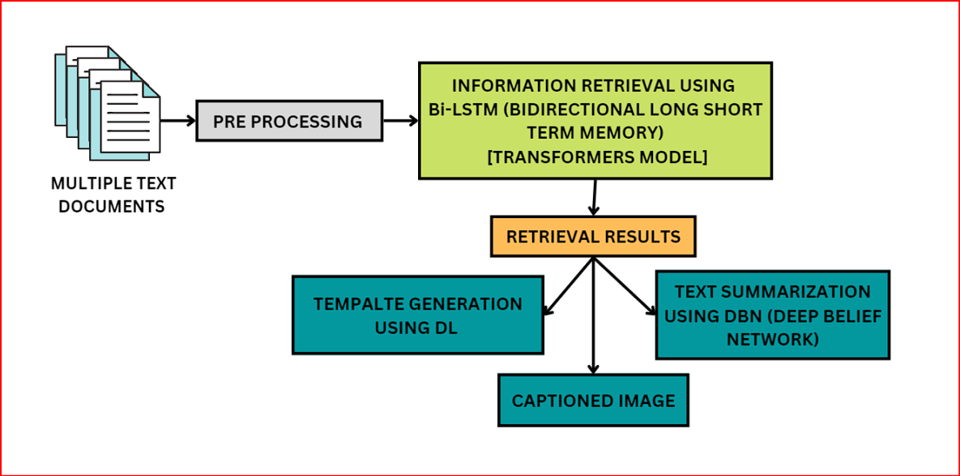
SYSTEM ARCHITECTURE DIAGRAM

Slide 12
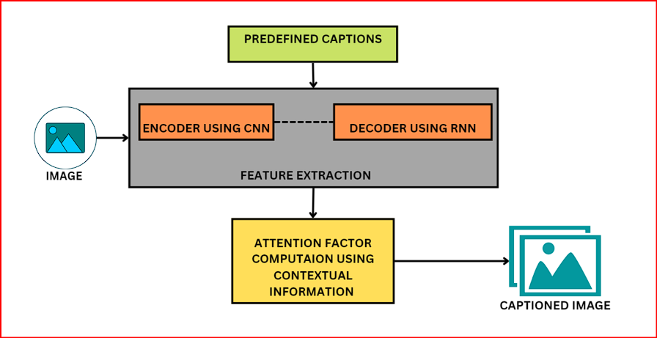
CAPTIONED IMAGE GENERATION USING DEEP LEARNING TECHNIQUE

Slide 13
LIST OF MODULES
1. Pre-processing.
2. Feature Extraction
3. Image Caption Generation
4. Summarization
PRE-PROCESSING:
Preprocessing for deep learning is the process of transforming raw data into a suitable format for deep learning models. Preprocessing can help enhance the features, reduce the noise, and normalize the data that the models need to learn from. Preprocessing can also reduce the computational cost and time of training and inference. Preprocessing methods can vary depending on the type and domain of data, such as images, text, audio, etc. Some common preprocessing methods for deep learning are:
Scaling: adjusting the range of values of data to a common scale, such as 0-1 or -1 to 1.
Cropping: removing unwanted parts of data, such as borders or backgrounds of images.
Padding: adding zeros or other values to data to make them have a uniform size or shape, such as

Slide 14
sentences or matrices.
FEATURE EXTRACTION:
Feature extraction in deep learning is the process of extracting meaningful and representative features from raw data using deep learning models.
Features are parts or patterns of data that help to identify or describe it. For example, features of an image can be edges, corners, colors, shapes, etc. Feature extraction can help reduce the dimensionality, complexity, and noise of data and improve the performance and accuracy of downstream tasks such as classification, detection, segmentation, etc. Feature extraction methods can vary depending on the type and domain of data, such as images, text, audio, etc. Some common feature extraction methods for deep learning are:
Convolutional neural networks (CNNs): using multiple layers of convolutional filters to learn hierarchical features from data, such as low-level features (e.g., edges) to high-level features (e.g., faces). CNNs are widely used for image feature extraction
Autoencoders: using a network that consists of an encoder and a decoder to learn a compressed representation of data that preserves its essential information. Autoencoders can be used for feature extraction by taking the output of the encoder as the features

Slide 15
Recurrent neural networks (RNNs): using a network that has a memory mechanism to process sequential data, such as text or speech. RNNs can learn features that capture the temporal dependencies and context of data.
Attention mechanisms: using a network that can learn to focus on relevant parts of data and ignore irrelevant ones. Attention mechanisms can enhance the feature extraction process by assigning different weights to different parts of data
IMAGE CAPTION GENERATION:
Image caption generation in deep learning is the process of automatically generating a natural language description of an image using deep learning models.
Image captioning requires both an understanding of the content of the image and the ability to generate a grammatically correct sentence. Image captioning has many applications, such as assisting visually impaired people, enhancing image search engines, creating photo albums, etc. Image captioning methods can vary depending on the architecture and technique used, but a common approach is to use a combination of convolutional neural networks (CNNs) and recurrent neural networks (RNNs).
CNNs are used to extract features from the image, and RNNs are used to generate captions based on the features. Some methods also use attention mechanisms to focus on relevant parts of the image while generating captions

Slide 16
SUMMARIZATION:
Summarization in deep learning is the process of automatically generating a concise and informative summary of a longer text using deep learning models.
Summarization can help users to quickly grasp the main idea and key information of a text without reading the whole document. Summarization can be of two types: extractive and abstractive. Extractive summarization selects important sentences or phrases from the original text and arranges them to form a summary.
Abstractive summarization generates new sentences that express the meaning of the original text in a shorter way. Summarization methods can vary depending on the architecture and technique used, but a common approach is to use a combination of sequence-to-sequence models and attention mechanisms.
Sequence-to-sequence models consist of an encoder and a decoder that can map a variable-length input sequence to a variable-length output sequence. Attention mechanisms allow the model to focus on relevant parts of the input sequence while generating the output sequence

Slide 17
CONCLUSION:
Deep learning has been effectively applied to both abstractive text summarization and image captioning. Abstractive text summarization involves using deep learning models to generate a concise and readable summary of a longer text.
There are several approaches, datasets, evaluation measures, and challenges associated with this task. For example, recurrent neural networks with an attention mechanism and long short-term memory (LSTM) are commonly used techniques for abstractive text summarization. The Gigaword dataset is commonly employed for single-sentence summary approaches, while the Cable News Network (CNN)/Daily Mail dataset is commonly employed for multisentence summary approaches. Recall-Oriented Understudy for Gisting Evaluation 1 (ROUGE1), ROUGE2, and ROUGE-L are determined to be the most commonly applied metrics for evaluating the quality of summarization.
For image captioning, deep learning-based techniques are capable of handling the complexities and challenges of generating descriptions for visualized entities that exist in images. These techniques have shown promising results and have the potential to further improve the field of image captioning.
In conclusion, deep learning has been effectively applied to both abstractive text summarization and image captioning. These techniques have shown promising results and have the potential to further improve these fields. However, there are still challenges that need to be addressed in order to continue advancing these technologies.

Slide 18
FUTURE ENHANCEMENTS
There are several future research trends and open challenges in the field of deep learning-based abstractive text summarization and image captioning.
For abstractive text summarization, some of the challenges include the unavailability of a golden token at testing time, out-of-vocabulary (OOV) words, summary sentence repetition, inaccurate sentences, and fake facts. Future research may focus on addressing these challenges and improving the performance of abstractive text summarization models.
For image captioning, future research may focus on improving the ability of deep learning-based techniques to recognize important objects, their attributes, and their relationships in an image, as well as generating syntactically and semantically correct sentences.
Overall, there is still much work to be done in the field of deep learning-based abstractive text summarization and image captioning. Researchers are actively working on addressing the challenges and improving the performance of these techniques.

Slide 19
REFERENCES
Parmar, Chandu, Ranjan Chaubey, and Kirtan Bhatt. "Abstractive Text Summarization Using Artificial Intelligence." Available at SSRN 3370795 (2019).
Gupta, Vanyaa, NehaBansal, and Arun Sharma. "Text summarization for big data: A comprehensive survey." In International Conference on Innovative Computing and Communications, pp. 503-516. Springer, Singapore, 2019.
Applications of automatic summarization : https://blog.frase.io/20- applications-of-automatic-summarization-in-the-enterprise/
ShanmugasundaramHariharan. "Studies on intrinsicsummary evaluation", International Journal of ArtificialIntelligenceand Soft Computing, 2010
Kim, Joo-Chang, and Kyungyong Chung. "Associative feature information extraction using text mining from health big data." Wireless Personal Communications 105, no. 2 (2019):691-707.
[6] Bhavadharani, M., M. P. Ramkumar, and Selvan GSR Emil. "Performance Analysis of Ranking Models

Slide 20
in Information Retrieval." In 2019 3rd International Conference on Trends in Electronics and Informatics (ICOEI), pp. 1207-1211. IEEE,2019.
7. Pan, Suhan, Zhiqiang Li, and Juan Dai. "An improved TextRank keywords extraction algorithm." In Proceedings of the ACM Turing Celebration Conference-China, pp. 1-7.2019.
8. Mihalcea, Rada. "Graph-based ranking algorithms for sentence extraction, applied to text summarization." In Proceedings of the ACL Interactive Poster and Demonstration Sessions, pp. 170-173.2004.

Slide 21
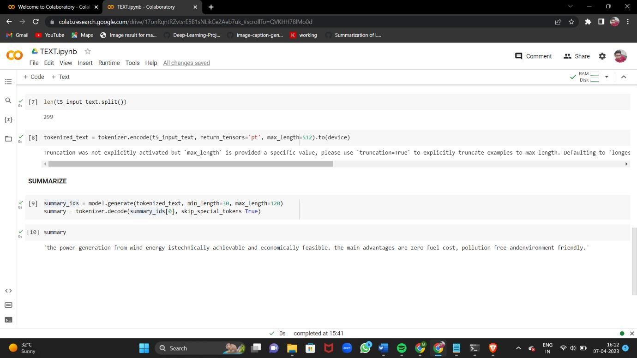
SCREENSHOTS
OUTPUT RESULT OF TEXT SUMMARIZATION

Slide 22
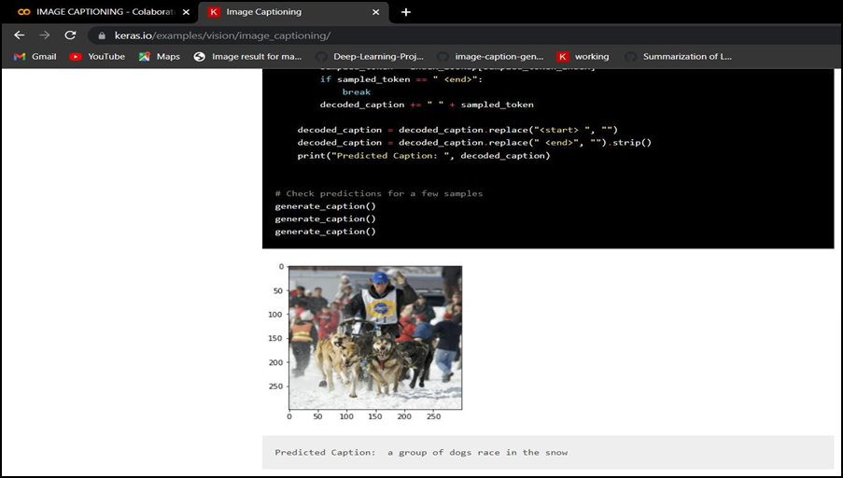
OUTPUT RESULT OF IMAGE CAPTIONING

Slide 23
THANK YOU

