Slide 1

Robin.T.Miller@gmail.com
10 January 2013
Updated May 16th, 2014 to remove NetApp specific information.
DT TOI 2013

Slide 2

Major New Features (for ~last 2 years)
I/O Monitoring (aka no-progress)
DT TOI 2013

Slide 3

IOT Corruption Analysis
Buffer Mode Control
Log File Enhancement
New Trigger Types
Retry Error Options
Restructuring for Multiple Threads
DT TOI 2013

Slide 4

Corruption Analysis Summary
Analyzes IOT Block Data
Side-By-Side Comparison
Corruption Rereads
Corruption Analysis Options
DT TOI 2013

Slide 5

Corruption Analysis (CA) Summary:
Analyzing IOT Record Data: (Note: Block #'s are relative to start of record!)
IOT block size: 512
Total number of blocks: 34 (17408 bytes)
Current IOT seed value: 0x13131313
Previous IOT seed value: 0x12121212
Start of good blocks: 1
Length of good blocks: 15 (7680 bytes)
Good blocks file offset: 122765824 (lba 239777)
Start of corrupted blocks: 16
Length of corrupted blocks: 19 (9728 bytes)
Corrupted blocks file offset: 122773504 (lba 239792)
Number of corrupted blocks: 19
Number of good blocks found: 15
Number of zero blocks found: 0 <- Note: Normally indicates unwritten blocks!
DT TOI 2013

Slide 6

IOT Block Data Example:
File offset: 122765824
Transfer count: 17408 (0x4400)
Read buffer address: 0x90d0000
Pattern base address: 0x90c9000
Prefix string: 'F:\ibmx346-31\nate_test-1612@IBMX346-31'
Prefix length: 44 bytes (0x2c)
Note: Incorrect data is marked with asterisk '*'
Record Block: 15
Record Block offset: 122773504 (lba 239792)
Expected Block Number: 239792 (0x0003a8b0)
Received Block Number: 709552 (0x000ad3b0)
Received data from seed: 0x12121212 (stale data)
DT TOI 2013

Slide 7

Example of Side-By-Side Comparison:
robin-ptc% dt.latest if=/var/tmp/nate_test-1612 bs=17408 count=1 position=122765824 \ prefix="'F:\ibmx346-31\nate_test-1612@IBMX346-31'" pattern=iot iotseed=0x13131313 flags=direct boff=dec dfmt=word dlimit=128
...
Byte Expected: address 0x90cae00 Received: address 0x90d1e00
0000 5c3a4627 786d6269 2d363433 6e5c3133 5c3a4627 786d6269 2d363433 6e5c3133
\ : F ' x m b i - 6 4 3 n \ 1 3 \ : F ' x m b i - 6 4 3 n \ 1 3
0016 5f657461 74736574 3136312d 42494032 5f657461 74736574 3136312d 42494032
_ e t a t s e t 1 6 1 - B I @ 2 _ e t a t s e t 1 6 1 - B I @ 2
0032 3433584d 31332d36 00000027 0003a8b0 * 3433584d 31332d36 00000027 000ad3b0
4 3 X M 1 3 - 6 ' 4 3 X M 1 3 - 6 '
0048 1316bbc3 2629ced6 393ce1e9 4c4ff4fc * 121ce5c2 242ef7d4 364109e6 48531bf8
0064 5f63080f 72761b22 85892e35 989c4148 * 5a652e0a 6c77401c 7e89522e 909b6440
0080 abaf545b bec2676e d1d57a81 e4e88d94 * a2ad7652 b4bf8864 c6d19a76 d8e3ac88
0096 f7fba0a7 0b0eb3ba 1e21c6cd 3134d9e0 * eaf5be9a fd07d0ac 0f19e2be 212bf4d0
0112 4447ecf3 575b0006 6a6e1319 7d81262c * 333e06e2 455018f4 57622b06 69743d18
...
DT TOI 2013

Slide 8

Corruptions are Reread after dumping blocks
dt: Rereading and verifying record data using Direct I/O...
dt: Seeked to block 239777 (0x3a8a1) at byte position 122765824
dt: Record #1 - Reading 17408 bytes (34 blocks) into buffer 0x90d5000, lba's 239777 - 239810 (pos 122765824)
dt: Reread data matches previous data read, possible write failure!
dt: Command line to re-read the corrupted data:
dt: -> ./dt if=/var/tmp/nate_test-1612 bs=17408 count=1 position=122765824 prefix="'F:\ibmx346-31\nate_test-1612@IBMX346-31'" pattern=iot iotseed=0x13131313 flags=direct dlimit=128
  for file systems, rereads are done with Direct I/O
  rereads matching previous read, flag as write failure
  reread data matching expected, flag as read failure
  if reread data matches neither, reported as such
  dt command to manually reread data is reported
DT TOI 2013

Slide 9

Corruption Analysis Options:
  boff=string Set the buffer offsets to: dec or hex (Default: hex)
  dfmt=string Set the data format to: byte or word (Default: word)
  dlimit=value Set the dump data buffer limit. (Default: 512 bytes)
  maxbad=value Set maximum bad blocks to display. (default is 10)
  enable=dumpall Dump all blocks (good and bad). (Default: disabled)
Corruption Reread Options:
  retry_delay=value The retry delay. (Default: 5)
  enable/disable flags:
    looponerror Loop on error. (Default: disabled)
    retryDC Retry data corruptions. (Default: enabled)
  for looponerror, the retry delay is multiplied by the retry count
    so with default delay, read/5 sec delay/reread/10 sec delay, etc
    this increasing reread delay reduces the resulting log file sizes
DT TOI 2013

Slide 10

Purpose is to Improve File System Testing
Creative use of Direct I/O (DIO) feature
Buffer Mode Parameters:
  bufmodes={buffered,unbuffered,cachereads,cachewrites} Sets one or more buffering modes (Default: none)
    buffered = means *no* special flags are added (normal I/O, uses the buffer cache)
    unbuffered = applies Direct I/O (DIO) on both write and read passes (same a flags=direct)
    cachereads = applies DIO flag on write pass only, reads are without DIO so cached
    cachewrites = applies DIO flag on read pass only, writes are without DIO so cached
  Ability to test both buffered and DIO in one invocation
DT TOI 2013

Slide 11

Trigger Types:
  br = Execute a bus reset.
  bdr = Execute a bus device reset.
  lr = Execute a device lun reset.
  seek = Issue a seek to the failing lba.
DT TOI 2013

Slide 12

Retry Related Options:
  retry_error=value The error code to retry.
  retry_delay=value The retry delay. (Def: 5)
  retry_limit=value The retry limit. (Def: 60)
  Error Strings Accepted:
    EIO (5), ENXIO (6), EBUSY (16), ENODEV (19), ESTALE (116)
    OR
    retry_error='*' or -1 to retry all errors.
DT TOI 2013

Slide 13

SCSI Library added to dt!
Automatically Gathers:
  Inquiry Information
    Serial Number
    Device Identifier
    more to come…
DT TOI 2013

Slide 14

SCSI Specific Options:
  sdsf=filename The SCSI device special file.
  scsi_timeout=value The SCSI timeout (in ms). (Def: 0ms)
Flags to enable/disable:
  scsi SCSI operations. (Default: enabled)
  sdebug SCSI debug output. (Default: disabled)
  serrors SCSI error logging. (Default: disabled)
DT TOI 2013

Slide 15
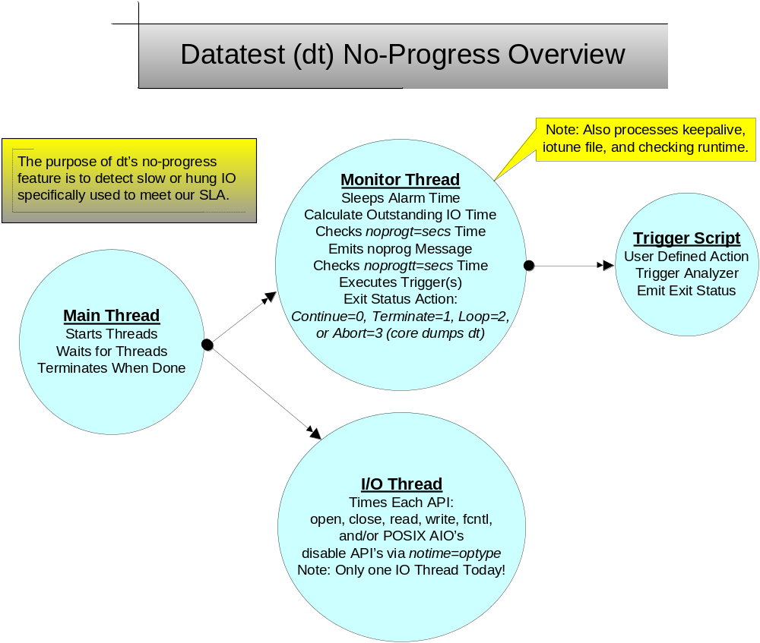
DT TOI 2013

Slide 16

The options added to support this feature are:
  noprogt=value - The time in seconds when to report no progress.
  noprogtt= value - The time in seconds when to execute trigger script.
  alarm=value - The time in seconds when to check for no progress.
  trigger=cmd:script - The (optional) trigger script to execute.
  enable=tdebug - Enable timer debug (added to recent versions).
  notime=optype - Disable timing of specified operation type:
    Valid operation types are:
      open close read write ioctl fsync msync aiowait
  add “notime=fsync” to avoid timing multiple buffer cache writes
DT TOI 2013

Slide 17

For each I/O Operation Time via:
if (dip->di_noprog_flag &&
optiming_table[READ_OP].opt_timing_flag) {
dip->di_optype = READ_OP;
dip->di_initiated_time = time((time_t *)0);
}
#if defined(WIN32)
if (!ReadFile(dip->di_fd, buffer, bsize, &count, NULL)) {
count = FAILURE;
}
#else /* !defined(WIN32) */
count = read(dip->di_fd, buffer, bsize);
#endif /* defined(WIN32) */
if (dip->di_noprog_flag) {
dip->di_optype = NONE_OP;
dip->di_initiated_time = (time_t) 0;
}
DT TOI 2013

Slide 18

Example I/O Monitoring Output
X:\SAN\bin\common\dt.staging\dt.exe of=H:\wshex3550-47\nate_test limit=1500m oncerr=abort disable=pstats notime=fsync,close oflags=trunc errors=1 procs=1 incr=var min=2k max=256k dispose=keep pattern=iot prefix='%d@%h' iotype=random keepalivet=300 keepalive="300SecKeepAliveMsg##%h@%d##PassCount:%p##IOMode:%i##TotalTestTime:%T##PassTestTime:%t##BlocksTransferred:%l##RecordsRead:%r##RecordsWritten:%w##KBsPerSecond:%kbps##IOsPerSecond:%iops" enable=noprog noprogt=15s noprogtt=10000 alarm=3s trigger="cmd:c:\\spt\\spt.bat" history=3 enable=syslog history=3 enable=syslog hdsize=128 stopon=%TEMP%\\1357307958.dt enable=deleteperpass flags=direct runtime=2592000
…
dt.exe (1136): No progress made for record 28897 (lba 2298042, offset 1176597504) during read() on H:\wshex3550-47\nate_test-1136 for 16 seconds!
…
[ Note: This trigger script was kicked off as the result of a read failure! ]
dt.exe (1136): Executing: c:\spt\spt.bat H:\wshex3550-47\nate_test-1136 read 512 1176597504 0 2298042 170 0
DT TOI 2013

