Slide 1

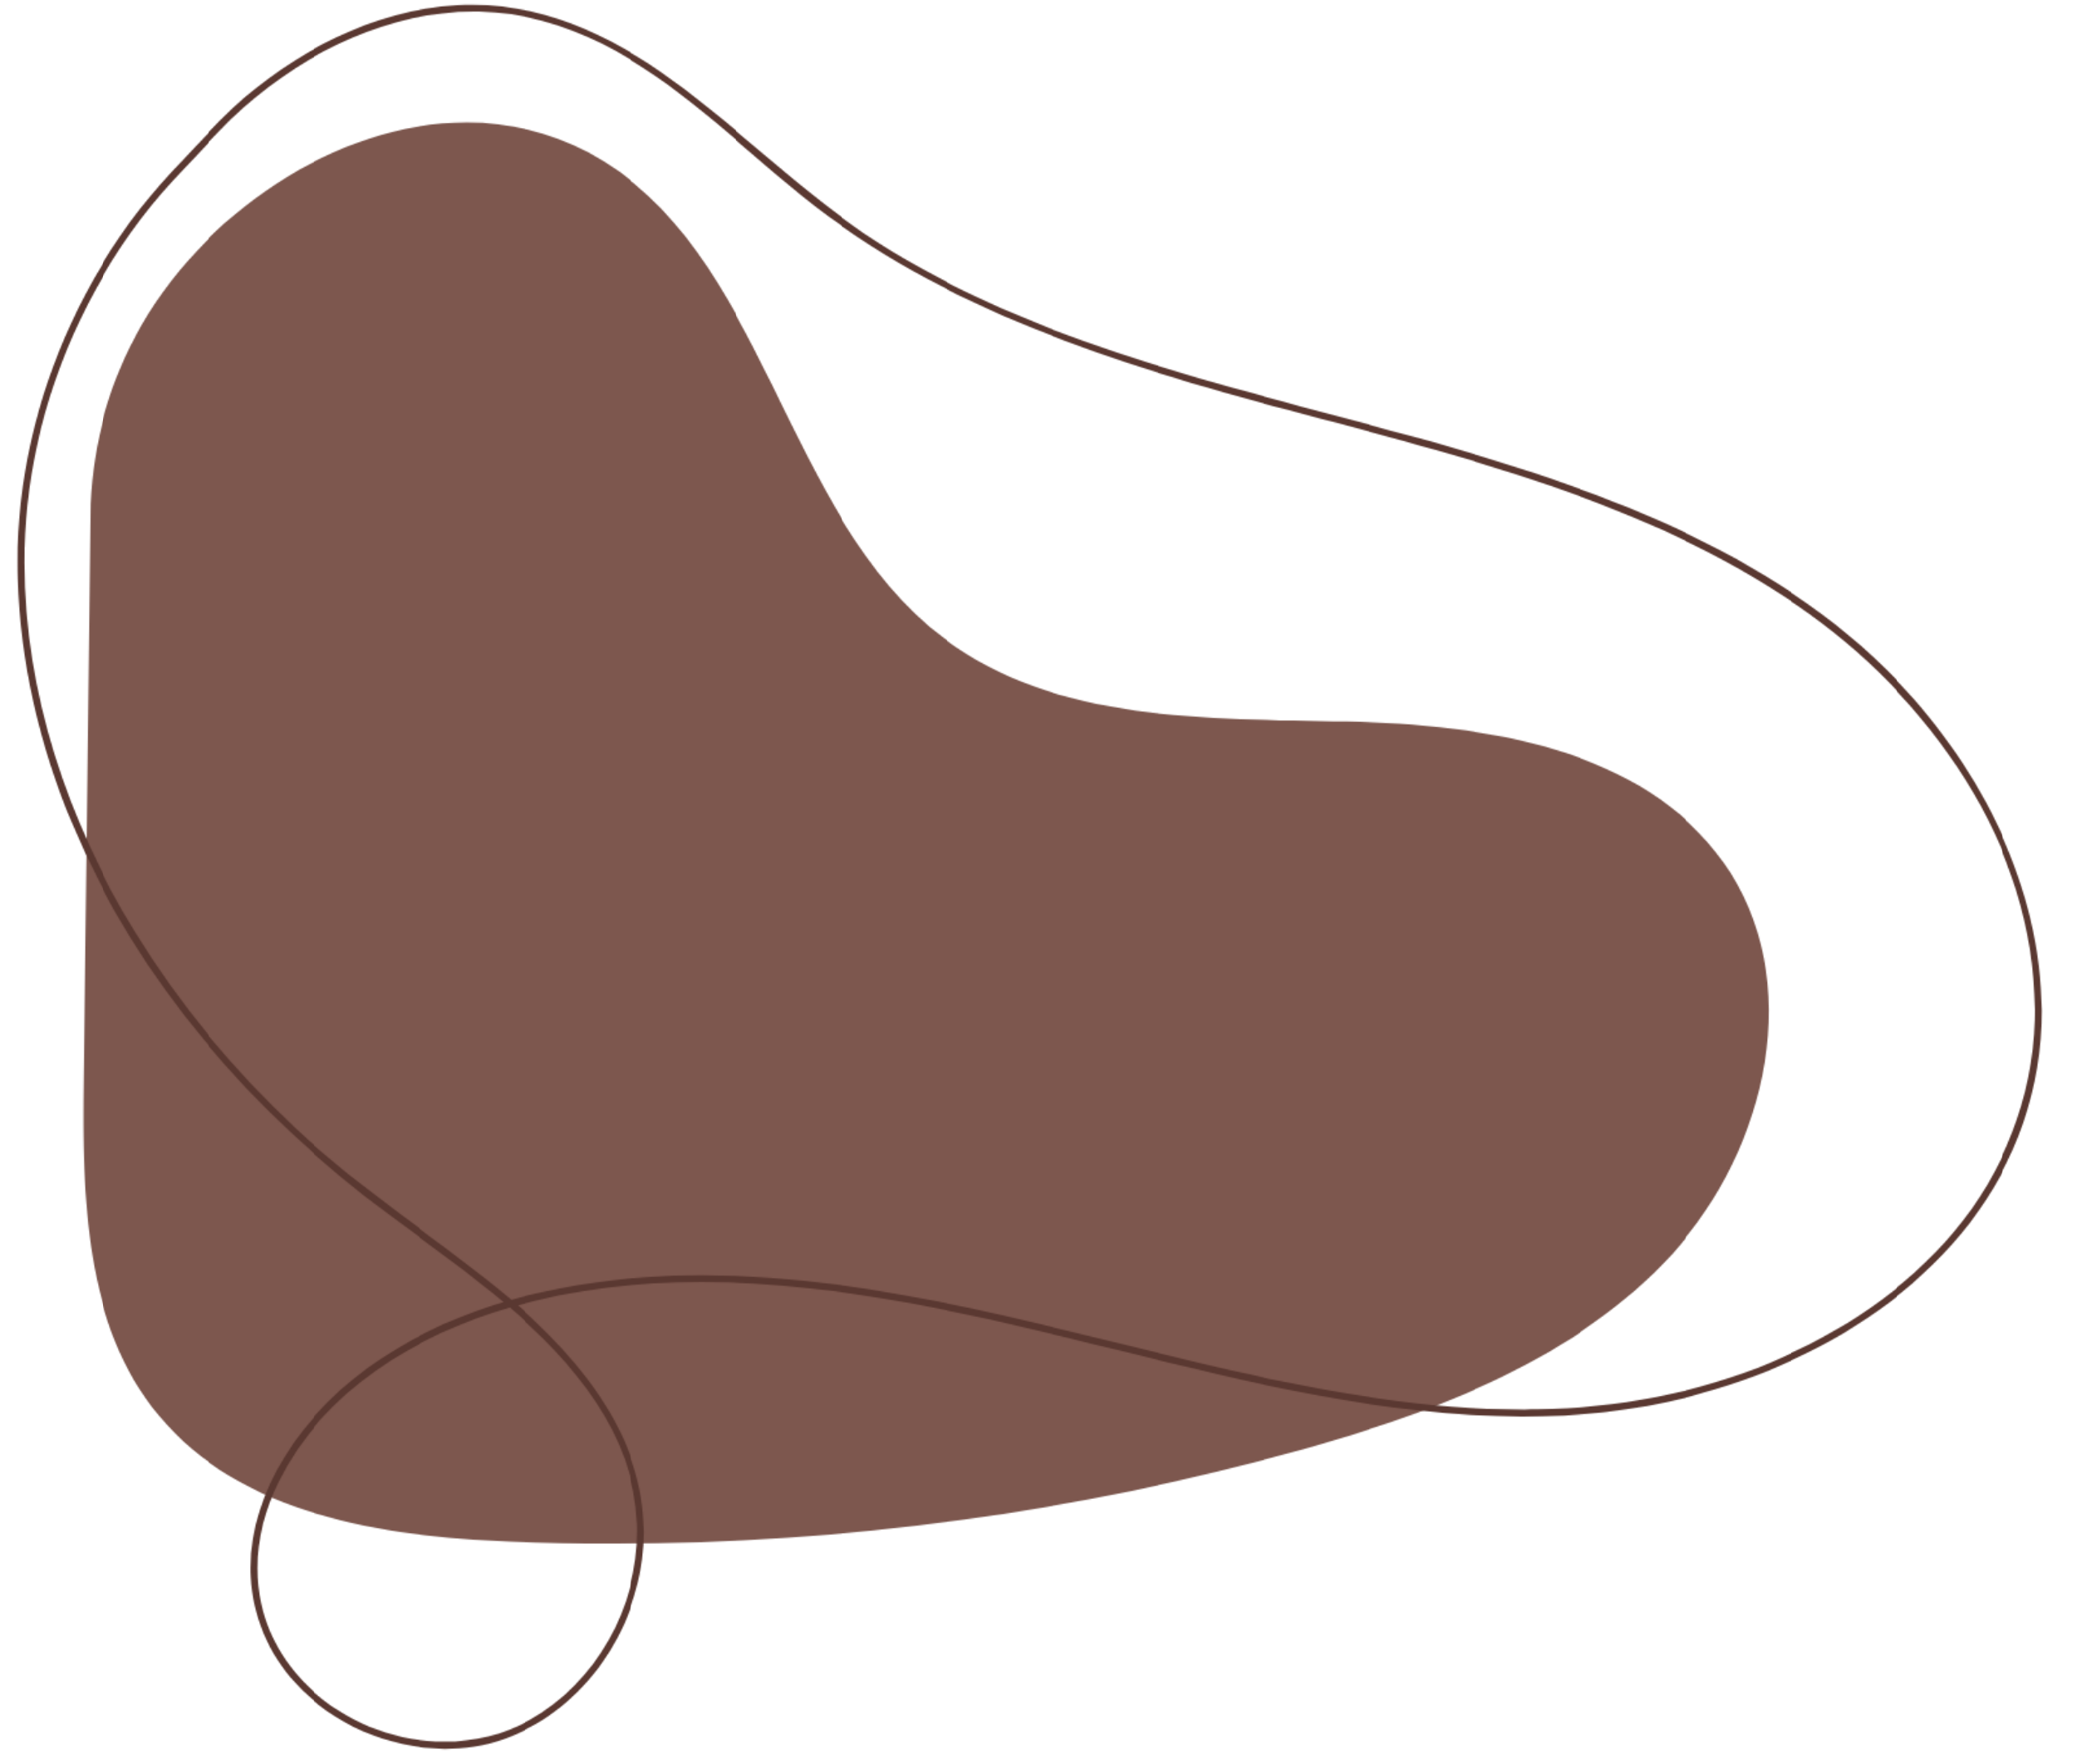






Digital Portfolio
STUDENT NAME: PURUSHOTHAMAN.E
REGISTER NO: asunm1397222405969
NMID: 1CBD96DB58C9382BCF640AE950A5CB42
DEPARTMENT: B.SC COMPUTER SCIENCE
COLLEGE: SRM ARTS AND SCIENCE COLLEGE
UNIVERSITY: MADRAS UNIVERSITY

Slide 2
Project Title
Digital Portfolio

Slide 3
Agenda
1.Problem Statement
2.Project Overview
3.End Users
4.Tools and Technologies
5.Portfolio design and Layout
6.Features and Functionality
7.Results and Screenshots
8.Conclusion
9.Github Link

Slide 4
Problem Statement
In today’s competitive world, having only a resume is not enough to showcase skillsand achievements.Many students and professionals struggle to present their projects in an attractive way.Traditional resumes fail to highlight creativity and technical abilities effectively.A well-structured portfolio can act as a digital identity for individuals.The problem is the lack of a simple and professional solution for this need.This project focuses on solving that by creating a portfolio website.It helps individuals stand out and create a better impression.

Slide 5
Project Overview
The project aims to design and develop a personalportfolio website using web technologies. The portfolioThis project is about designing and developing a personal portfolio website.It acts as a one-stop platform to display skills, education, and achievements.highlights a user’s personal details, skills, education, andThe website is user-friendly and can be accessed anytime, anywhere.projects in an organized format. It focuses on creating aIt is designed with a professional layout to catch the attention of recruiters.clean layout that is both attractive and easy to navigate.Different sections are included for About Me, Skills, and Projects.HTML, CSS, and JavaScript are used to structure, style,The aim is to give users a digital space to highlight their work.and add interactivity. The final product provides anIt combines design, functionality, and accessibility in one platform.

Slide 6
Who are the End Users?
The main users of this portfolio project are students, graduates,The primary users are students who want to showcase their work to recruiters.and job seekers who want to showcase their achievements online.Job seekers can use it to highlight their experience and skills effectively.It is also useful for freelancers and professionals to display theirFreelancers can use the portfolio to attract clients by showing past work.services and completed works. Employers and recruiters benefitRecruiters and employers can access portfolios to evaluate candidates easily.from accessing candidate information quickly and clearly.Teachers and institutions may also encourage students to use such platforms.Overall, it connects talent with opportunities in a professional manner.Institutions can encourage learners to create digital portfolios asIt benefits both the candidate and the evaluator equally.part of skill development. Thus, the portfolio serves multiple

Slide 7
Tools and Techniques
This project uses fundamental web development tools andtechnologies. HTML provides the structure of the website, while CSSis applied for design and styling. JavaScript is included to addinteractive elements and improve functionality. Coding is carried outusing a text editor such as Visual Studio Code. GitHub is used forhosting and sharing the project online. Browser developer tools assistin testing and debugging the final design.

Slide 8
DESIGN AND LAYOUT
The portfolio is designed with a clean, modern, and minimal layout.It has sections such as Home, About, Skills, Projects, and Contact.It has sections such as Home, About, Skills, Projects, and Contact.Navigation is smooth with menus and quick links for easy access.Navigation is smooth with menus and quick links for easy access.The color scheme and fonts are chosen to look professional.The color scheme and fonts are chosen to look professional.The design is fully responsive, working well on both mobiles andThe design is fully responsive, working well on both mobiles andlaptops.laptops.Images, icons, and project cards make the design moreImages, icons, and project cards make the design more attractive.attractive.The layout focuses on clarity, simplicity, and readability.The layout focuses on clarity, simplicity, and readability.

Slide 9
Features and Functionality
The website highlights personal information, skills, and projectsupports responsive design, so it looks perfect on any device.showcases. contact form is included to connect with visitors or recruiters.It supports responsive design, so it looks perfect on any device.It has smooth navigation for an easy user experience.A contact form is included to connect with visitors or recruiters.Links to GitHub, LinkedIn, or other platforms are integrated.It has smooth navigation for an easy user experience.Users can view live project demos through provided links.Links to GitHub, LinkedIn, or other platforms are integrated.Overall, the site balances design with real functionality.Users can view live project demos through provided links.Overall, the site balances design with real functionality.

Slide 10
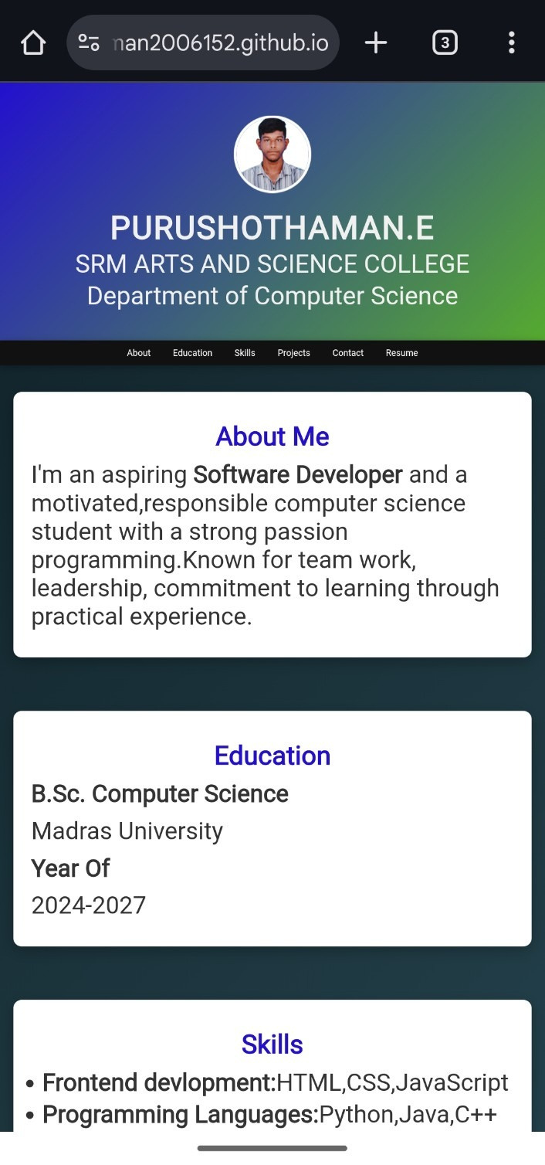
Result and Screenshots
The final portfolio website is fully functional and responsive.
Screenshots show different types of Home,About and projects.

Slide 11
Conclusion
The project successfully solves the problem of professionalpresentation.The project successfully solves the problem of professional presentatioIt creates a strong online presence for students and professionals.It creates a strong online presence for students and professionals.The portfolio is easy to use, well-designed, and highly responsive.The portfolio is easy to use, well-designed, and highly responsive.It helps in personal branding and career growth opportunities.It helps in personal branding and career growth opportunities.The design and tools used make it simple yet powerful.The design and tools used make it simple yet powerful.Future improvements can include adding animations or blogs.Future improvements can include adding animations or blogs.It shows the importance of a digital portfolio in today’s world.It shows the importance of a digital portfolio in today’s world.

Slide 12
GitHub Link
https://purushothaman2006152.github.io/purushothaman_portfolio/

Slide 13
Thank You

