Slide 1
Digital Portfolio
STUDENT NAME: PURUSHOTHAMAN.S
REGISTER NO AND NMID:1AA6949B856D796BC4A415D882360A86
DEPARTMENT: B.SC COMPUTER SCIENCE.
COLLEGE: Apollo Arts And Science College Chennai /
MADRAS UNIVERSITY

Slide 2
PROJECT TITLE
PERSONAL PORTFOLIO WEBSITE USING FRONT-END DEVELOPMENT

Slide 3


AGENDA
Problem Statement
Project Overview
End Users
Tools and Technologies
Portfolio design and Layout
Features and Functionality
Results and Screenshots
Conclusion
Github Link
3/21/2024 Annual Review

Slide 4

PROBLEM STATEMENT
Students often struggle to stand out with onlytraditional resumes.
Recruiters need a way to see creativity + coding skills in action.
Solution: A portfolio website that demonstrates design,responsiveness, and projects with futuristic vision.

Slide 5

PROJECT OVERVIEW
This project is a modern portfolio site built to:
Introduce myself as an aspiring web developer.
Showcase my skills and unique projects.
Provide a contact channel for communication.
Reflect my career journey and goals.

Slide 6

WHO ARE THE END USERS?
Recruiters - to measure skills and coding abilities.
Faculty - for project evaluation & academic use.
Tech Community - to explore my projects and open-source work.

Slide 7

TOOLS AND TECHNIQUES
HTML, CSS, JavaScript - for Layout & interactivity.
Responsive Web Design - for accessibility.
Creative Typography & Icons - to make it engaging.
CodePen/GitHub - for hosting.
Front end development – accessible and clean design.

Slide 8
PORTFOLIO DESIGN AND LAYOUT
Hero Section - name, tagline, and CTA button.
About Me - simple intro as an aspiring developer.
Projects Section :
Nove Nest - "Innovating tomorrow, one Line of code at a time.“
Code Current - "Where ideas flow into intelligent solutions.“
Skyware - "Cloud-native, future-focused development.“
Contact Section - form for direct communication
8

Slide 9
FEATURES AND FUNCTIONALITY
Responsive design for all devices.
Clean UI with gradient theme.
Project showcase with creative branding.
Contact form for easy communication.
Designed to highlight both skills & vision.

Slide 10
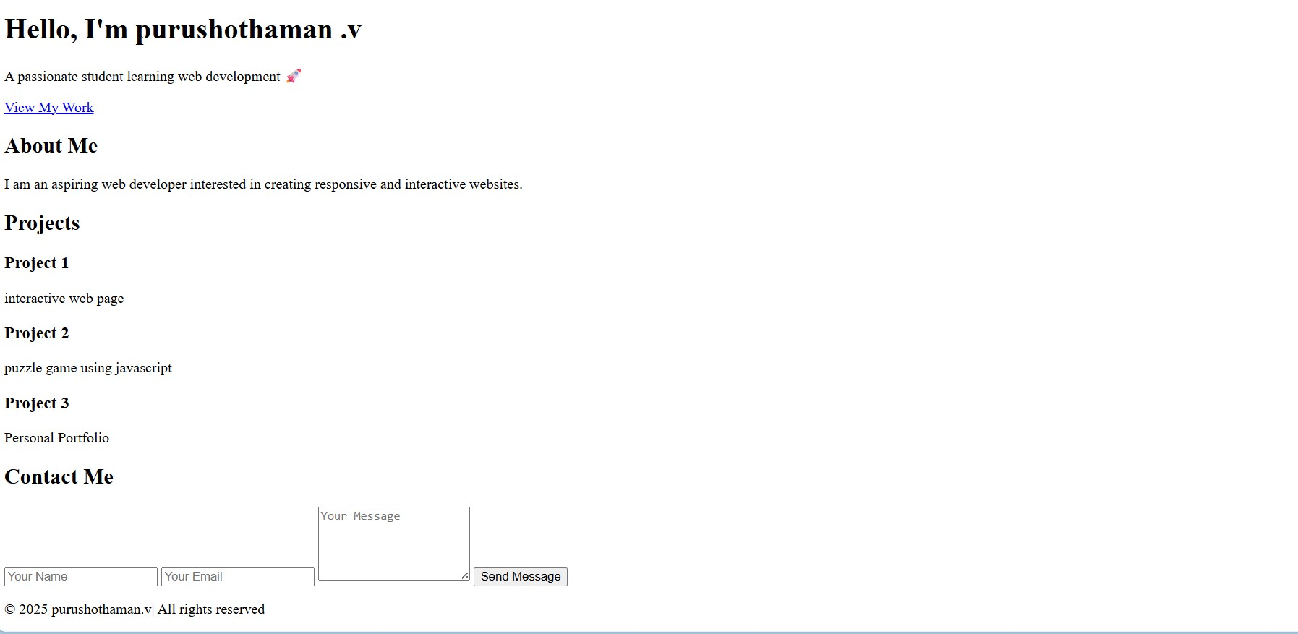
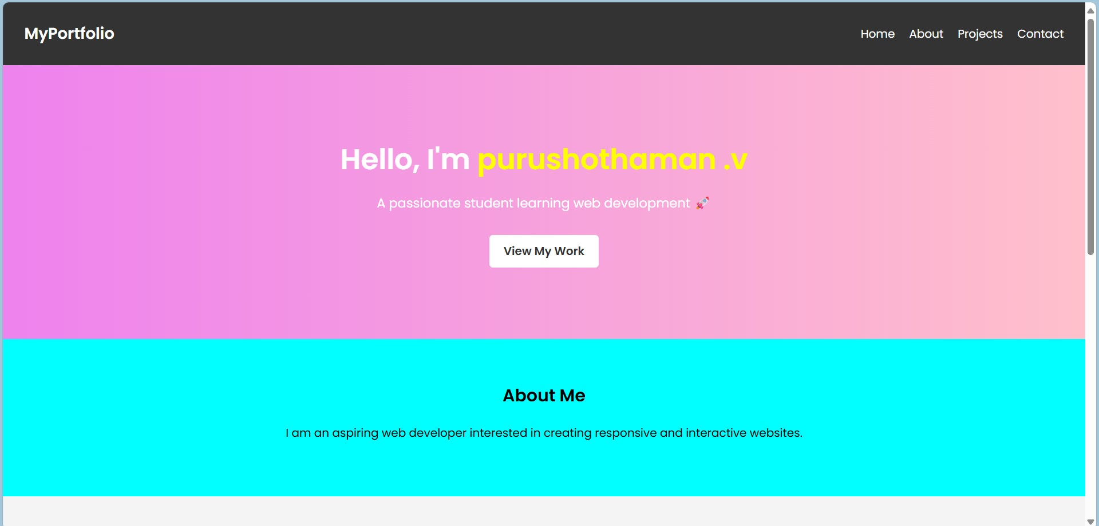
RESULTS AND SCREENSHOTS
BEFORE ADDING CSS : AFTER ADDING CSS:
3/21/2024 Annual Review
10

Slide 11
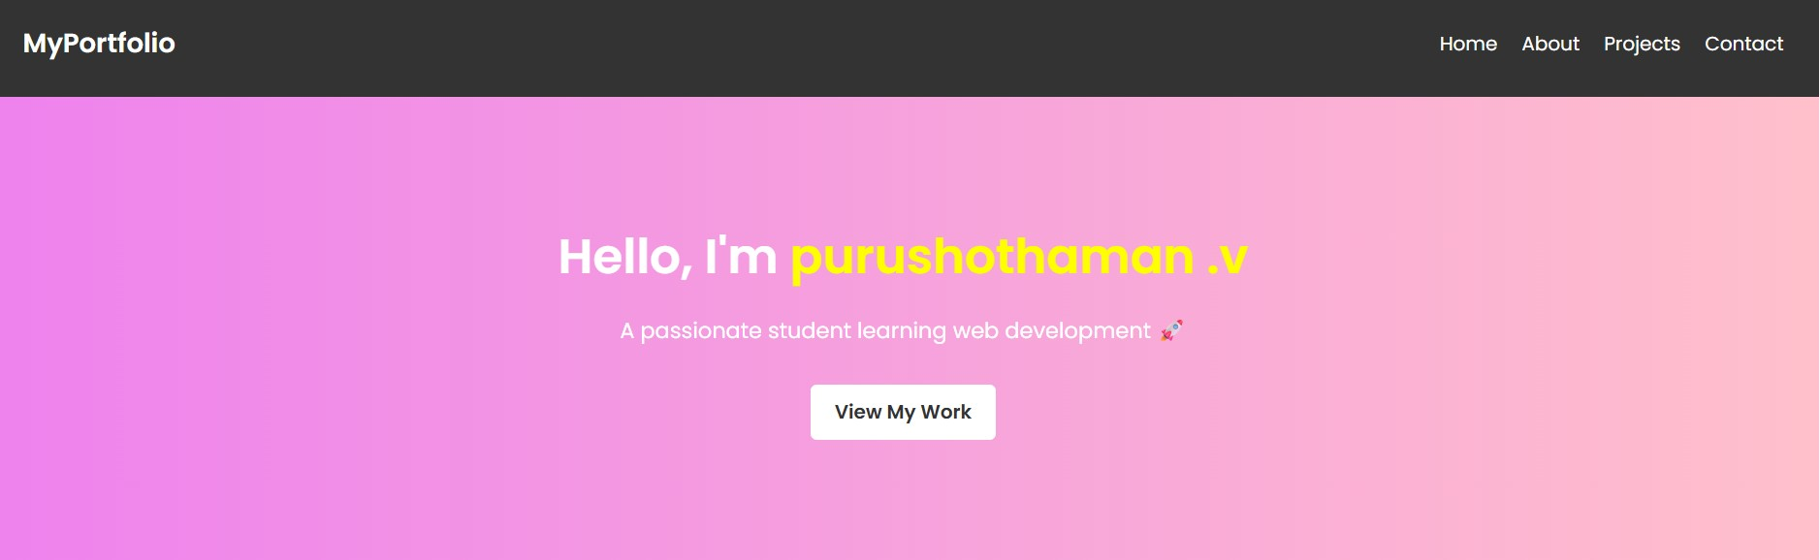
HOME SECTION:

Slide 12

ABOUT SECTION

Slide 13
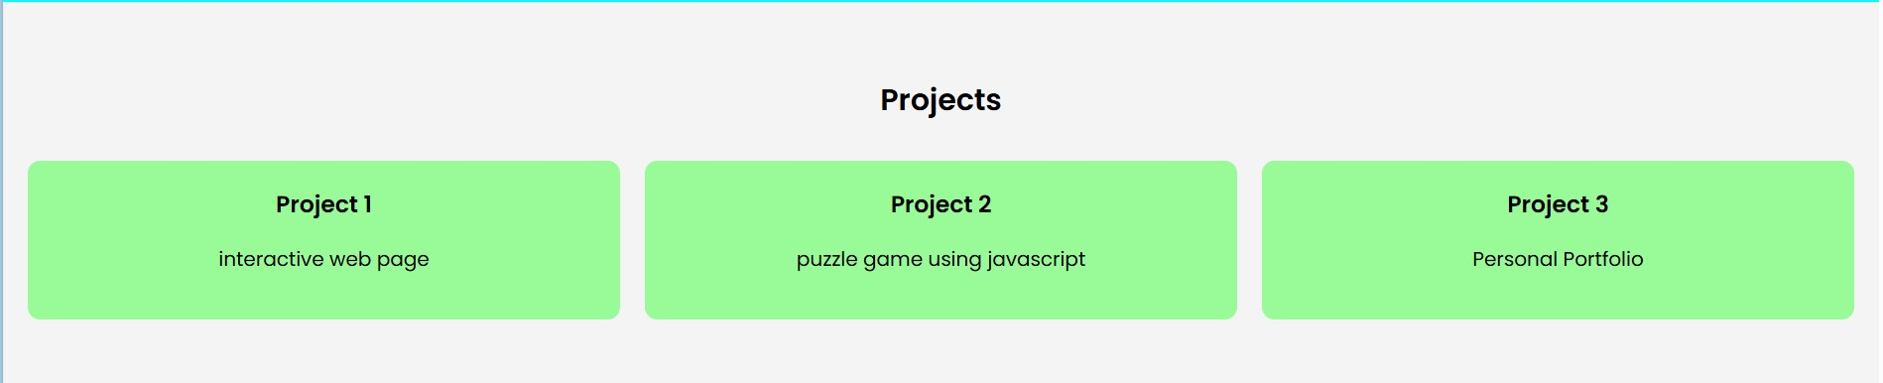
PROJECT SECTION:

Slide 14

CONTACT SECTION:

Slide 15
CONCLUSION
Designed a portfolio emphasizing Python, C++ & Web DeveLopment.
Combines academic learning with practical project building.
Future scope: Add advanced apps, certifications, and live project demos.
15

Slide 16
GITHUB LINK:
https://purushothbsc24aascc-star.github.io/TNSDC-FWD-DIGITALPORTFOLIO-/

