Slide 1
TMI/TMLI Patient Simulation and planning Detail
Additional file: Preclinical validation and treatment of Volumetric Modulated Arc Therapy Based Total Bone Marrow Irradiation in Halcyon™ Ring Gantry Linear Accelerator.

Slide 2
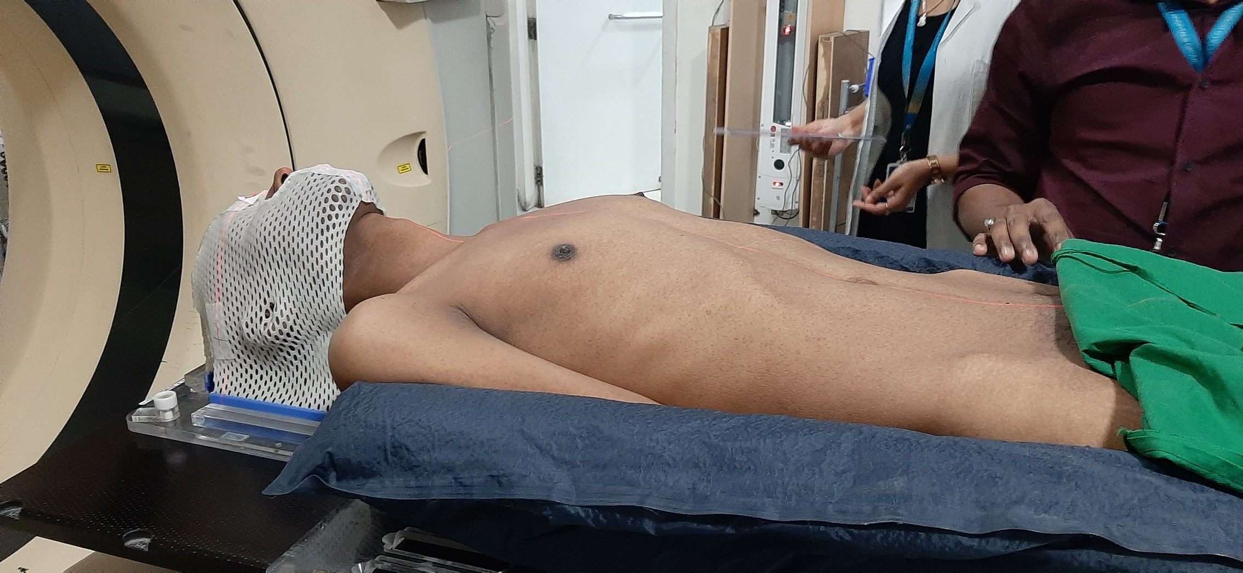
Simulation: Lean patient

Slide 3
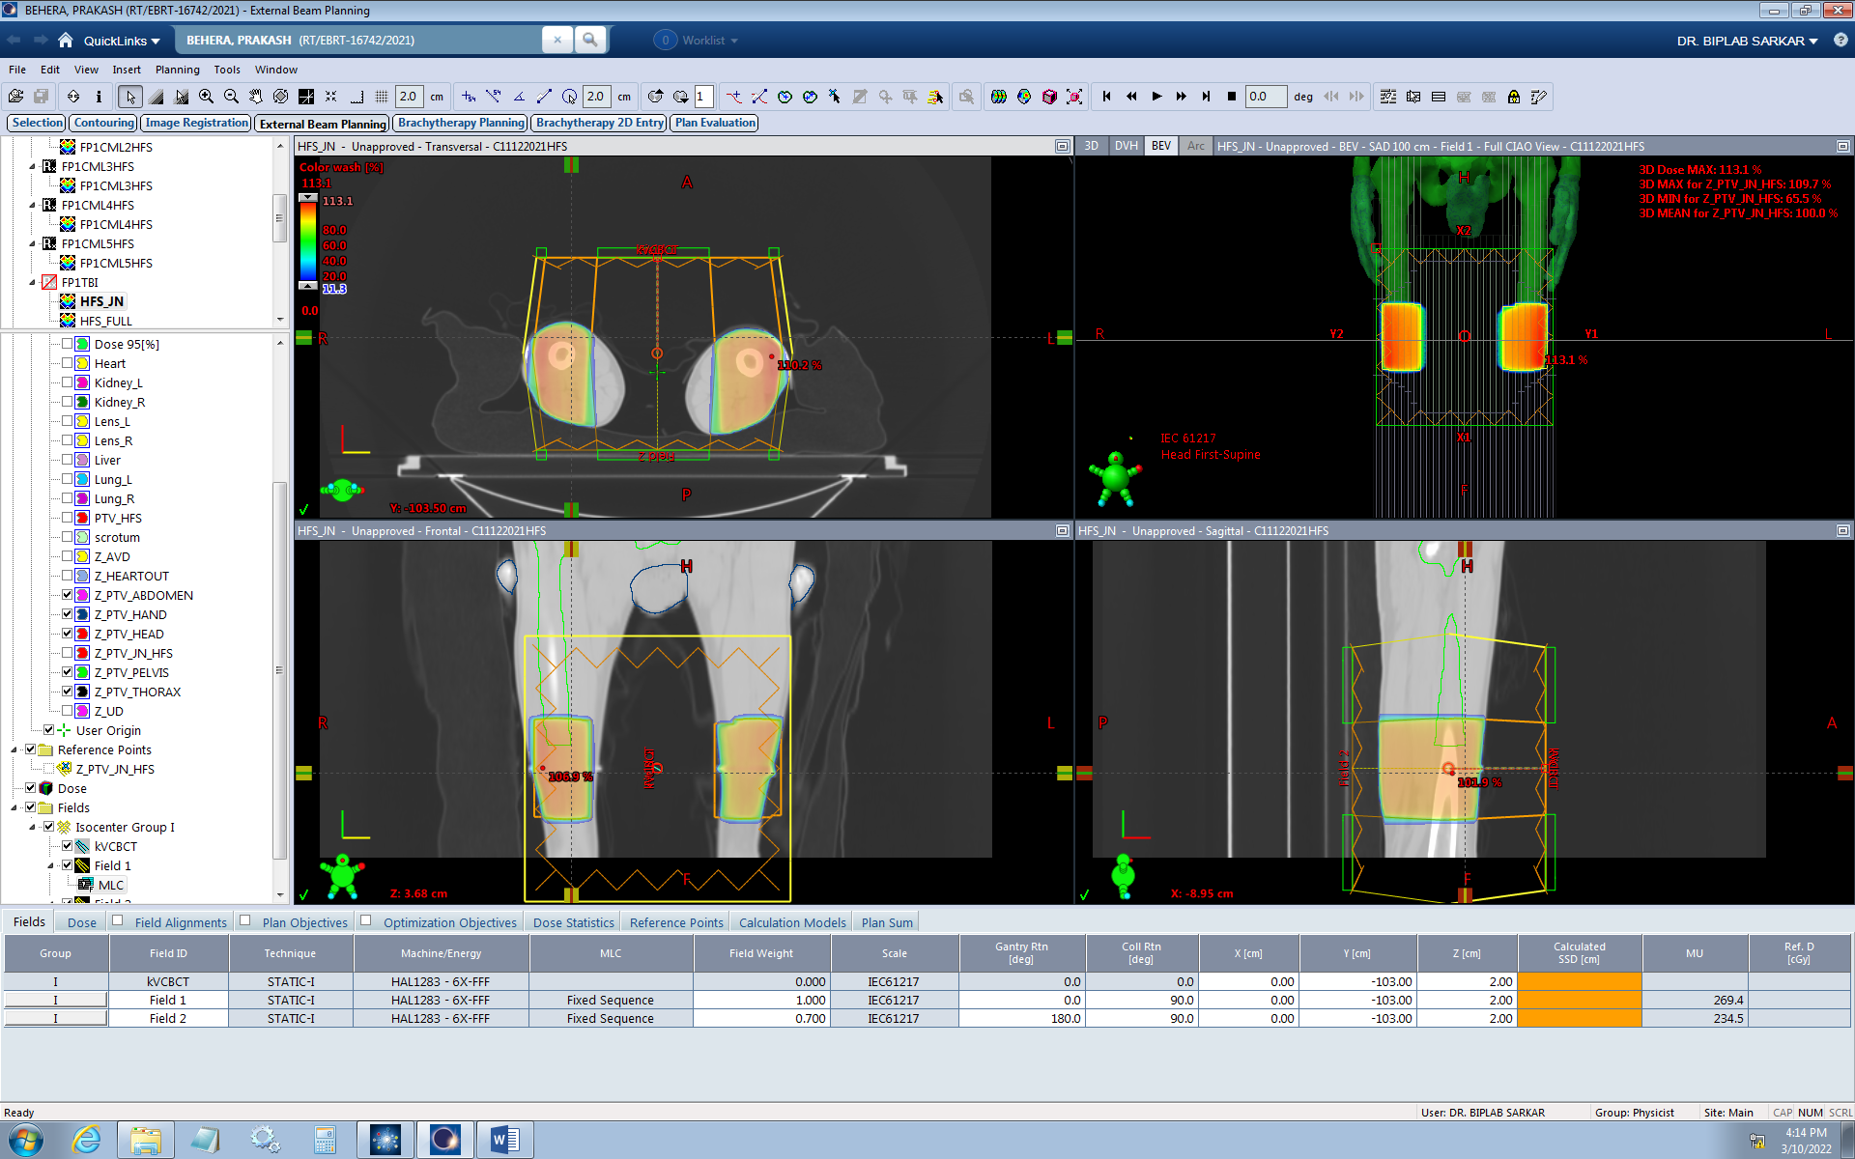
Junction Plan Junction Contour, and AP-PA open Beam Plan in HFS CT Set ,
Element-1

Slide 4
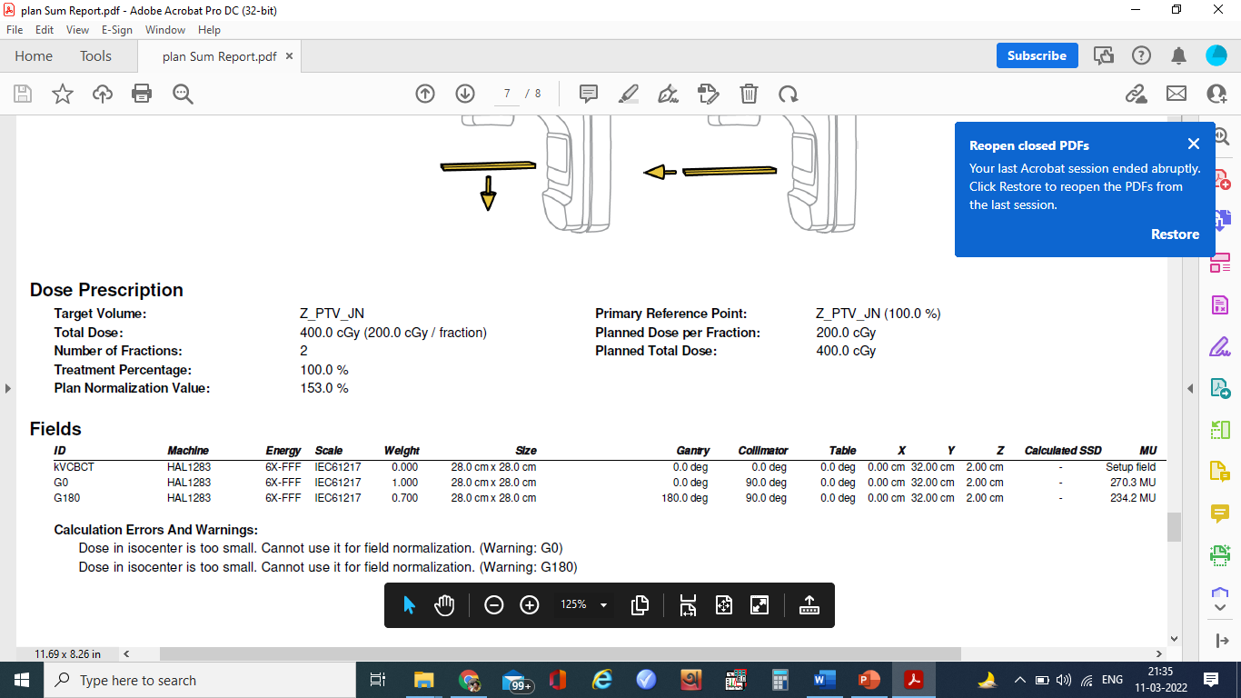
Beam Arrangement for Junction Contour and MU

Slide 5
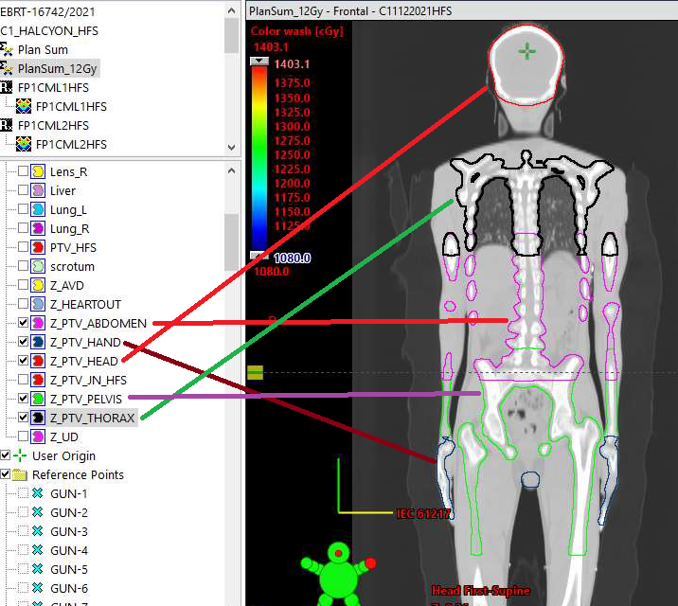
HFS Plan
Creation of PTV segments for ease of optimization and better control over dose build-up during optimization over each PTV segment.

Slide 6
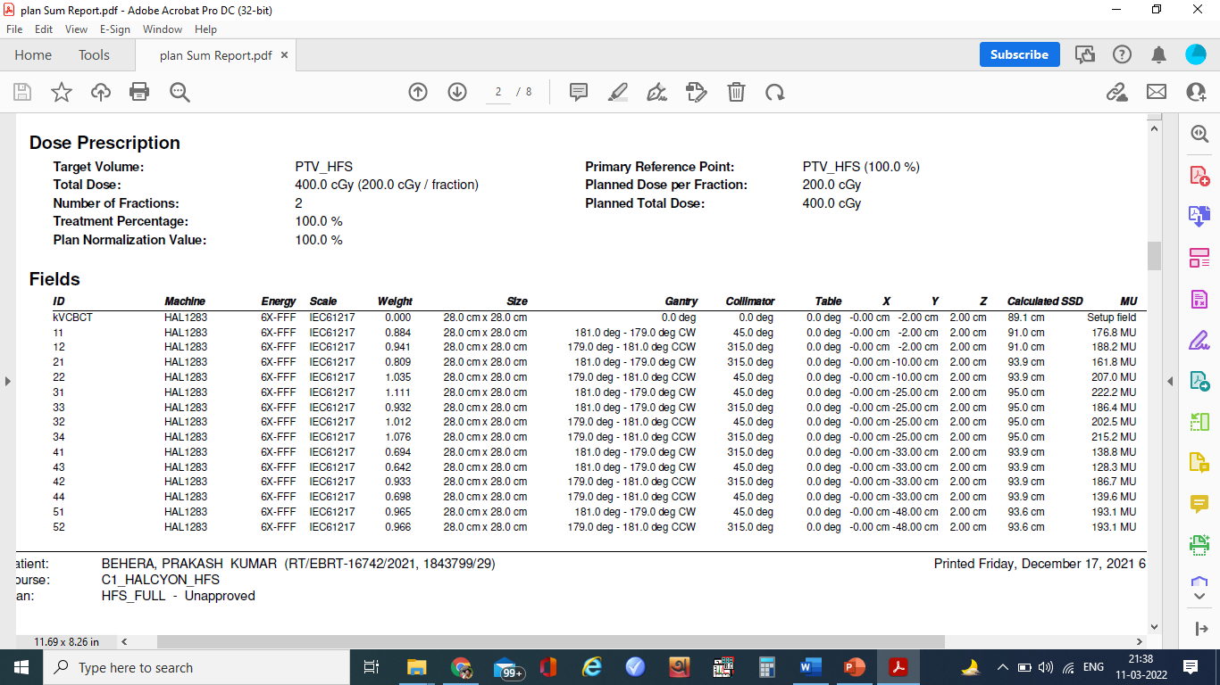
Beam Arrangement and MU _HFS 1 of 2

Slide 7
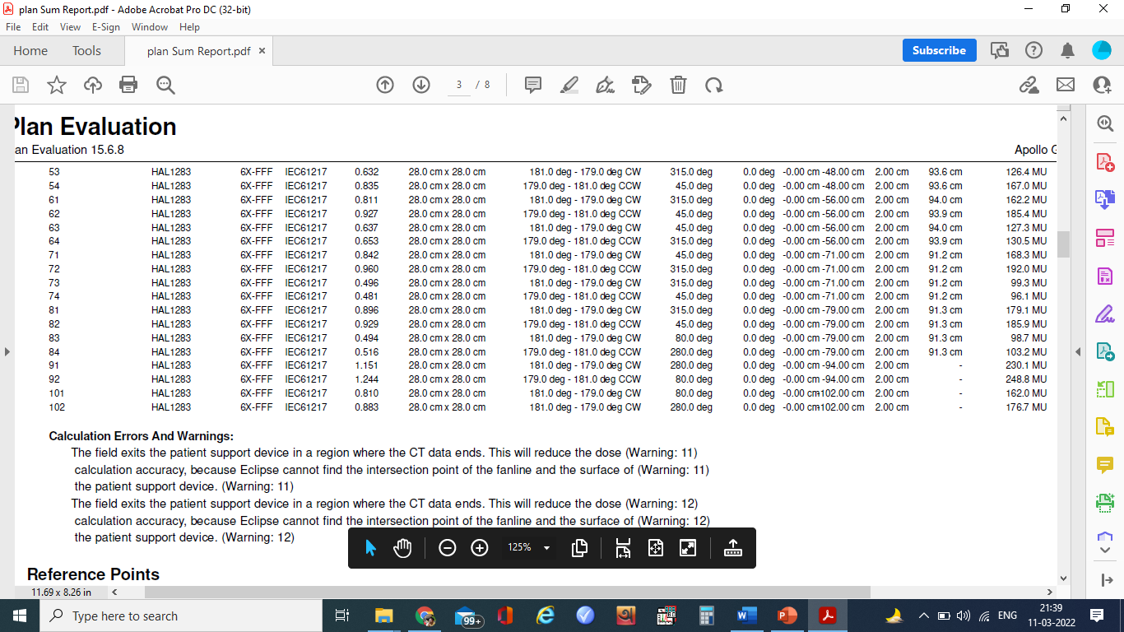
Beam Arrangement and MU _HFS 2 of 2

Slide 8
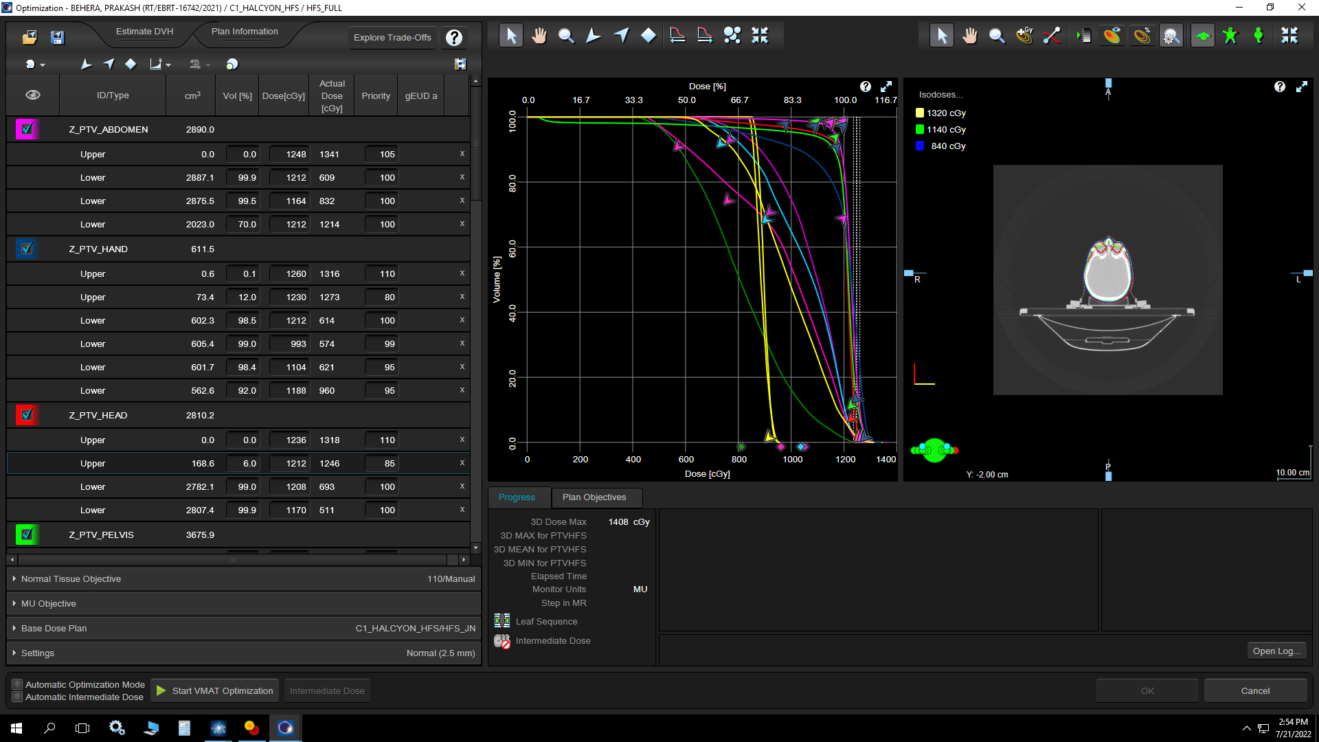
HFS
Optimization Parameters Set -1 of 4

Slide 9
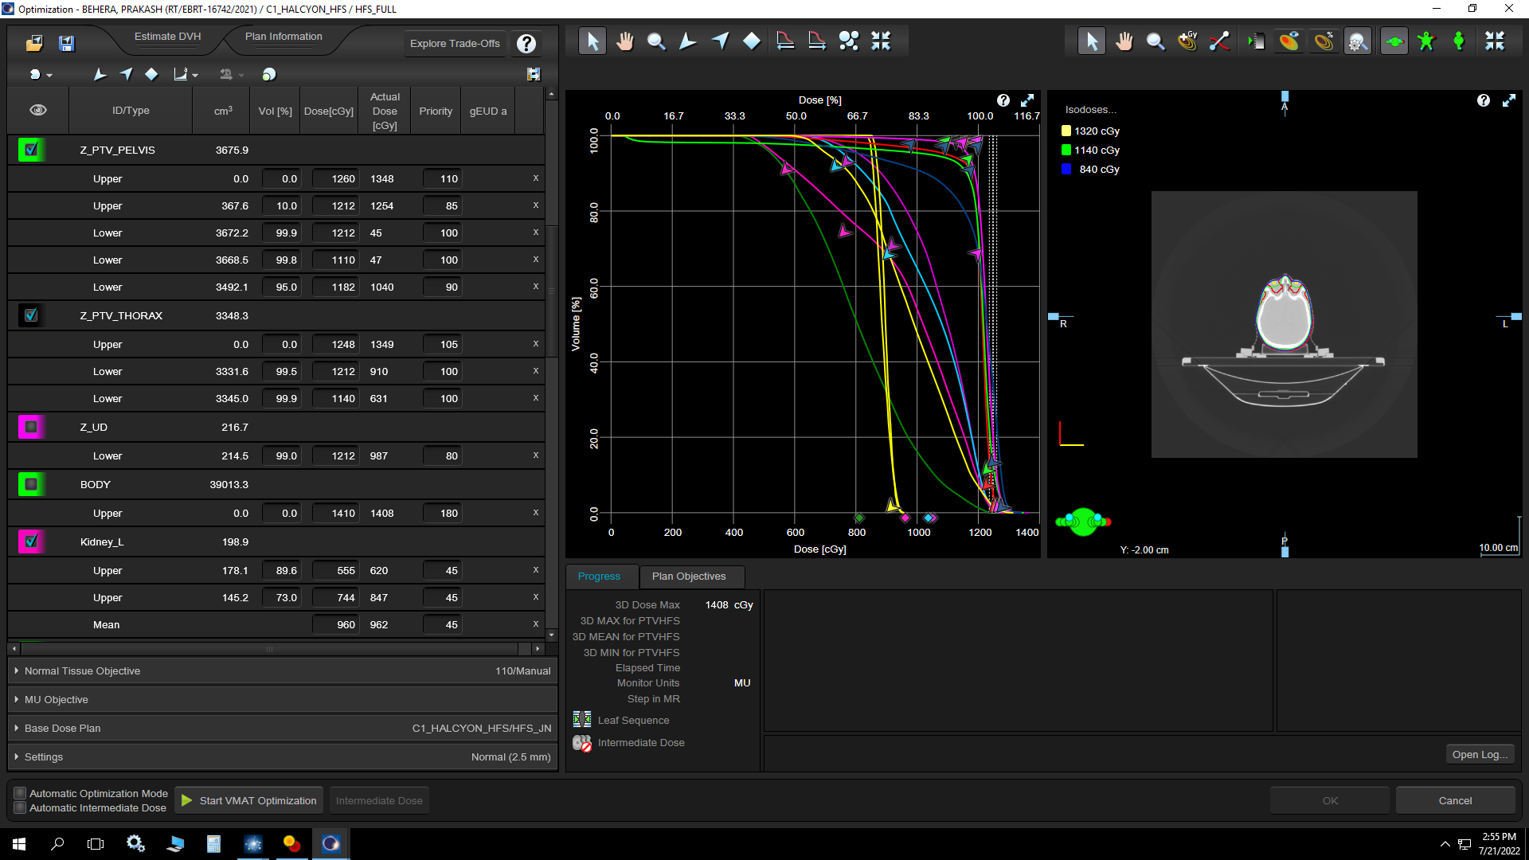
HFS
Optimization Parameters Set -2 of 4

Slide 10
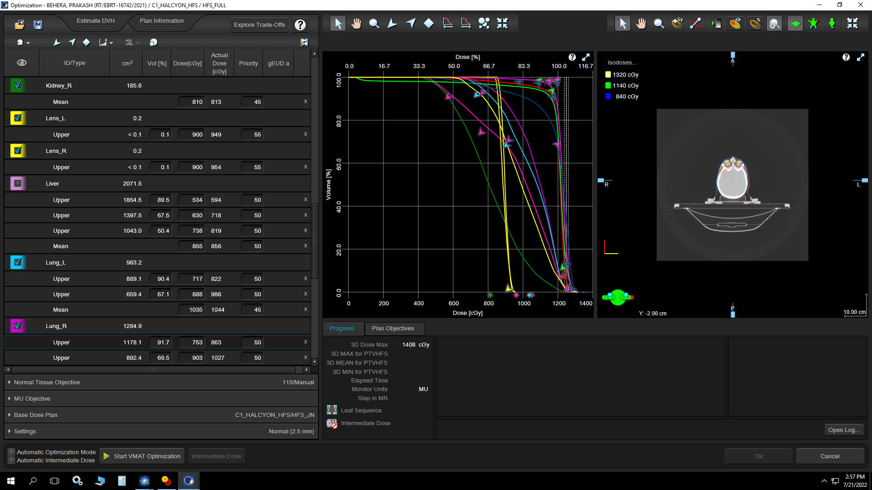
HFS
Optimization Parameters Set -3 of 4

Slide 11
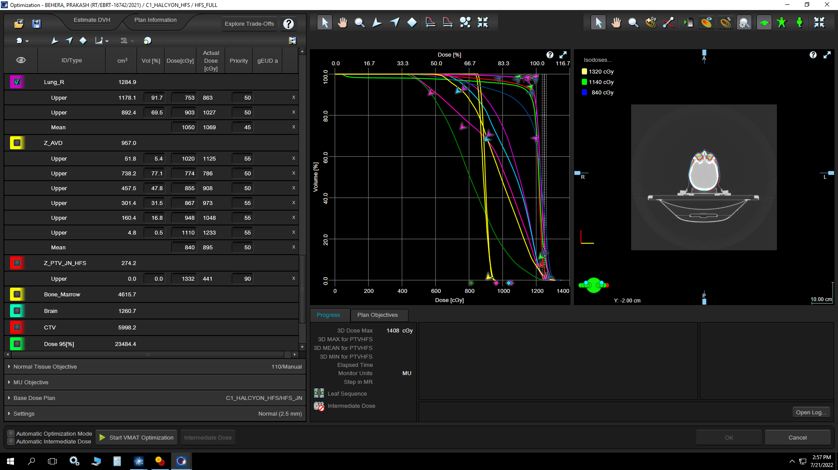
HFS
Optimization Parameters Set -4 of 4

Slide 12
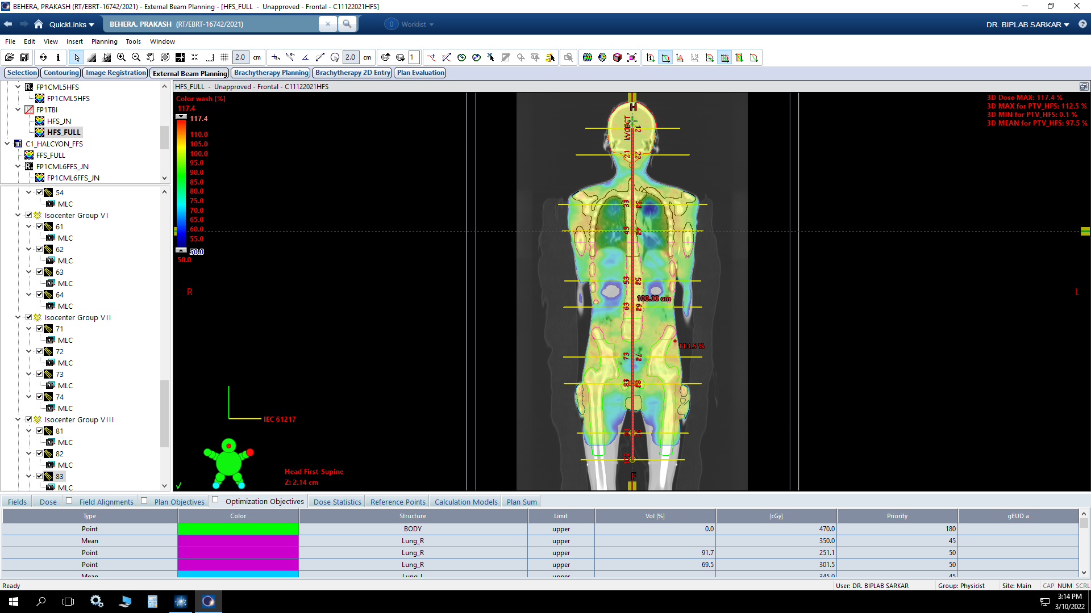
Isocentre placement and Dose Distribution (coronal)-HFS Element-2

Slide 13
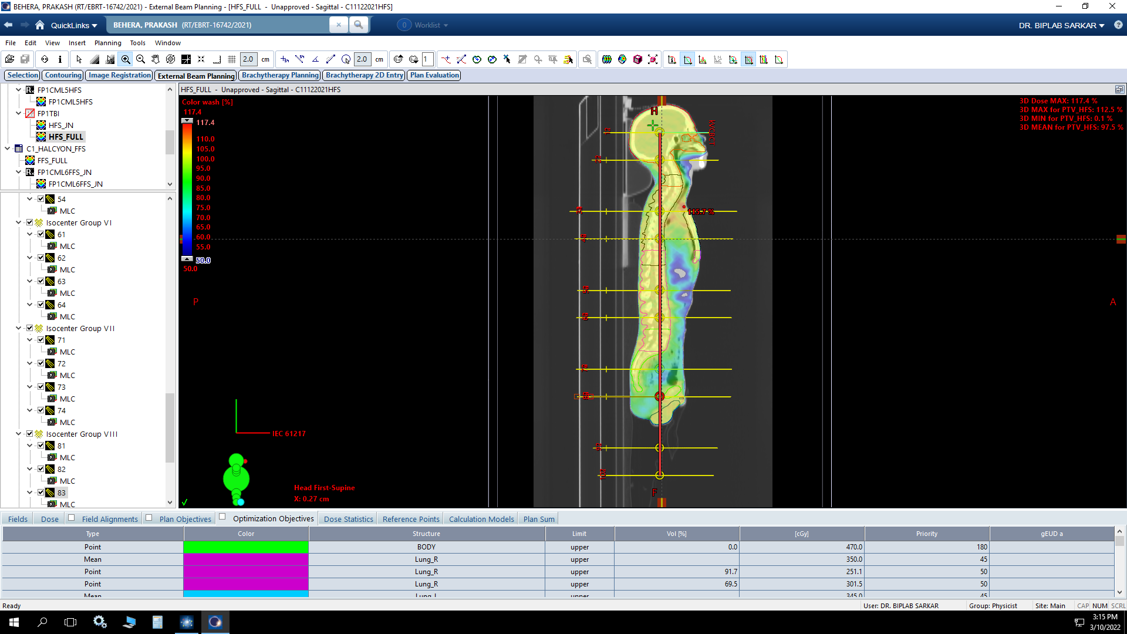
Isocentre placement and Dose Distribution (Sagittal)-HFS

Slide 14
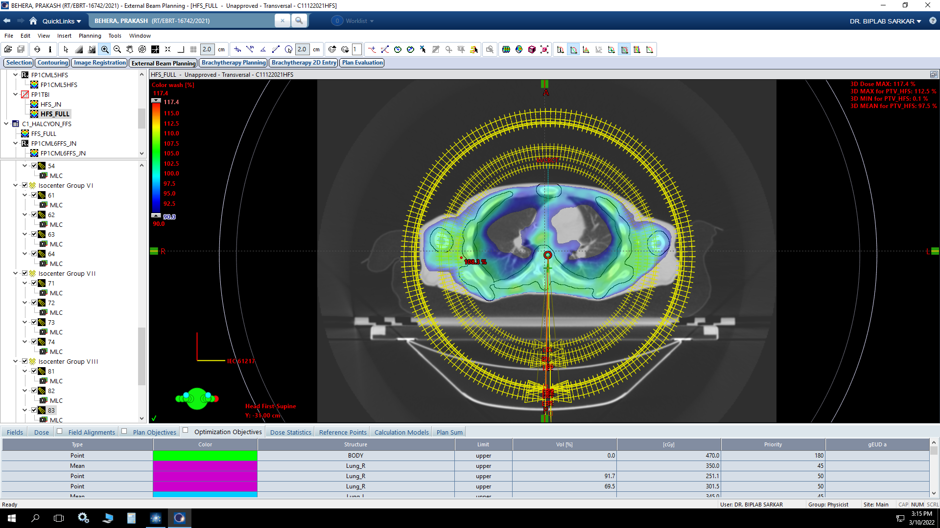
Arcs and Dose Distribution (Axial)- HFS CT

Slide 15
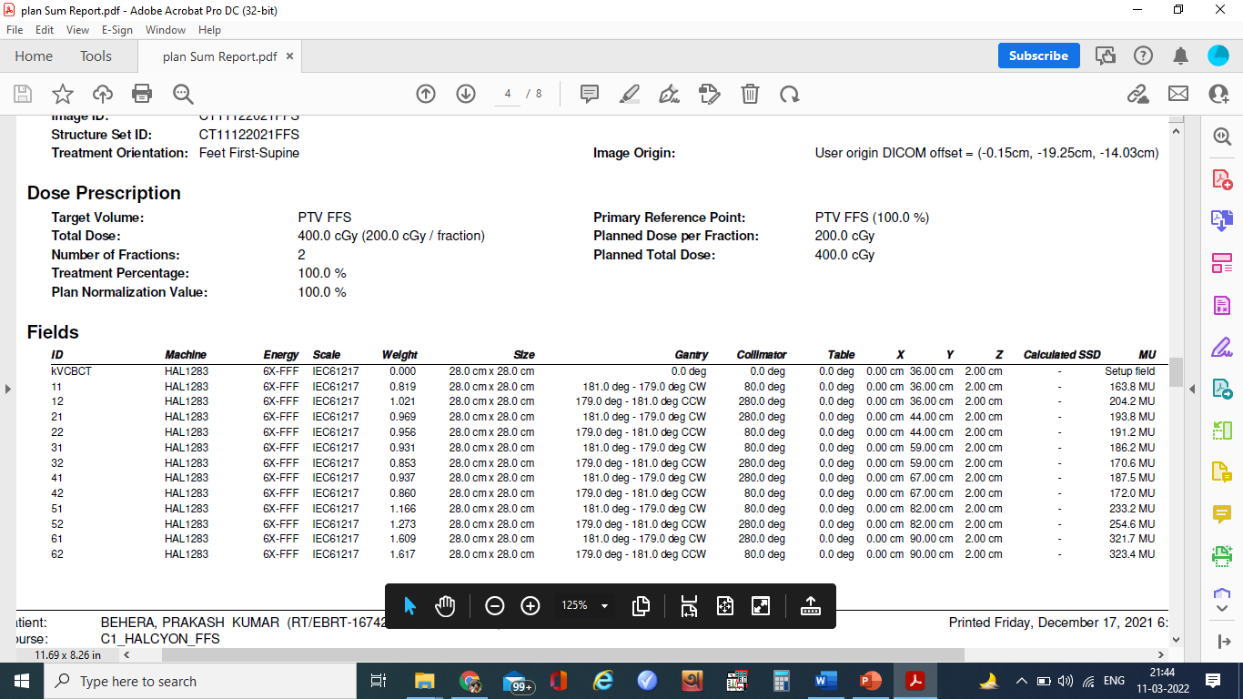
FFS Plan :
Beam Arrangement and MU

Slide 16
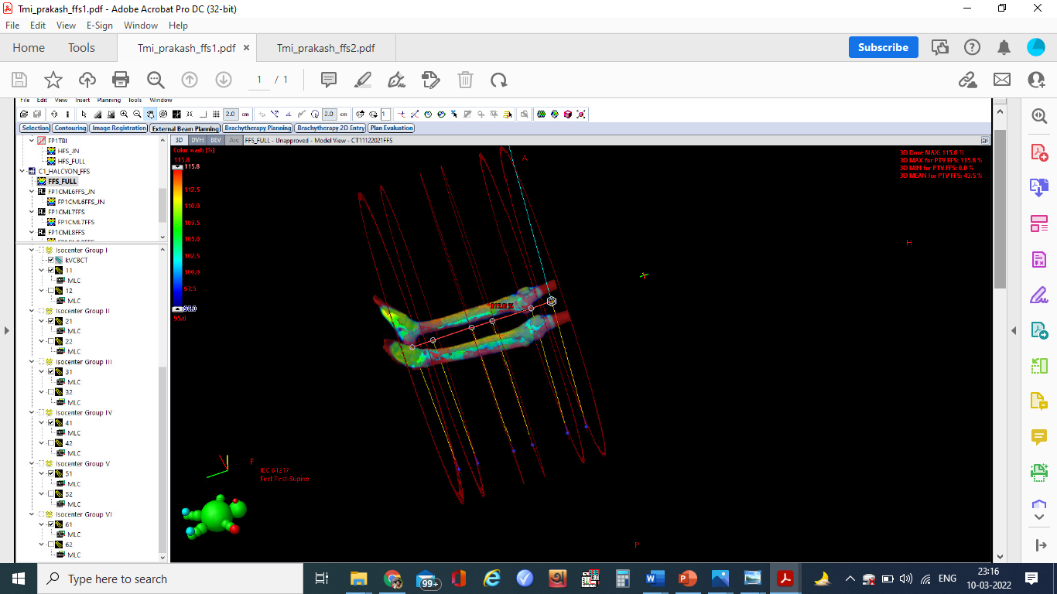
FFS-CT beam Placement and dose distribution (3D Representation) – Element -3

Slide 17
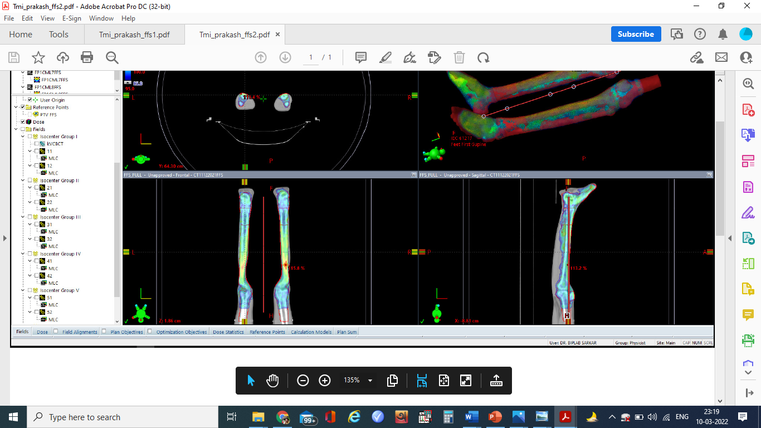
FFS Plan :
FFS-CT dose distribution (Sagittal and Coronal)

Slide 18
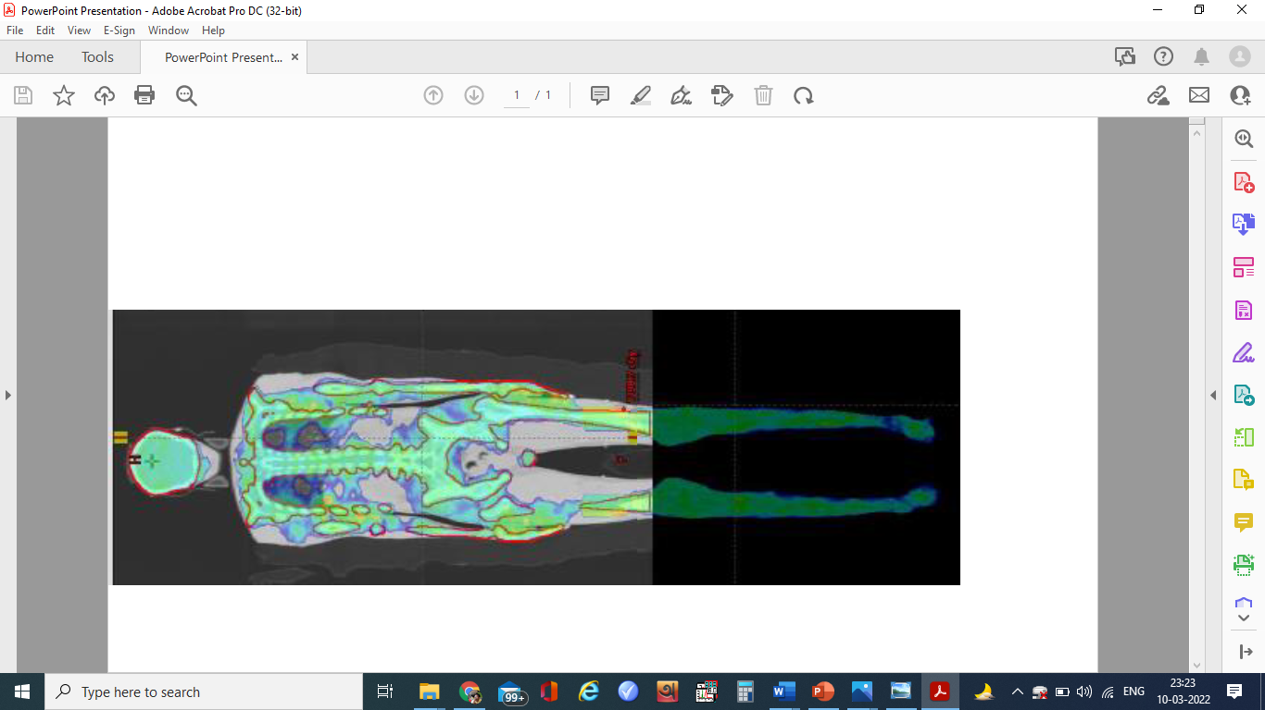
Resultant dose distribution: HFS Plan + FFS Plan+ HFS Junction Plan Element 1+2+3

Slide 19
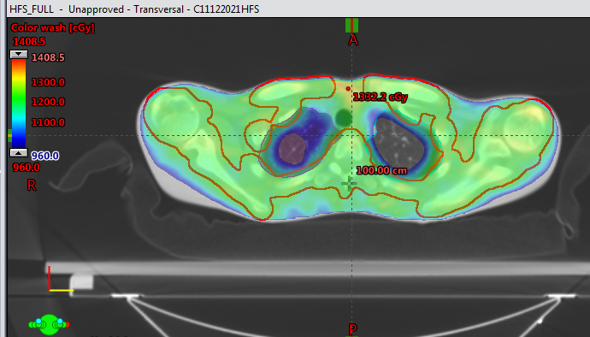
Typical Dose Distribution (lung :superior)

Slide 20
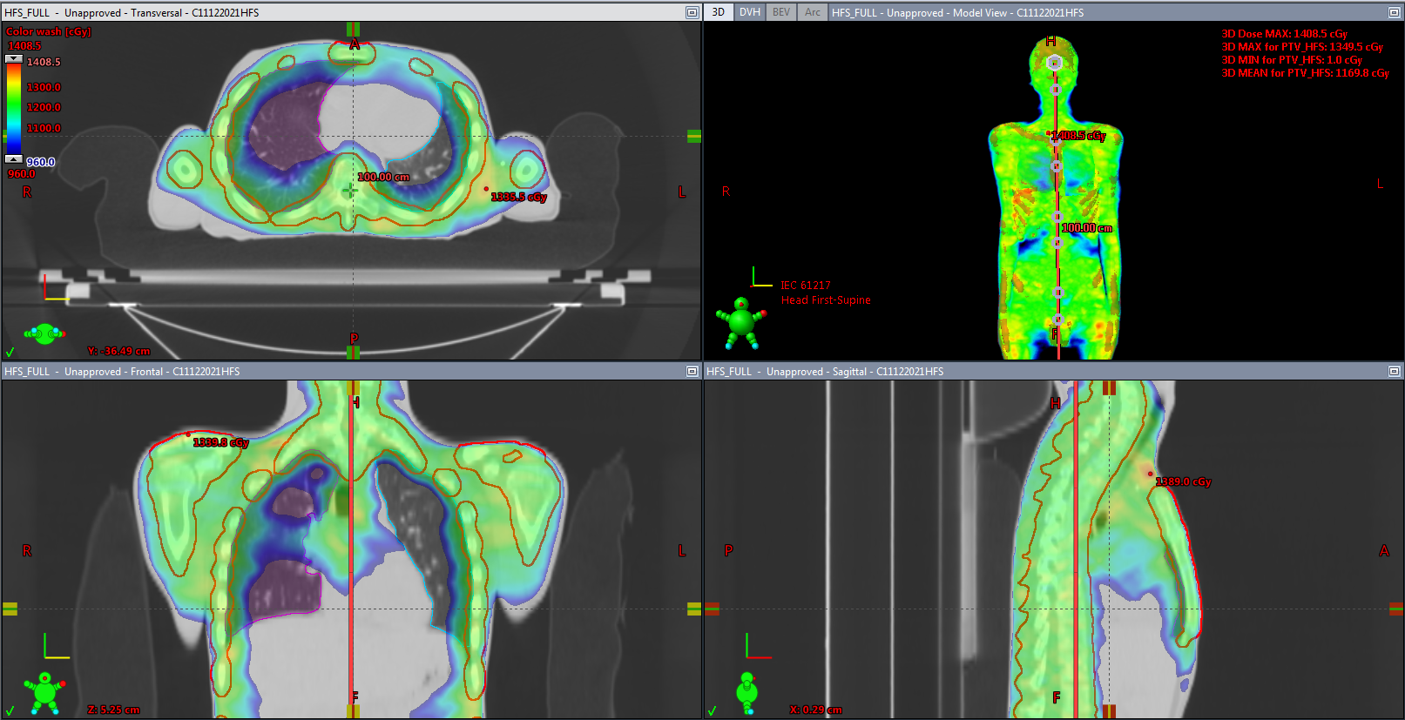
Typical Dose Distribution (lung: mid level)

Slide 21
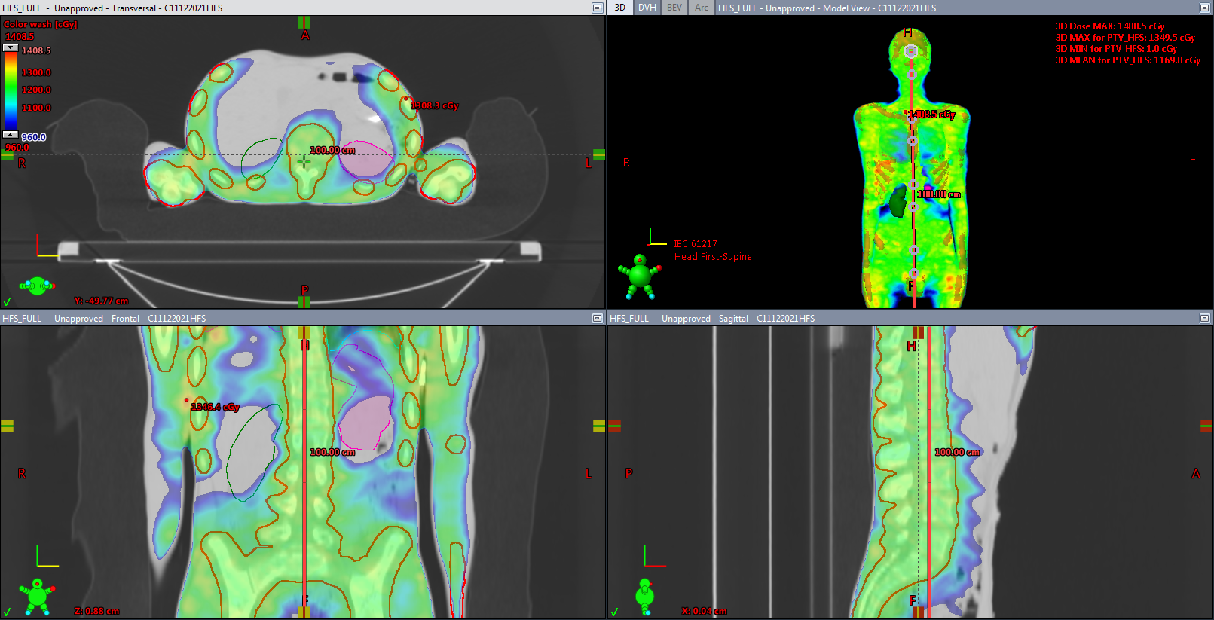
Typical Dose Distribution (Kidney level)

