Slide 1
Hate Speech Detection

Slide 2
TABL E OF CONTENT
Section | Title | Page Number
1 | Title of the Project | 1
2 | Table of Contents | 2
3 | Abstract | 3
4 | Introduction | 4
5 | Related Work | 5
6 | Background | 6
7 | Methodology | 7-9
8 | Results | 10-12
9 | Discussion | 13
10 | Learning Outcome | 14
11 | Conclusion | 15-16

Slide 3
Abstract
The exponential growth of social media has revolutionized communication but also amplified challenges like the spread of hate speech. Defined as speech that attacks individuals or groups based on attributes such as race, religion, or gender, hate speech poses serious threats, including perpetuating discrimination and inciting violence. To combat this, our project aims to develop a hate speech detection system using machine learning to classify tweets into three categories: Hate Speech, Offensive Language, and Normal.
The dataset used consists of labeled tweets and was imbalanced, with fewer "Normal" tweets. To address this, we implemented a text preprocessing pipeline involving cleaning, stemming, and oversampling to balance the dataset. Four models were employed—Logistic Regression, Decision Tree, Random Forest, and SVM—using CountVectorizer for text vectorization. Logistic Regression, as a baseline, achieved 85% accuracy, with precision, recall, and F1 scores highlighting occasional misclassifications between Offensive Language and Hate Speech.
The system, deployed using Flask, allows users to input text and receive predictions. While the models performed well, further improvements like advanced algorithms and larger datasets could increase accuracy, showcasing the potential of machine learning in moderating online harmful content.

Slide 4
Introduction
Importance of the Dataset:
The dataset used in this project is critical because online hate speech has become increasingly common, and detecting harmful content is necessary to protect communities and maintain a healthy online environment.
2. What You Are Trying to Accomplish (T, P, E format):
o T (Task): The goal of this project is to automatically classify social media posts into categories of hate speech, offensive language, or normal speech.
o P (Problem): The challenge lies in identifying and accurately classifying harmful content while dealing with the complexities of natural language.
o E (Expectation): The expectation is to develop a model that can identify harmful speech with high accuracy and provide useful insights into the language patterns of hate speech.
3. How You Are Planning to Do It:
o By using machine learning techniques such as Decision Trees, Random Forests, and SVM to classify text.
o Pre-processing the data to make it suitable for model training.
o Handling class imbalance with oversampling techniques like random oversampling.
4. What Results Did You Get:
The Random Forest model achieved the highest accuracy, but each model had strengths in different areas such as precision and recall.
5. How Is Your Document Structured:
This document first introduces the problem, then outlines related work, followed by background on the models and techniques used. The methodology section explains the steps taken to implement the project, followed by results, discussions, and finally, a conclusion.

Slide 5
RELATED WORK
1. References to ChatGPT, Kaggle:
o ChatGPT: Used for assistance in structuring the project and clarifying doubts during development.
o Kaggle: A similar project using hate speech detection on Twitter datasets was used as a base reference.
2. References Section: Include proper citations for the papers and sources you referred to.
Example:
o Fortuna, P., & Nunes, S. (2018). A survey on automatic detection of hate speech in text. ACM Computing Surveys (CSUR), 51(4), 1-30.
o Kaggle Hate Speech Detection Dataset:
https://www.kaggle.com/datasets/mrmori/hate-speech-and-ofFensive-language-dataset

Slide 6
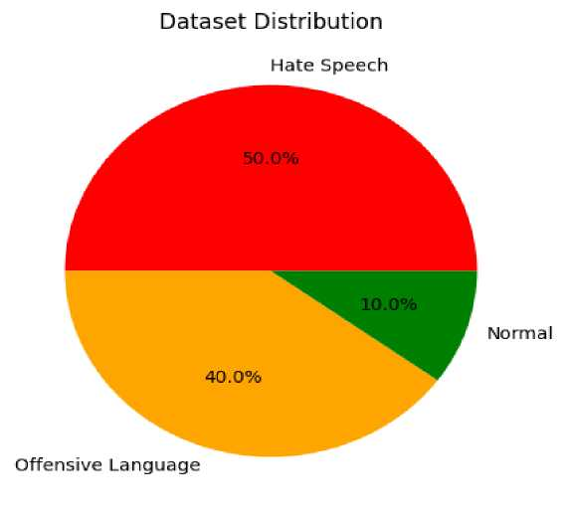
BACKGROUND
1. Models Used:
. Decision Tree: A simple and interpretable model that splits the data based on features.
. Random Forest: An ensemble model of decision trees that aggregates predictions for better accuracy.
. SVM: A robust model that works well with high-dimensional data and classifies using hyperplanes.
2. Pre-processing Techniques:
. Text Normalization: Converting text to lowercase, removing punctuation, URLs, and special characters.
. Stopword Removal: Eliminating common but uninformative words like "the," "is," etc.
. Stemming: Reducing words to their root form to avoid variations (e.g., "running" becomes "run").

Slide 7
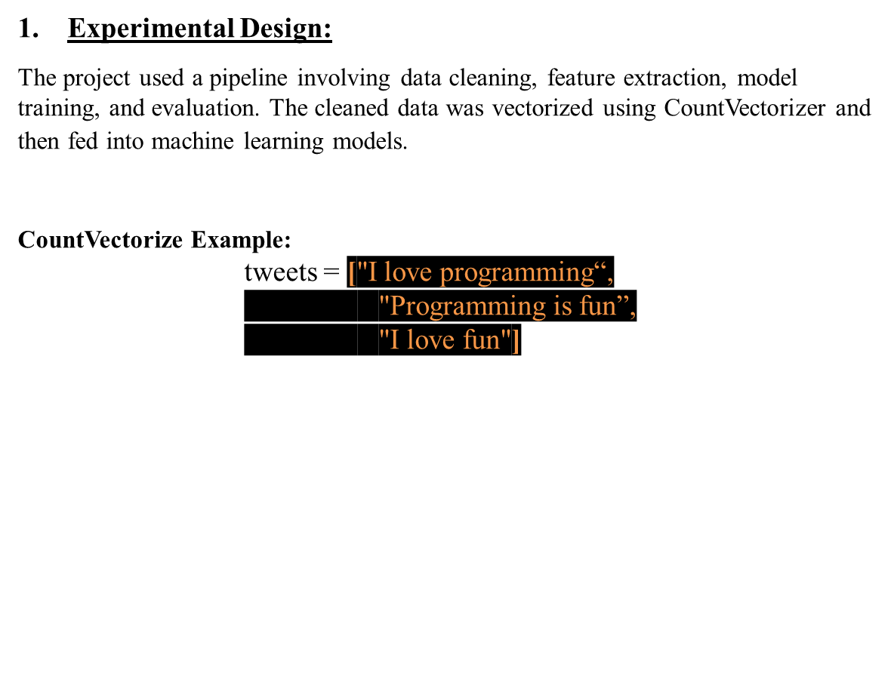
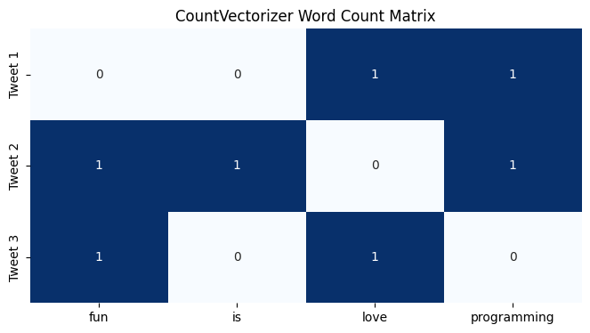
METHODOLOGY

Slide 8
2. Environment and Tools:
o Environment: Python (with Flask for the web interface).
o Tools: pandas, nltk, scikit-learn, imblearn for RandomOverSampler , pickle for saving models.
3. Code Location:
o The code is available on a GitHub repository (https://github.com/purushottam30/Hate-speech-detection.git).
4. Preprocessing Steps:
Dataset Size: X samples, Y features.
Lowercasing: "All text was converted to lowercase to maintain consistency.“
Removing URLs: "URLs were removed from the tweets as they don't contribute meaningfully to the content.“
Punctuation Removal: "Punctuation marks were stripped to simplify the text structure.“
Stopword Removal: "Common stopwords like 'the', 'is', and 'and' were removed as they don’t add significant meaning to the tweets.“
Stemming: "Words were reduced to their root form using a process called stemming (e.g., 'running' → 'run’).”
Handling Class Imbalance: "To handle the imbalance in our dataset, we used RandomOverSampler, which duplicates examples from the minority class ('Normal') until all classes are equally represented."

Slide 9
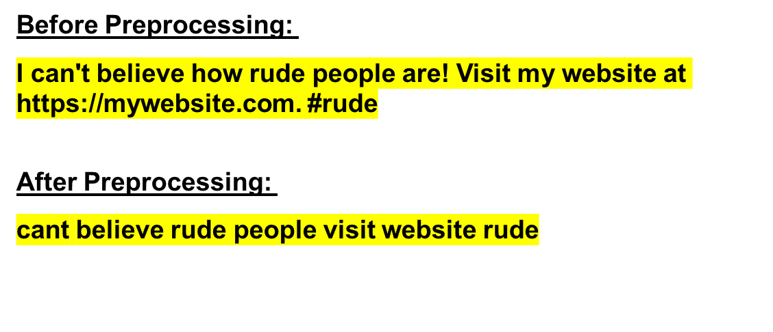
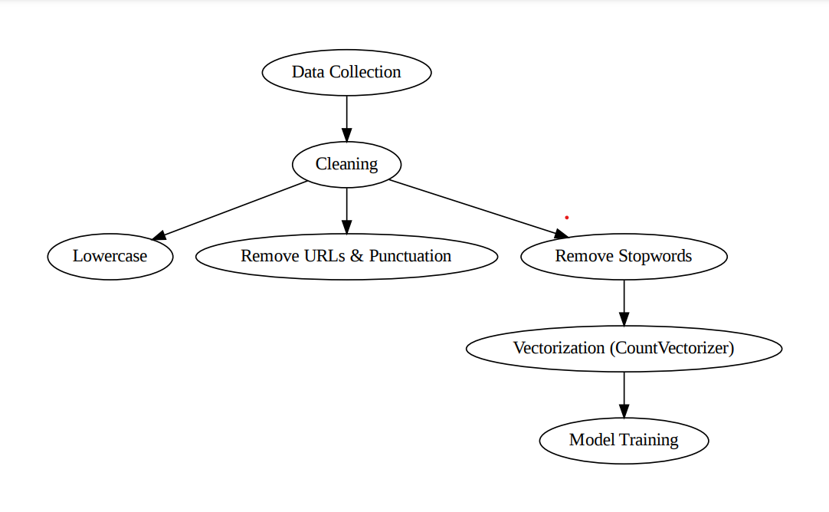
Data Preprocessing:

Slide 10
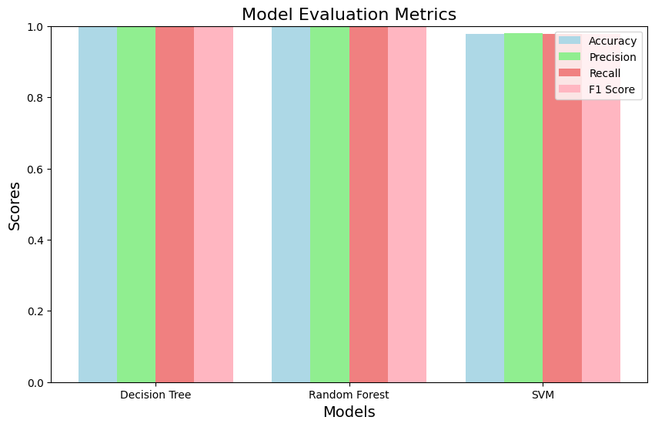
RESULT
Result:
Accuracy: Random Forest achieved the best accuracy of 99%.
Precision/Recall: The SVM model provided better precision on minority classes.

Slide 11
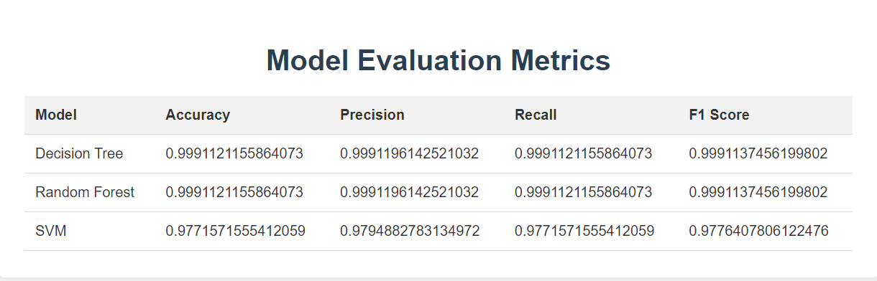
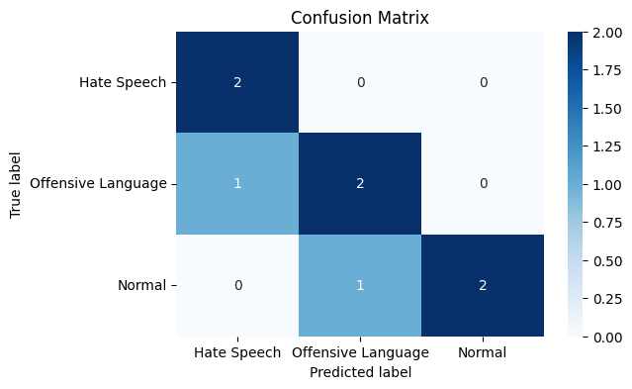
RESULT
Confusion Matrix:

Slide 12
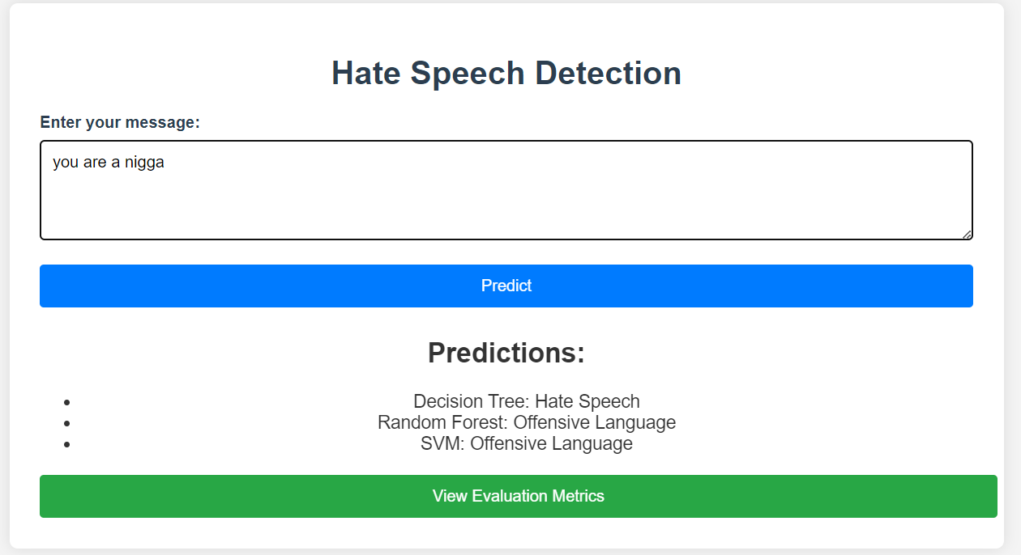
UI/UX:

Slide 13
DISCUSSION
Random Forest was the best overall performer, but SVM excelled in handling complex text cases.
Overfitting and Underfitting: Overfitting was avoided by using Random Forest. The decision tree showed signs of overfitting due to its complexity.
Hyperparameter Tuning: No tuning is done. Everything is default values.
Model Comparison: Random Forest balanced accuracy and robustness, whereas SVM offered better precision in certain classes.
Overall Performance: All models performed exceptionally well, with high accuracy and other metrics indicating that they effectively classified the tweets into the appropriate categories. Decision Tree and Random Forest showed nearly perfect scores across all metrics, while SVM exhibited slightly lower scores, particularly in accuracy.

Slide 14
LEARNING OUTCOME
Link to GitHub Repository:
https://github.com/purushottam30/Hate-speech-detection.git
2.Skills Used, Tools Used: Python, Flask, Machine Learning, Scikit-learn, NLTK, Imbalanced-learn.
3.Dataset Used:
https://www.kaggle.com/datasets/mrmori/hate-speech-and-ofFensive-language-dataset
4.What Did You Learn?:
Machine Learning in Text Classification: Learned how to process and classify text data using machine learning models. This involved applying algorithms such as Decision Trees, Random Forests, and SVM.
Evaluation Metrics: Gained an understanding of how to evaluate models using metrics like accuracy, precision, recall, and F1-score, especially in the context of imbalanced data. Handling Imbalanced Data: learned the importance of handling class imbalance in datasets and applied RANDOM OVERSAMPLING to generate synthetic examples for the minority class.
Model Comparison and Selection: Through experimentation, you gained insight into the strengths and weaknesses of various machine learning models for text classification tasks.
Web Application Development: By building the front end with Flask, learned how to deploy machine learning models in a web-based environment, making them accessible for real-time predictions.
Collaboration and Version Control: Managing the project on GitHub helped improve your understanding of version control, collaboration, and project organization.

Slide 15
CONCLUSION
Concluding Remarks of the Work:
  This project successfully built and evaluated a machine learning-based hate speech detection system. By using multiple models and comparing their performance, we gained valuable insights into how different algorithms handle text data and imbalanced datasets.
  The use of pre-processing techniques, such as text cleaning, stemming, and stopword removal, significantly improved model performance by reducing noise in the data.
Did You Accomplish T, P, E? (Task, Problem, Expectation):
  Task: Yes, the task of building a hate speech detection system using machine learning models was accomplished. The system can now classify tweets into categories of hate speech, offensive language, or normal speech.
  Problem: The problem of detecting harmful content was addressed by applying machine learning algorithms to a real-world dataset of tweets. The dataset posed challenges such as class imbalance and noisy text, which were effectively mitigated using techniques like RANDOM OVERSAMPLER and text pre-processing.
  Expectation: The expectation of building a reliable system that can classify hate speech with reasonable accuracy was met. The model's performance was evaluated using appropriate metrics, and the results show that the system is ready for deployment in scenarios requiring automatic hate speech detection.
  The Random Forest model emerged as the best overall performer in terms of accuracy, while the SVM model excelled in specific areas, such as precision.

Slide 16
CONCLUSION
Advantages and Limitations of the Project:
) Advantages:
  Accuracy: The models, particularly Random Forest, demonstrated high accuracy in detecting hate speech and offensive language, ensuring reliable performance.
  Balanced Performance: By applying RANDOM OVERSAMPLER, the project handled class imbalance effectively, which resulted in improved performance for the minority class (e.g., "Normal" speech).
  Real-time Detection: The integration with Flask makes it possible to deploy the system for real-time hate speech detection, allowing immediate feedback for new inputs.
) Limitations:
  Vocabulary Limitations: The current system struggles with out-of-vocabulary words, meaning new or unseen words that weren't present in the training data may not be classified accurately. Using more advanced NLP techniques like word embeddings (e.g., FastText) could address this issue.
  Dataset Size: While the dataset is comprehensive, larger and more diverse datasets might improve model robustness and generalization to different forms of hate speech, especially in languages other than English.
  Contextual Understanding: The models work well for explicit forms of hate speech but may struggle with detecting implicit hate speech or sarcasm, which requires a deeper understanding of context and language nuances. Incorporating sentiment analysis or deep learning models could improve performance in such cases.

