Slide 1
Customer Segmentation using K-Means and DBSCAN
Purushottam Raj &
Rajan Neupane

Slide 2
Introduction
• Customer segmentation helps businesses understand different customer groups.
• Analyzes customer behavior based on income and spending patterns.
• Clustering algorithms can automatically group similar customers.
• This project uses machine learning for customer segmentation.

Slide 3
Motivation
• Businesses need to understand customer purchasing behavior.
• Different customers have different spending habits.
• Identifying these groups improves marketing strategies.
Clustering helps discover hidden patterns in customer data.

Slide 4
Problem Definition & Objectives
• Businesses often have customer data but do not analyze it effectively.
• Goal: Segment customers based on spending behaviour and annual income.
• Apply K-Means and DBSCAN clustering algorithms.
• Evaluate results using Silhouette Score.

Slide 5
Dataset Description
Dataset: Mall Customers Dataset (Kaggle)
Attributes:
Customer ID
Gender
Age
Annual Income (k$)
Spending Score (1–100)
Features used for clustering: Income & Spending Score.

Slide 6
K-Means Clustering
Divides dataset into K clusters.
Uses centroid-based clustering.
Customers assigned to nearest centroid.
Optimal K determined using Elbow Method.
In this project K = 5 clusters.

Slide 7
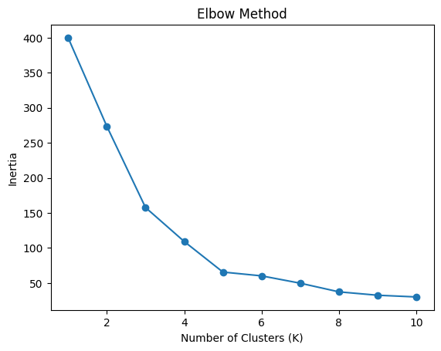

Slide 8
K-Means Results
5 Customer Segments Identified:
1.Premium Customers (High Income, High Spending)
2.Average Customers
3.Low Income High Spending
4.High Income Low Spending
5.Low Income Low Spending
K-Means produced well-separated clusters.

Slide 9
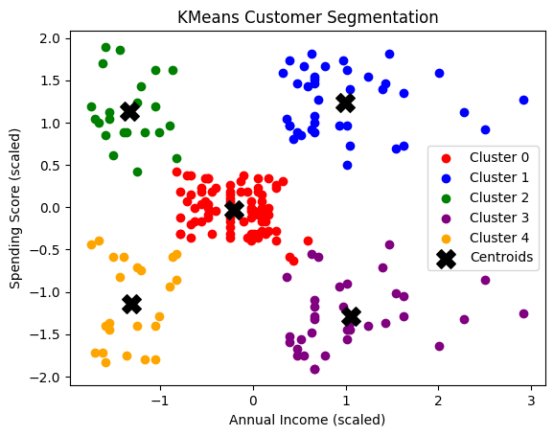

Slide 10
DBSCAN Clustering
Density-based clustering algorithm.
Groups points based on neighborhood density.
Does not require predefined cluster number.
Can detect noise and outliers.
Uses parameters: eps and min_samples.

Slide 11
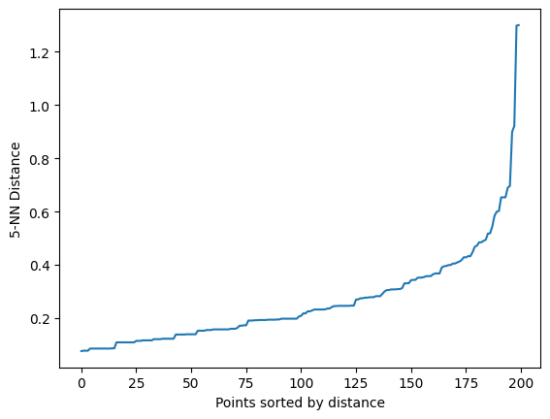
K-Nearest Neighbours(KNN)

Slide 12
DBSCAN Results
DBSCAN detected:
1.Cluster 0: Average Customers
2.Cluster 1: High Income High Spending
3.Noise Points (-1): Outliers
Useful for identifying irregular patterns and anomalies.

Slide 13
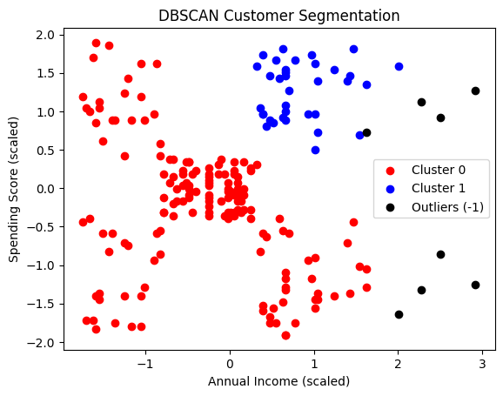

Slide 14
Evaluation Metric
Silhouette Score:
• Measures cluster separation quality.
• Range: -1 to 1
• Higher value means better clustering.
Results:
K-Means: 0.554
DBSCAN: 0.387

Slide 15
Conclusion
• Customer segmentation was performed using clustering.
• K-Means and DBSCAN algorithms were compared.
• K-Means achieved higher silhouette score.
• DBSCAN detected outliers effectively.
• Customer segmentation helps businesses design targeted marketing strategies.

