Slide 1
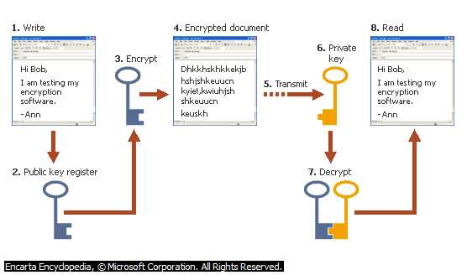
ENCRYPTION OF DATABASE
CSE-102
PBL REVIEW-1
FACULTY:S.BHARTIRAJA

Slide 2
GROUP MEMBER NAME ARE:-
Purushottam-14BEC1043
Rohit Kumar Pandey-14BEC1022

Slide 3
PROBLEM UNDERTAKING
ENCRYPTION, PROCESS OF CONVERTING MESSAGES OR DATA INTO A FORM THAT CANNOT BE READ WITHOUT DECRYPTING OR DECIPHERING IT.
TO HIDE THE INTEGRITY OF DATABASE
TO ENCRYPT DATABASE
A SCENARIO IN WHICH A COMPANY WANTS TO HIDE THE TRUE IDENTITY OF ITS EMPLOYEES . WE ARE MAKING A PROGRAM THAT HELPS TO ACHIEVE THIS GOAL

Slide 4
APPROACH
LANGUAGE USED:C
LARGER DATABASES HAVE BECOME INCREASINGLY IMPORTANT IN BUSINESS LIFE
WE WILL BE SECURING THE COMPANY DATABASE USING
ENCRYPTED DATA STRUCTURE.

Slide 5
CONCLUSION
THIS PBL WILL HELP US TO UNDERSTAND THE CONCEPT OF STACKS , QUEUES , SEARCHING AND SORTING IN LINKED LISTS
ALSO WE WILL LEARN SOME ADVANCE CONCEPTS OF ENCRYPTION AND CRYPTOGRAPHY

Slide 6
THANK YOU

