Slide 1





[SCHEDULE]-Me- Automate-[ALL]
SYNC

Slide 2
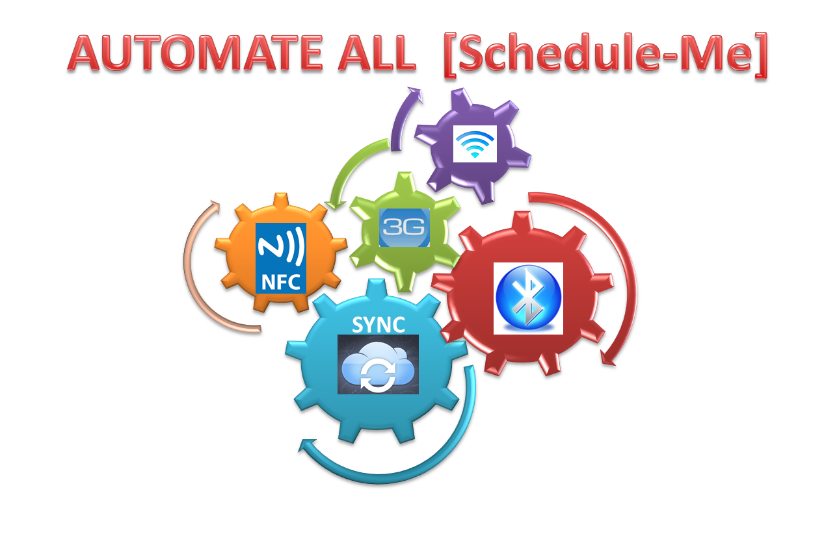

Slide 3
