Slide 1




RESUME PROJECT
Challenge #12
ALTIQ MOTORS
Electric Vehicle Insights
purvan76@gmail.com
linkedin.com/in/purva-nikam-704434315/
Presented By
Purva Jayanteelal Nikam

Slide 2
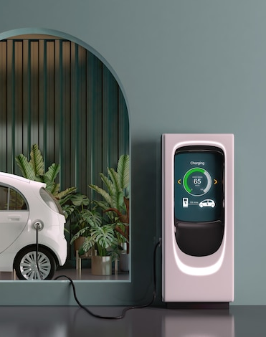
Agenda
01
Problem Statement
02
Goal
03
Dashboard Showcase
04
Insights
05
Recommendations

Slide 3
Problem Statement
AtliQ Motors, a prominent electric vehicle (EV) manufacturer in the USA, aims to expand its presence in India's EV and hybrid market, where it currently holds less than 2% market share. As a Data Analyst, my task is to analyze the existing EV/hybrid vehicle market in India and provide insights that can guide strategic decisions for the potential launch of AtliQ Motors' top-selling models in the country. The objective is to generate actionable recommendations that will help AtliQ Motors effectively enter the Indian market and boost its market share in this segment.

Slide 4
Goal
My goal is to perform an in-depth analysis of the EV/hybrid vehicle market in India using the provided datasets, focusing on creating meaningful metrics and visuals. Additionally, I will design a user-friendly dashboard for AtliQ Motors to deliver data-driven recommendations.

Slide 5
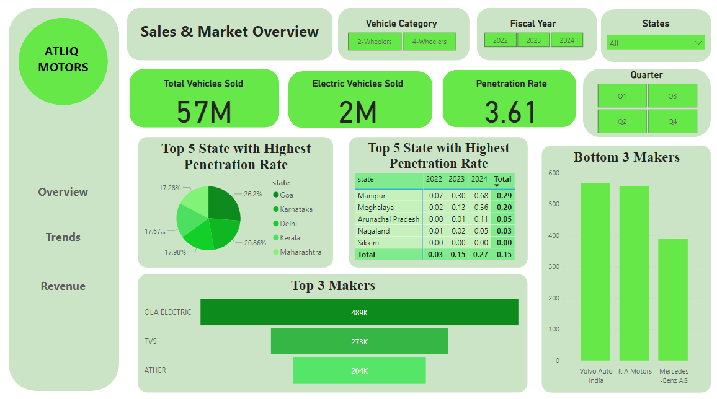
DashBoard (Desktop View)

Slide 6
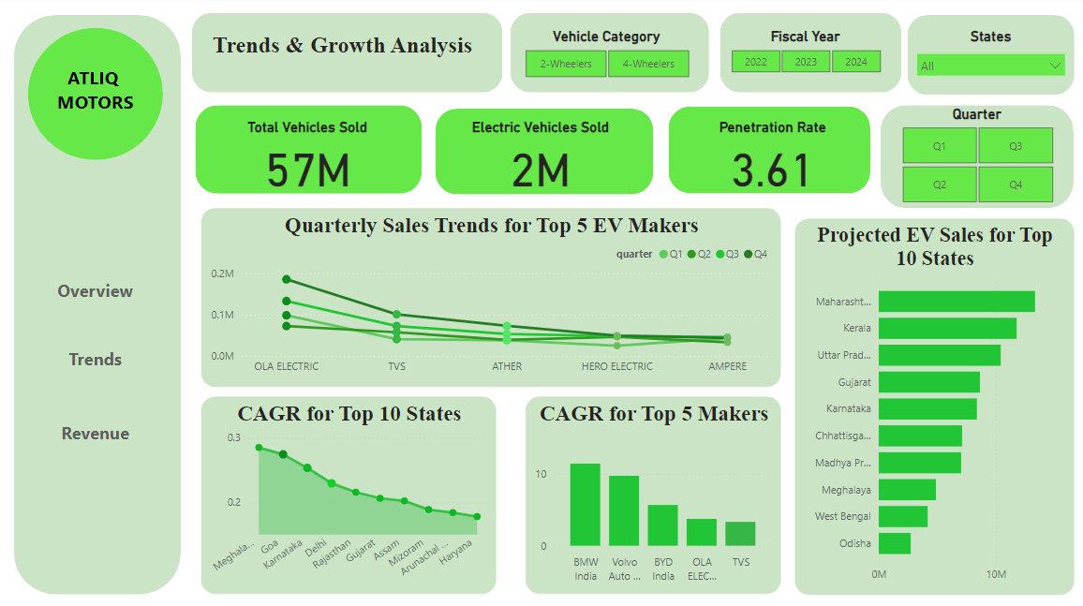
DashBoard (Desktop View)

Slide 7
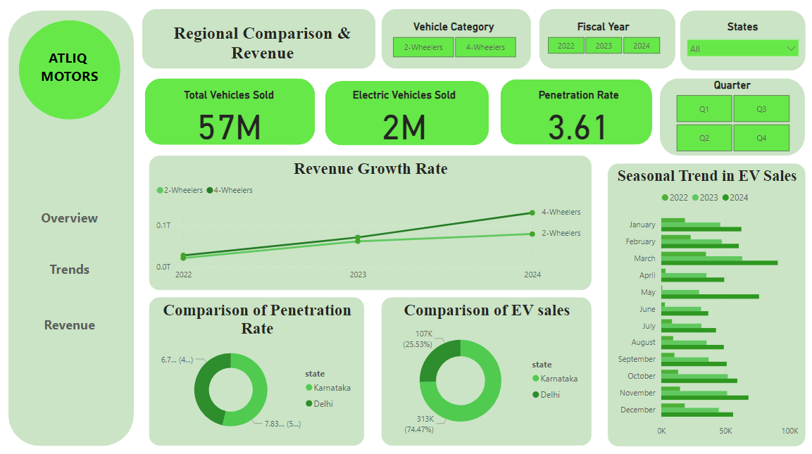
DashBoard (Desktop View)

Slide 8
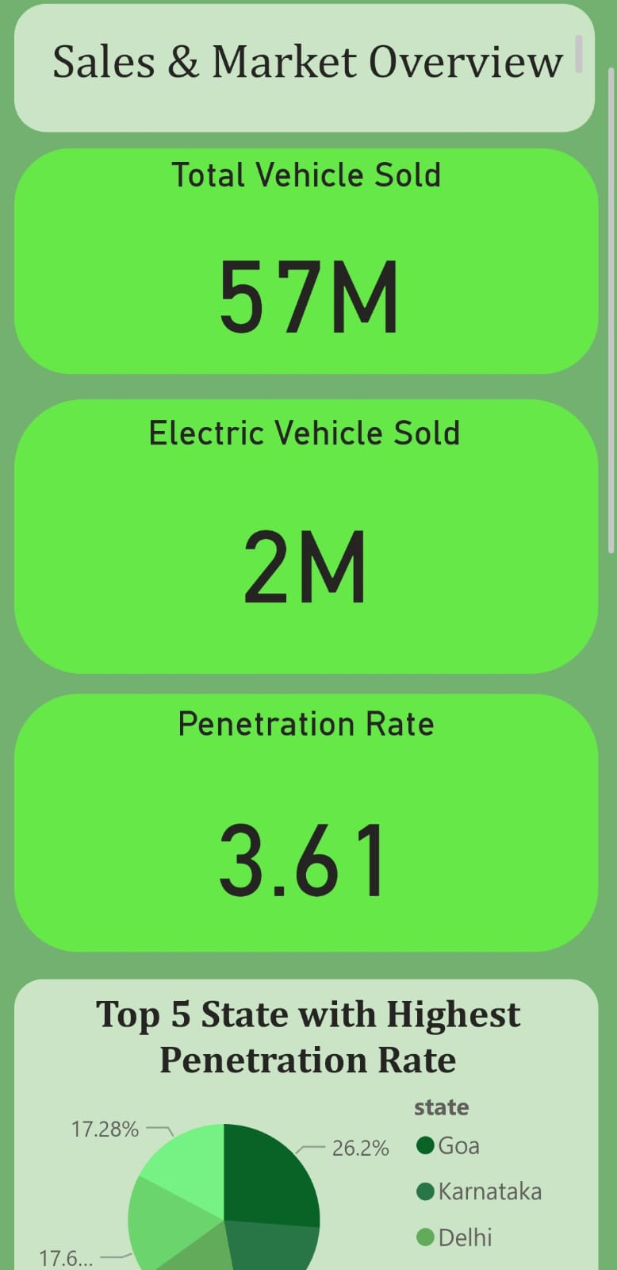
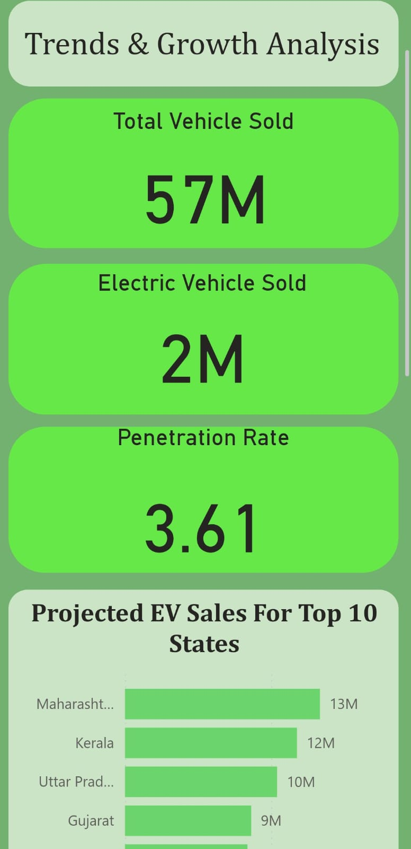
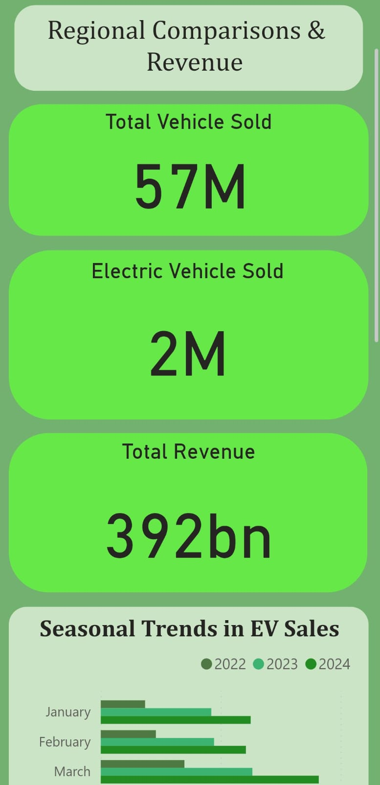
DashBoard (Mobile Layout)

Slide 9
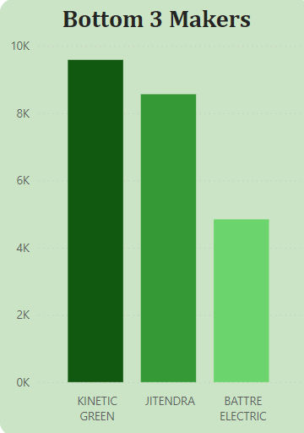
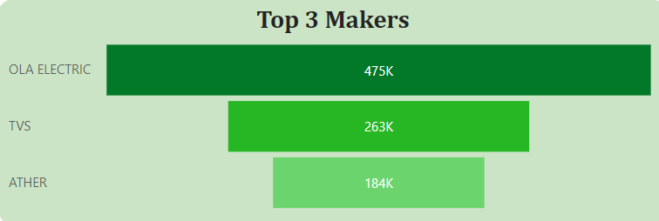
Primary Insights
1. List the top 3 and bottom 3 makers for the fiscal years 2023 and 2024 in terms of the number of 2-wheelers sold.

Slide 10
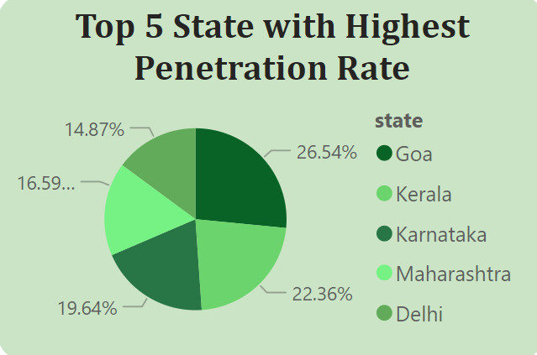
Primary Insights
2. Identify the top 5 states with the highest penetration rate in 2-wheeler and
4-wheeler EV sales in FY 2024.

Slide 11
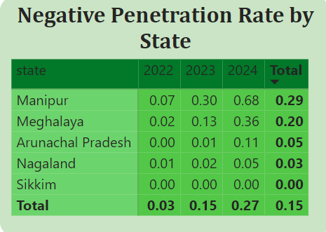
Primary Insights
3. List the states with negative penetration (decline) in EV sales from 2022 to 2024?

Slide 12
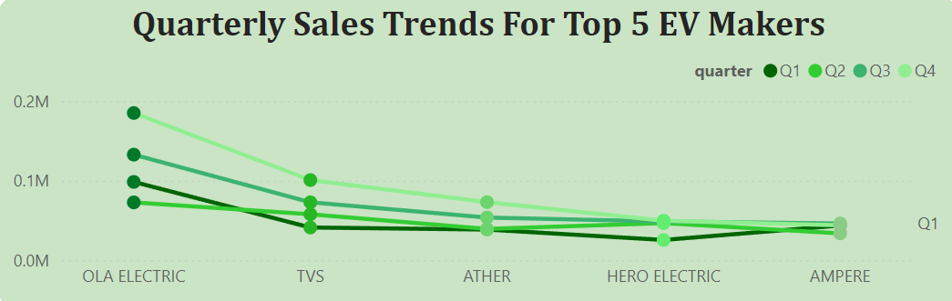
Primary Insights
4. What are the quarterly trends based on sales volume for the top 5 EV makers (4-wheelers) from 2022 to 2024?

Slide 13
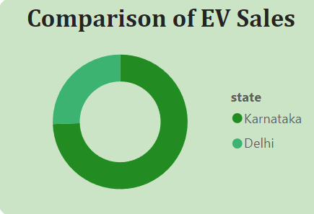
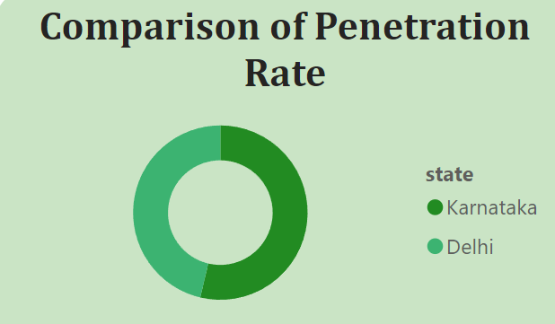
Primary Insights
5. How do the EV sales and penetration rates in Delhi compare to Karnataka for 2024?

Slide 14
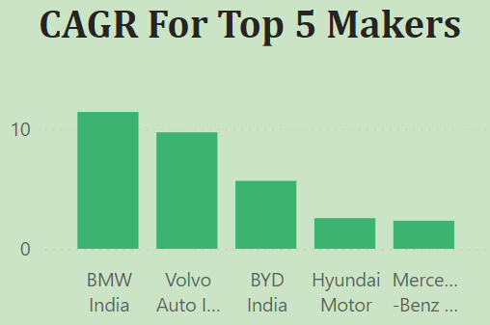
Primary Insights
6. List down the compounded annual growth rate (CAGR) in 4-wheeler units for the top 5 makers from 2022 to 2024.

Slide 15
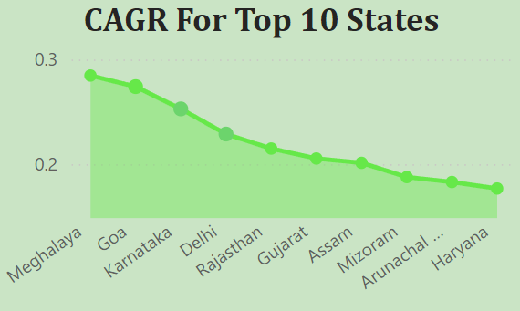
Primary Insights
7. List down the top 10 states that had the highest compounded annual growth rate (CAGR) from 2022 to 2024 in total vehicles sold.

Slide 16
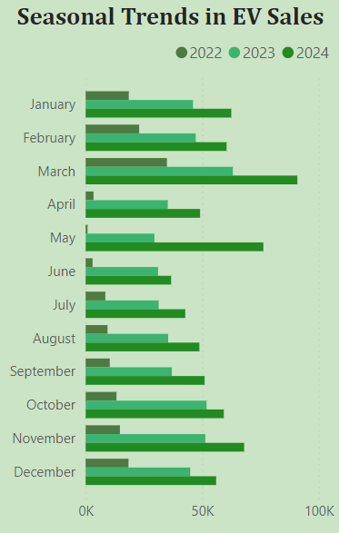
Primary Insights
8. What are the peak and low season months for EV sales based on the data from 2022 to 2024?

Slide 17
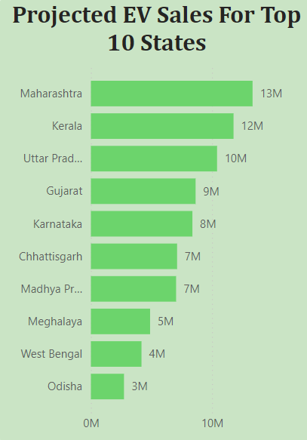
Primary Insights
9. What is the projected number of EV sales (including 2-wheelers and
4-wheelers) for the top 10 states in 2030?

Slide 18
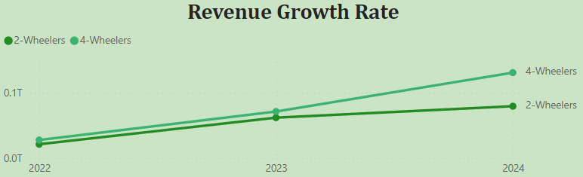
Primary Insights
10. Estimate the revenue growth rate of 4-wheeler and 2-wheelers EVs in India. Assuming an average unit price for 2-Wheelers is Rs. 85,000 and for 4-Wheelers is Rs. 15,00,000.

Slide 19
Secondary Insights
1. What are the primary reasons for customers choosing 4-wheeler EVs in 2023 and 2024 (cost savings, environmental concerns, government incentives)?
1. Cost Savings: EVs offer lower running costs due to reduced fuel and maintenance expenses, making them economically appealing.
2. Environmental Concerns: Consumers are increasingly choosing EVs to minimize their carbon footprint and contribute to environmental protection.
3. Government Incentives: Subsidies, tax breaks, and other government incentives make EVs more affordable and accessible.

Slide 20
Secondary Insights
2. How do government incentives and subsidies impact the adoption rates of 2-wheelers and 4-wheelers? Which states in India provided most subsidies?
Government incentives and subsidies make EVs more affordable by reducing purchase costs, offering tax exemptions, and lowering registration fees. This decreases the overall cost of owning an EV, making them more accessible and encouraging more consumers to adopt electric vehicles.
Key subsidizing states in India, such as Maharashtra, Gujarat, Delhi, Tamil Nadu, and Karnataka, provide substantial subsidies, tax exemptions, and infrastructure incentives, significantly boosting the adoption of 2-wheelers and 4-wheelers EVs.

Slide 21
Secondary Insights
3. How does the availability of charging stations infrastructure correlate with the EV sales and penetration rates in the top 5 states?
States with robust charging infrastructure, such as Maharashtra, Delhi, Karnataka, Gujarat, and Tamil Nadu, experience greater EV sales and market penetration. The widespread availability of charging stations reduces range anxiety and enhances convenience, boosting consumer confidence and driving higher adoption rates of electric vehicles in these regions.

Slide 22
Secondary Insights
4. Who should be the brand ambassador if AtliQ Motors launches their EV/Hybrid vehicles in India and why?
Alia Bhatt - Alia is known for her advocacy of environmental issues and her involvement in green initiatives. Her image as a progressive and eco-friendly celebrity can resonate with AtliQ's sustainability message, making her a great fit to promote EVs.

Slide 23
Secondary Insights
5. Which state of India is ideal to start the manufacturing unit? (Based on subsidies provided, ease of doing business, stability in governance etc.)
Maharashtra is an ideal location for an electric vehicle (EV) manufacturing unit due to its attractive subsidies, business-friendly environment, and developed infrastructure. The state provides significant financial incentives, streamlined processes, and a stable governance, creating a favorable investment climate. Its advanced infrastructure, including ports and roads, coupled with its strategic location and strong logistics network, further supports efficient manufacturing and distribution.

Slide 24
01
Focus on Infrastructure: Take advantage of Maharashtra’s developed infrastructure by selecting a location with excellent connectivity to ports, roads, and power sources to streamline operations and logistics.
Recommendations
02
Invest in Talent Development: Tap into the state’s skilled workforce and consider partnering with local educational institutions for talent development and training programs specific to the EV industry..
03
Monitor Market Trends: Stay informed about market trends and consumer preferences in the EV sector to adapt your manufacturing strategies and product offerings accordingly.

Slide 25
Thank You!

