Slide 1
DATA COMMUNICATION & NETWORKS
Experimental Analysis of Error Detection
Techniques in Data Communication
Comparative Diagnostic & Performance Evaluation of VRC, LRC, Internet Checksum, and CRC
Author / Presenter: Purva Deshmukh
Project Scope: End-to-End Simulation, Dual Interactive Interfaces (CLI & Web), and Empirical Benchmarking
Techniques Analyzed: Vertical Redundancy Check (VRC) | Longitudinal Redundancy Check (LRC) | Internet Checksum | CRC-16 / CRC-32

Slide 2
1. PROJECT BACKGROUND
Introduction: Transmission Impairments & Reliability
Physical Channel Realities
• Noise and Interference: Physical channels (copper, fiber, wireless) are prone to thermal noise, cross-talk, and impulse spikes.
• Bit Corruption: Transmitted electrical signals distort, flipping binary 1s to 0s and vice versa.
• Error Distribution Patterns: Real physical channels produce single-bit flips, random multi-bit noise, and contiguous burst errors.
• Data Link Layer Obligation: Packets cannot be safely delivered to upper protocol layers without rigorous frame integrity verification.
The Engineering Trade-Off Dilemma
• Detection Power vs. Bandwidth: Adding redundancy bits increases channel overhead and reduces effective payload throughput.
• Computational Complexity: Simple parity calculation runs in O(1) CPU time, whereas polynomial division incurs significant processing latency.
• Algorithmic Blind Spots: Simple algorithms fail on specific multi-bit or burst patterns (e.g. even parity blind spots).
• Project Goal: Rigorously evaluate and compare all four canonical error-detection mechanisms across identical payloads and channel conditions.

Slide 3
2. PROJECT OBJECTIVES
System Objectives & Engineering Requirements
End-to-End 3-Stage Pipeline
Model realistic Sender (Transmitter Encoding), Physical Channel (Noise/Corruption), and Receiver (Integrity Verification) without external black-box libraries.
Four Canonical Techniques
Implement native mathematical logic for VRC (Parity), LRC (2D block matrix), 1's Complement Internet Checksum, and CRC (Modulo-2 polynomial division).
Five Physical Error Models
Support clean transmission, single-bit flips, independent multiple-bit flips, burst errors, and manual bit-index injection for targeted stress testing.
Dual Interface & Benchmarking
Provide an interactive CLI and modern browser web interface backed by empirical batch experiments generating 4 publication-quality analytical graphs.

Slide 4
3. ARCHITECTURE & WORKFLOW
System Architecture: 3-Tier Layered Design
Tier 1: Core Mathematical Algorithms
Location: algorithms/
• parity.py: VRC (Even/Odd schemes)
• lrc.py: Block matrix column-wise XOR
• checksum.py: 1's complement addition with end-around carry
• crc.py: Modulo-2 polynomial division (CRC-8, CRC-16, CRC-32)
Zero third-party algorithm dependencies.
Tier 2: Physical Channel & Simulation
Location: simulation/ & experiments/
• error_generator.py: 5 physical noise injection models
• simulator.py: End-to-end 3-stage pipeline coordinator
• experiment_runner.py: Multi-threaded batch benchmarking
• metrics.py: Data aggregation with clean/corrupted separation
Tier 3: Dual Presentation Layer
Location: main.py, web/, web_integration/
• Terminal CLI: Interactive console with session data retention
• Web Application: Modern Flask + HTML5/CSS3/JS UI
• web_integration: Adapter layer preserving original backend code intact
• Staging Manager: Prevents unexpected file overwrite.

Slide 5
4. METHODOLOGY
Methodology: End-to-End Transmission Pipeline
Stage 1: Transmitter (Sender)
Input Payload: Binary bit sequence (e.g. 10110011)
1. Encode payload using selected technique.
2. Compute redundancy / check bits (r bits).
3. Append check bits to generate Protected Frame (n = k + r bits).
4. Record encoding latency (T_enc).
Stage 2: Physical Channel
Channel Noise Simulation:
1. Apply selected error model (Single, Multiple, Burst, Manual).
2. Flip binary bits at designated channel indices (0 -> 1, 1 -> 0).
3. Produce Received / Corrupted Frame.
4. Track exact corrupted bit indices.
Stage 3: Receiver Verification
Integrity Verification:
1. Extract payload and redundant check bits.
2. Recompute check sequence on received payload.
3. Compare received vs expected check sequence.
4. Emit binary verdict: ERROR DETECTED vs ERROR MISSED.

Slide 6
5. ERROR GENERATION LOGIC
Physical Error Models Implemented
1. Clean Transmission
No bits altered (Channel Noise = 0). Validates that legitimate clean frames pass verification without false alarms.
2. Single-Bit Error
Exactly one bit flipped at a random or specified index. Corresponds to isolated white noise or thermal fluctuation in copper wires.
3. Multiple-Bit Errors
m independent bit flips scattered across payload. Crucial for exposing the fundamental limitations of single parity checks.
4. Burst Error
A contiguous sequence of bits of length B, where the first and last bits are guaranteed flipped, and intermediate bits flip with probability p=0.5.
5. Manual Error Injection
User or tester provides exact comma-separated bit indices to flip. Enables reproducible scenario testing (e.g. flipping identical columns in LRC).

Slide 7
6. ALGORITHMIC WORKING
Mathematical Principles of the 4 Detection Techniques
Vertical Redundancy Check (VRC)
• Mechanism: Appends 1 parity bit to ensure even number of 1s in the frame.
• Mathematics: P = b_0 ⊕ b_1 ⊕ ... ⊕ b_{k-1}
• Detection: Catches 100% of odd-count bit errors.
• Limitation: 0% detection on even errors (d_min = 2).
Longitudinal Redundancy Check (LRC)
• Mechanism: Organizes payload into 2D matrix of 8-bit blocks; calculates column-wise parity.
• Mathematics: LRC_j = ⊕_{i=1}^m Block_{i,j}
• Detection: Catches burst errors across blocks.
• Limitation: Misses 2-bit flips in the identical column.
Internet Checksum (RFC 1071)
• Mechanism: Divides payload into 8-bit/16-bit words; sums using 1's complement arithmetic.
• Mathematics: Checksum = ~(Sum + End-around Carries)
• Detection: Receiver sum of payload + checksum must equal all 1s (0xFF).
• Feature: Low CPU overhead, used in TCP/IP/UDP.
Cyclic Redundancy Check (CRC)
• Mechanism: Modulo-2 binary polynomial division using XOR arithmetic.
• Mathematics: T(x) = D(x) · x^r + R(x), where R(x) = (D(x) · x^r) mod G(x)
• Polynomials: CRC-8 (100000111), CRC-16 (IBM/CCITT), CRC-32 (IEEE 802.3).
• Detection: Mathematically guarantees detection of all burst errors ≤ r bits.

Slide 8
7. IMPLEMENTATION
Implementation: Terminal CLI & Web Interface
Interactive Terminal CLI (main.py)
• 1. Simulate Data Transmission: Interactive parameter selection with Sender -> Channel -> Receiver breakdown.
• 2. Compare Error Detection Techniques: Runs VRC, LRC, Checksum, and CRC under synchronized payload error positions.
• 3. View Algorithm Working: Full step-by-step mathematical trace generation (matrix grids, XOR steps).
• 4. Run Experiments and View Graphs: Benchmark generator with temporary staging & confirmation workflow.
• 5. Session Persistence: Data entered once is reused across all menus without repeated prompting.
Browser Web Application (web/ + web_integration/)
• Zero Backend Modification: Invokes native Python backend directly via typed adapter layer.
• Visual Bit Highlighting: Corrupted bits are highlighted in red inline for intuitive visual comparison.
• Tabbed Navigation: Four dedicated modules matching the terminal operations.
• Staging Protection: Staged runs allow user to preview newly generated graphs before applying to project baseline.
• One-Click Launcher: start_website.bat auto-binds to 0.0.0.0 and launches browser to http://127.0.0.1:5000.

Slide 9
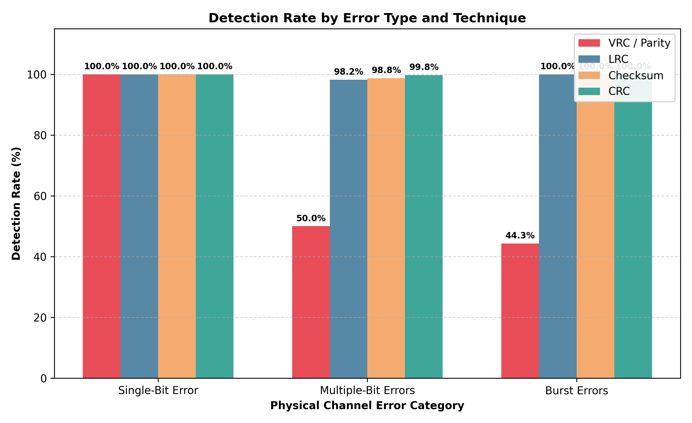
8. RESULTS & PERFORMANCE
Analytical Graph 1: Detection Rate by Error Type
Empirical Insights
• Single-Bit Errors: All 4 techniques achieve 100% detection rate. Single-bit errors are completely caught by any standard parity bit or checksum.
• Multiple-Bit Errors: VRC detection rate drops drastically (~50%) because any even number of corrupted bits preserves the original parity bit.
• Burst Errors: CRC and LRC demonstrate superior resilience, catching 100% of burst spans within their design parameters.
• Checksum Behavior: Catches >90% of random multiple-bit errors, but misses compensating errors where carry bits cancel out.

Slide 10
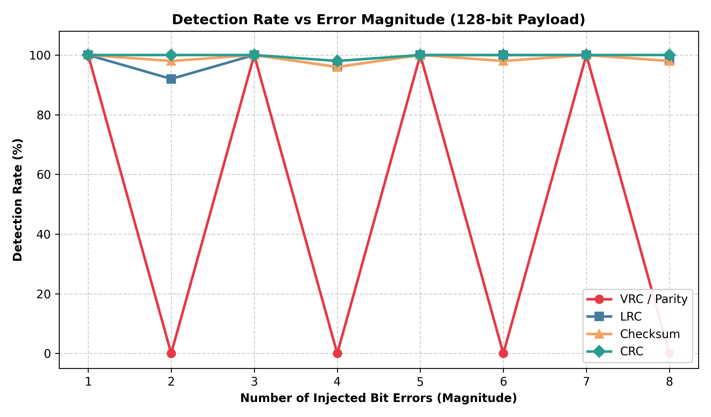
9. RESULTS & PERFORMANCE
Analytical Graph 2: Detection Rate vs. Error Magnitude
The Parity Paradox Demonstrated
• Oscillating Parity Curve: Graph clearly proves the textbook parity limitation:
- Odd bit errors (1, 3, 5): 100% Detection
- Even bit errors (2, 4, 8): Exactly 0% Detection
• LRC 2D Robustness: Because bits are distributed across 8 columns, LRC detects even errors provided they do not occur in the exact same column.
• CRC Immunity: CRC maintains a flat 100% line across almost all error magnitudes for standard payloads.
• Engineering Significance: Proves why simple parity is unsuitable for noisy physical media without higher-order checks.

Slide 11
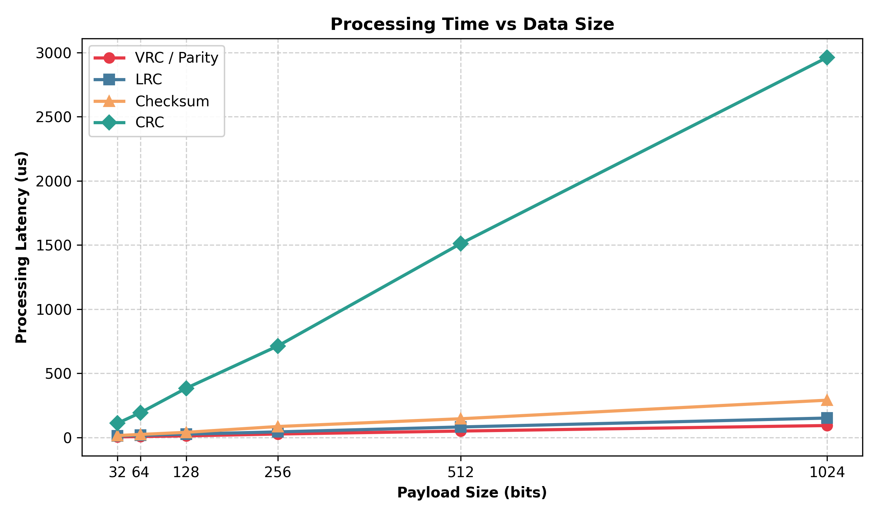
10. RESULTS & PERFORMANCE
Analytical Graph 3: Processing Latency vs. Data Size
Computational Complexity
• Linear Growth: All four techniques scale linearly O(N) with payload size, but with substantially different slope coefficients.
• VRC Latency: Minimal CPU time (single bitwise count/accumulation), making it ideal for low-power microcontroller links.
• Internet Checksum: Highly optimized in software due to native 8/16-bit integer ALU register additions.
• CRC Latency: Higher computational overhead due to modulo-2 polynomial division steps; modern NICs offload CRC to dedicated hardware silicon.

Slide 12
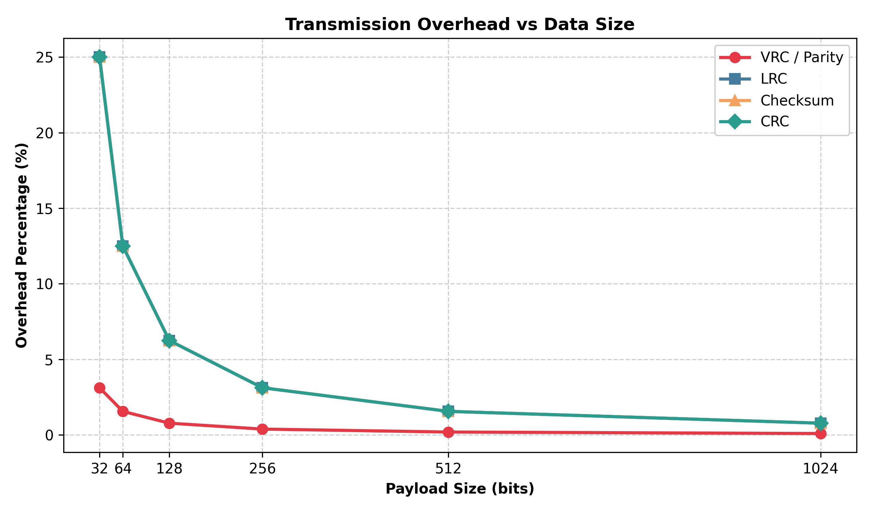
11. RESULTS & PERFORMANCE
Analytical Graph 4: Transmission Overhead vs. Data Size
Bandwidth Utilization Penalty
• Diminishing Overhead Ratio: Fixed-width check codes (VRC: 1 bit, CRC-16: 16 bits, Checksum: 8 bits) decrease in percentage overhead as payload grows.
• Short Frame Penalty: At 32-bit payload, CRC-16 incurs a 50% bandwidth penalty; at 512 bits, overhead drops to just 3.125%.
• LRC Block-Scaling: LRC requires an 8-bit check block, maintaining moderate overhead across varying data sizes.
• Protocol Design Rule: For tiny payloads (e.g. sensor telemetry), lightweight checksums or VRC save channel airtime; for MTU-sized packets (1500 bytes), CRC overhead is negligible (<0.2%).

Slide 13
12. COMPARATIVE EVALUATION
Comprehensive Comparative Matrix
Technique | Redundancy (Bits) | CPU Cost | Single-Bit | Even-Bit | Burst Errors | Primary Real-World Use
VRC / Parity | 1 bit | Minimal (O(1)) | 100% | 0% (Fails) | Poor | Async Serial, ASCII, RAM parity
LRC | 8 bits (block) | Low (O(N)) | 100% | Good* | Moderate | Magnetic tape, ISO 7816 Smart Cards
Checksum | 8 / 16 bits | Low (O(N)) | 100% | High (~90%) | Good | TCP, UDP, IP headers (Transport Layer)
CRC-16 / 32 | 16 / 32 bits | Moderate (Div) | 100% | 100% | Guaranteed* | Ethernet, Wi-Fi 802.11, HDLC, SATA

Slide 14
13. CONCLUSION
Conclusion & Engineering Recommendations
Key Takeaways
• 1. No Universal Solution: Error detection selection is an explicit engineering trade-off between channel error characteristics, bandwidth penalty, and computational latency.
• 2. CRC Dominance at Data Link: CRC-16 and CRC-32 remain the undisputed standard for physical and data link layers due to mathematical guarantees against burst and multi-bit errors.
• 3. Software Checksum Dominance at Transport: Internet Checksum remains optimal for host software TCP/IP stacks because 1's complement summation executes in ALU integer units without division overhead.
• 4. Modular Dual-Interface Success: The architecture cleanly decouples the mathematical backend from both the CLI and modern Flask web interface.
Future Scope & Extensions
• Error Correction Integration: Extend the simulation pipeline from detection-only to forward error correction (FEC) using Hamming Codes (7,4) and Reed-Solomon.
• Hardware Emulation: Implement lookup table (LUT) accelerated CRC algorithms to compare software bit-by-bit vs table-driven division speedups.
• Real-World Noise Modeling: Integrate statistical Gilbert-Elliott burst channel Markov models to simulate realistic fading wireless links.
• Automated ARQ Simulation: Implement Automatic Repeat reQuest (Stop-and-Wait, Go-Back-N, Selective Repeat) over detected frame corruptions.

Slide 15
Thank You!
Questions & Jury Discussion
GitHub Repository: https://github.com/purvaa211/dcn-error-detection-analysis
Project: DCN Error Generation, Detection & Comparative Analysis

