Slide 1
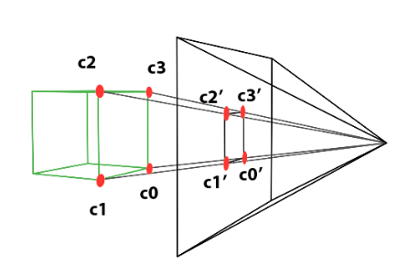
What is Ray Tracing?
Ray Tracing is a method of generating photo realistic images of the 3D scenes by tracing the path of light through each pixel in an image plane.
Aim is to find the intersection of the rays with a scene consisting of a set of geometric primitives like polygons, spheres, cones etc.

Slide 2
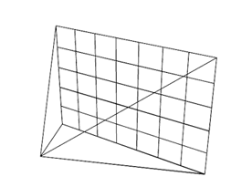
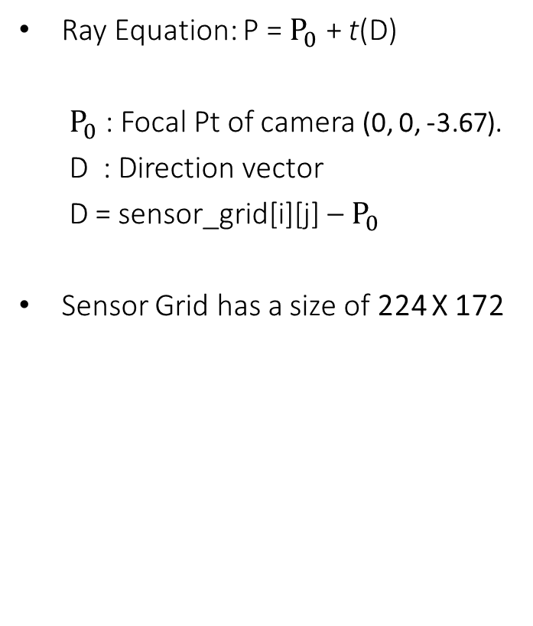

Construction of Rays
Ray Equation: P = $P_{0}$ + t(D)
$P_{0}$: Focal Pt of camera (0, 0, -3.67).
D : Direction vector
D = sensor_grid[i][j] – $P_{0}$
Sensor Grid has a size of 224 X 172
Sensor Grid
$$P_{0}$$

Slide 3
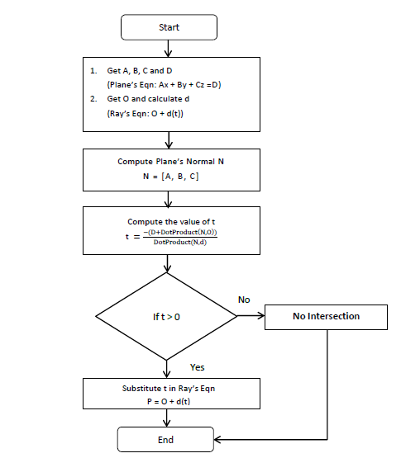
Ray-Plane Intersection

Slide 4
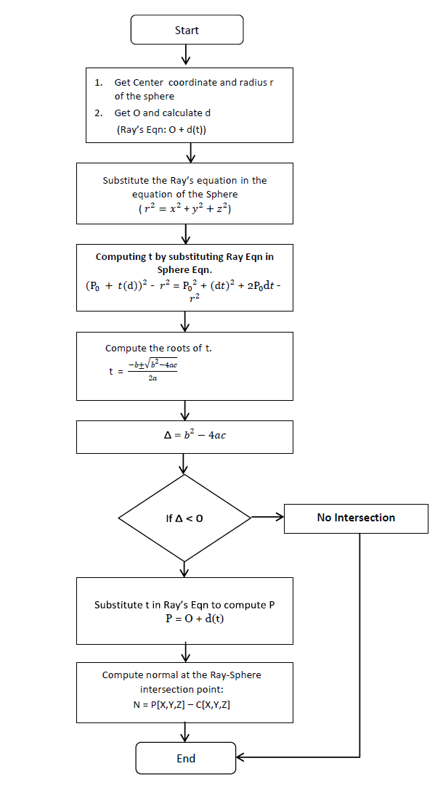
Ray-Sphere Intersection

Slide 5
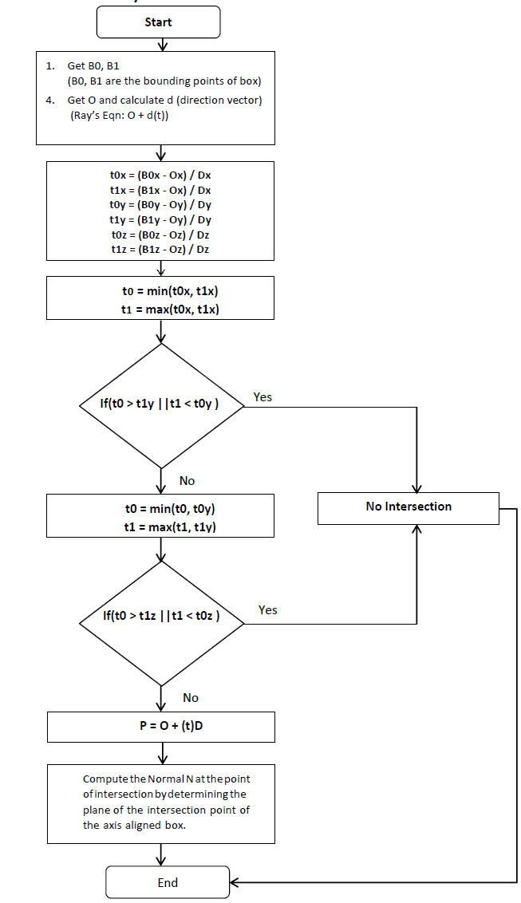
Ray-Box Intersection (AABB)

Slide 6
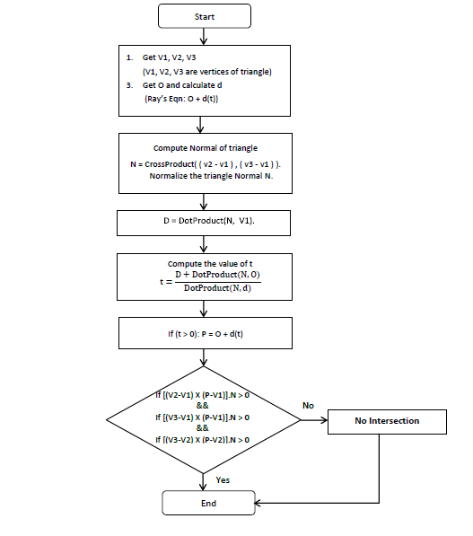
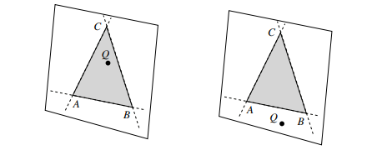
Ray-Triangle Intersection

Slide 7
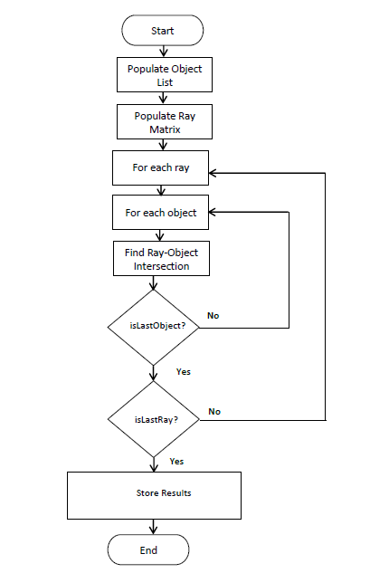
Sequential Algorithm

Slide 8
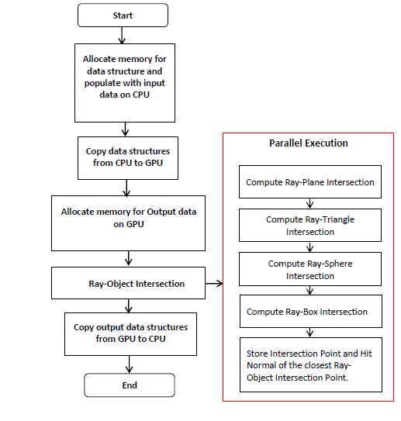
Parallel Algorithm

Slide 9
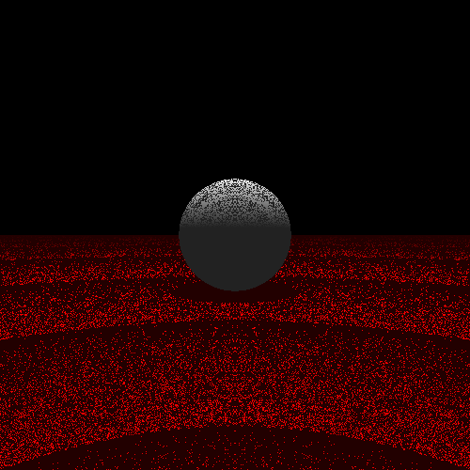
Object Visibility - Shadow Ray Tracing
Shadow Ray = Light_Source – RayObject IntersectionPoint
Normalize Shadow Ray.
Trace Shadow Ray recursively.
Remove Self Ray-Object Intersection
Use Double Precision
newIntersectionPoint = oldIntersectionPoint + bias*hitNormal

Slide 10
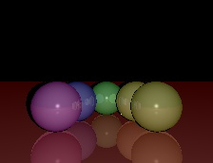
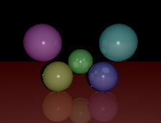
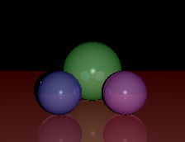
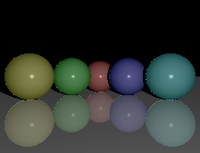
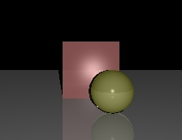
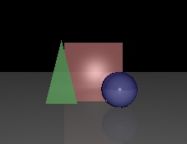
Outputs

Slide 11
GPU Specifications
GPU Architecture | GF117 | Jetson TX2 | GM107 | GV100
Cores | 96 | 256 | 640 | 5120
Memory Capacity | 2 GB | 8 GB | 2 GB | 16 GB
Memory Bus | 64 Bit | 128 Bit | 128 Bit | 4096 Bit
Power Consumption | 15 W | 50 W | 60 W | 300 W

Slide 12
GPU Results for Standard Shapes
Sr No | Object | CPU I-5200U (in secs) | GPU GeForce 820M Block Size: 1024 (in secs) | GPU Jetson TX2 1024 (in secs) | GPU GeForce 750Ti Block Size: 1024 (in secs) | GPU Volta V100 Block Size:1024 (in secs)
1. | Plane | 0.128000 | 0.026612 | 0.005975 | 0.005305 | 0.004813
2. | Sphere | 0.108000 | 0.013464 | 0.003085 | 0.002855 | 0.002716
3. | Triangle | 0.279000 | 0.013631 | 0.003281 | 0.002783 | 0.002656
4. | Box | 0.085000 | 0.013256 | 0.003295 | 0.002846 | 0.002586
5. | Plane, Triangle | 0.344000 | 0.015780 | 0.003105 | 0.002713 | 0.002609
6. | Plane, Sphere | 0.185000 | 0.014559 | 0.003159 | 0.002759 | 0.002664
7. | Plane, Box | 0.159000 | 0.015242 | 0.003219 | 0.002749 | 0.002597
8. | Triangle, Sphere | 0.325000 | 0.014261 | 0.002995 | 0.002727 | 0.002598
10. | Sphere, Box | 0.137000 | 0.014654 | 0.003058 | 0.002870 | 0.002595
11. | Plane, Triangle, Sphere | 0.442000 | 0.016918 | 0.003056 | 0.002708 | 0.002614
12. | Plane, Triangle, Box | 0.382000 | 0.014352 | 0.002998 | 0.002810 | 0.002300
13. | Triangle, Sphere, Box | 0.365000 | 0.017592 | 0.003586 | 0.003032 | 0.002252
14. | Plane, Sphere, Box | 0.213000 | 0.014864 | 0.003074 | 0.002781 | 0.002271
15. | Plane, Triangle, Sphere, Box | 0.508000 | 0.021761 | 0.003181 | 0.002804 | 0.002310

Slide 13
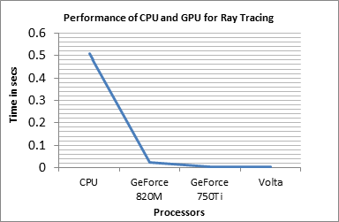
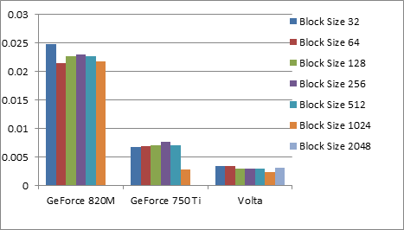
Conclusion
The parallel implementation was tested and analyzed on 4 GPUs viz- GeForce 820M, GeForce 750Ti, Jetson TX2 and Volta having 96, 640, 256 and 5120 CUDA cores respectively.
The block sizes from 32 to 1024 for GeForce 820M, Jetson TX2, 750Ti and from 32 to 2048 for Volta.
Highest speed up of 219.913 is obtained on Volta GPU for the block size 1024

Slide 14
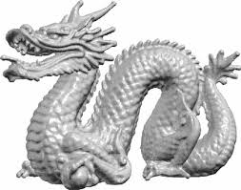
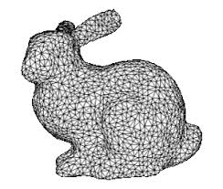
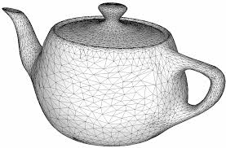
Generalization of Objects
Any object can be approximated as a Triangular Mesh

Slide 15
Challenges Of Ray Tracing
Highly computation Intensive.
Highly time-consuming
Triangles | 871,414
Ray-Triangle Intersections | 33573838592
Triangles | 69451
Ray-Triangle Intersections | 2675808128
Triangles | 6320
Ray-Triangle Intersections | 243496960

Slide 16
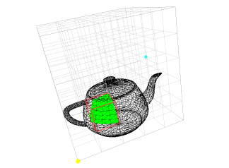
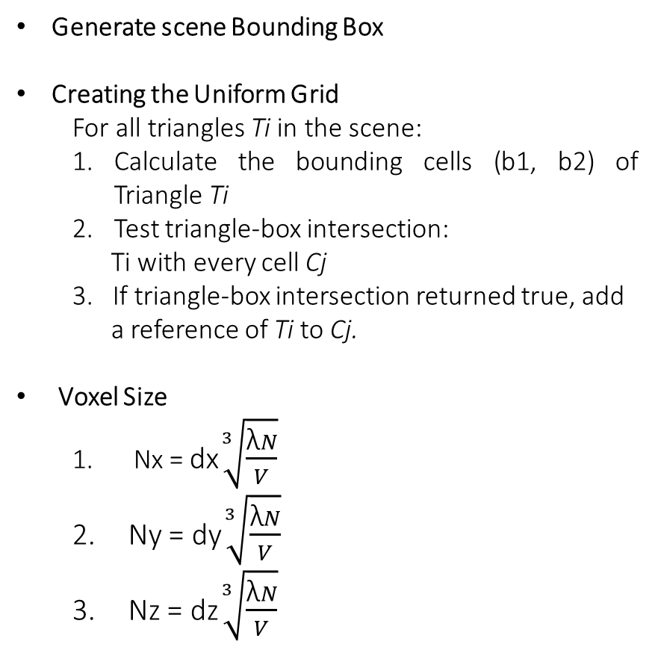
Accelerating Data Structure -Uniform Grid
Generate scene Bounding Box
Creating the Uniform Grid
For all triangles Ti in the scene:
Calculate the bounding cells (b1, b2) of Triangle Ti
Test triangle-box intersection:
Ti with every cell Cj
3. If triangle-box intersection returned true, add
a reference of Ti to Cj.
Voxel Size
Nx = dx$\sqrt[3]{\frac{\text{λ}N}{V}}$
Ny = dy$\sqrt[3]{\frac{\text{λ}N}{V}}$
Nz = dz$\sqrt[3]{\frac{\text{λ}N}{V}}$

Slide 17
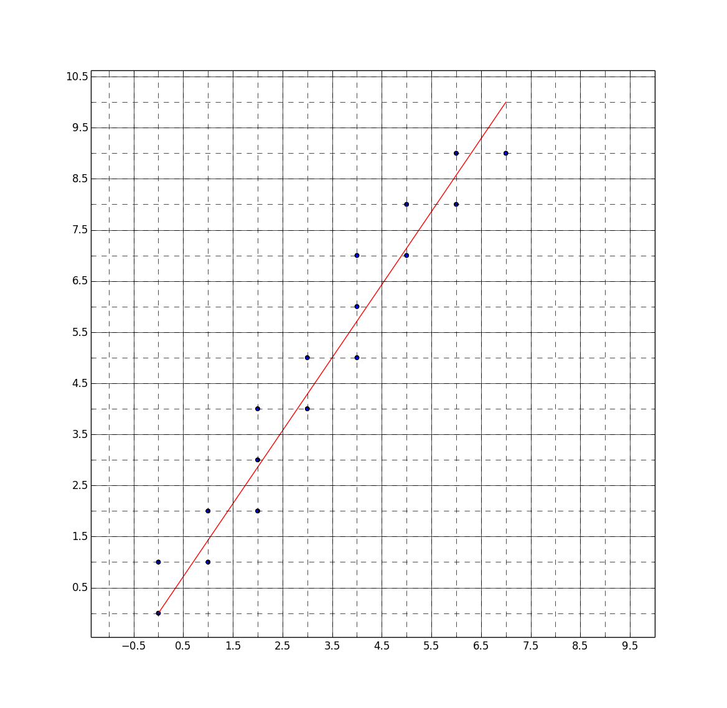
Uniform Grid Traversal
Paper Referred:
Fast Voxel Traversal Algorithm by John Amanatides
Algorithm
Initialization
tDelta
tMax
Step
Incremental Traversal

Slide 18
Uniform Grid Traversal
list= NIL;
do {
if(tMaxX < tMaxY) {
if(tMaxX < tMaxZ) {
X= X + stepX;
if(X == justOutX) return(NIL); /* outside grid */
tMaxX= tMaxX + tDeltaX;
} else {
Z= Z + stepZ;
if(Z == justOutZ) return(NIL); /* outside grid */
tMaxZ= tMaxZ + tDeltaZ;
}
} else {
if(tMaxY < tMaxZ) {
Y= Y + stepY;
if(Y == justOutY) return(NIL); /* outside grid */
tMaxY= tMaxY + tDeltaY;
} else {
Z= Z + stepZ;
if(Z == justOutZ) return(NIL); /* outside grid */
tMaxZ= tMaxZ + tDeltaZ;
}
}
List= ObjectList[X][Y][Z];
} while(list == NIL);
return(list);

Slide 19
Results using Spatial Data Structure
Triangles | 871,414
Ray-Triangle Intersections | 33573838592
Ray Triangle Intersections using Accelerated Data structures | 322992
Triangles | 69451
Ray-Triangle Intersections | 2675808128
Ray Triangle Intersections using Accelerated Data | 20960
Triangles | 6320
Ray-Triangle Intersections | 243496960
Ray Triangle Intersections using Accelerated Data | 5878

Slide 20
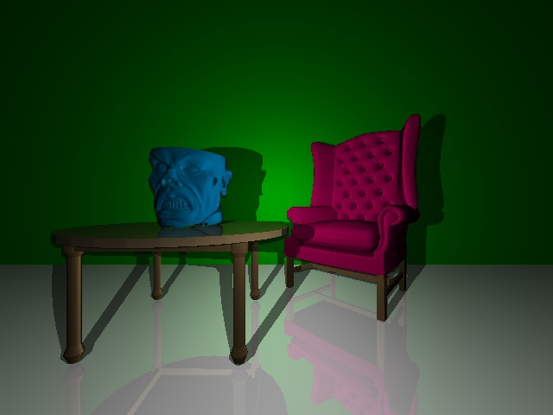
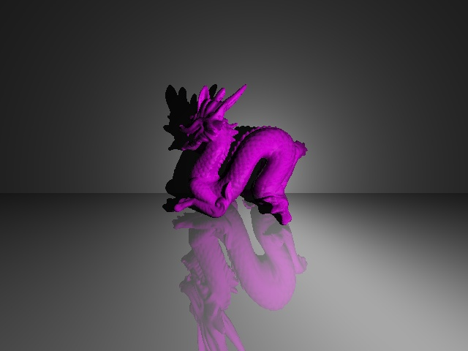
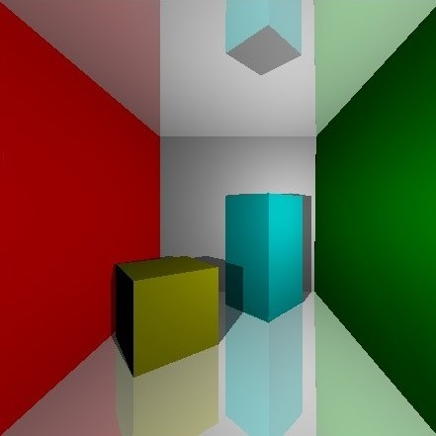
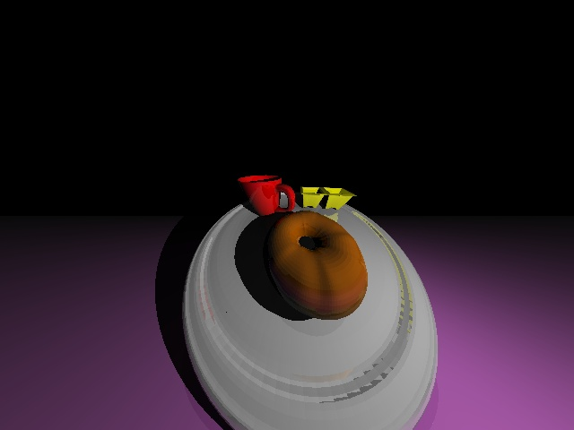
Output Images

Slide 21
References
[1] Dr.-Ing. Thorsten Ringbeck “A 3D time of flight camera for object detection”, Optical 3-D Measurement Techniques 09-12.07.2007 ETH Zürich Plenary Session 1: Range Imaging I
[2] Maik Keller, “A Simulation Framework for Time-Of-Flight Sensors”, IEEE International Symposium on Signals, Circuits and Systems 2007.
[3] White Paper: “NVIDIA’s next generation CUDA Compute Architecture”, 2014.
[4] T. Moller and B. Trumbore, “Fast, Minimum Storage Ray-Triangle ¨ Intersection,” Journal of Graphics Tools, vol. 2, no. 1, pp. 21–28, 1997.
[5] Kay, T. L., AND Kajiya, J. T, “Ray tracing complex scenes”, In Proceedings of the 13th Annual Conference on Computer Graphics and Interactive Techniques, ACM, New York, NY, USA, SIGGRAPH ’86, 269–278.
[6] J. Owens, “GPU Gems 2: Programming Techniques for High-Performance Graphics and General-Purpose Computation”, Addison-Wesley Professional, 2005, ch. Streaming Architectures and Technology Trends, pp. 457–470.
[7] R. Lange, “3D time-of-flight distance measurement with custom solidstate image sensors in CMOS/CCD-technology,” Ph.D. dissertation, University of Siegen, 2000.
[8] White Paper: “NVIDIA GeForce GTX 750 Ti”, 2014.
[9] G. Alenya “ToF cameras for active vision in robotics”, Sensors and Actuators A: Physical, Elsevier, 2014.
[10] White Paper, “NVIDIA TESLA V100 GPU ARCHITECTURE”, 2017

