Slide 1


SMART INDIA HACKATHON 2026
KrishiSetu
Problem Statement ID– SIH26033
Problem Statement Title –Farmer-first agricultural trading platform with pooled delivery
Theme – Agriculture, FoodTech & Rural Development
PS Category – Software
Team ID – SIH26-SW059
Team Name – Logic_Lords — Ramrao Adik Institute of Technology
The farmer names their price. Everything after that is shared transport and a bill you can read.
Working prototype live at krishisetu-weld.vercel.app
Notes:
Open with the problem in one line: a small farmer cannot fill a tempo alone, so hiring one eats the margin, and that is why the farmer keeps only a modest share of what the buyer finally pays. KrishiSetu pools the produce of several farmers all sending to the same neighbourhood, moves it once, and drops it at one pickup point a hundred households already live around. Close by saying this is a working application, not a mockup: every number in this deck is read out of the running system, and anything that is an estimate is labelled as one on the slide.

Slide 2
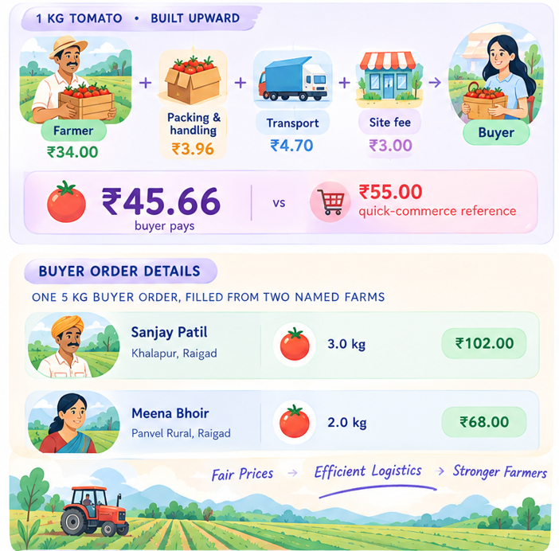
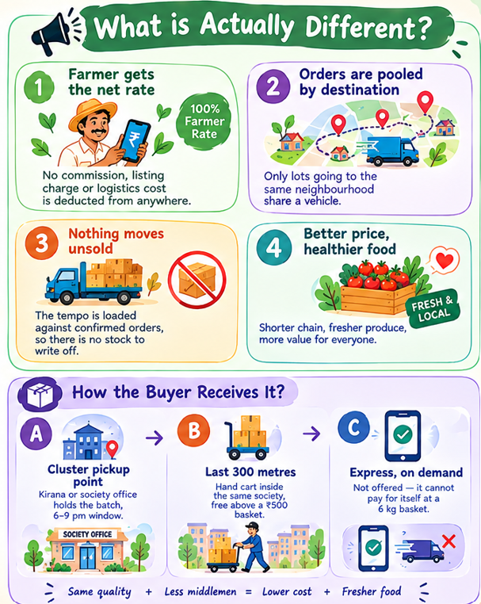
KRISHISETU — POOLED FARMER-FIRST DELIVERY
Logic_Lords
2
.
C
Worked with the same pricing function the live site uses. ₹55/kg is an assumed quick-commerce reference, not a live scrape.
@SIH Idea submission- Template
2
Notes:
The bar is the whole argument. We do not start from a retail price and work down to whatever is left for the farmer; we start from the rate the farmer accepted and add the real shared costs on top. Sanjay Patil and Meena Bhoir are named because a pooled consignment must never hide whose produce it is: one buyer order can draw from two farms, and each farm's kilograms and rupees stay its own row. On the right, note that door delivery is tier B, not the default. A weekly household basket is about six kilograms, so a dedicated rider drop would eat a tenth of the order value. Collection at a neighbourhood point is the default, the last 300 metres is a priced extra that is free above a ₹500 basket, and ten-minute express is deliberately not offered because at this basket size it cannot pay for itself.

Slide 3

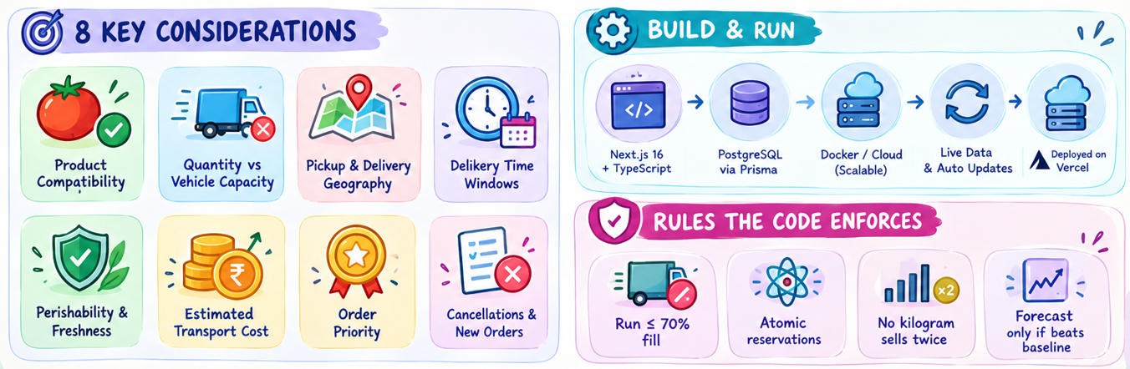
TECHNICAL APPROACH
Logic_Lords
Routing returns a feasible nearest-neighbour plan compared against a fixed-order baseline over the same stops. We do not claim a global optimum.
@SIH Idea submission- Template
3
Notes:
D-COA stands for Decision and Coordination Optimisation Algorithm. Say the full form out loud: it is our working name for the decision layer in our own codebase, not a claim that we invented or published a new algorithm. Walk the chain left to right, then explain the chips: five of the eight considerations are hard feasibility conditions, so if any one fails the order cannot be on that run. Cost and priority only rank among options that are already feasible, and a cancellation or new order forces a replan before dispatch. The important part for a judge: when an order is left out, the engine says which of these eight rules rejected it, in plain English, on the operator's screen. Nothing is a black-box score.

Slide 4
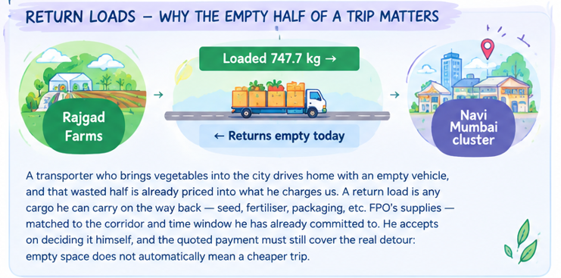
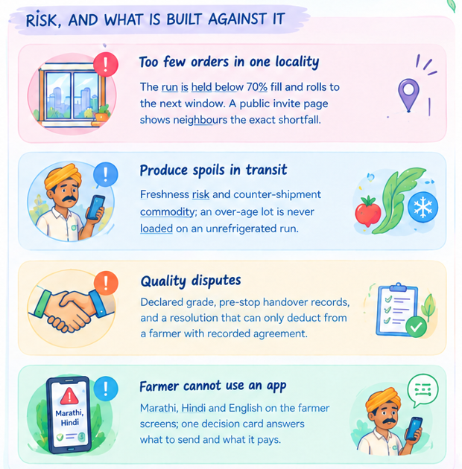
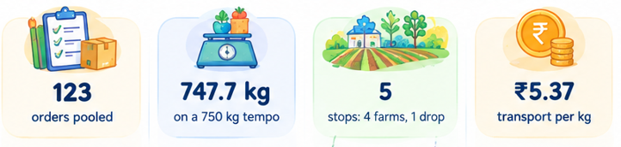
FEASIBILITY AND VIABILITY
Logic_Lords
Return-load matching is designed and specified; it is deliberately after the core proof, and is not claimed as shipped.
@SIH Idea submission- Template
4
Notes:
Return loads, in plain words: today a transporter brings vegetables into the city and drives back with an empty vehicle. He is already charging us for that empty half, because he has to. A return load — also called a backhaul — is any cargo he can carry on the journey home: seed, fertiliser, crates, an FPO's supplies. Because we already know his corridor, his time window and his spare capacity, we can offer him compatible work on the way back, which lowers the cost per kilogram of the outbound vegetable trip without anyone subsidising it. Two honest caveats: empty space does not automatically mean a cheaper or suitable trip, and the driver must accept the work with the payment covering the actual detour. It is specified but not yet shipped, and the slide says so. On the fill threshold: 123 orders filled a 750 kg tempo to 100 percent and brought transport down to ₹5.37 per kilogram. Below 70 percent we hold the run rather than deliver at a loss.

Slide 5
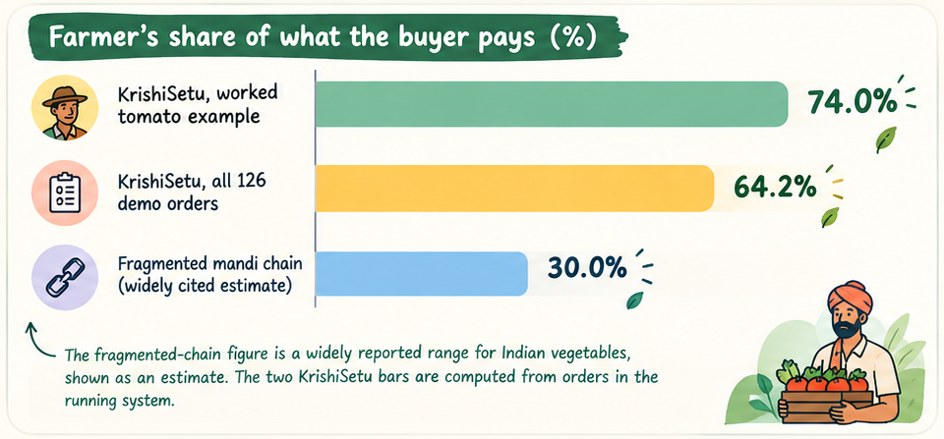
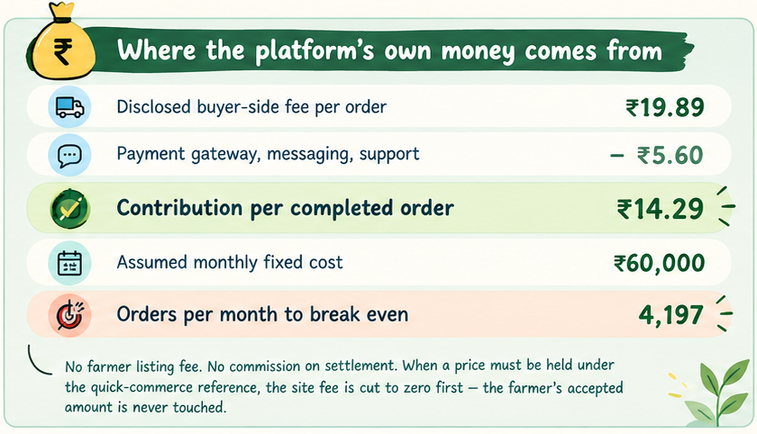
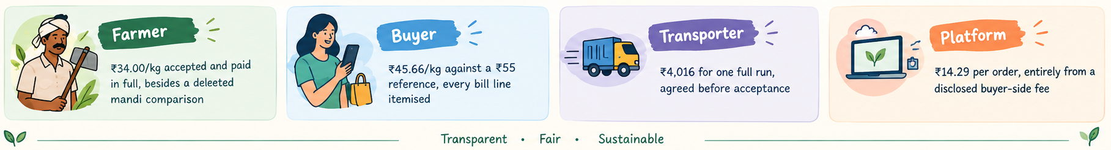
IMPACT AND BENEFITS
Logic_Lords
Figures are computed over synthetic demonstration orders, so they size the model rather than measure a business. No production cost is recorded, so no column here is farming profit.
@SIH Idea submission- Template
5
Notes:
Three claims, in order. First, the farmer keeps far more of the buyer's rupee: 64 percent across all 126 orders in the system, 74 percent on the worked tomato example, against the quarter-to-a-third widely reported for fragmented vegetable trade. That estimate is labelled as an estimate on the slide. Second, the buyer still pays less than the quick-commerce reference, so nobody is being asked to pay extra out of sympathy. Third, and this is the question every judge asks, where does our money come from. It comes from one disclosed line on the buyer's bill, ₹19.89 per order. After gateway and support costs we keep ₹14.29, so at an assumed ₹60,000 monthly fixed cost we break even at about 4,199 orders a month, roughly four clusters running twice a week. Be honest about the limit: a single-cluster pilot covers its fulfilment cost but not that fixed cost, and our own operator screen shows the shortfall. What we will not do is close it from the farmer's side.

Slide 6
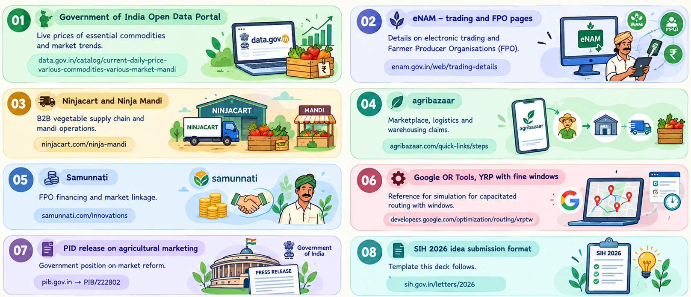
RESEARCH AND REFERENCES
Logic_Lords
What this does not prove: demand history and the fitted price series in the prototype are synthetic and labelled so on screen. An unmentioned capability on a competitor's public page is not evidence they lack it, and we claim no measured superiority without a comparable pilot.
@SIH Idea submission- Template
6
Notes:
Keep this slide short. The first source is live in the product, not just cited: the daily mandi price feed from the Government of India open data portal refreshes on a cron and every price on our screens carries its source label and date. The four incumbents are the ones we studied for gaps, and our positioning page states, for each gap, both what we built and where it stops. The routing reference is a formulation we follow, not a library we claim to have beaten. Then read the closing caveat aloud — the synthetic demand history is the honest limit of this prototype, and saying it first is stronger than being asked.

