Slide 1


SMART INDIA HACKATHON 2026
KrishiSetu
Problem Statement ID – SIH26033
Problem Statement Title – Farmer-first agricultural trading platform with pooled delivery
Theme – Agriculture, FoodTech & Rural Development
PS Category – Software
Team ID – SIH26-SW059
Team Name – Logic_Lords — Ramrao Adik Institute of Technology
The farmer names the price.
Everything after it is shared transport.
Working prototype · krishisetu-weld.vercel.app
Notes:
Open with the problem in one line: a small farmer cannot fill a tempo alone, so hiring one eats the margin, and that is why the farmer keeps only a modest share of what the buyer finally pays. KrishiSetu pools the produce of several farmers all sending to the same neighbourhood, moves it once, and drops it at one pickup point a hundred households already live around. Close by saying this is a working application, not a mockup: every number in this deck is read out of the running system, and anything that is an estimate is labelled as one on the slide.

Slide 2








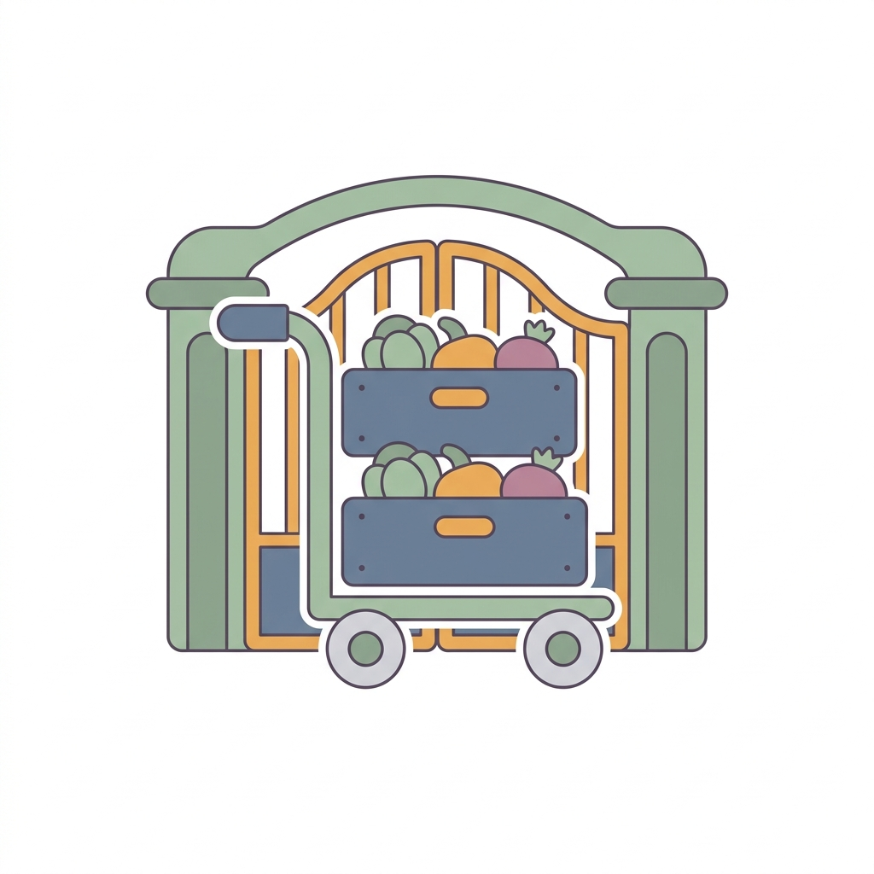

KRISHISETU — POOLED DELIVERY
Logic_Lords
The farmer's rate is an input to the price, never the leftover
ONE KILOGRAM OF TOMATO, BUILT UPWARD
WHAT IS ACTUALLY DIFFERENT
Farmer
Transport
Packing
Site fee
₹34.00
₹4.70
₹3.96
₹3.00
₹45.66 buyer pays vs ₹55.00 quick-commerce
Net rate
Pooled by place
Sold before loaded
nothing deducted, ever
one neighbourhood, one vehicle
no stock written off
ONE 5 KG ORDER · TWO NAMED FARMS
Sanjay Patil
3.0 kg
₹102.00
Khalapur, Raigad
Fresher, cheaper
Demand by place
Surplus re-placed
Meena Bhoir
₹68.00
shorter chain, lower price
Nerul 246 · Kharghar 207
151 kg split across three
Panvel Rural, Raigad
2.0 kg
HOW THE BUYER RECEIVES IT
Cluster pickup
Last 300 m
Express
₹10
₹20
not offered
Free above a ₹500 basket on the last 300 m. ₹55/kg is an assumed quick-commerce reference, not a live scrape.
Notes:
The bar is the whole argument. We do not start from a retail price and work down to whatever is left for the farmer; we start from the rate the farmer accepted and add the real shared costs on top. Sanjay Patil and Meena Bhoir are named because a pooled consignment must never hide whose produce it is: one buyer order can draw from two farms, and each farm's kilograms and rupees stay its own row. The six tiles on the right are what no competitor does together, and the last two are new: demand is forecast per neighbourhood, not just per crop, and an unsold lot is re-placed across the pickup points that can still take it inside its freshness limit. On delivery, note that the door drop is tier B, not the default. A weekly household basket is about six kilograms, so a dedicated rider would eat a tenth of the order value. Collection at a neighbourhood point is the default, the last 300 metres is free above a ₹500 basket, and ten-minute express is deliberately not offered because at this basket size it cannot pay for itself.

Slide 3




TECHNICAL APPROACH
Logic_Lords
D-COA — Decision & Coordination Optimisation Algorithm
Our own engine's working name, not a claim of a new published algorithm.
›
›
›
›
›
Confirmed orders
Compatibility
Lot allocation
Capacity & freshness
Route plan
Explained batch
EIGHT CONSIDERATIONS, EVERY RUN
Product compatibility
hard
Pickup & delivery geography
hard
Quantity vs vehicle capacity
hard
Delivery time windows
hard
Next.js 16 · PostgreSQL · Prisma
Vercel · live mandi prices, daily
Perishability & freshness
hard
Estimated transport cost
ranking
Order priority
ranking
Cancellations & new orders
replan
RULES THE CODE ENFORCES
• Under 70% fill, the run is held
• Atomic reservations: no kilogram twice
• A forecast shows only if it beats the baseline
Routing returns a feasible nearest-neighbour plan measured against a fixed-order baseline. We claim no global optimum.
Notes:
D-COA stands for Decision and Coordination Optimisation Algorithm. Say the full form out loud: it is our working name for the decision layer in our own codebase, not a claim that we invented or published a new algorithm. Walk the chain left to right, then explain the chips: five of the eight considerations are hard feasibility conditions, so if any one fails the order cannot be on that run. Cost and priority only rank among options that are already feasible, and a cancellation or new order forces a replan before dispatch. The important part for a judge: when an order is left out, the engine says which of these eight rules rejected it, in plain English, on the operator's screen. Nothing is a black-box score. The same engine answers the second question a farmer asks — not only what is in demand, but where an unsold lot should now go, ranked by which pickup point can still absorb it inside the freshness limit.

Slide 4




FEASIBILITY AND VIABILITY
Logic_Lords
Return loads, the fill threshold, and what can go wrong
RISK, AND WHAT IS BUILT AGAINST IT
RETURN LOADS — THE EMPTY HALF OF EVERY TRIP
Too few orders
loaded 747.7 kg ›
Held below 70% fill, rolls to the next window
‹ returns empty today
The empty half is already priced into what he charges us.
Spoilage in transit
Freshness is a hard constraint, per commodity
123
747.7 kg
5
₹5.37
Quality disputes
orders pooled
on a 750 kg tempo
stops: 4 farms, 1 drop
transport per kg
Graded, handover recorded, deduction by agreement
One real run, planned by the live system
Farmer cannot use an app
Marathi, Hindi, English · one decision card
Return-load matching is designed and specified. It sits deliberately after the core proof and is not claimed as shipped.
Notes:
Return loads, in plain words: today a transporter brings vegetables into the city and drives back with an empty vehicle. He is already charging us for that empty half, because he has to. A return load — also called a backhaul — is any cargo he can carry on the journey home: seed, fertiliser, crates, an FPO's supplies. Because we already know his corridor, his time window and his spare capacity, we can offer him compatible work on the way back, which lowers the cost per kilogram of the outbound vegetable trip without anyone subsidising it. Two honest caveats: empty space does not automatically mean a cheaper or suitable trip, and the driver must accept the work with the payment covering the actual detour. It is specified but not yet shipped, and the slide says so. On the fill threshold: 123 orders filled a 750 kg tempo to 100 percent and brought transport down to ₹5.37 per kilogram. Below 70 percent we hold the run rather than deliver at a loss.

Slide 5



IMPACT AND BENEFITS
Logic_Lords
More for the farmer, less for the buyer, and still self-funding
FARMER'S SHARE OF WHAT THE BUYER PAYS
Fragmented mandi chain
30.0%
WHERE OUR OWN MONEY COMES FROM
KrishiSetu · 126 orders
64.2%
Disclosed buyer-side fee, per order
₹19.89
Gateway, messaging, support
− ₹5.60
KrishiSetu · tomato example
74.0%
Contribution per order
₹14.29
Assumed monthly fixed cost
₹60,000
The fragmented-chain figure is a widely reported estimate. The two KrishiSetu bars are computed from orders in the running system.
Orders a month to break even
4,199
No listing fee. No commission. To hold a price, our fee is cut to zero first — never the farmer's amount.
Farmer
Buyer
Transporter
Platform
₹34.00/kg, paid in full
₹45.66/kg vs ₹55 reference
₹4,016 a run, agreed first
₹14.29, one disclosed fee
Figures are computed over synthetic demonstration orders: they size the model rather than measure a business. No column here is farming profit.
Notes:
Three claims, in order. First, the farmer keeps far more of the buyer's rupee: 64 percent across all 126 orders in the system, 74 percent on the worked tomato example, against the quarter-to-a-third widely reported for fragmented vegetable trade. That estimate is labelled as an estimate on the slide. Second, the buyer still pays less than the quick-commerce reference, so nobody is being asked to pay extra out of sympathy. Third, and this is the question every judge asks, where does our money come from. It comes from one disclosed line on the buyer's bill, ₹19.89 per order. After gateway and support costs we keep ₹14.29, so at an assumed ₹60,000 monthly fixed cost we break even at about 4,199 orders a month, roughly four clusters running twice a week. Be honest about the limit: a single-cluster pilot covers its fulfilment cost but not that fixed cost, and our own operator screen shows the shortfall. What we will not do is close it from the farmer's side.

Slide 6

RESEARCH AND REFERENCES
Logic_Lords
Sources, and what they do and do not prove
Government of India open data portal
LIVE IN APP
eNAM — trading and FPO pages
INCUMBENT
data.gov.in — daily mandi prices
enam.gov.in/web/trading-details
Ninjacart and Ninja Mandi
INCUMBENT
agribazaar
INCUMBENT
ninjacart.com/ninja-mandi
agribazaar.com/quick-links/steps
Samunnati
INCUMBENT
Google OR-Tools, VRP with time windows
METHOD
samunnati.com/innovations
developers.google.com/optimization/routing/vrptw
PIB release on agricultural marketing
POLICY
SIH 2026 idea submission format
FORMAT
pib.gov.in — PRID 2222802
sih.gov.in/letters/2026
What this does not prove: demand history and the fitted price series are synthetic and labelled so on screen. An unmentioned capability on a competitor's page is not evidence they lack it, and we claim no measured superiority without a comparable pilot.
Notes:
Keep this slide short. The first source is live in the product, not just cited: the daily mandi price feed from the Government of India open data portal refreshes on a cron and every price on our screens carries its source label and date. The four incumbents are the ones we studied for gaps, and our positioning page states, for each gap, both what we built and where it stops. The routing reference is a formulation we follow, not a library we claim to have beaten. Then read the closing caveat aloud — the synthetic demand history is the honest limit of this prototype, and saying it first is stronger than being asked.

