Slide 1
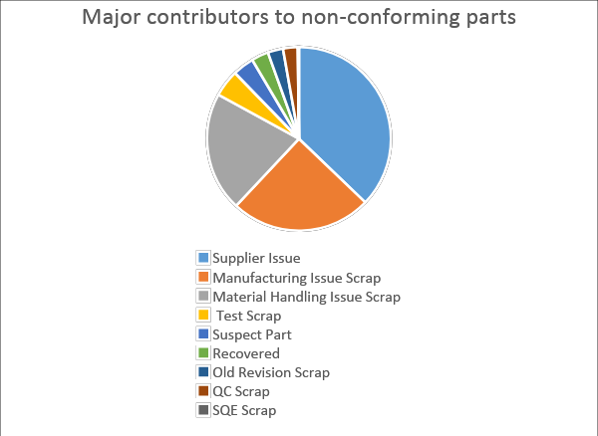
Project 1: Implementation of Material review and disposition process to reduce waste and scrap
Problem Statement: Waste generation due to lack of material disposition process for non-conforming parts
Objective: To implement a new process to identify disposition of non-conforming parts
Approach:
Understand the existing system
Identify the gaps in the processes
Analysis of parameters contributing to non-conforming parts
Utilize tools like 5 Whys and Value stream mapping
Observation:
Major contributors to non-conforming parts:
a. Supplier Quality issue(38%)
b. Manufacturing issue scrap(25%)
c. Material Handling(19%)
No robust process to review the rejections from the line causing repeated rejections

Slide 2
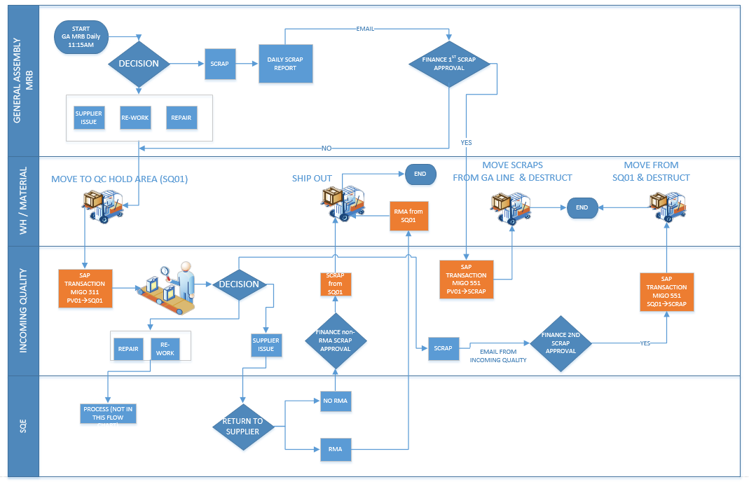
Continued...
Results:
New system implemented (As depicted in flowchart)
Improved communication and resolution
Supplier communication and RMA process implemented
Scrap reduction and cost recovery for SQ issues
Reduced Supplier Quality defects by 10%
Material Handling and kitting improved
Scrap reduction by 25% over period of 3 months
Improved productivity and efficiency

Slide 3
Project 2: Implementation of QMS and development of supplier scorecard
Problem Statement: Being a start-up, there is no formal communication of quality issues and systematic problem solving within timeline defined by 8D
Objective:
To introduce a problem solving method within a QMS through SAP
To develop a supplier scorecard linked with the system QMS to track supplier performance
Approach:
Identify of stakeholders and their requirements
Capturing all quality related data
Development of QMS system based on 8D methodology
Testing and validation of QMS system
Launching systematic problem solving through QMS to entire supplier base
Identification of KPIs for supplier scorecard

Slide 4
Continued...
Observation:
Inefficient methodology of problem solving
Proper documentation and supporting evidence of every step of 8D not available
Inadequate communication with the suppliers regarding the quality issues
Results:
Quality issues handled using 7 Diamond and 8Ds
QMS system rolled out internally
QMS system encourages proper problem solving methodology, thus helping in documentation of complete analysis including containment actions, root cause analysis and preventive actions
Issue related and inspection related data captured, thus avoiding discrepancies
Reduced time on containment activities
Next Action Items:
To formalize the supplier scorecard and connect this with the QMS system to auto-update the supplier scorecard thus reflecting real time data

Slide 5
Other responsibilities during current and previous roles:
Preliminary root cause analysis of daily quality issue
Supporting Incoming Quality Inspection
Reviewing of PPAP packages
Product Design and Development
Cross functional collaboration as and when required

