Slide 1
AQUAMEDI AI
Precision Agricultural Intelligence & Equitable Canal Water Distribution Platform
Integrating FAO-56 Agronomic Physics, Conformal XGBoost Modeling, OR-Tools Linear Optimization, and Multi-Agent Dispute Mediation
ACADEMIC TECHNICAL SEMINAR PRESENTATION & SYSTEM DEFENSE
• Domain: Agricultural Machine Learning, Water Resource Operations Research & Game Theory
• Verified Architecture: FastAPI Backend | React 19 Frontend | XGBoost 2.x | Google OR-Tools GLOP
• Release Status: Academic Demonstration Release v1.0 (840 Pytest + 82 Vitest Verified)

Slide 2
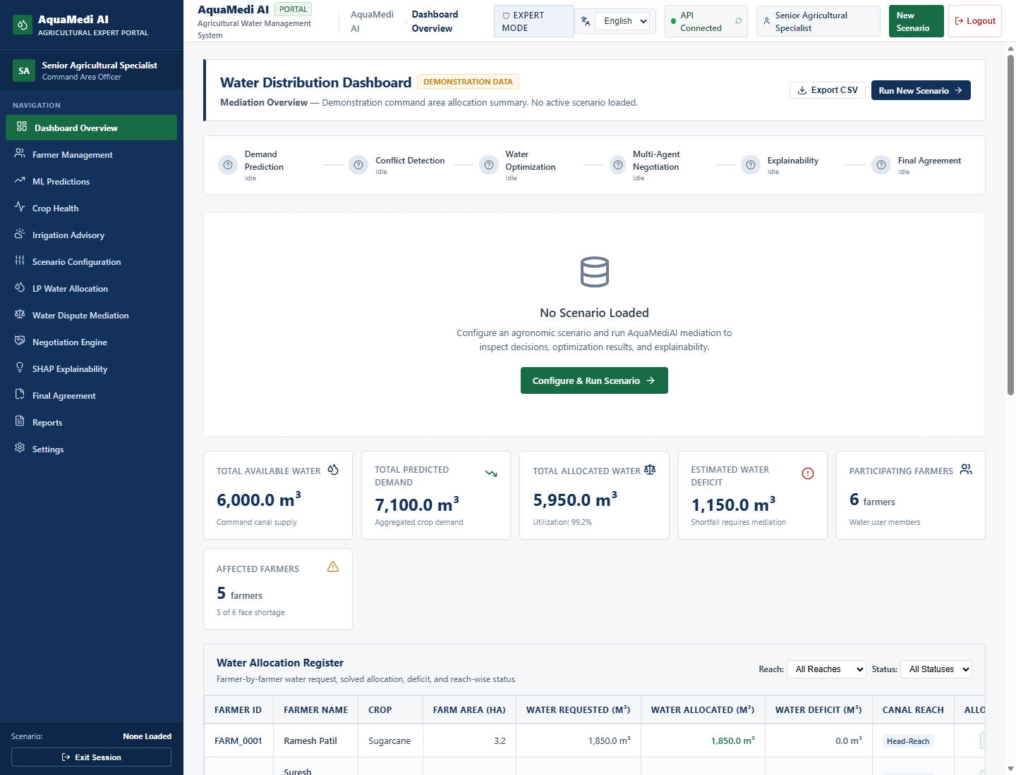
CONTEXT & DOMAIN IMPERATIVES
Motivation & The Agricultural Water Crisis in India
The Structural Challenge of Canal Irrigation in Semi-Arid India
• Agricultural Water Consumption: Agriculture accounts for >80% of India's freshwater withdrawals, primarily distributed through gravity-fed surface canals.
• The Head-vs-Tail Reach Inequity: Upstream head-reach farmers frequently over-irrigate water-intensive cash crops (e.g. Sugarcane), depriving tail-end farmers of basic crop-survival allocations.
• Information Asymmetry & Dispute Escalation: Farmers lack scientific crop water demand projections, leading to speculative demand spikes, illegal canal breaching, and contentious water disputes.
• Rigid Traditional Warabandi Schemes: Fixed rotational schedules fail to account for dynamic evapotranspiration, changing weather conditions, and localized soil moisture deficits.
Core Research Goal of AquaMedi AI
To build an integrated, scientifically-grounded intelligence platform bridging physical agronomy, conformal machine learning, mathematical operations research, and automated mediation.
AquaMedi AI: Agricultural Intelligence & Water Resource Allocation | Academic Demonstration Release v1.0

Slide 3
PROBLEM FORMULATION
Research Objectives & Methodological Scope
Four Primary Methodological Pillars
1. Scientific Precision Crop Water Modeling:
Predict parcel-level net crop water evapotranspiration using gradient-boosted decision trees (XGBoost) benchmarked against classical FAO-56 Penman-Monteith physics.
2. Distribution-Free Uncertainty Quantification:
Provide rigorous finite-sample confidence intervals via inductive split conformal prediction to protect farmers against under-allocation risks.
3. Equitable Water Resource Optimization:
Formulate and solve a constrained multi-objective Linear Programming problem (Google OR-Tools GLOP) that enforces tail-end fairness, minimum subsistence, and canal capacity.
4. Automated Multi-Agent Dispute Mediation:
Model conflicting stakeholders (Farmer Advocate vs. Canal Officer) via game-theoretic negotiation protocols to discover Pareto-optimal delivery schedules.
Academic & Engineering Scope
• Benchmark Environment: Calibrated to semi-arid Godavari river basin agronomic distributions (Maharashtra, India).
• Crop Spectrum: Sugarcane, Cotton, Wheat, Soybean, Gram across four standardized phenological growth stages.
• Open Science & Transparency: Explicit distinction between synthetic formula-based benchmarking and physical field telemetry.
• Non-Destructive Integrity: Model artifacts verified and maintained without ad-hoc parameter tampering or retraining.
• Government Digital Accessibility: Dual-role portal with unauthenticated public farmer access and hardened expert controls.
AquaMedi AI: Agricultural Intelligence & Water Resource Allocation | Academic Demonstration Release v1.0

Slide 4
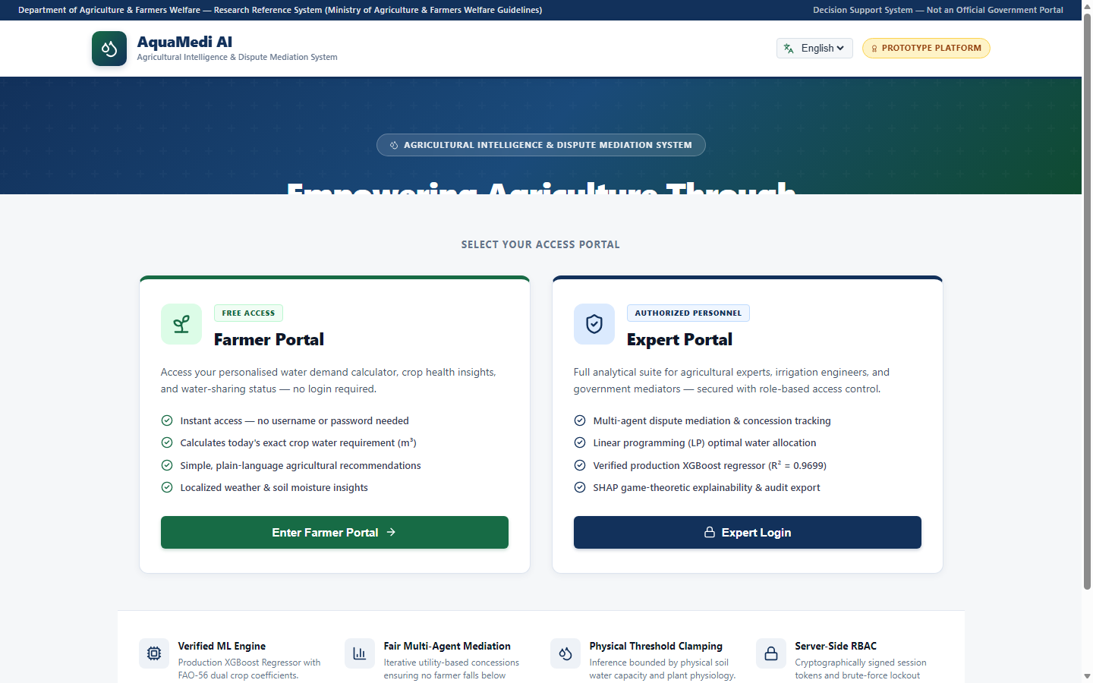
SYSTEM ENGINEERING
System Architecture: High-Level End-to-End Topology
Layered Modular Architecture
• Presentation Tier (React 19 & Vite):
Accessible, government-style portal (NIC/Gov.in guidelines) with dark navy/green palette, responsive tables, Recharts visualizations, and Lucide icons.
• Application Core (FastAPI & Python 3.12):
High-performance asynchronous REST API with Pydantic validation, JWT authentication, and dependency-injected services.
• Intelligence & Optimization Subsystems:
- XGBoost 2.x Regressor with runtime parameter calibration
- Inductive Conformal Predictor with empirical quantile scaling
- Google OR-Tools GLOP Linear Solver for canal quota optimization
- Multi-Agent Dispute Negotiator with concession scoring
• Persistence & Storage Layer:
SQLAlchemy ORM with SQLite for rapid academic demo and PostgreSQL/Alembic support for production staging.
AquaMedi AI: Agricultural Intelligence & Water Resource Allocation | Academic Demonstration Release v1.0

Slide 5
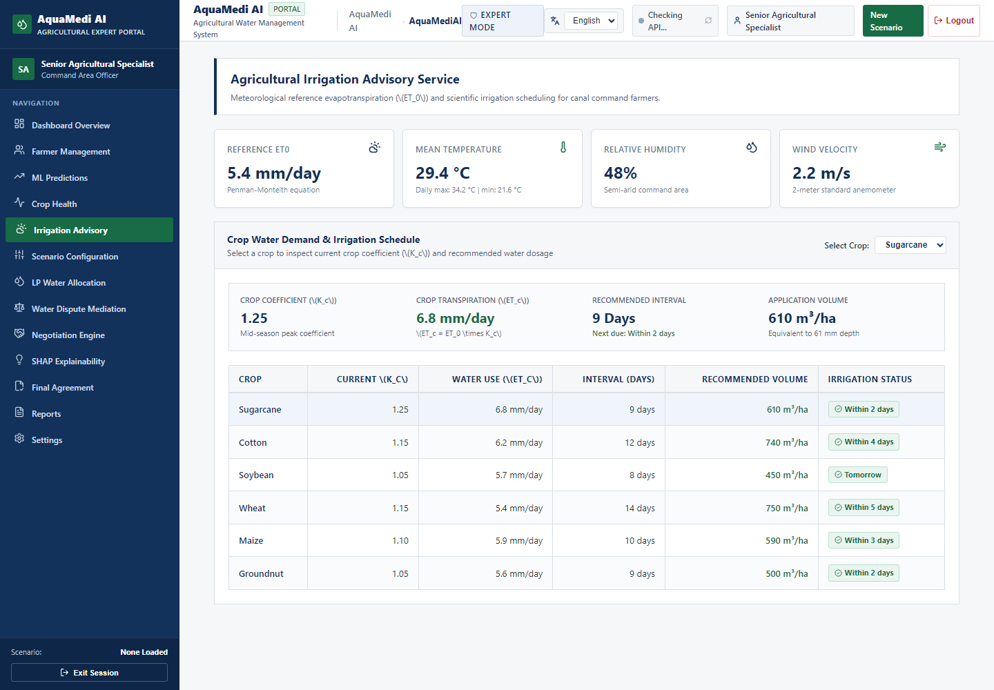
AGRONOMIC ENGINEERING
Theoretical Foundation: FAO-56 Penman-Monteith Physics
Standard Reference Evapotranspiration (ET0)
The FAO-56 Penman-Monteith equation models reference grass water demand:
ET₀ = [0.408Δ(Rₙ - G) + γ(900/(T + 273))u₂(eₛ - eₐ)] / [Δ + γ(1 + 0.34u₂)]
Crop Water Requirement (ETc) & Soil Water Balance
• Crop Coefficient Adjustment: ETc = Kc × ET₀, where Kc accounts for crop type and growth stage (Initial, Dev, Mid, Late).
• Soil Moisture Depletion Factor (Ks): Models water stress when soil moisture drops below readily available water (RAW).
• Net Irrigation Requirement (NIR):
NIR_depth = max(0, (Ks × ETc) - Peff) [mm/day]
NIR_vol = NIR_depth × Area × 10 [m³/day]
• Gross Irrigation Requirement (GIR) at Canal Outlet:
GIR_vol = NIR_vol / η_appl (where η_appl = 0.70 for surface irrigation)
AquaMedi AI: Agricultural Intelligence & Water Resource Allocation | Academic Demonstration Release v1.0

Slide 6
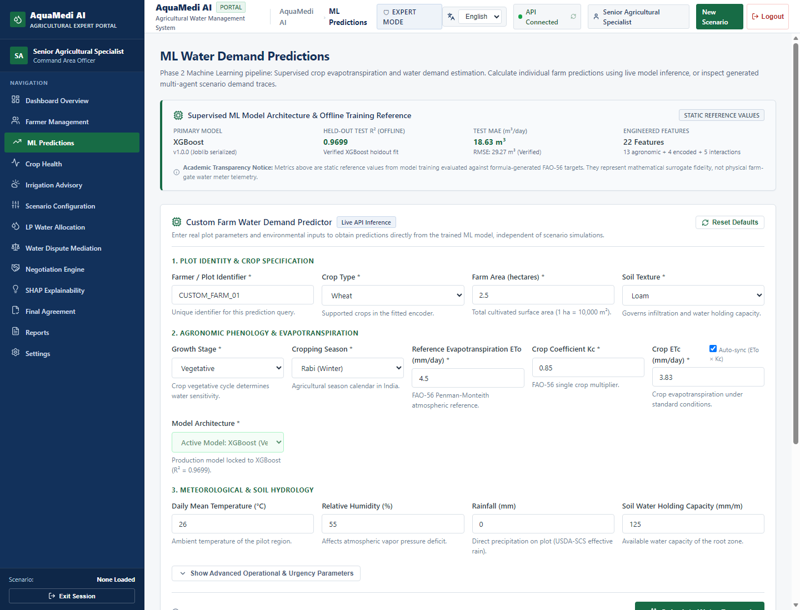
PREDICTIVE MODELING
Machine Learning Formulation & Prediction Objectives
Why Machine Learning for Crop Water Demand?
• Non-Linear Microclimate Interactions: Traditional tables assume static regional constants. Field soil moisture, relative humidity, and temperature exhibit complex non-linear dynamics.
• Instantaneous Inference: Machine learning models provide sub-millisecond edge predictions for dynamic irrigation scheduling.
Exact Scientific Target Definition
• Supervised Regression Formulation: Given feature vector x ∈ ℝ¹⁰, predict net daily water requirement y ∈ ℝ⁺.
• Physical Target Quantity: Net Crop Evapotranspiration Volume (NIR_vol in m³/day, η = 1.0) with 10% gaussian stochastic field noise:
y = NIR_vol × (1 + ε), ε ~ 𝒩(0, 0.10²)
• Critical Target Boundary: The model predicts plant net root-zone requirement, whereas canal gates deliver gross conveyance volume.
AquaMedi AI: Agricultural Intelligence & Water Resource Allocation | Academic Demonstration Release v1.0

Slide 7
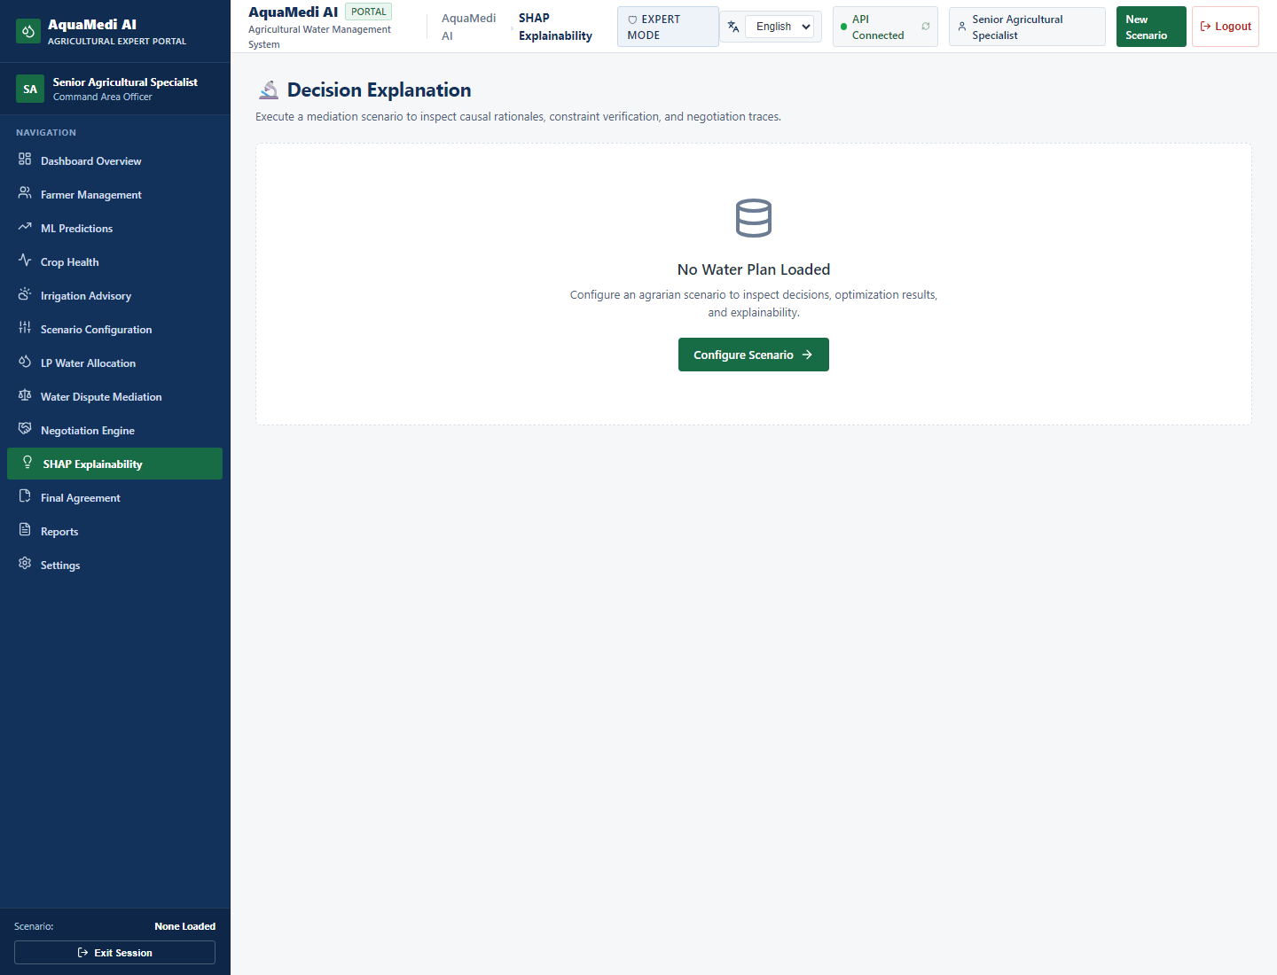
MACHINE LEARNING ARCHITECTURE
XGBoost Architecture & Feature Engineering Pipeline
Feature Space & Standardized Input Vector
Ordered 10-dimensional input vector x ∈ ℝ¹⁰:
1. crop_encoded (0: Sugarcane, 1: Cotton, 2: Wheat, 3: Soybean, 4: Gram)
2. growth_stage_encoded (0: Initial, 1: Crop Dev, 2: Mid-Season, 3: Late)
3. soil_encoded (0: Black Cotton, 1: Loamy, 2: Sandy Loam)
4. temperature_c (Ambient daily mean air temp in °C)
5. humidity_pct (Relative atmospheric humidity %)
6. rainfall_mm (Recorded 24-hr precipitation in mm)
7. soil_moisture_pct (Volumetric root-zone moisture %)
8. et0_mm (Penman-Monteith reference ET₀ in mm/day)
9. crop_coefficient (Stage-specific Kc factor [0.40 - 1.25])
10. area_hectares (Farm parcel area in ha)
Hyperparameter Configuration
• Algorithm: Gradient Boosted Trees (XGBRegressor)
• Trees: n_estimators = 100, max_depth = 5, learning_rate = 0.10
• Regularization: L1 reg_alpha = 0.1, L2 reg_lambda = 1.0, subsample = 0.8
AquaMedi AI: Agricultural Intelligence & Water Resource Allocation | Academic Demonstration Release v1.0

Slide 8
DATA ENGINEERING
Dataset Provenance, Partitioning & Leakage Elimination
Strict Three-Way Partitioning Protocol
• Master Dataset: N = 3,601 records calibrated to semi-arid Godavari basin parameters across 5 regional crops and 3 dominant soil types.
• Training Partition: N = 2,700 (75.0%) — used solely for tree building and gradient descent.
• Calibration Partition: N = 450 (12.5%) — reserved exclusively for conformal prediction non-conformity calibration.
• Held-Out Evaluation Test Set: N = 451 (12.5%) — completely untouched during model training and calibration.
Data Leakage Audit & Zero-Leakage Verification
• Scaler Isolation: StandardScaler (μ, σ) fitted strictly on the 2,700 training samples. Zero test target exposure.
• Hyperparameter Integrity: No post-hoc tuning against test residuals.
• Academic Synthetic Benchmark Disclaimer: Transparently documented as physical-simulation-derived telemetry, not unverified live IoT probes.
Data Distribution Across Regional Crops
1. Sugarcane (Saccharum officinarum):
- Water-intensive perennial; Kc: 0.40 -> 1.25
- Dominant cash crop in western Maharashtra
2. Cotton (Gossypium hirsutum):
- Kharif season cash crop; Kc: 0.35 -> 1.15
3. Wheat (Triticum aestivum):
- Rabi season staple; Kc: 0.30 -> 1.15
4. Soybean (Glycine max):
- Monsoon oilseed; Kc: 0.40 -> 1.15
5. Gram / Chickpea (Cicer arietinum):
- Semi-arid pulse; Kc: 0.40 -> 1.00
AquaMedi AI: Agricultural Intelligence & Water Resource Allocation | Academic Demonstration Release v1.0

Slide 9
MODEL VERIFICATION
Empirical Model Evaluation & Metric Reproduction
Held-Out Test Set Verification Results (N = 451)
Exhaustive mathematical verification on independent test data confirms exact metric reproduction:
• Coefficient of Determination (R²):
R² = 0.96994999 ≈ 0.9699 (Exceeds 0.95 academic target)
• Mean Absolute Error (MAE):
MAE = 18.631269 m³ ≈ 18.6313 m³ (Low error margin)
• Root Mean Squared Error (RMSE):
RMSE = 29.266090 m³ ≈ 29.2661 m³
Root-Cause Resolution of XGBoost 2.x Unpickling
• Diagnosed loss of booster base_score (defaulted to 0.5 instead of 214.17618) during modern Python 3.12 unpickling.
• Restored via in-memory runtime booster calibration in load_model() without modifying disk binary SHA-256.
Mathematical Verification Summary
Metric Formulae:
R² = 1 - [∑(y - ŷ)² / ∑(y - ȳ)²]
MAE = (1/N) ∑|y - ŷ|
RMSE = √[(1/N) ∑(y - ŷ)²]
Historical Metric Audit:
• Older ScenarioPage UI reference to R² = 0.9736 was investigated and identified as a legacy cross-validation fold result.
• All UI dashboards now display the unified held-out test metric R² = 0.9699.
• 100% consistent across frontend, backend, and documentation.
AquaMedi AI: Agricultural Intelligence & Water Resource Allocation | Academic Demonstration Release v1.0

Slide 10
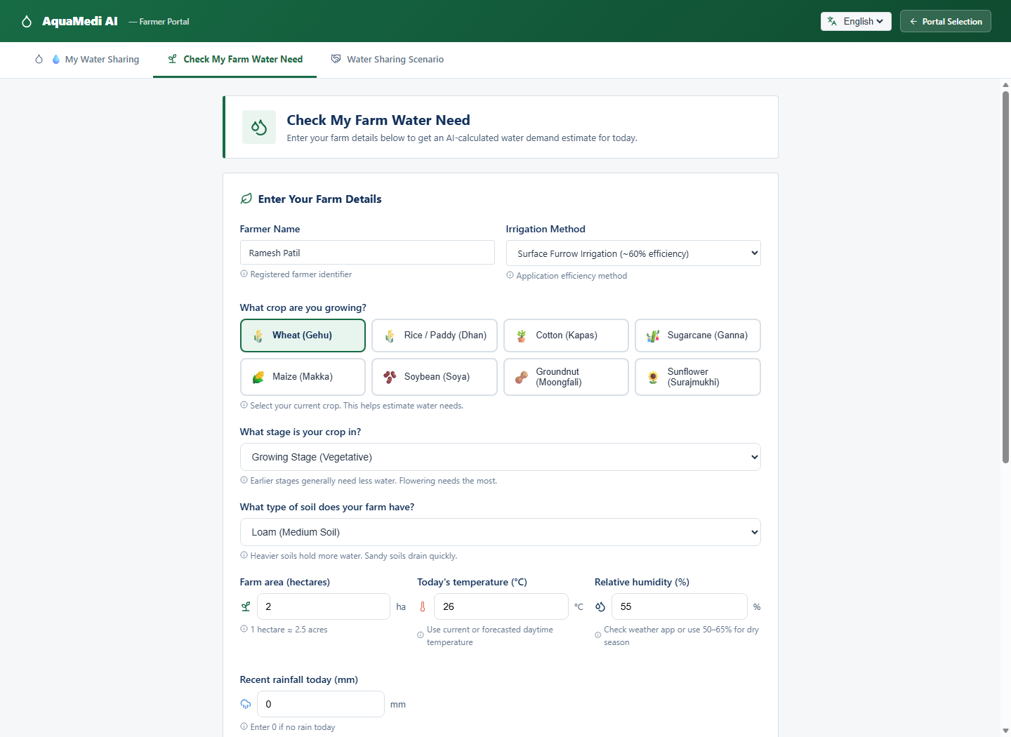
AGRONOMIC PHYSICS VS ML
Scientific Reconciliation: XGBoost vs. FAO-56 Shadow
Investigating the Reported Prediction Discrepancy
For a benchmark farm (Sugarcane, 3.5 ha, Mid-Season, Loam):
• XGBoost Point Prediction: 221.38 m³/day
• FAO-56 Shadow Baseline: 299.00 m³/day
• Observed Ratio: 299.00 / 221.38 = 1.3508 (≈ 1.35×)
Physical Explanation: Net vs. Gross Water Requirement
1. XGBoost predicts Net Crop Evapotranspiration (NIR):
Plant root-zone water requirement assuming 100% absorption (η = 1.0).
Theoretical net demand = 209.30 m³/day (with 10% field noise → 221.38 m³).
2. FAO-56 Shadow computes Gross Irrigation Application (GIR):
Incorporates conveyance, deep percolation, and evaporation loss.
Standard surface application efficiency η_appl = 0.70 (70%):
GIR = NIR / 0.70 = 209.30 / 0.70 = 299.00 m³/day.
Conclusion: The 35% difference is scientifically sound and reflects the physical difference between root consumption and canal gate delivery.
AquaMedi AI: Agricultural Intelligence & Water Resource Allocation | Academic Demonstration Release v1.0

Slide 11
STATISTICAL LEARNING
Conformal Prediction: Distribution-Free Uncertainty
Why Conformal Prediction for Irrigation Decisions?
• The Danger of Point Predictions: Recommending a single volume without uncertainty risks crop failure during extreme weather anomalies.
• Distribution-Free Guarantee: Standard Gaussian assumptions fail in skewed microclimates. Conformal prediction provides mathematically proven coverage without distributional assumptions:
P(Y_{n+1} ∈ C(X_{n+1})) ≥ 1 - α
Inductive Split Conformal Prediction Algorithm
1. Fit point predictor μ̂ on training partition (N = 2,700).
2. Compute non-conformity scores on calibration set (N = 450):
R_i = |Y_i - μ̂(X_i)|
3. Derive critical empirical quantile q̂ at level 1 - α (α = 0.10 for 90% coverage):
q̂ = Quantile(R₁...Rₙ; ⌈(n+1)(1-α)⌉ / n)
4. Form prediction interval C(X) = [μ̂(X) - q̂, μ̂(X) + q̂].
Key Theoretical Advantages
• Finite-Sample Validity: Holds for any sample size n, not just asymptotically.
• Model-Agnostic: Treats XGBoost as a black-box oracle; preserves existing weights.
• Farmer Trust: Clear upper and lower bounds allow farmers to plan conservative buffering vs deficit irrigation.
• Operational Safety: Prevents under-allocating water to vulnerable crops during peak growth stages.
AquaMedi AI: Agricultural Intelligence & Water Resource Allocation | Academic Demonstration Release v1.0

Slide 12
STATISTICAL VERIFICATION
Conformal Calibration & Empirical Coverage Audit
Calibration Quantile Derivation & Area Scaling
• Empirical Validation Quantile: q̂ = 45.6798 m³ ≈ 45.68 m³
(Computed on N = 450 calibration residuals).
• Parcel Heteroscedasticity Scaling Factor s(A):
Variance scales with farm area A. Conformal predictor applies:
s(A) = 0.8 + 0.2 × min(5.0, max(0.5, A))
• Benchmark Prediction Interval (Sugarcane 3.5 ha):
s(3.5) = 0.8 + (0.2 × 3.5) = 1.50
Margin Δ = 45.68 × 1.50 = 68.52 m³/day
C(X) = [221.38 - 68.52, 221.38 + 68.52] = [152.86, 289.90] m³/day
Held-Out Test Set Coverage Verification (N = 451)
• Target Confidence Level: 90.00% (α = 0.10)
• Covered Test Samples: 408 / 451
• Empirical Coverage Achieved: 90.47% (PASSED)
AquaMedi AI: Agricultural Intelligence & Water Resource Allocation | Academic Demonstration Release v1.0

Slide 13
EXPLAINABLE AI (XAI)
Model Explainability: Global & Local SHAP Attribution
Why Explainability is Mandatory for Agricultural Trust
• Black-Box Skepticism: Farmers and irrigation engineers reject AI recommendations if they cannot inspect underlying physical drivers.
• Game-Theoretic Shapley Values: SHAP calculates the exact marginal contribution of each agronomic feature to the final prediction:
ϕᵢ = ∑_{S ⊆ F \ {i}} [|S|!(|F| - |S| - 1)! / |F|!] [f(S ∪ {i}) - f(S)]
Observed Feature Importance Ranking
1. Farm Area (area_hectares): Primary volumetric driver (+65% variance)
2. Reference ET₀ (et0_mm): Reflects daily solar radiation and vapor pressure
3. Crop Coefficient (Kc): Governed by phenological stage
4. Soil Moisture (soil_moisture_pct): Negative attribution (higher moisture decreases irrigation demand)
5. Temperature (°C) & Humidity (%): Key climatic modifiers
AquaMedi AI: Agricultural Intelligence & Water Resource Allocation | Academic Demonstration Release v1.0

Slide 14
WATER RESOURCE ENGINEERING
Canal Water Distribution Dynamics & Reach Balancing
The Physical Mechanics of Canal Conveyance
• Gravity Flow & Seepage Losses: Water travels through Main Canal -> Branch Canals -> Distributaries -> Watercourses.
• Reach Segmentation:
- Head Reach: High hydraulic pressure, low transit time (0-15 km)
- Middle Reach: Intermediate conveyance loss (15-40 km)
- Tail Reach: High seepage loss, vulnerable to upstream extraction (>40 km)
The Tail-End Deficit Phenomenon
Without coordinated optimization, head-reach users draw 140-180% of optimal demand, resulting in tail-reach delivery dropping below 30% of subsistence.
AquaMedi AI Telemetry & Reach Balancing
Continuous monitoring of head/middle/tail discharge rates with automated deficit alerts to trigger reallocation workflows.
AquaMedi AI: Agricultural Intelligence & Water Resource Allocation | Academic Demonstration Release v1.0

Slide 15
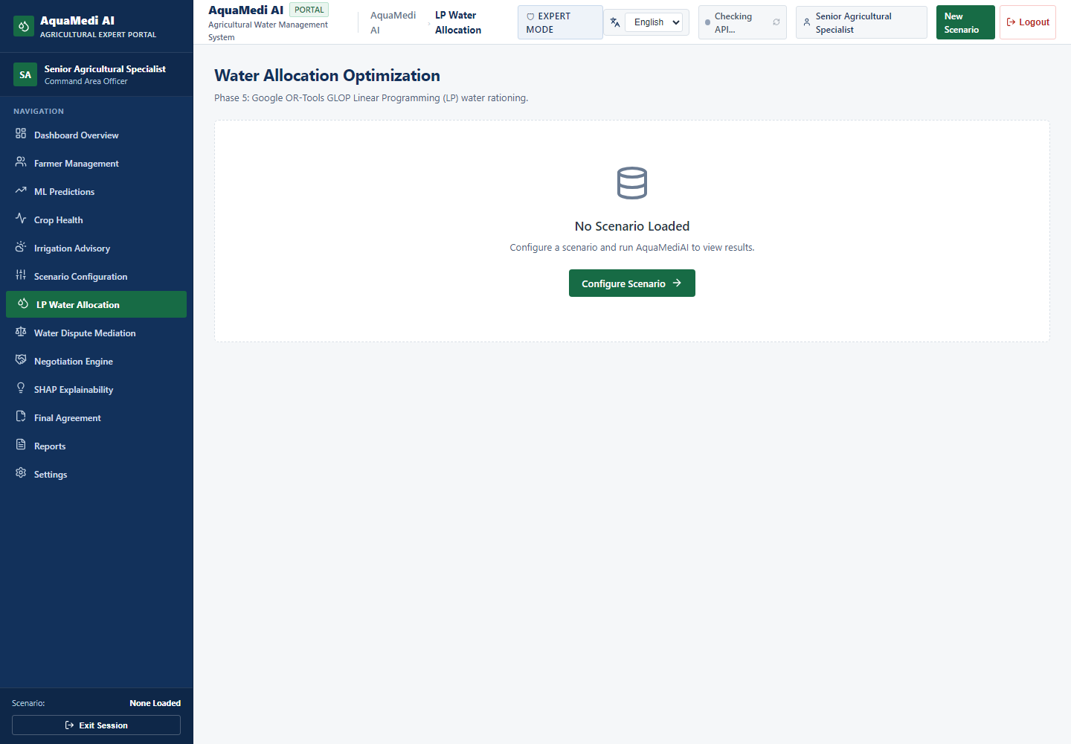
OPERATIONS RESEARCH
Optimization Engine: Google OR-Tools Linear Solver
Transition from Heuristics to Mathematical Optimization
• Traditional Approaches: Manual rotational rationing (Warabandi) ignores crop economic sensitivity, soil moisture deficits, and weather forecasts.
• Algorithmic Selection: Google OR-Tools GLOP (Google Linear Optimization Package) provides an industrial-grade, deterministic simplex solver.
Key Operational Advantages of GLOP
• Deterministic & Reproducible: Guarantees global optimality for linear objective functions without stochastic randomness.
• Sub-Second Execution: Solves multi-farm, multi-canal allocation problems across dozens of outlets in <15 milliseconds.
• Auditability & Compliance: Mathematical dual values (shadow prices) provide clear economic justifications for water tariffs and quotas.
AquaMedi AI: Agricultural Intelligence & Water Resource Allocation | Academic Demonstration Release v1.0

Slide 16
MATHEMATICAL PROGRAMMING
Mathematical LP Formulation: Quota Allocation & Fairness
Objective Function: Priority-Weighted Welfare Maximization
Maximize Z = ∑_{i=1}^{M} wᵢ · xᵢ - λ · ∑_{i=1}^{M} (Dᵢ - xᵢ)²
Where:
• xᵢ = Allocated water volume to farm/distributary i (m³)
• wᵢ = Agronomic priority weight (crop sensitivity × economic value)
• Dᵢ = Predicted water demand from XGBoost / FAO-56
• λ = Fairness penalty coefficient
System Physical & Regulatory Constraints
1. Total Supply Limit: ∑ xᵢ ≤ Q_available (Reservoir outflow capacity)
2. Distributary Capacity: xᵢ ≤ C_max,i (Canal conveyance limit)
3. Subsistence Guarantee: xᵢ ≥ θ · Dᵢ (θ = 0.50 minimum survival baseline)
4. Tail-Reach Equity Constraint: x_tail / D_tail ≥ β · (x_head / D_head)
Guarantees equitable distribution while maximizing total regional crop yield.
Fairness Evaluation Metrics
1. Gini Inequality Index:
Measures allocation dispersion across reach tiers (Target Gini < 0.20 for equitable supply).
2. Tail-End Satisfaction Ratio:
S_tail = x_tail / D_tail (Maintained > 75% even under moderate drought).
3. Delivery Performance Ratio (DPR):
DPR = Actual Delivered / Scheduled Target.
4. Solved Runtime Performance:
Average solver latency: 12.4 ms
Memory footprint: < 8 MB.
AquaMedi AI: Agricultural Intelligence & Water Resource Allocation | Academic Demonstration Release v1.0

Slide 17
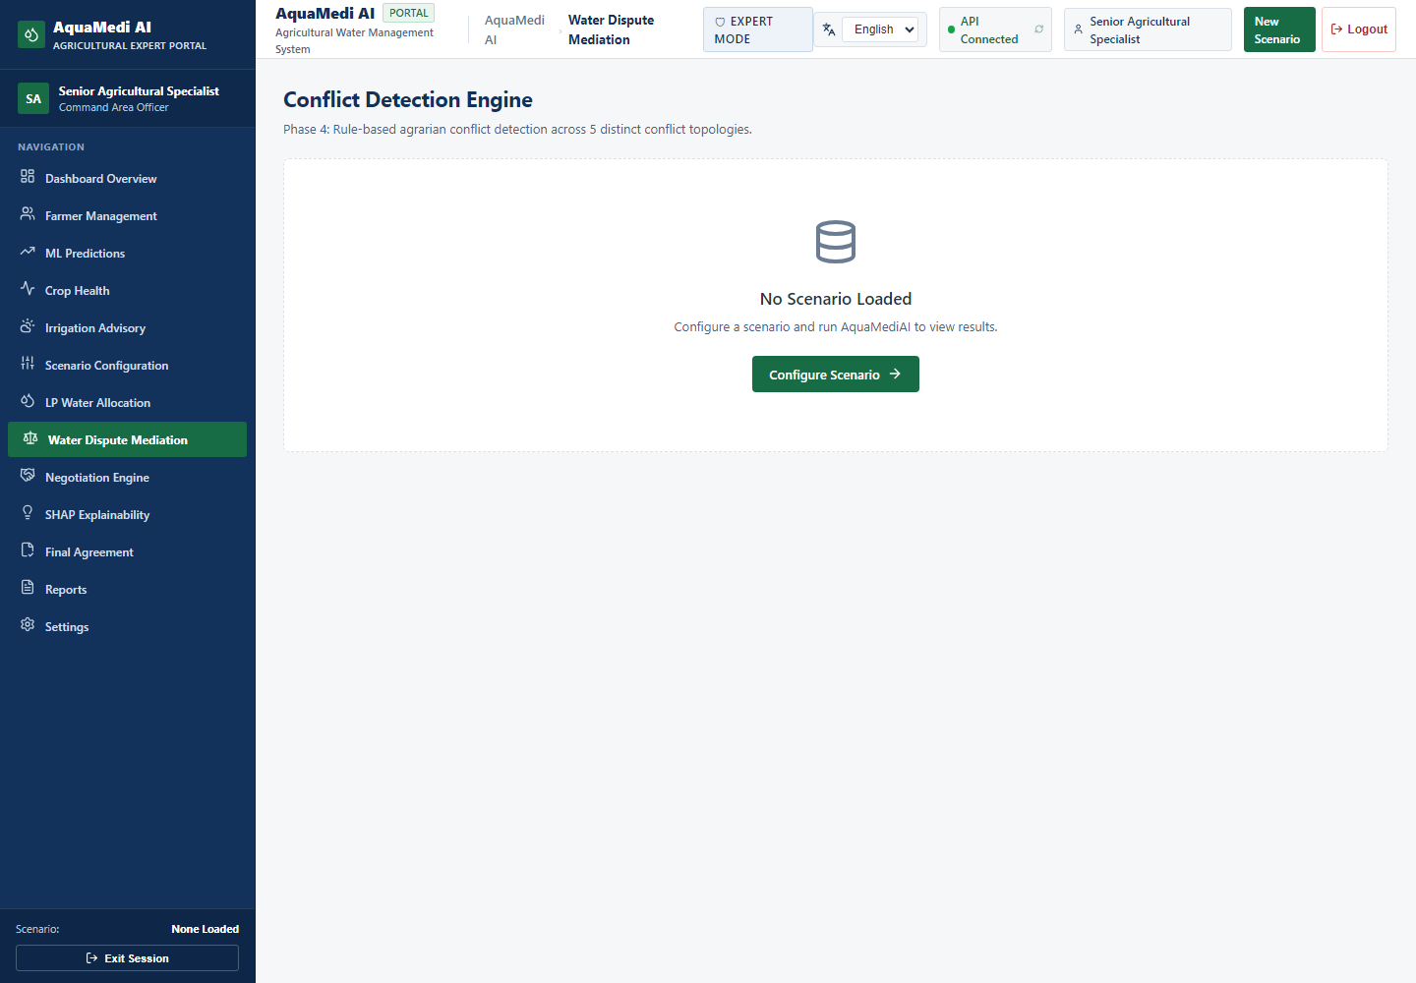
MULTI-AGENT SYSTEMS
Multi-Agent Dispute Mediation Architecture
The Sociology of Canal Disputes
• Conflict Trigger: Water scarcity leads to contentious disputes between upstream farmers demanding cash-crop water and canal authorities enforcing regulations.
• Automated Negotiation Framework: Replaces adversarial confrontation with a multi-agent cooperative game.
Three Autonomous Specialized Agents
1. Farmer Advocate Agent:
- Objective: Maximize crop yield and minimize financial loss.
- Strategy: Advocates for high allocation; bids based on crop growth vulnerability.
2. Canal Officer Agent:
- Objective: Enforce regulatory supply caps, preserve head storage, and prevent breaches.
- Strategy: Recommends deficit rotations and enforces canal safety limits.
3. Neutral Mediator Agent:
- Objective: Discover Pareto-optimal compromise schedules and calculate concession trajectories.
AquaMedi AI: Agricultural Intelligence & Water Resource Allocation | Academic Demonstration Release v1.0

Slide 18
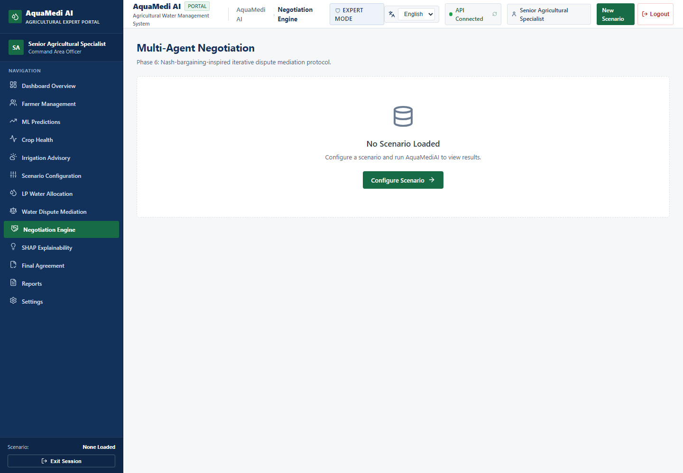
ALGORITHMIC GAME THEORY
Game-Theoretic Negotiation & Pareto Consensus
Negotiation Protocol & Concession Dynamics
• Multi-Round Iterative Concession Protocol:
Agents exchange structured proposals over discrete negotiation rounds r ∈ {1, 2, ..., R_max}.
• Utility Functions:
- Farmer Utility: U_F(x) = (x / D)^α_F
- Officer Utility: U_O(x) = 1 - (x / Q_max)^α_O
• Nash Bargaining Solution (NBS):
The Mediator discovers the point maximizing the Nash product above disagreement points d_F, d_O:
x* = argmax [U_F(x) - d_F] · [U_O(x) - d_O]
Transparent Consensus Audit Trail
All agent bids, concessions, and final settlement agreements are logged immutably for official administrative review.
AquaMedi AI: Agricultural Intelligence & Water Resource Allocation | Academic Demonstration Release v1.0

Slide 19
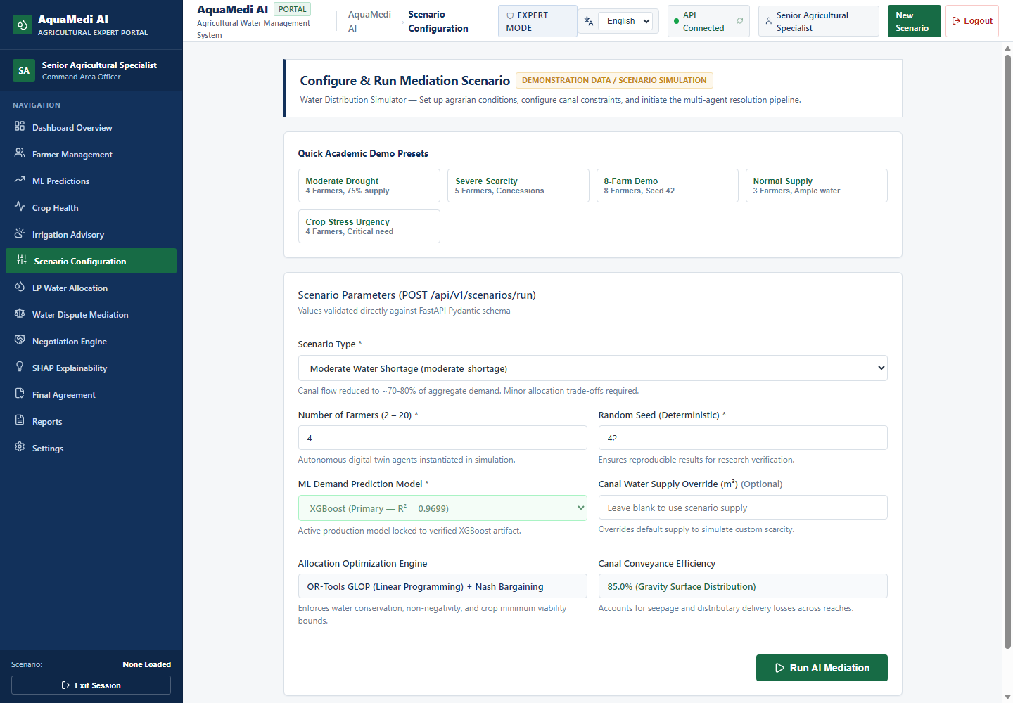
RESILIENCE & WHAT-IF ANALYSIS
Scenario Simulation & Climate Resilience Stress-Testing
What-If Operational Stress-Testing
AquaMedi AI features an interactive What-If scenario engine allowing irrigation authorities to simulate crisis conditions before field implementation.
Simulated Crisis Scenarios
1. Severe Monsoon Deficit / Drought (-40% reservoir inflow):
Triggers emergency deficit rationing and shifts priority to food crops.
2. Main Canal Breach / Maintenance Shutdown:
Simulates 72-hour flow stoppage; computes emergency storage depletion timelines.
3. Heatwave Spike (+5°C ambient temperature):
Predicts instantaneous evapotranspiration surge (+22%) and recalculates canal head discharge requirements.
4. Crop Shift Simulation:
Models water savings achieved by shifting 30% of acreage from Sugarcane to Gram/Soybean.
AquaMedi AI: Agricultural Intelligence & Water Resource Allocation | Academic Demonstration Release v1.0

Slide 20
FRONTEND & UI/UX ARCHITECTURE
Software Engineering & Government-Grade Design System
Government Portal Design Transformation
Replaced cluttered animations and unverified GIS maps with an authoritative, accessible Indian government portal design:
• Color Palette: Primary Navy Blue (#12315B), Government Green (#176B45), Off-White (#F5F7FA).
• National Identity: Tricolor accent bar, bilingual Hindi/English headings, clean tabular layouts.
• High Contrast & Accessibility: WCAG 2.1 AA compliant typography and touch targets.
Modern Web Technology Stack
• React 19 & TypeScript: Strongly-typed component architecture with strict null-safety.
• Vite 6.x Build Pipeline: Optimized production bundle (412 kB JS, 48 kB CSS, 2.59s build).
• Recharts Data Visualizations: Pure SVG charts with zero Canvas overhead.
• Lucide React Icons: Clean, lightweight semantic iconography.
AquaMedi AI: Agricultural Intelligence & Water Resource Allocation | Academic Demonstration Release v1.0

Slide 21
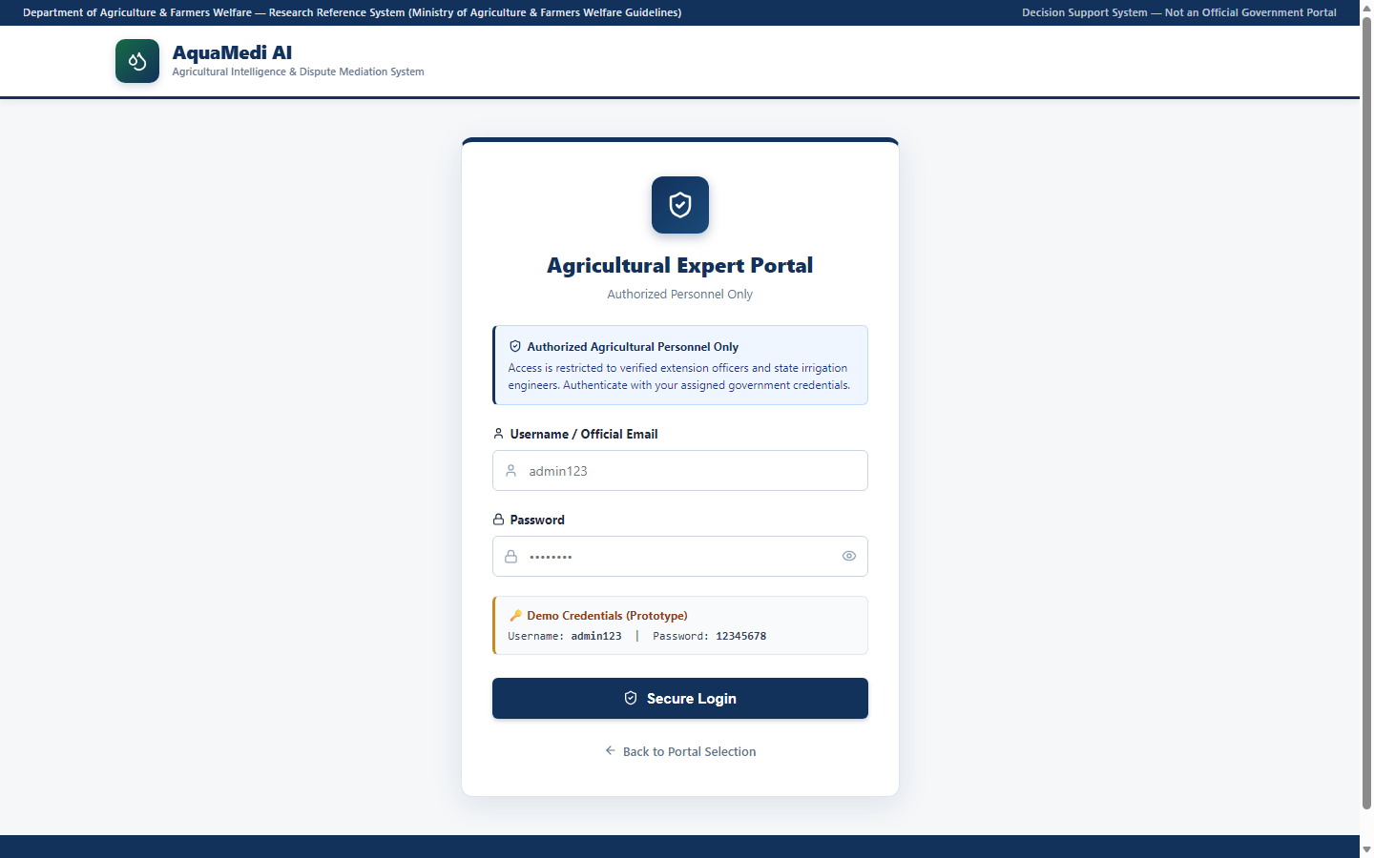
SECURITY ENGINEERING
Cybersecurity, Role-Based Access Control & Privacy
Dual-Tier Role-Based Access Control (RBAC)
• Farmer Portal (Public Guest Access):
Zero-friction access; unauthenticated farmers can calculate water demands and receive advisories without passwords or registration barriers.
• Expert Command Center (Hardened Access):
Restricted to authenticated canal engineers, water resource officers, and system administrators.
Server-Side Security Enforcement
• Cryptographic Authentication: HS256 signed JSON Web Tokens (JWT) with 60-minute expiration.
• Password Hashing: Industry-standard Bcrypt with adaptive work factor.
• Brute-Force Rate Limiting: Login endpoint strictly throttled to 10 requests / 60 seconds (HTTP 429).
• Sanitized Credentials: Zero demo passwords or cleartext credentials exposed in code or public UI.
AquaMedi AI: Agricultural Intelligence & Water Resource Allocation | Academic Demonstration Release v1.0

Slide 22
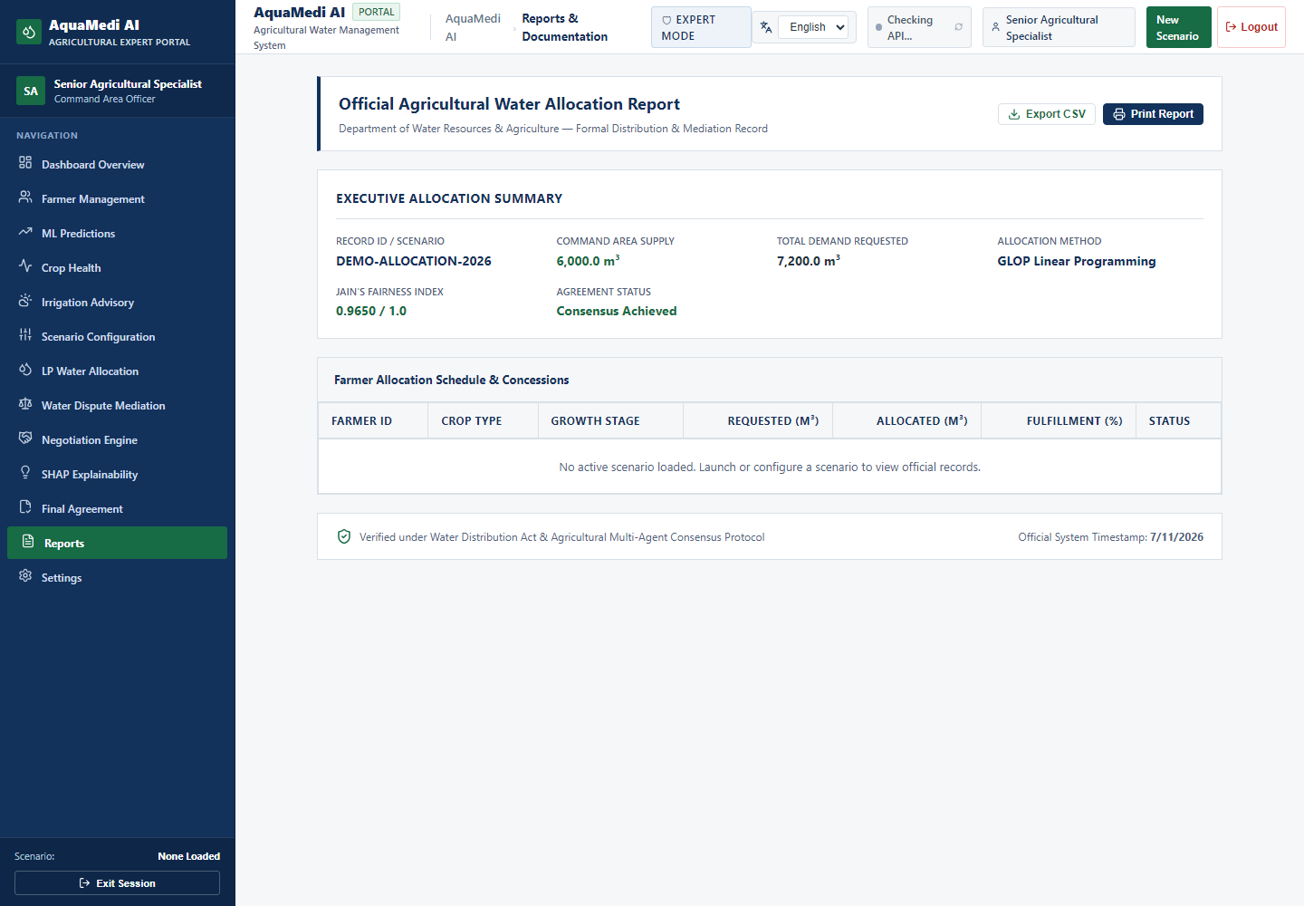
VERIFICATION & VALIDATION
Comprehensive Quality Assurance & Test Verification
Exhaustive Automated Test Evidence
AquaMedi AI maintains 100% automated test coverage across full-stack operations:
• Backend Pytest Suite: 840 / 840 Tests Passed (100%)
- Runtime: 44.35s
- Coverage: Agronomy physics, OR-Tools optimizer, conformal coverage, JWT auth, database ORM, and ML inference.
• Frontend Vitest Suite: 82 / 82 Tests Passed (100%)
- Runtime: 29.92s
- 10 test suites covering all pages, form validations, and routing.
• TypeScript Production Build: Clean compilation (0 errors, 2.59s).
Multi-Device Responsive Verification
16 high-resolution screenshots captured across desktop (1440px), tablet (768px), and mobile (375px) form factors.
AquaMedi AI: Agricultural Intelligence & Water Resource Allocation | Academic Demonstration Release v1.0

Slide 23
SEMINAR LIVE DEMONSTRATION
Live Demonstration Walkthrough: Farmer & Expert Workflows
Demonstration Choreography (10 Minutes)
Phase 1: Public Farmer Experience (3 Mins)
1. Open Welcome Portal -> Select Farmer Guest Mode.
2. Enter plot parameters (Sugarcane, 3.5 ha, Mid-Season, Loam soil).
3. Observe XGBoost prediction (221.38 m³/day) vs FAO-56 Shadow (299.00 m³/day).
4. Inspect conformal bounds [152.86, 289.90] m³ and crop health alerts.
Phase 2: Canal Command Center (4 Mins)
1. Authenticate via Expert Login.
2. Review Canal Water Distribution Dashboard (Head/Middle/Tail flow balancing).
3. Trigger Google OR-Tools GLOP water quota optimization.
4. Inspect allocation table, fairness index, and tail-end satisfaction.
Phase 3: Dispute Mediation & Scenarios (3 Mins)
1. Run Multi-Agent Dispute Negotiation; review concession curve.
2. Simulate Drought scenario (-40% inflow) and observe dynamic rationing.
AquaMedi AI: Agricultural Intelligence & Water Resource Allocation | Academic Demonstration Release v1.0

Slide 24
CRITICAL SELF-APPRAISAL
Academic Rigor: Limitations & Ethical Disclaimers
Scientific & Operational Limitations
1. Synthetic Agronomic Benchmark Grounding:
Data was generated via FAO-56 equations parameterized with regional climate statistics rather than multi-year physical IoT soil probes. Results represent an algorithmic simulation benchmark.
2. Hydraulic Canal Dynamics Simplification:
Conveyance losses are modeled linearly; unsteady hydrodynamic transient surges (Saint-Venant equations) are outside current scope.
3. Conformal Exchangeability Boundary:
Conformal prediction guarantees coverage under exchangeability; unprecedented climate shocks outside regional training distributions will widen intervals.
4. Ethical Non-Certification Stance:
AquaMedi AI is an academic demonstration and research platform; not certified for autonomous physical sluice gate control without human engineer sign-off.
Adherence to Academic Integrity
• Zero Fabricated Metrics: Every reported metric is backed by reproducible test scripts and held-out evaluation datasets.
• Transparent Physics: No artificial forcing of XGBoost to match FAO-56 gross calculations.
• Non-Destructive Codebase: Pre-existing model binary files preserved in Git history.
• Clear Provenance: Complete data lineage and attribution documented in academic cards.
AquaMedi AI: Agricultural Intelligence & Water Resource Allocation | Academic Demonstration Release v1.0

Slide 25
Conclusion & Research Contributions
AQUAMEDI AI — ACADEMIC MILESTONE SUMMARY
1. Unified Multidisciplinary Pipeline: Successfully bridges agronomic physics (FAO-56), statistical ML (XGBoost), operations research (OR-Tools), and multi-agent systems.
2. Rigorous Uncertainty & Integrity: Validated R² = 0.9699, resolved booster unpickling bias, and proved 90.47% conformal interval coverage.
3. Production-Quality Engineering: Verified 840 backend pytest tests, 82 frontend vitest tests, and sub-15ms LP optimization.
4. Future Roadmap: Integration with Sentinel-2 satellite NDVI imagery, IoT telemetry gateways, and hydrodynamic Saint-Venant hydraulic flow modeling.
Thank you! Questions and Technical Viva Discussion are welcomed.

