Slide 1
Web Technology - 2160708
Chapter-1
Intoduction

Slide 2
Content
Concept of WWW
Internet and WWW
HTTP Protocol :Request and Response
Web browser and Web servers
Features of Web 2.0

Slide 3
Concept of WWW
WWW is stands for World Wide Web.
The World Wide Web (WWW) is a global information medium which users can read and write via computer connected to the internet.
WWW is collection of software and corresponding protocols used to access the resources over the network.
In short, World Wide Web (WWW) is collection of text pages, digital photographs, music files,videos, and animations you can access using hyperlinks.

Slide 4
History of WWW
Tim Berners-Lee, in 1980 was investigating how computer could store information with random links.
In 1989, while working at European Particle Physics Laboratory, he proposed to idea of global hypertext space in which any network-accessible information could be referred to by single “universal Document Identifier”.
After that in 1990, this idea expanded with further program and knows as World Wide Web.
In 1990, Bernes -Lee intoduces tools HTTP,HTML,web browser.
In 1994 World Wide Web Consortium(W3C) was founded by Bernes-Lee
During 1996-1998 E-commerce intorduced.
During 1999-2000 dotcom intoduced
From 2000 to till date www has got evolving with efficient search engines and social networking sites and so on.

Slide 5
What is Internet?
The Internet is a massive network of networks, a networking infrastructure. It connects millions of computers together globally, forming a network in which any computer can communicate with any other computer as long as they are both connected to the Internet.
Information that travels over the Internet does so via a variety of languages known as protocols.
So we can says that Internet is network of computer which connect to together and any computer communicate with any other computer.

Slide 6
What is WWW (World Wide Web)?
The World Wide Web, or simply Web, is a way of accessing information over the medium of the Internet. It is an information-sharing model that is built on top of the Internet.
•The Web uses the HTTP protocol, only one of the languages spoken over the Internet, to transmit data. The Web also utilizes browsers, such as Internet Explorer or Firefox, to access Web documents called Web pages that are linked to each other via hyperlinks. Web documents also contain graphics, sounds, text and video.

Slide 7
Difference between Internet and WWW
The terms Internet and World Wide Web are often used without much distinction. However,the two are not the same.
The Web is a Portion of The Internet. The Web is just one of the ways that information can be disseminated over the Internet. The Internet, not the Web, is also used for email, which relies on SMTP, Usenet news groups, instant messaging and FTP. So the Web is just a portion of the Internet.

Slide 8
Difference between Internet and WWW
Internet | WWW
Internet is a massive network of networks, a networking infrastructure. | Internet is a massive network of networks, a networking infrastructure.
It connects millions of computers together globally forming a network in which any computer can communicate with any other computer a long as both are connected to internet. | It is an information sharing model that is built on the top of internet.
Information that travels over the internet does so via a variety of languages know as protocols | The web uses HTTP protocol, to transmit data
It does not utilize web browsers. It is the structure on which WWW is based | It is also utilizes browsers such as internet explorer or firefox to access web documents called web pages that are linked via hyperlinked
No such creator | It was created by Tim Berners lee in 1992

Slide 9
HTTP
HTTP stands for Hypertext Transfer Protocol.
HTTP is based on the client-server architecture model and a stateless request/response protocol that operates by exchanging messages across a reliable TCP/IP connection.
An HTTP "client" is a program (Web browser) that establishes a connection to a server for the purpose of sending one or more HTTP request messages. An HTTP "server" is a program (generally a web server like Apache Web Server) that accepts connections in order to serve HTTP requests by sending HTTP response messages.

Slide 10
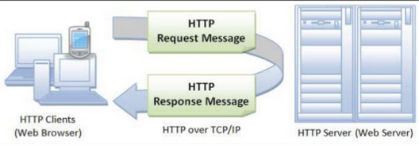

Slide 11
Features of HTTP
HTTP is communication protocol used between web browser and web server.
HTTP is connectionless: After a request is made, the client disconnects from the server and waits for a response. The server must re-establish the connection after it process the request.
HTTP is media independent: Any type of data can be sent by HTTP as long as both the client and server know how to handle the data content.
HTTP is stateless: This is a direct result of HTTP's being connectionless. The server and client are aware of each other only during a request. Afterwards, each forgets the other. For this reason neither the client nor the browser can retain information between different request across the web pages.
HTTP has Cache control: It automatically saves recently visited web pages. So, if user visit the same page again, then it can be displayed from cache.

Slide 12
HTTP Request Message structure
Like most network protocols, HTTP uses the client-server model: An HTTP client opens a connection and sends a request message to an HTTP server; the server then returns a response message, usually containing the resource that was requested. After delivering the response, the server closes the connection.
The format of the request and response messages are similar and will have following structure:
Start line
Header lines
A blank line
An optional message body like file, query data or query output

Slide 13
Start Line:
it consists three parts separeted by single space.
Request Method
Request- URI
HTTP Version
The request method indicates the method to be performed on the resource identified by the given Request-URI.
The method is case-sensitive and should always be mentioned in uppercase.

Slide 14
The following table lists all the supported methods in HTTP/1.1.
Method | Description
GET | The GET method is used to retrieve information from the given server using a given URI. Requests using GET should only retrieve data and should have no other effect on the data.
HEAD | Same as GET, but it transfers the status line and the header section only
POST | A POST request is used to send data to the server, for example, customer information, file upload, etc. using HTML forms.
DELETE | Removes all the current representations of the target resource given by URI.
CONNECT | Establishes a tunnel to the server identified by a given URI.
OPTION | Describe the communication options for the target resource.
TRACE | Performs a message loop back test along with the path to the target resource.

Slide 15
Request-URI
The Request-URI is a Uniform Resource Identifier and identifies the resource upon which to apply the request.
The URI is combination of URL ( Uniform Resource Locator) and URN (Uniform Resource Name).
The web address denotes URL and specific name of place or a person or a item denotes URN.
Every URI consists two parts:
The part before colon denotes scheme
The part after colon depend upon scheme
The URI are case sensitive , but generally written in lowercase.
HTTP Version:
Official version of HTTP is HTTP 1.1.

Slide 16
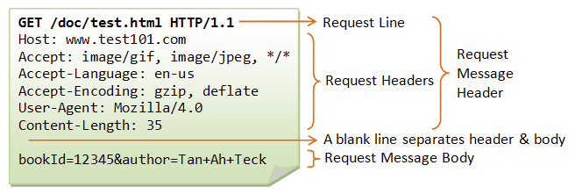
HTTP Request Message structure

Slide 17
HTTP Response Message structure
The format of the request and response messages are similar and will have following structure:
Status line
Header lines
A blank line
An optional message body
Status line consists three fields:
HTTP version: denotes vesrsion 1.1
Status code : indicates type of response
Reason phrase: indicates information about status code
For Ex: HTTP/1.1 200 OK
HTTP version Status Code Reason Phrase
Header field: same as in request message
Message Body: consists response of message

Slide 18
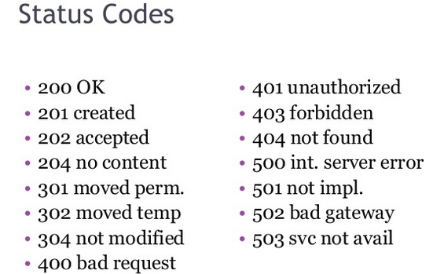
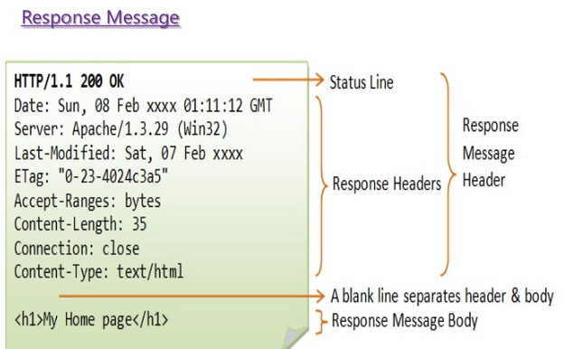

Slide 19
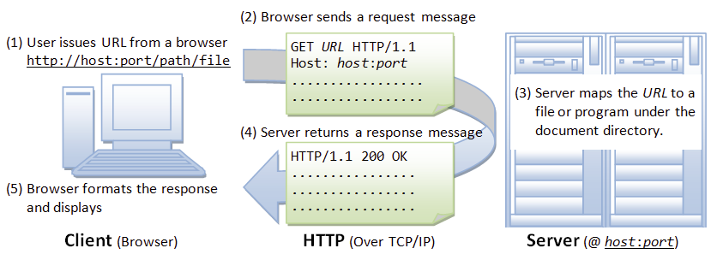
How HTTP Works

Slide 20
Difference between GET and POST
GET | POST
Requests data from a specified resource | Submits data to be processed to a specified resource
GET requests can be cached | POST requests are never cached
GET requests remain in the browser history | POST requests do not remain in the browser history
GET requests can be bookmarked | POST requests cannot be bookmarked
GET requests should never be used when dealing with sensitive data | POST requests used for sensitive data
GET requests have length restrictions | POST requests have no restrictions on data length

Slide 21
Limitations of HTTP Protocol
HTTP is not Secure
HTTP is stateless protocol.
HTTP is text based protocol

Slide 22
Web Browser
web browser is a software application for retrieving, presenting, and passing over information resources on the World Wide Web.
An information resource is identified by a Uniform Resource Identifier (URI) and may be a web page, image, video, or other piece of content”.
It is a software application to accesses information provided by Web servers.◻ Brings information resources to the user.◻ Retrieve, present, and traverse information resources on the World Wide Web.
Current Web browsers:◻
Internet Explorer for Mac◻
Internet Explorer for windows◻
Mozilla Firefox◻
Netscape◻
Safari◻
Opera◻
Google chrome

Slide 23
Web Browser
Web browser protocol--HTTP protocol
Scripting languages HTML,XML,DHTML,PHP—client side scripting
Server side scripting –JSP,ASP
Functions:
Reformat URL and send valid HTTP request
Converts website domain name to IP address
Establish connection with web browser while processing user request.
Sends HTTP request to the web server.
Web server processes the web request sent by web browser and return desired web page to the client machine. The web browser on client machine displays web page in appropriate format.
Web browser automatically stores most recently visited web pages. This feature is called cache control.

Slide 24
Web Server
Web server is a special type of server to which the web browser submits requests of web pages which is desired by client.
Web site is collection of web pages while web server is a software that respond to the request for web resources.

Slide 25
Web Server Operations:
1. First user types website address for demanding the desired web page . For Ex:
http://www.gtu.com/home.aspx
and then home page of this website appears on screen.
The web address is divided in three parts:
http: protocol whih tells web browser that user wishes to communicate with web server on port 80, which is reserved for communication between web browser and web server.
Server Address: tells web browser that which server it needs to contact to retrive information you are looking for.Web browser communicates with Domain Name Server (DNS) to find out IP addresses for communications.
Resource: that user wants to see.
2. The web browser after getting IP address ,need by communicating with name server , sends request directly to web server using port 80 asking for file home.aspx.
3. The web server sends html for this page back to user`s web browser, which reads HTML tags and formats them for viewing on the screen.

Slide 26
General Server Characteristics:
There are two types of directories for server. The roots of these directories are document root and server root. These directories and the subdirectories store the software required for server execution.
Server stores the documents that are readable to its client outside document root.
The virtual document trees are the areas from which the server can serve the documents to its clients.
Proxy servers allow the access to the web documents that are in the document root of other machine.
Web server support protocols such as HTTP,FTP,News and Mail.
Web server can interact with database systems with the help of CGI or Server side script.

Slide 27
Different types servers
Apache Web Server | IIS Web Server
Apache web server is operating system independent. It useful for both window and UNIX platform | IIS web server is operating system dependent. It runs only on windows environment
Apache is developed by Apache foundation. | IIS is developed by Microsoft
Apache server runs in user space and Kernal space | IIS server runs in user space
Apache webserver is open source i.e., Apache is known to be open source because the source code is available for configuration as per our requirements, its a linux based product | IIS is not Open Source

Slide 28
Role of Web server
Hosting websites refers to placing websites on web servers to bring them into access by people over internet. Web servers play a significant role in web hosting services as they form the key elements.
Functions performed by web servers in hosting:
Stores and secures website data: In web hosting services, a web server stores all website data and secures it from unauthorized users when it is properly configured.
Provides web database access:A web server’s responsibility is to provide access to websites that are hosted. Web hosting service providers own some web servers that are used in variable ways to provide different web hosting services, such as backend database servers.
Serve the end user requests: Web servers accept requests from different users connected over the internet and serve them accordingly.
Proxy Server is used to control, monitor or unbound the network traffic. Some proxy serve s cache the requested data.

Slide 29
Web 2.0
Web 2.0 simply retrieves the information .
Web 2.0 is used to focus on ability of people to collaborate and share information online.
Web 2.0 refers transition from static HTML web pages to more dynamic web.
It includes open communication with emphasis on web based communities of users.
Blogs, wikis are componenets of Web 2.0.
Features :
Users can collectively classify and find desired information.
User can obtain dynamic contents.
Information shared by multiple users.
Contributions are available for Use,reuse or re-purpose.
Allows mass participation in particular discussion

Slide 30
Web 2.0
Web 2.0 can be described in 3 parts which are as follows:
Rich Internet application (RIA) — defines the experience brought from desktop to browser whether it is from a graphical point of view or usability point of view. Example RIA framework are Ajax and Flash.
Service-oriented architecture (SOA) — is a key piece in Web 2.0 which defines how Web 2.0 applications expose their functionality so that other applications can leverage and integrate the functionality providing a set of much richer applications (Examples are: Feeds, RSS, Web Services, Mash-ups)
Social Web — defines how Web 2.0 tends to interact much more with the end user and make the end-user an integral part.

