Slide 1
Web Technology - 2160708
Chapter-2
Web Design

Slide 2
Ch 2 - Outline
2
Concepts of effective web design
Web design issues including Browser, Bandwidth and Cache, Display resolution, Look and
Feel of the Website, Page Layout and linking, User centric design, Sitemap
Planning and publishing website
Designing effective navigation
Notes:
Ankit Shah

Slide 3
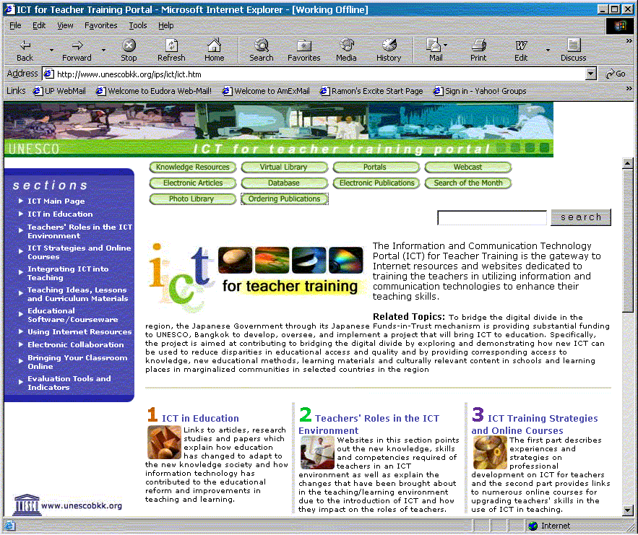
Basic Introduction of Web page
3
Document title
Address (URL)
Banner
Web page title
Navigational tools
Search tool
Table /
Navigational tools
Graphic elements
Hyperlinks
Content
Hyperlinks
Frames
Footer /
Copyright

Slide 4
Good Concept of Web Design
4
Plan the web site structure and navigation
Keep the layout simple
standard navigation tools to each page
copyright and contact information on each page
Use original or free graphics
Use images wisely and keep file size small for fast download
Always state the source of all materials used
Spell check and proof read each page

Slide 5
Bad Concept of Web Design
5
Don’t design for a specific browser
Don’t crowd your pages – text, graphics and space
Don’t overuse graphics, animations and other bleeding edge technology – use them to support and enhance but not to overpower your work
Don’t use background that distracts the user or makes text unreadable
Don’t use blinking or glowing text for emphasis
Don’t use long paragraphs of text – divide them into readable chunks
Don’t create dead end pages, which have no links to any other local page in the site

Slide 6
Web Design Issues
6
Simplicity
Identity
Consistency
Robustness
Navigation
Visuality
Compatibility
Accuracy

Slide 7
Cont’d..
7
Browser Compatibility Issue
Bandwidth
Cache
Display Resolution
Look and Feel
Page Layout and linking
Making Design user-Centric
Site map

Slide 8
Browser Compatibility Issue
8
Different browser providers have implemented HTML standards differently, leading to significant differences between the presentation of websites on different browsers.
Sometimes this problem was so acute that different versions of the same browser displayed a site differently.
font availability
screen size

Slide 9
Solution
9
Follow World Wide Web Consortium (W3C) Standard- Use correct Scripting language.
Validate the code- check syntax code.
Know your target audience.
Test your work on multiple browser and devices.

Slide 10
Bandwidth
10
Users internet connection speed express in terms of bits per second is called bandwidth.
Websites and web pages are constantly growing in size and today it’s not unusual for the average page to be a few Megabyte in size.
There’s still a huge proportion of people that don’t have a reasonable speed internet connection.
Solution:-Web designer must test the execution of web pages at variety of connection speed.

Slide 11
Cache
11
Cache means temporary storage area.
Browser provides temporary memory called cache to store the graphics.
When user gives the URL of the web page for the first time, HTML file together with all the graphics
files referred in a page is downloaded and displayed.

Slide 12
Role of Cookies and cache in Browser
12
The cookies is small text file that server embeds in client web browser. Each time when the user makes the request for the web page it send the cookies.
The browser retrieve the values from the cookies.

Slide 13
Display Resolution
13
Display resolution is another important factor affecting the Web page design, as we do not have any control on display resolution of the monitors on which user views our pages.
Display or screen resolution is measured in terms of pixels and common resolutions are 800 X 600
and 1024 X 786.

Slide 14
Cont’d..
14
We have three choices for Web page design.
Design a web page with fixed resolution.
Make a flexible design using HTML table to fit into different resolution.
If the page is displayed on a monitor with a higher resolution, the page is displayed on left hand side and some part on the right-hand side remains blank. We can use centered design to display page properly.

Slide 15
Look and Feel of the website
15
Look and feel of the website decides the overall appearance of the website.
It includes all the design aspects such as
Web site theme
Graphics
Visual structure
Navigation etc…

Slide 16
Guidelines for Designing Look and Feel of Website
16
Balance the Design and Content
Plan for Easy Access of information
Plan for clear presentation of the website information.

Slide 17
Page Layout and Linking
17
Website should contain individual web pages that are linked together using various navigational links.
Page layout defines the visual structure of the page and divides the page area into different parts to present the information of varying importance.
Flexible Page Layout
Fixed Page Layout

Slide 18
Flexible Page Layout
18
The most relaxed method of providing a dynamically expanding or contracting design.
makes use of percentage (%) unit measurement.
This layout type has gained mass popularity because it is the ultimate way of allowing the total opposite of a fixed layout where the content will simply take whatever space is available to it.
Works well for text based contents.

Slide 19
Flexible Page Layout
19
Advantages:
Ability to adapt lower screen resolution.
Disadvantages:
Line of text can be excessively at wider screen resolution and decrease legibility.
Challenging for complex design.

Slide 20
Fixed Page Layout
20
This page layout has consistent height and width.
Regardless of user`s screen resolution, the designed contents remain at fixed position.
Advantages:
Easier to use and easier to customize in terms of design.
Widths are same for every browser, so. Less hassle with frames, images, video and fixed width contents.
Disadvantages:
Create excessive white space for users with large screen resolution.
Smaller screen resolution require horizontal scroll bar.
Textures, patterns and image continuation are needed to accommodate with larger resolution.

Slide 21
Making Design user-Centric
21
User centric design means all the design effort keeping user as main factor.
It is very difficult for any Web designer to predict the exact behavior of the Web site users.
However, idea of general behavior of common user helps in making design of the Web site user centric.

Slide 22
Points to be noted for user centric Design
22
Design for interaction- How user want to interact.
Design for location- Reading Habits
Keep flat hierarchy – divide into section
Use Hyperlink effectively- powerful ability.
Limit the number of content
Reformat contents for online presentation

Slide 23
Sitemap
23
The sitemap is a structural overview of site that shows the grouping of the pages based on the topic.
It becomes difficult for visitors to quickly move from one part to other.
To make it simple, keep your hierarchy of information to few levels or provide the navigation bar on each page to jump directly to a particular section.

Slide 24
Cont’d.
24
Need for sitemap- Navigation
Representation of sitemap
Textual site map- represent all the link as basic HTML tag with different size, color.
Graphical sitemap- Use Graphical icons

Slide 25
Site map designing Issue
25
Map Production method
Small Map Graphical Map- cane be designed on paper
Large map- should be produced Dynamically
Forms of sitemap
Large sites or dynamic sites- Textual site map
Small sites or Static sites- Graphical site map
Map Detail
Small Sitemap- show the link for all pages
Large Site map- show the link for primary pages

Slide 26
Cont’d..
26
Page Characteristics
File size, access right
Landmark indication
Indicate Important pages with graphic, text, color, size or position
Location Indication
Show the current location of the user.

Slide 27
Planning and publishing website
27
3. Develop
Web page layout
Site layout
Web page construction
Graphics techniques
Implement
User Interaction
Final Checklist
Maintain
Marketing
Optimisation
Traffic analysis
1. Analyse
Info / content
Target Audience
Top 10 Checklist
2. Organise
Navigation
Content
Page layout
Page design

Slide 28
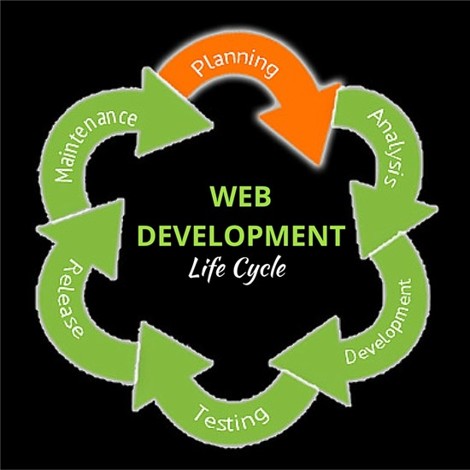
Web Development Life cycle
28

Slide 29
Process of Publishing Web site
29
Publishing is a process of making site live by transferring the web site files to web server.
Step 1:- Choose the web hosting service provider
Step 2:- Register Domain Name
Step 3:- upload file with File Transfer Protocol

Slide 30
Designing Effective Navigation
30
Navigation allows user the flexibility of movement from one page to another within website.
Features of Browser navigation:
Open URL allows direct access to any page on a web site. Back and Forward provide a bidirectional backtracking capability.
The History menu allows random access to pages visited during the current session, and Bookmark or Favorites enables users to save the location of specific pages for future reference.

Slide 31
Designing Effective Navigation
31
color-coding hypertext links indicates, unvisited hypertext links are one color and visited hypertext links are another.
web browsers allow for a prospective view that can influence how users navigate. As the user passes the cursor over a hypertext link, the destination URL appears at the bottom of the browser window

Slide 32
Types of Navigation system:
32
Hierarchical Navigation System:
The information hierarchy is the primary navigation system. The user can traverse to destination page from main page by using actual contents on the web page.
Global Navigation System:
A global or site-wide navigation system often complements the information hierarchy by enabling greater vertical and lateral movement throughout the entire site. At the heart of most global navigation systems are some standard rules that dictate the implementation of the system at each level of the site.

Slide 33
Types of Navigation system:
33
Local Navigation System:
It allows the user to move towards the sub sites from the main web page. For Ex: User can view the details of particular product by using name of the product.
Ad-Hoc Navigation System:
Relationships between content items do not always fit neatly into the categories of hierarchical, global, and local navigation. An additional category of ad hoc links provides the information about these items. For Ex: reading some texts from wikipedia the meaning of certain word can be obtained using adhoc links. The word items that are hyperlinked are called link phrases.

