Slide 1
Web Technology - 2160708
Chapter-3
HTML

Slide 2
HTML
HTML is a primary scripting language for Developing web pages.
Stands for Hypertext Markup Language.
Most documents that appear on the World Wide Web were written in HTML.
HTML is a markup language, not a programming language.
We can apply this markup language to your pages to display text, images, sound and movie files, and
almost any other type of electronic information.
We use the language to format documents and link them together, regardless of the type of computer with which the file was originally created.

Slide 3
HTML Documents = Web Pages
HTML documents describe web pages
HTML documents contain HTML tags and plain text
The purpose of a web browser (like Internet Explorer or Firefox) is to read HTML documents and display them as web pages.
The browser does not display the HTML tags, but uses the tags to interpret the content of the page:
documents are also called web pages

Slide 4
HTML Document Structure
In HTML anything written in angular bracket is called tag.
Generally We write this tags in lowercase, not case sensitive.
The text between <html> and </html> describes the web page
The text between <body> and </body> is the visible page content
The text between <h1> and </h1> is displayed as a heading
The text between <p> and </p> is displayed as a paragraph

Slide 5
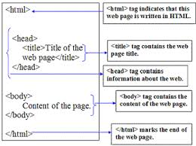
HTML Document Structure

Slide 6
Web Browsers
The purpose of a web browser (Chrome, IE, Firefox, Safari) is to read HTML documents and display them.
The browser does not display the HTML tags, but uses them to determine how to display the document:

Slide 7
HTML Editors
Write HTML Using Notepad or Gedit.
Step 1: Open any text editor.
Step 2: Write Some HTML
Step 3: Save the HTML Page
You can use either .htm or .html as file extension. There is no difference
Step 4: View the HTML Page in Your Browser

Slide 8
HTML Elements
An HTML element is defined by a starting tag. If the element contains other content, it ends with a closing tag, where the element name is preceded by a forward slash as shown below with few tags:
Start Tag Content End Tag
<p> This is paragraph content. </p>
<h1> This is heading content. </h1>
<div> This is division content. </div>
<br > Line break

Slide 9
HTML Elements
Container Elements: A tag that is in paired means having an opening <TAG> and closing </TAG>.
Such as <p>..</p>,<h1>..</h1> ...
Empty Elements: HTML elements which don't need to be closed, such as <img>, <hr> and <br> elements. These are known as void or empty elements.

Slide 10
HTML Attributes
An attribute is used to define the characteristics of an HTML element and is placed inside the element's opening tag. All attributes are made up of two parts: a name and a value:
The name is the property you want to set. For example, the paragraph <p> element in the example carries an attribute whose name is align, which you can use to indicate the alignment of paragraph on the page.
The value is what you want the value of the property to be set and always put within quotations.
The value of attribute is displayed in double quotes.
Attribute names and attribute values are case-insensitive.

Slide 11
HTML Elements Vs. Tags Vs. Attributes
HTML elements: An element in HTML represents some kind of structure or semantics and generally consists of a start tag, content, and an end tag. The following is a paragraph element:
<p> This is the content of the paragraph element.</p>.
HTML tags: Tags are used to mark up the start and end of an HTML element.
<p></p>
HTML attributes: An attribute defines a property for an element, consists of an attribute/value pair, and appears within the element’s start tag. An element’s start tag may contain any number of space separated attribute/value pairs.
<font face="verdana" size="10" color="red"> Font value </font>

Slide 12
HTML <!DOCTYPE> Declaration
The <!DOCTYPE> declaration must be the very first thing in your HTML document, before the <html> tag.
The <!DOCTYPE> declaration is not an HTML tag; it is an instruction to the web browser about what version of HTML the page is written in.

Slide 13
Basic HTML
HTML Headings
Search engines use the headings to index the structure and content of your web pages.
It is important to use headings to show the document structure.
<h1> headings should be used for main headings, followed by <h2> headings, then the less important <h3>, and so on.
Note: Use HTML headings for headings only. Don't use headings to make text BIG or bold.

Slide 14
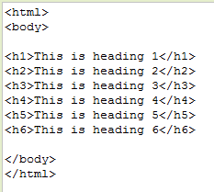
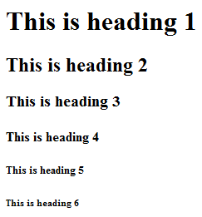
Output

Slide 15
Basic HTML
HTML Horizontal Rules
The <hr> tag defines a thematic break in an HTML page, and is most often displayed as a horizontal rule.
The <hr> element is used to separate content (or define a change) in an HTML page:

Slide 16
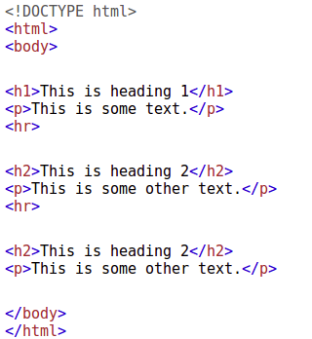
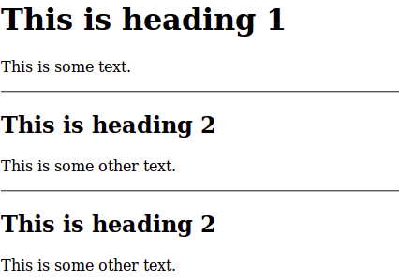
Output

Slide 17
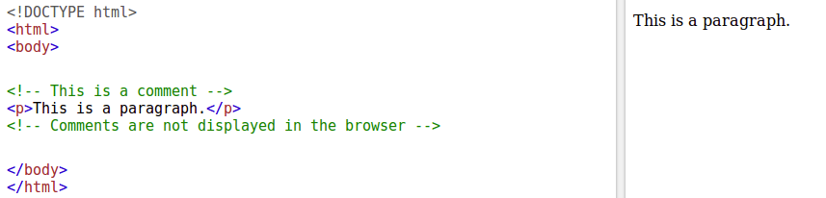
Basic HTML
HTML <!--...--> Tag
The comment tag is used to insert comments in the source code. Comments are not displayed in the browsers.
You can use comments to explain your code, which can help you when you edit the source code at a later date. This is especially useful if you have a lot of code.

Slide 18
HTML Paragraphs
HTML paragraphs are defined with the <p> tag.
HTML Display
You cannot be sure how HTML will be displayed.
Large or small screens, and resized windows will create different results.
With HTML, you cannot change the output by adding extra spaces or extra lines in your HTML code.
The browser will remove any extra spaces and extra lines when the page is displayed

Slide 19
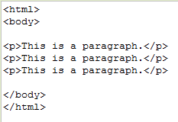
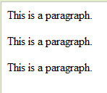
Output

Slide 20
HTML Paragraphs
HTML Line Breaks
The HTML <br> element defines a line break.
Use <br> if you want a line break (a new line) without starting a new paragraph
<pre> element defines preformatted text.
The text inside a <pre> element is displayed in a fixed-width font (usually Courier), and it preserves both spaces and line breaks:

Slide 21
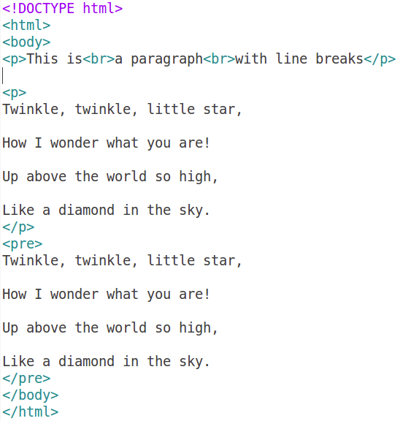
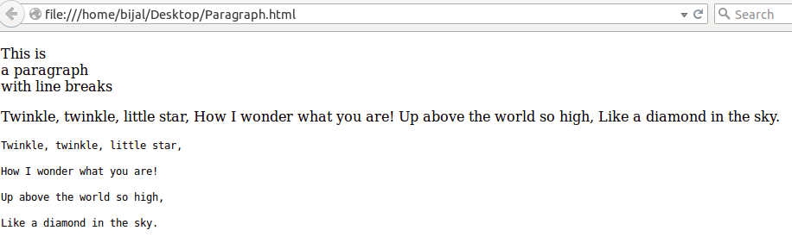

Slide 22
HTML Formatting Elements
Formatting elements were designed to display special types of text:
<b> - Bold text
<strong> - Important text
<i> - Italic text
<em> - Emphasized text
<mark> - Marked text
<small> - Small text
<del> - Deleted text
<ins> - Inserted text
<sub> - Subscript text
<sup> - Superscript text

Slide 23
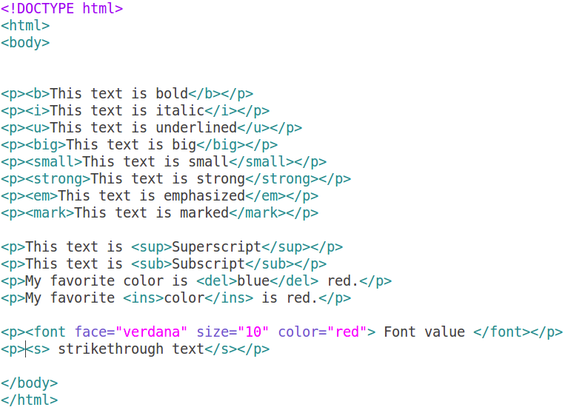
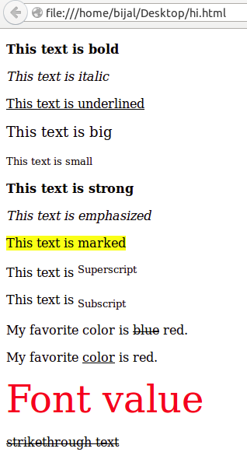
Output

Slide 24
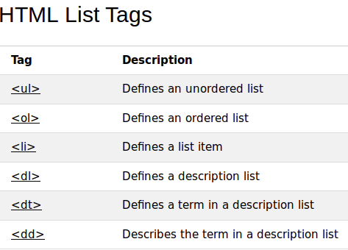
HTML LISTS
A useful ability in HTML is to form quick, concise lists, which can be numbered or just bulleted.

Slide 25
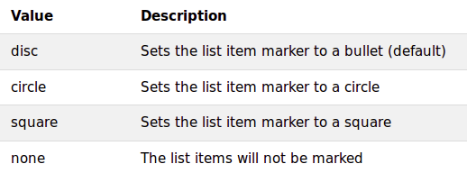
1. HTML Unordered Lists
An unordered list starts with the <ul> tag. Each list item starts with the <li> tag.
The actual character used can be changed and set to square, disc(default) or circle.
<ul type=“square”>

Slide 26
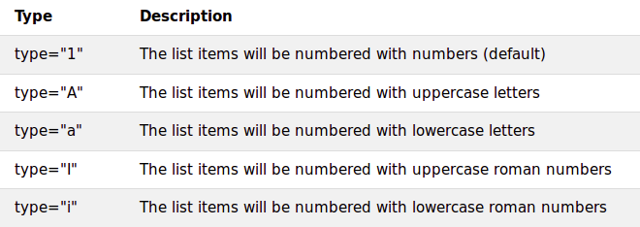
2. HTML Ordered Lists
An ordered list starts with the <ol> tag. Each list item starts with the <li> tag.
The list items are marked with numbers.
<ol> …. </ol>
It is possible to have different numbering rather than the default 1,2,3,4,….:
<ol type = i>

Slide 27
3. HTML Nested List
We can also nest one list within another, so we could make an unordered list inside a numbered one, or vice versa

Slide 28
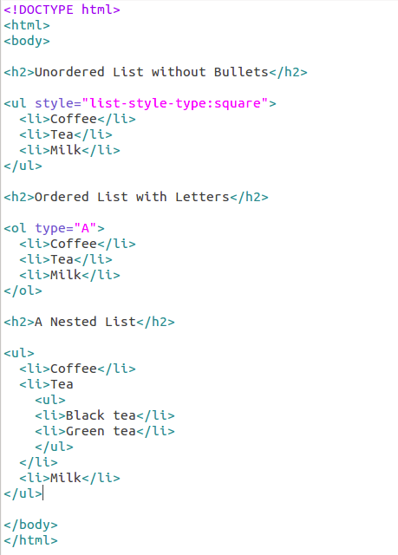
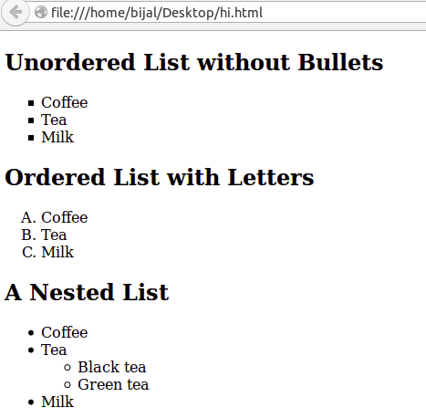
Output

Slide 29
4. HTML Definition Lists
A definition list is a list of items, with a description of each item.
The <dl> tag defines a definition list.
The <dl> tag is used in conjunction with <dt> (definition term) and <dd> (definition description):
<dl>
<dt></dt>
<dd></dd>
<dt></dt>
<dd></dd>
</dl>

Slide 30
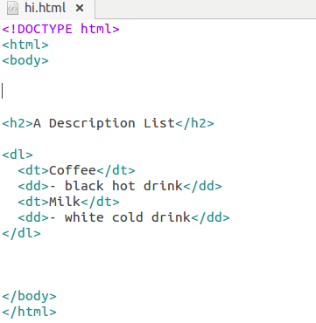
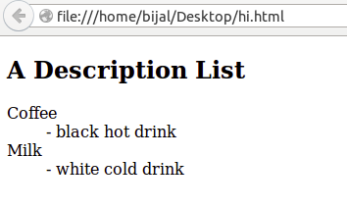
Output

Slide 31
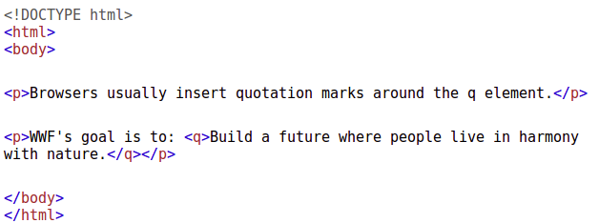
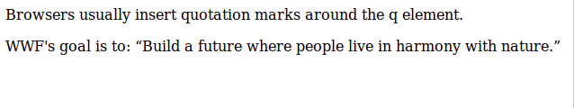
HTML Quotation
HTML <q> for Short Quotations
The HTML <q> element defines a short quotation.
Browsers usually insert quotation marks around the <q> element.
Output

Slide 32
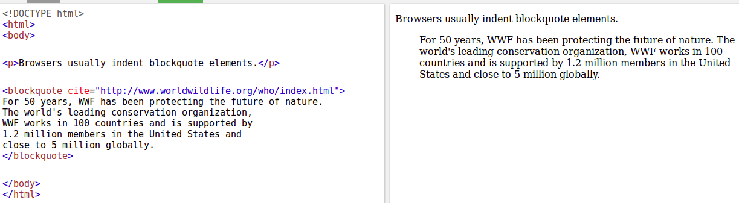
HTML Quotation
The HTML <blockquote> element defines a section that is quoted from another source.
Output

Slide 33
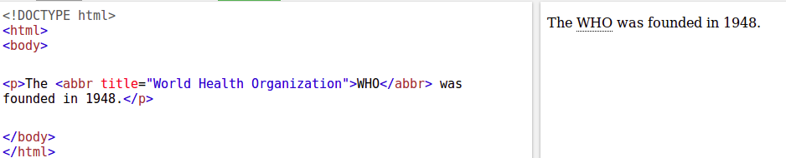
HTML Quotation
The <abbr> tag defines an abbreviation or an acronym, like "Mr.", "Dec.", "ASAP", "ATM".
An abbreviation and an acronym are both shortened versions of something else. Both are often represented as a series of letters.
Output

Slide 34
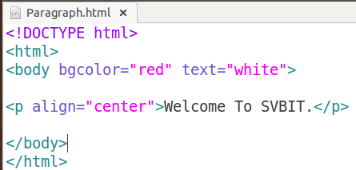
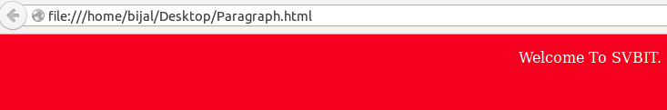
HTML Background & Text Color Tag
The attribute bgcolor is used for changing the back ground color of the page.
Syntax: <body bgcolor=“Green” >
Text is used to change the color of the enclosed text
Syntax: <body text=“White”>
Output

Slide 35
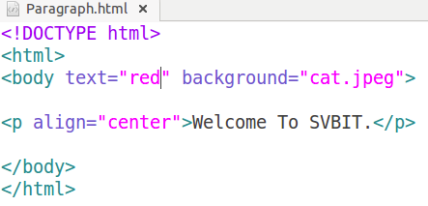
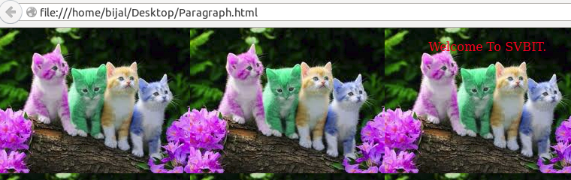
HTML Background & Text Color Tag
The attribute background is used for put background image in webpage
Syntax: <body backgound=“cat.jpeg” >
Output

Slide 36
HTML Hyperlinks
A webpage can contain various links that take you directly to other pages and even specific parts of a given page. These links are known as hyperlinks.
Hyperlinks allow visitors to navigate between Web sites by clicking on words, phrases, and images. Thus you can create hyperlinks using text or images available on a webpage.
In A link is specified using HTML tag <a>. This tag is called anchor tag and anything between the opening <a> tag and the closing </a> tag becomes part of the link and a user can click that part to reach to the linked document.

Slide 37
HTML Hyperlinks
HTML Links - Syntax
<a href="url">link text</a>
Example
<a href="http://www.site.com/html/"> Visit our HTML tutorial</a>
<a> element to define a link
href attribute to define the link address
target attribute to define where to open the linked document
<img> element (inside <a>) to use an image as a link
id attribute (id="value") to define bookmarks in a page
href attribute (href="#value") to link to the bookmark

Slide 38
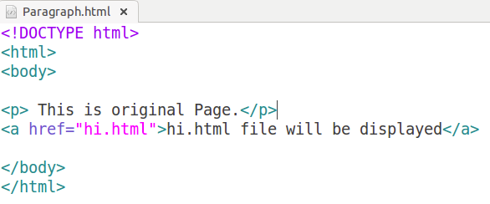
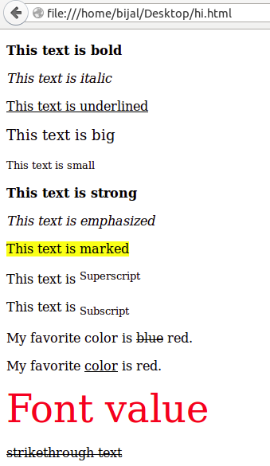
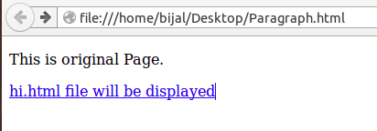
href attribute example
Output

Slide 39
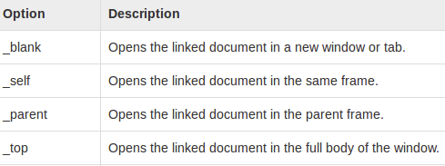
target attribute example
This attribute is used to specify the location where linked document is opened.
Following are possible options:

Slide 40
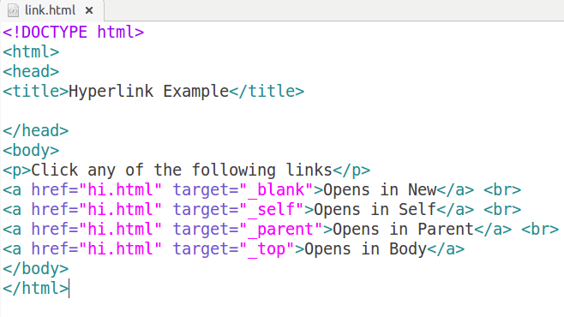
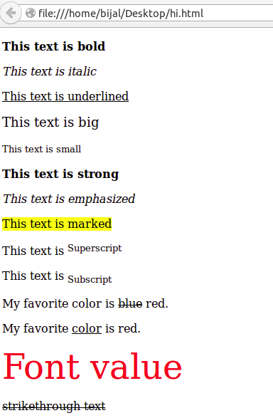
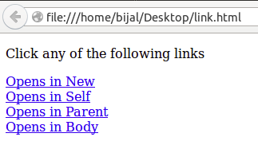
target attribute example
Output

Slide 41
id attribute example
HTML bookmarks are used to allow readers to jump to specific parts of a Web page.
Bookmarks can be useful if your webpage is very long.
To make a bookmark, you must first create the bookmark, and then add a link to it.
When the link is clicked, the page will scroll to the location with the bookmark.
Example: First, create a bookmark with the id attribute:
<h2 id="C5">Chapter 5</h2>
Then, add a link to the bookmark ("Chapter 5"), from within the same page:
<a href="#C5">Visit Chapter 5</a>

Slide 42
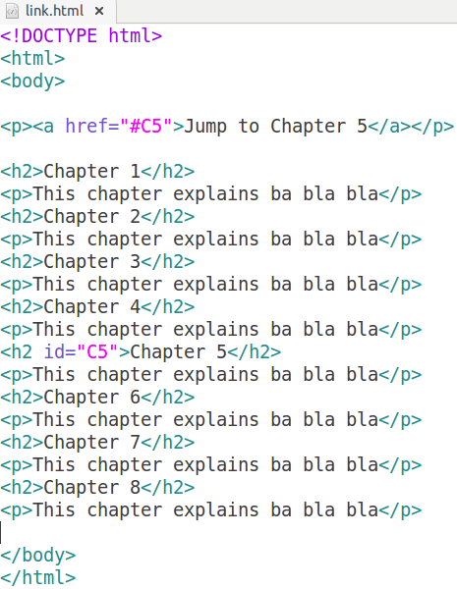
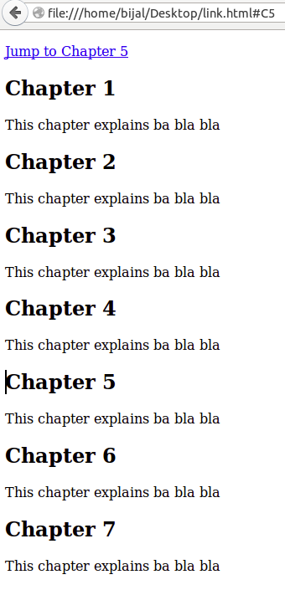
id attribute example
Output

Slide 43
HTML Images
The <img> tag defines an image in an HTML page.
<img> tag has no end tag.
Attribute | Value | Description
src | URL | Specifies the URL of an image
align | top,middle,left,right | Specifies the alignment of an image according to surrounding elements
alt | text | Specifies an alternate text for an image
border | pixels | Specifies the width of the border around an image
height | pixels | Specifies the height of an image
width | pixels | Specifies the width of an image
hspace | pixels | Specifies the whitespace on left and right side of an image
vspace | pixels | Specifies the whitespace on top and bottom of an image

Slide 44
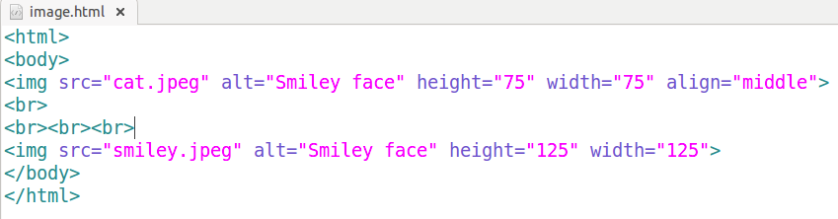
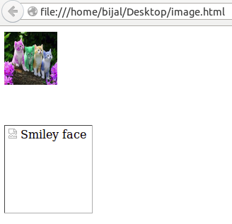
HTML Image example
Output

Slide 45
HTML Tables
Useful to display data in tabular format
Table Tags mainly created with 3 basic tags :
< table> - start of the table
</table> - end of the table
Consists of no. of rows, with no. of cells
<tr> ….. </tr>
To add data
<td> … </td>
<td> tag can contain text, links, images, lists, other tables, etc.

Slide 46
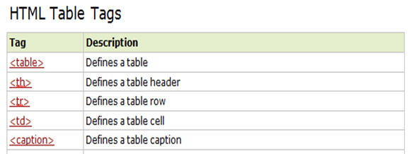

Slide 47
table tag attributes
Attribute | Value | Description
align | left center right | Specifies the alignment of a table according to surrounding text
bgcolor | rgb(x,x,x) #xxxxxx colorname | Specifies the background color for a table
border | 1 0 | Specifies whether or not the table is being used for layout purposes
cellpadding | pixels | Specifies the space between the cell wall and the cell content
cellspacing | pixels | Specifies the space between cells
width | Pixels % | Specifies the width of a table
summary | text | Specifies a summary of the content of a table

Slide 48
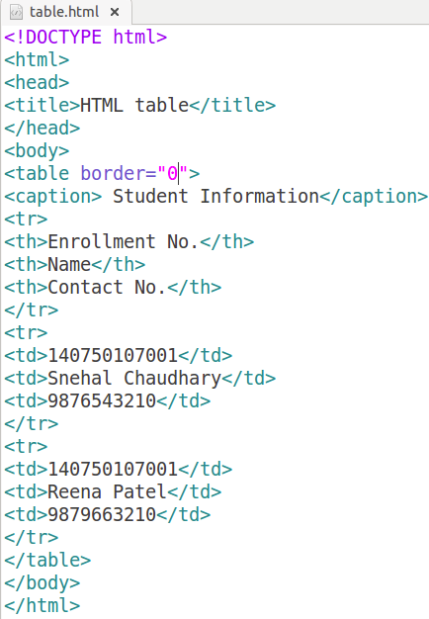
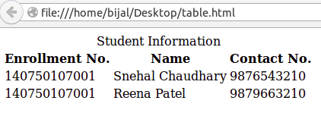
Caption Tag
Output
Border Value is 0 means no border

Slide 49
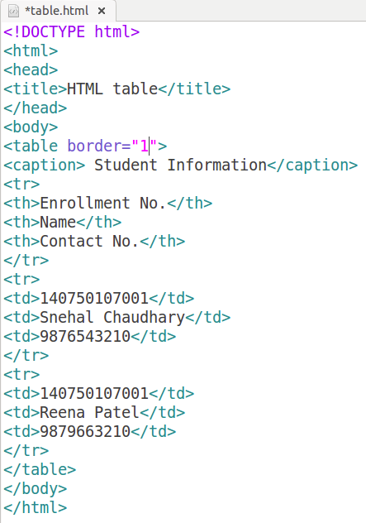
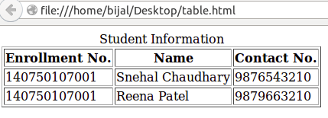
Output
Border Value is 1 means table with border

Slide 50
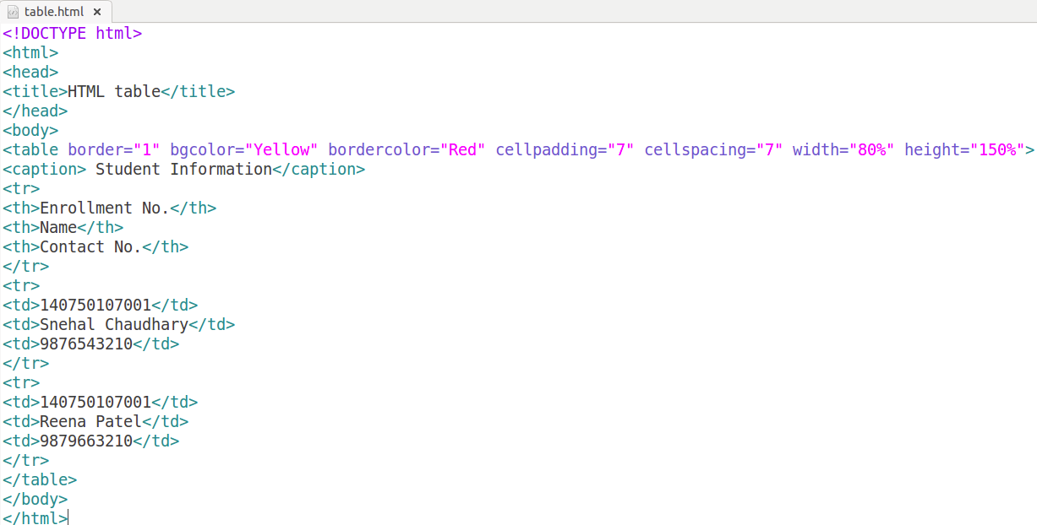
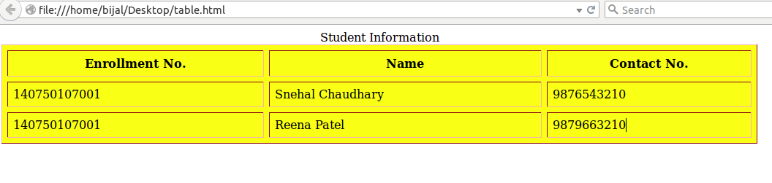
Cellpadding, Cellspacing, bgcolor, bordercolor, width and height attribute of <table tag>
Output
The cellspacing attribute defines the width of the border, while cellpadding represents the distance between cell borders and the content within a cell.

Slide 51
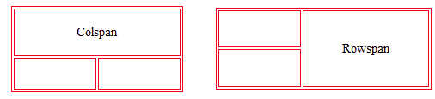
RowSpan & ColSpan
To make a cell span multiple rows and columns, the tags <rowspan> and <colspan> are used,
<rowspan> - no. of rows a cell spans vertically. That is , you want to merge two or more Cells in the same column.
<colspan> - no. of columns a cell span (or merge) horizontally.That is, you want to merge two or more Cells in a row.

Slide 52
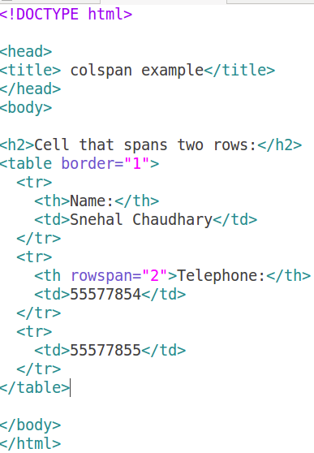
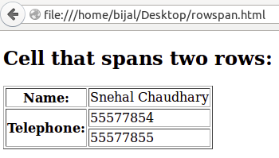
Example RowSpan
Output

Slide 53
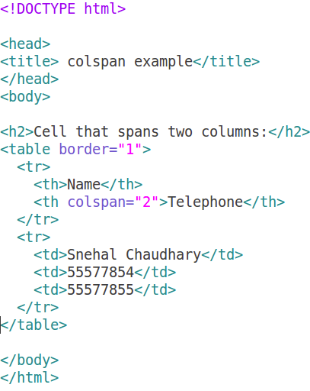
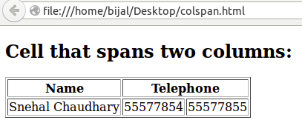
Example ColSpan
Output

Slide 54


Example RowspanColSpan
Output

Slide 55


Example Nested Table
Output

Slide 56
HTML Forms and Input
HTML Forms are used to select different kinds of user input.
A form will take input from the site visitor and then will post it to a back-end application such as CGI, ASP Script or PHP script etc.
The back-end application will perform required processing on the passed data
The <form> tag is used to create an HTML form:
<form action="Script URL" method="GET|POST">
form elements like input, textarea etc.
</form>

Slide 57
Form Attributes
Every <form> element should carry at least two attributes:
action
method
The <form> element carries an attribute called action whose value is the URL of the page on the web server that handles search requests.
The method attribute indicates which HTTP method will be used in getting the form data to the server.

Slide 58
The action Attribute
The action attribute indicates what happens to the data when the form is submitted.
For example, if you have a login form consisting of a username and password, the details the user enters may get passed to a page written in ASP.net on the web server called login.aspx, in which case the action attribute would read as follows:
<form action=”http://www.example.org/membership/login.aspx”>

Slide 59
The method Attribute
Form data can be sent to the server in two ways, each corresponding to an HTTP method:
The get method, which sends data as part of the URL
The post method, which hides data in the HTTP headers

Slide 60
HTML Form Controls
Text Input Controls
Checkboxes Controls
Radio Box Controls
Select Box Controls
File Select boxes
Hidden Controls
Clickable Buttons
Submit and Reset Button
Most of the control elements are created using <input> tag having attribute type.
When a user fills in a form, the data is sent to the server in name/value pairs. The name corresponds to the name of the form control, and the value is what the user has entered

Slide 61
Text Inputs
There are actually three types of text input used on forms:
Single-line text input controls: This control is used for items that require only one line of user input.They are created using HTML <input> tag.
Password input controls: This is also a single-line text input but it masks the character as soon as a user enters it.They are created using HTML <input> tag.
Multi-line text input controls: his is used when the user is required to give details that may be longer than a single sentence. Multi-line input controls are created using HTML <textarea> tag.

Slide 62
Single-Line Text Input Controls
Attribute | Description
type | Indicates the type of input control and for text input control it will be set to text.
name | Used to give a name to the control which is sent to the server to be recognized and get the value.
value | This can be used to provide an initial value inside the control.
size | Allows to specify the width of the text-input control in terms of characters.
maxlength | Allows to specify the maximum number of characters a user can enter into the text box.

Slide 63
Password Input Controls
Attribute | Description
type | Indicates the type of input control and for text input control it will be set to password.
name | Used to give a name to the control which is sent to the server to be recognized and get the value.
value | This can be used to provide an initial value inside the control.
size | Allows to specify the width of the text-input control in terms of characters.
maxlength | Allows to specify the maximum number of characters a user can enter into the text box.

Slide 64
Multiple line Text Input Controls
Attribute | Description
name | Used to give a name to the control which is sent to the server to be recognized and get the value.
rows | Indicates the number of rows of text area box.
columns | Indicates the number of columns of text area box

Slide 65


Input Controls Example
Output

Slide 66
Button Controls
Push buttons can be created using the <input> tag, with the type = “button”
<input type=“button” value=“login”>
Attribute | Description
submit | This creates a button that automatically submits a form.
reset | This creates a button that automatically resets form controls to their initial values.
button | This creates a button that is used to trigger a client-side script when the user clicks that button.
image | This creates a clickable button but we can use an image as background of the button.

Slide 67


Button Controls Example
Output

Slide 68


Radio Button
<input type="radio" /> defines a radio button.
Radio buttons are used when out of many options, just one option is required to be selected.
Output

Slide 69


Label
Content of label is ordinary text.
Used to add a label to a form field.
Describes the meaning of associated control.
<label for=“6thIT”> 6thIT </label>
Output

Slide 70


Checkboxes
<input type="checkbox"> defines a checkbox. Checkboxes allow user to select ONE or MORE options from limited number of choices.
Output

Slide 71


Selection List (Dropdown List)
A drop-down select box allows users to select one item from a drop-down menu.
Advantage: Drop-down selection list can take up far less space than a group of radio buttons.
Dis ad. : user cannot see all options until click on it. (in default case)
Output

Slide 72


Creating Scrolling Select Boxes
it’s possible to create scrolling menus where users can see a few of the options in a select box at a time.
add the size attribute to the <select> element.
The value of the size attribute is the number of options you want to be visible at any one time.
Output

Slide 73


Grouping Options with the <optgroup> Element
Output

Slide 74


Hidden Controls
Sometimes you want to pass information between pages without the user seeing it; to do this you can use hidden form controls.
Hidden elements are one way in which programmers can pass values between pages.
This control hides inside the code and does not appear on the actual page.
Application: Session Tracking
Output

Slide 75



File Upload Box
To upload a file to your web site, you will need to use a file upload box, also known as a file select box.
This is also created using the <input> element but type attribute is set to file.
accept attribute Specifies the types of files that the server accepts.
Output

Slide 76
Structuring Your Forms with <fieldset> and <legend> Elements
Large forms can be confusing for users, so it’s good practice to group together related form controls. The <fieldset> and <legend> elements.
The <fieldset> element creates a border around the group of form controls to show that they are related.
The <legend> element allows you to specify a caption for the <fieldset> element, which acts as a title for the group of form controls. When used, the <legend> element should always be the first child of the <fieldset> element.

Slide 77

<fieldset> and <legend> Example

Slide 78


Slide 79

HTML Form Tags

Slide 80
HTML Div & span tag
The <div> tag defines a division or a section in an HTML document.
The <div> tag is used to group block-elements to format them with CSS.
The <span> tag is used to group inline-elements in a document.
A <span> element used to color a part of a text

Slide 81



Slide 82
XHTML
XHTML stands for EXtensible HyperText Markup Language.
By combining the strengths of HTML and XML, XHTML was developed.
XHTML is supported by all major browsers.
XHTML uses:
◦ the elements and attributes of HTML
◦ the syntax of XML (eXtensible Markup Language).

Slide 83
HTML Vs. XHTML
Document Structure
XHTML DOCTYPE is mandatory
The xmlns attribute in XHTML is mandatory
<html>, <head>, <title>, and <body> are mandatory
XHTML Elements
XHTML elements must be properly nested
XHTML elements must always be closed
XHTML elements must be in lowercase
XHTML documents must have one root element
XHTML Attributes
Attribute names must be in lower case
Attribute values must be quoted
Attribute minimization is forbidden
(Ex: Html Style: disabled Xhtml Style: disabled=”disabled”)
Replace the name attribute with the id attribute.

Slide 84
HTML Meta Tags
HTML lets you specify metadata - additional important information about a document in a variety of ways.
The <meta> tag is used to provide such additional information. This tag is an empty element and so does not have a closing tag but it carries information within its attributes.
You can include one or more meta tags in your document based on what information you want to keep in your document but in general, meta tags do not impact physical appearance of the document so from appearance point of view, it does not matter if you include them or not.

Slide 85
HTML Meta Tags
<meta> tag to specify important keywords related to the document and later these keywords are used by the search engines while indexing your webpage for searching purpose.
<meta> tag to give a short description about the document.
<meta> tag to give information about when last time the document was updated.
<meta> tag can be used to specify a duration after which your web page will keep refreshing automatically.
Set an author name in a web page using meta tag.

Slide 86


HTML Meta Tags
Output

Slide 87

XHTML Document Structure

Slide 88

XHTML Document Structure

Slide 89
HTML Character Entities
Some characters are reserved in HTML.
If you use the less than (<) or greater than (>) signs in your text, the browser might mix them with tags.
Character entities are used to display reserved characters in HTML.
Entity names are case sensitive.

Slide 90

HTML Character Entities

Slide 91



Slide 92
HTML Frame
Allows to divide a page into several blocks called frames
Each frame may display a separate web page.
So it displays multiple HTML document in one browser window simultaneously.
The user can put html document, images in the frame.
Advantages:
1. it lets the user to have multiple pages in the same browser.
2. Using frames we can keep one part of the page static while changing the other parts of the page.
3. Frames can be used to reduce server load, as there is no need to reload all the pages when ever a new page is visited.

Slide 93
HTML Frame
Disadvantages:
1. One of the main disadvantage of frames is search engines will not deal with them properly.
2. Its hard to navigate through pages in frames when we have more than two or three frames.
3. Some browsers doesn't support frames, so we need to place the content seperately for the people who doesn't have frames using <noframes> ... </noframes>
4. We cannot bookmark individual pages using browser's Favourites Menu.

Slide 94
Frameset Element
Layout is specified by <frameset> element.
To do this <FRAMESET>…</FRAMESET> tag is used.
This tag is put in the parent HTML document without <body> tag.
Contains a <frame> element each of which creates a frame.
Attribute | Value | Desciption
rows | % * | Specifies the number and size of rows in a frameset, * indicatees remaining space
cols | % * | pecifies the number and size of columns in a frameset, indicatees remaining space

Slide 95
Frame Element
The <frame> tag defines one particular window (frame) within a <frameset>.
Attribute | Value | Desciption
frameborder | 0 1 | Specifies whether or not to display a border around a frame
marginheight | pixels | Specifies the top and bottom margins of a frame
marginwidth | pixels | Specifies the left and right margins of a frame
name | text | Specifies the name of a frame
noresize | noresize | Specifies that a frame is not resizable
scrolling | yes no auto | Specifies whether or not to display scrollbars in a frame
src | URL | Specifies the URL of the document to show in a frame

Slide 96

Frameset : Vertical

Slide 97


Slide 98

Frameset : Horizontal

Slide 99


Slide 100

Mix columns and row

Slide 101


Slide 102
<IFRAME ...>
The <iframe> tag specifies an inline frame.
An inline frame is used to embed another document within the current HTML document.
The <iframe> tag defines a rectangular region within the document in which the browser can display a separate document
Frame | IFrame
Frames are HTML tag which divides the browser's window into multiple parts where each part can load a separate HTML document | IFrame inline frame means it is used to embed some other document within the current HTML document.
<frame> tag specifies each frame within a frameset tag. | It is related to frameset but it can appear anywhere in your document.
Each Frame can be linked with a single and different sources. | <iframe> tag defines a rectangular region within the document in which the browser can display a separate document.
Frame object represents an HTML frame | IFrame object represents an HTML inline frame

Slide 103
<IFRAME ...>
The <iframe> tag specifies an inline frame.
An inline frame is used to embed another document within the current HTML document.
The <iframe> tag defines a rectangular region within the document in which the browser can display a separate document
Frame | IFrame
Frames are HTML tag which divides the browser's window into multiple parts where each part can load a separate HTML document | IFrame inline frame means it is used to embed some other document within the current HTML document.
<frame> tag specifies each frame within a frameset tag. | It is related to frameset but it can appear anywhere in your document.
Each Frame can be linked with a single and different sources. | <iframe> tag defines a rectangular region within the document in which the browser can display a separate document.
Frame object represents an HTML frame | IFrame object represents an HTML inline frame

Slide 104


<IFRAME ...> Example

Slide 105
Web Site Structure
A web site is a collection of pages associated by hyperlinks, but it should also be broken up into areas for structures, which aids both memory and ordering resources.
Main site can be broken into several sub-sites.
A web site generally has a root directory, the one which is entered first , then several sub-directories that serve as the sub-sites.
By making the site into directories it makes it a lot easier to find files and also to navigate the actual web site ,which uses the sub-directories as extensions of the main site.

Slide 106
Browser Architecture
The most basic component that all web browser must exhibit are listed below:
Controller/Dispatcher
Interpreter
Client Programs
Controller works as a control unit in CPU. It takes input from the keyboard or mouse, interpret it and make other services to work on the basis of input it receives.

Slide 107
Browser Architecture
Interpreter receives the information from the controller and execute the instruction line by line. Some interpreter are mandatory while some are optional For example, HTML interpreter program is mandatory and java interpreter is optional.
Client Program describes the specific protocol that will be used to access a particular service. Following are the client programs tat are commonly used:
HTTP
SMTP
FTP
NNTP
POP

Slide 108

Browser Architecture

Slide 109

HTML Vs. HTML 5

