Slide 1
Chapter-4
CSS

Slide 2
HTML Vs. CSS
HTML, HyperText Markup Language, gives content structure and meaning by defining that content as, for example, headings, paragraphs, or images. 
CSS, or Cascading Style Sheets, is a presentation language created to style the appearance of content—using, for example, fonts or colors. 
As a rule, HTML will always represent content, and CSS will always represent the appearance of that content.
If HTML is the skeleton, CSS is the skin. ◻ Stands for “Cascading Style Sheets”. ◻

Slide 3
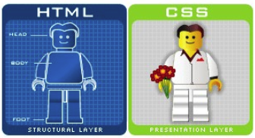
HTML Vs. CSS
Robust and powerful design tool that defines how each element should be rendered. ◻
Has a separate language with its own syntax. ◻ Separates content/structure (HTML) from formatting/ styling/presentation (CSS)

Slide 4
CSS-Cascading Style Sheet
Cascading: Multiple styles can overlap in order to specify a range of style from a whole web site down to a unique element.
Style: CSS deals specifically with the presentation domain of designing a web page (color, font, layout, etc).
Sheet: Normally, CSS is a file separatefrom the HTML file –linked to the HTML file through its <head> (exceptions apply).

Slide 5
Need of CSS
Allows for much richer document appearances than HTML.
Reduce work load by centralizing commands for visual appearance instead of scattered throughout the HTML doc.
Use same style on multiple pages.
Reduce page download size.
to save a lot of work and our time;
easier to handle and edit web documents;
easier to control content and layout of the multiple web sites.
Note: Use HTML for content; CSS for Presentation.

Slide 6
Example
<h1> This is heading 1 </h1>
To add color, size, style, font type in HTML ?
In CSS
- h1{color:red; font:calibri;}

Slide 7
How to write style rules : Basic Syntax & Structure( Style Specification Format)
Two parts: (1) selector and (2) declaration.
Selector: the HTML element you want to add style to.
<p> <h1> <table> etc
Declaration: the statement of style for that element. Made up of property and value.
Selector {declaration;}

Slide 8
Cont’
Declaration = {property: value;}
Property: what aspect you want to change
ex: color, font, margins, etc.
Value: the exact setting for that aspect.
ex: red, italic, 40px, etc.

Slide 9
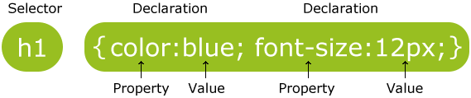
Selector
Definition: identifies the HTML elements that the rule will be applied to, identified by the actual element name, e.g. <body>, or by other means such as class attribute values.
Example:
* The selector is normally the HTML element
you want to style

Slide 10
Property & Value
Definition: The property is the style attribute you
want to change. Each property has a value.
Properties are separated from their respective values by colons :
*Pairs are separated from each other by semicolons ;
*

Slide 11
Declaration
Definition: Each CSS line that includes property and value
*Each declaration consists of a property and a value.

Slide 12
Declaration Block
Definition: multiple declaration lines including the curly braces

Slide 13
Curly Braces
Definition: the curly braces contain the properties of the element you want to manipulate, and the values that you want to change them to. The curly braces plus their content is called a declaration block.
Example:

Slide 14
Points to be remembered..
The <STYLE> element is always positioned in the <HEAD> section of the document.
The <STYLE> element always contains <TYPE> attribute. The value “text/css” defines the style language as Cascading Style Sheets.

Slide 15
CSS Example
CSS declarations always ends with a semicolon, and declaration groups are surrounded by
curly brackets:
p {color:red;text-align:center;}
To make the CSS more readable, you can put
one declaration on each line, like this:
p
{
color:red;
text-align:center;
}

Slide 16
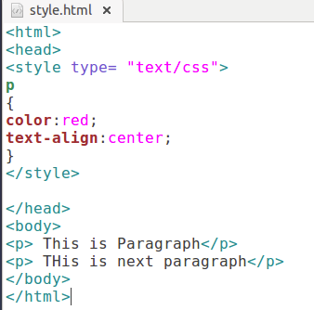
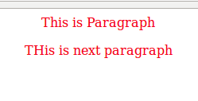
Output

Slide 17
CSS Comments
A CSS comment begins with "/*", and ends with "*/", like this:
/*This is a comment*/
p
{
text-align:center;
/*This is another comment*/
color:black;
font-family:arial;
}

Slide 18
How CSS is Applied to A Web
Page
CSS is applied to a web page using three different methods:
Inline style
Internal style sheet
External style sheet

Slide 19
Inline CSS
Inline styles are applied to specific HTML elements. The HTML attribute style is used to define rules that only apply to that specific element.
For Example:
<p style=“color: red;”> This is a simple paragraph using inline CSS </p>

Slide 20
Inline CSS
Inline style specification appears within opening tag and can be applied to the contents of that tag.
This method is called inline because style is applied at occurence of HTML element by using style attribute.

Slide 21
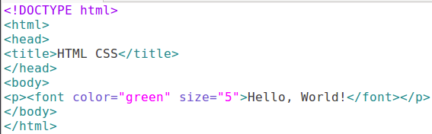
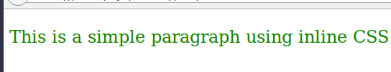
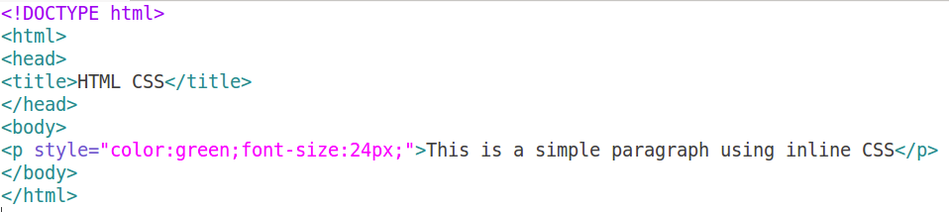
Inline CSS Example
Using HTML
Output
Using CSS(internal.html)

Slide 22
Inline CSS Advantages & Disadvantages
Advantage:
Using inline styele sheet we can apply uniform style on tags for whole document.
Disadvantage:
Not much suitable for web page design because actual contents of web page mixed with presentation.

Slide 23
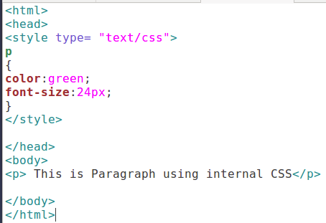

Internal Style Sheet
Also known as Embedded or Document level CSS
Applies styles to HTML by placing the CSS rules inside
the tag <style> inside the document tag <head>.
For Example:
Internal.html
Output

Slide 24
Internal CSS Advantages & Disadvantages
Advantage:
Helps to decide layout of web page.
Helpful for applying unique style sheet for web page.
Disadvantage:
Not useful when we want to apply style to more than one documents at a time.

Slide 25
External CSS
With an external style sheet, you can change the look of an entire website by changing just one file.
Each page must include a reference to the external style sheet file inside the <link> element. The <link> element goes inside the <head> section.
An external style sheet can be written in any text editor. The file should not contain any html tags. The style sheet file must be saved with a .css extension.
Advantage: External style sheets are best because they allow you to save all the style information on a separate file from the content. You can then modify a style for a site and it will update all of the pages in a site

Slide 26
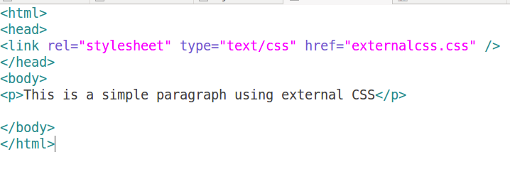
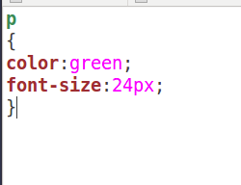

External CSS Example
external.html
externalcss.css
Output:

Slide 27
Which style sheet is best?
Web developers rarely use inline CSS. Since they prefer to not mix content with presentation. And it is not efficient since you have to declare the style individually for every component.
Internal and External style sheets are more popular because you can style multiple elements with one rule.
External style sheets are best because they allow you to save all the style information on a separate file from the content. You can then modify a style for a site and it will update all of the pages in a site.

Slide 28
CSS Selectors
There are various ways or forms by which the
selector can be defined.
Simple Selector forms
Class Selectors
Generic Selectors
Id Selectors
Universal Selectors
Pseudo Selectors

Slide 29
Simple Selector Forms
Simple element form is a single element to which the property and value is applied.
We can apply style to more than one element.

Slide 30
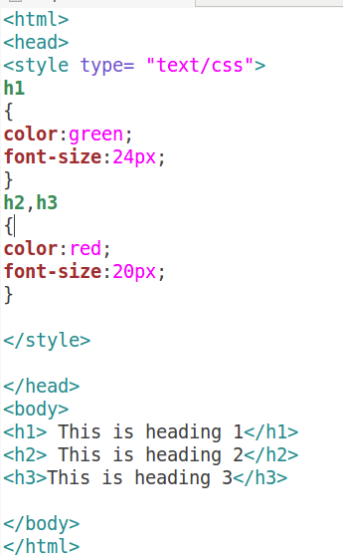
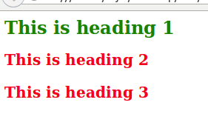
Simple Selector Forms Example
Simpleselector.html
Grouping Elements
output

Slide 31
Class Selector Forms
The class selector is the most useful of all CSS selectors.
It’s declared with a dot preceding a string of one or more characters.
This string of characters is defined by the developer.
Using class selector we can assign different styles to same element.

Slide 32
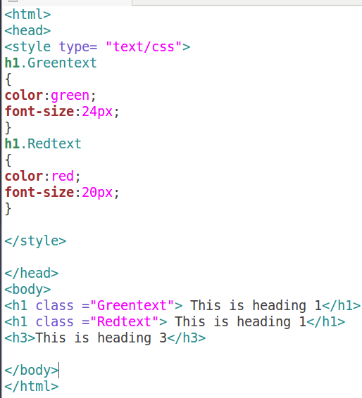
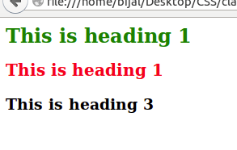
Class Selector Forms Example
classselector.html
Output

Slide 33
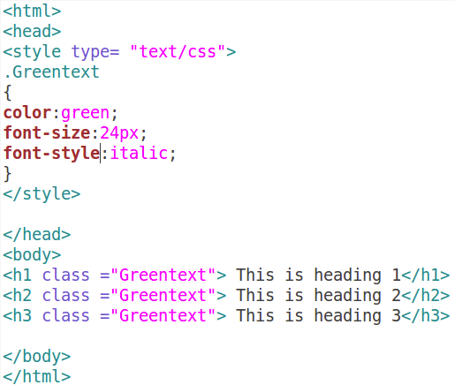
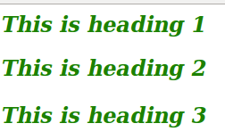
Generic Selector Forms
Using this particular class can be applied to any tag.
genericselector.html
output

Slide 34
id Selector Forms
The id selector is similar to class selector but only difference is class selector is applied to more than one element where as using id selector the id selector is applied to one element.
The ID selector selects the HTML element which has the given ID. The ID of an HTML element is set via the id attribute and is defined with a "#"..

Slide 35
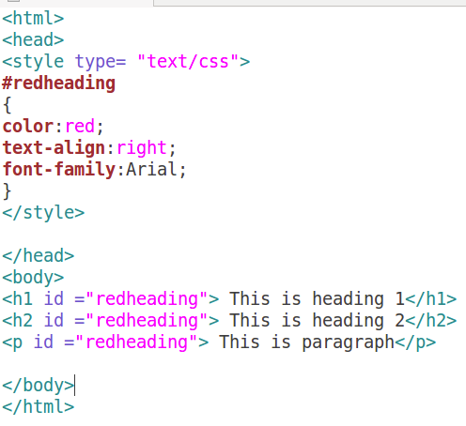
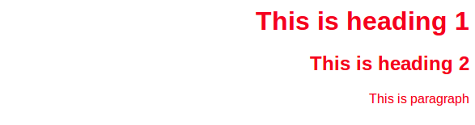
id Selector Forms Example
idselector.html
output

Slide 36
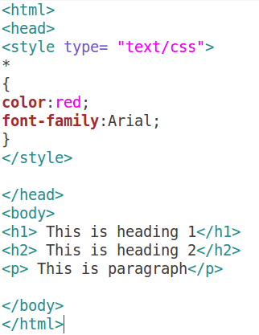
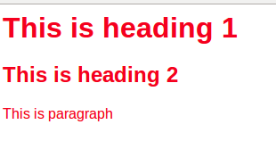
Universal Selector Forms
This selector is denoted by *.
This selector can be applied to all elements in the document.
universalselector.html
output

Slide 37
Pseudo classes selectors
Using pseudo classes we can give special effects on selectors.
Pseudo classes:
Focus
Hover
Hyperlink
While defining pseudo-classes in a <style>...</style> block, following points should be noted −
a:hover MUST come after a:link and a:visited in the CSS definition in order to be effective.
a:active MUST come after a:hover in the CSS definition in order to be effective.
Pseudo-class names are not case-sensitive.

Slide 38
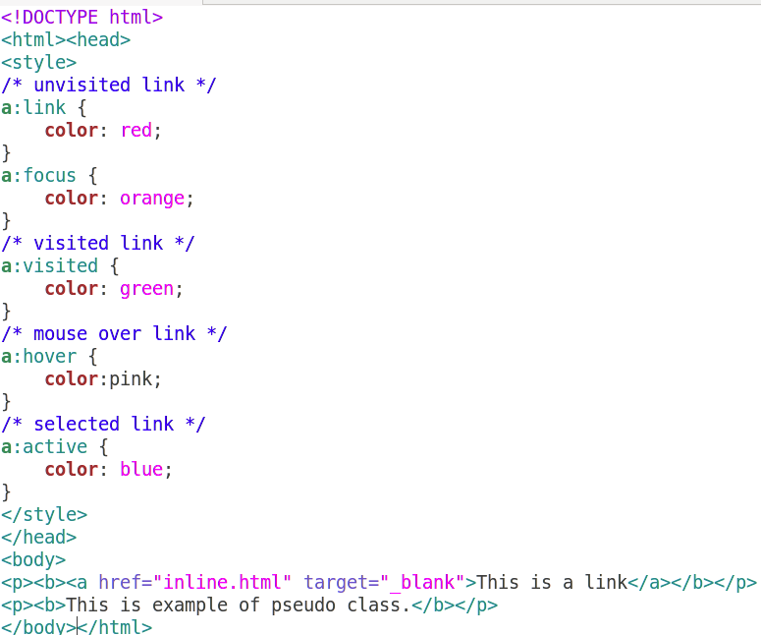
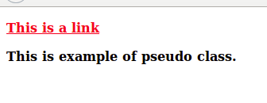
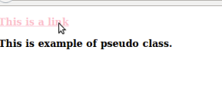


Pseudo classes selectors Example

Slide 39
CSS Background
CSS background properties are used to define the background effects of an element.
CSS properties used for background effects:
background-color
background-image
background-repeat
background-attachment
background-position

Slide 40
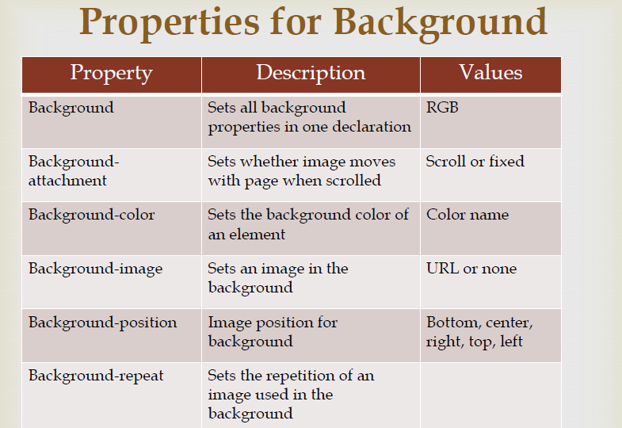

Slide 41
Background Color
The background-color property specifies the background color of an element.
The background color of a page is defined in the body selector.
Syntax:-body {
background-color:red;
}
With CSS, a color is most often specified by:
a HEX value - like "#ff0000"
an RGB value - like "rgb(255,0,0)"
a color name - like "red"

Slide 42
Keyword Color | Hex
aqua | #00ffff
black | #000000
blue | #0000ff
fuchsia | #ff00ff
grey | #808080
green | #008000
lime | #00ff00
maroon | #800000
navy | #000080
olive | #808000
orange (added in CSS 2.1) | #ffa500
purple | #800080
red | #ff0000
silver | #c0c0c0
teal | #008080
white | #ffffff
yellow | #ffff00

Slide 43
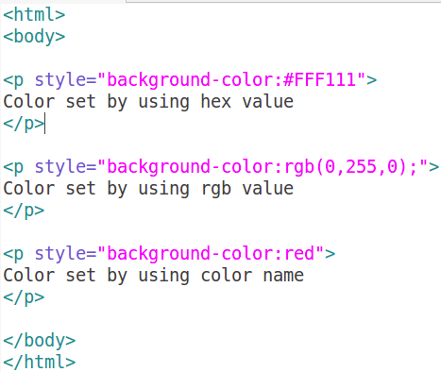
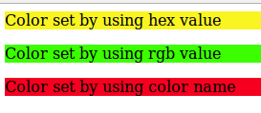
Background Color Example
Color.html
Output

Slide 44
Background Image
The background-image property specifies an image to use as the background of an element.
By default, the image is repeated so it covers the entire element.
Syntax:-
body{
background: #F4a460;
background-image: url(“abc.png”);
}

Slide 45
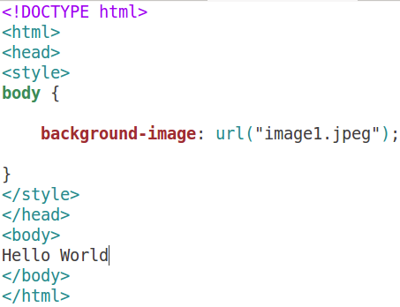

Background Image Example
Backimage.html
output

Slide 46
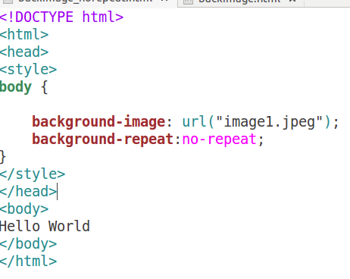
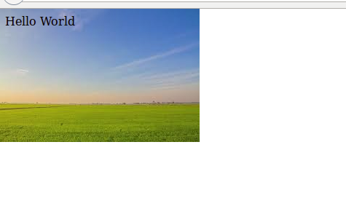
Background Image Norepeat Example
Backimage_norepeat.html
output

Slide 47
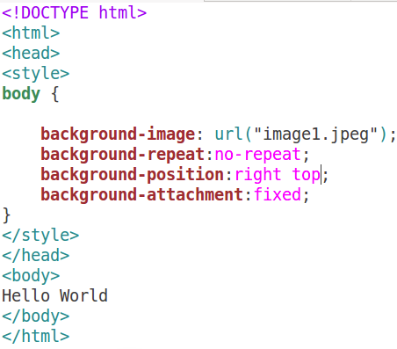

Background Image Position Example
Backimage_position.html
The background-position property sets the starting position of a background image.
output

Slide 48
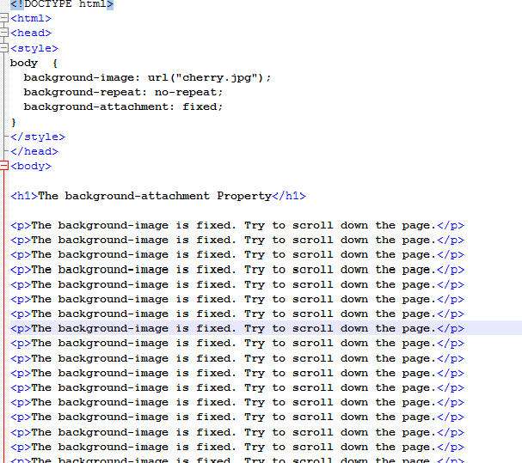
Background Image attachment (Backattach.html)
Backimage_attachment.html
output

Slide 49
Manipulating Text
text properties of an element −
The color property is used to set the color of a text.
The direction property is used to set the text direction
values: rtl or ltr
The letter-spacing property is used to add or subtract space between the letters that make up a word.
The word-spacing property is used to add or subtract space between the words of a sentence.
The text-indent property is used to indent the text of a paragraph.

Slide 50
Manipulating Text
The text-align property is used to align the text of a document. values are left, right, center, justify.
The text-decoration property is used to decorate text. values are none, underline, overline, line-through, blink.
The text-transform property is used to capitalize text or convert text to uppercase or lowercase letters.values are none, capitalize, uppercase, lowercase.
The white-space property is used to control the flow and formatting of text. values are normal, pre, nowrap.
The text-shadow property is used to set the text shadow around a text.

Slide 51
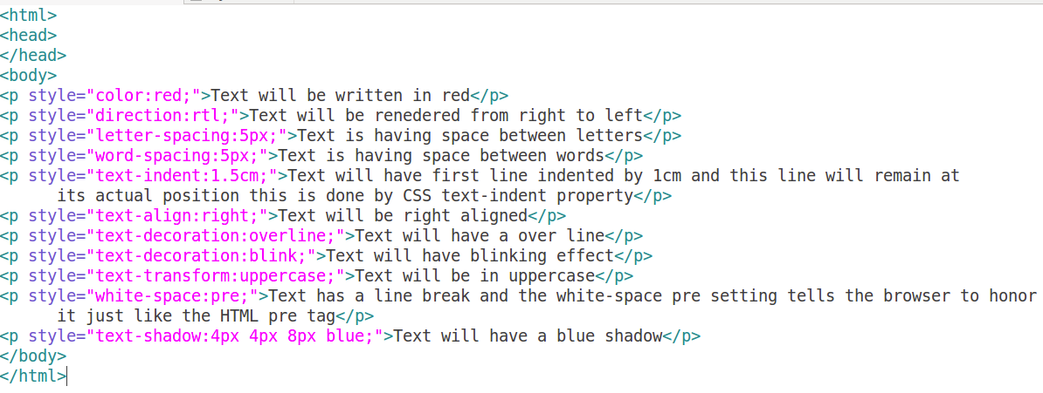
Manipulating Text Example
Textmanipulation.html

Slide 52
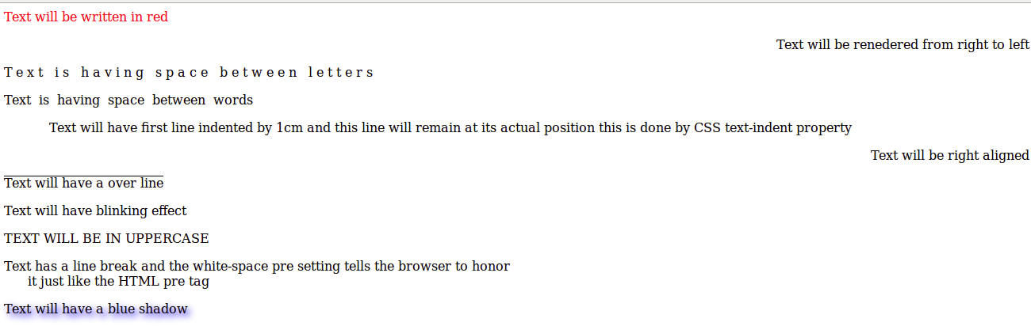
output

Slide 53
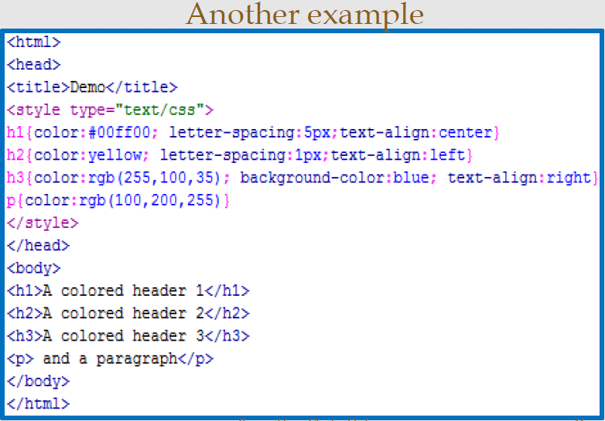

Slide 54
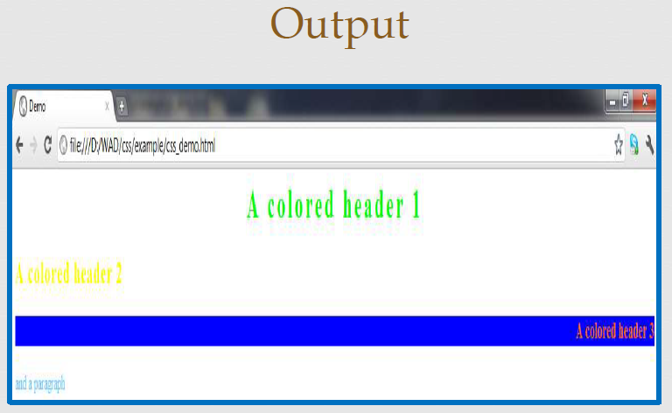

Slide 55
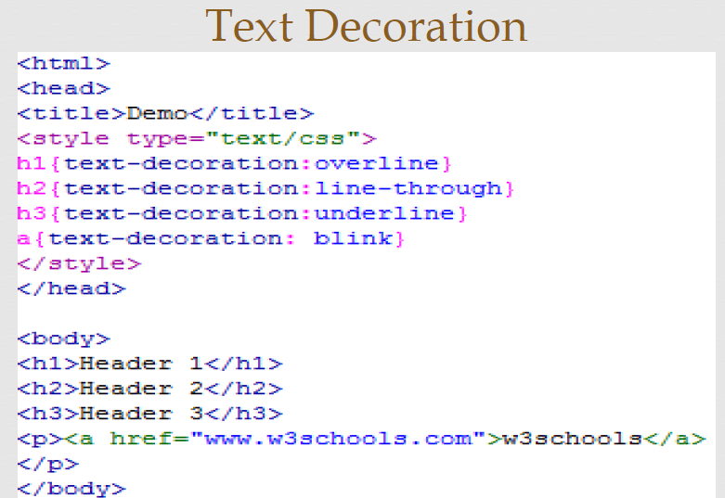

Slide 56
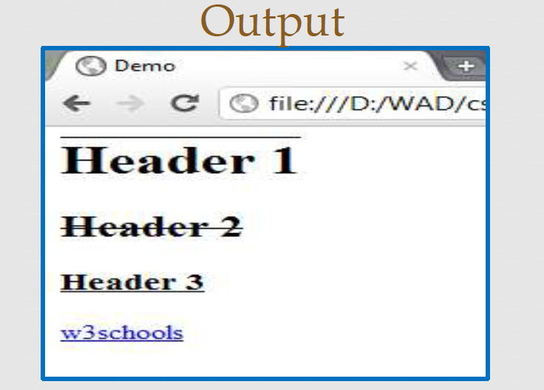

Slide 57
Fonts in CSS
The font-family property is used to change the face of a font.
The font-style property is used to make a font italic or oblique.
The font-variant property is used to create a small-caps effect.
The font-weight property is used to increase or decrease how bold or light a font appears.
The font-size property is used to increase or decrease the size of a font.
The font property is used as shorthand to specify a number of other font properties.

Slide 58
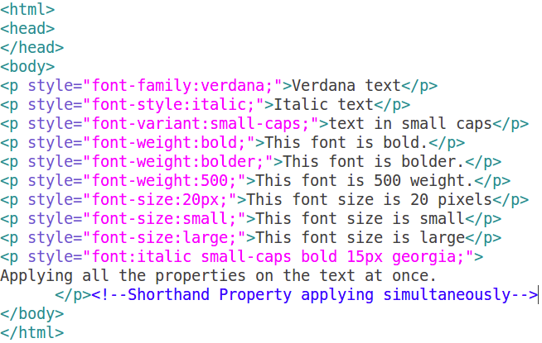
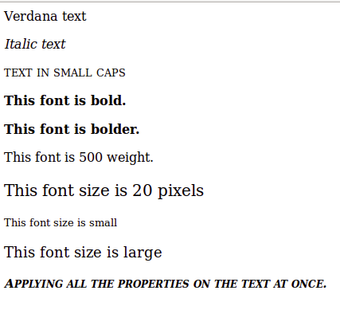
Fonts in CSS Example
Fonts.html
output

Slide 59
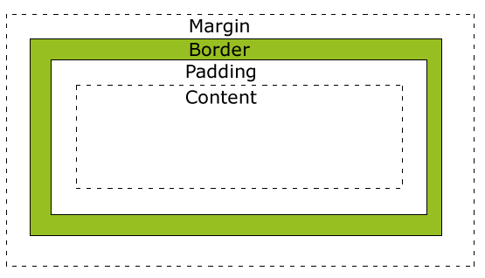
CSS BOX Model

Slide 60
Cont..
All HTML elements can be considered as boxes.
In CSS, the term "box model" is used when talking about design and layout. The CSS box model is essentially a box that wraps around HTML elements, and it consists of: margins, borders, padding, and the actual content.
The box model allows us to add a border around elements, and to define space between elements.

Slide 61
Cont..
Explanation of the different parts:
Margin - Clears an area around the border. The margin does not have a background color, it is completely transparent
Border - A border that goes around the padding and content. The border is affected by the background color of the box
Padding - Clears an area around the content. The padding is affected by the background color of the box
Content - The content of the box, where text and images appear

Slide 62
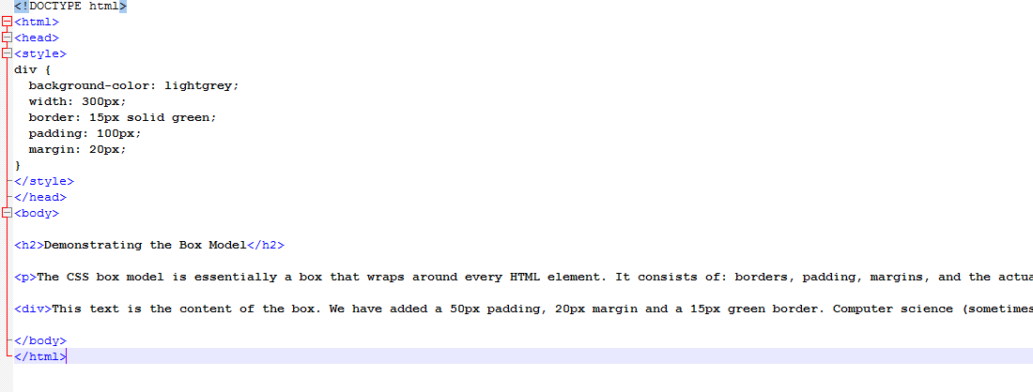

Slide 63
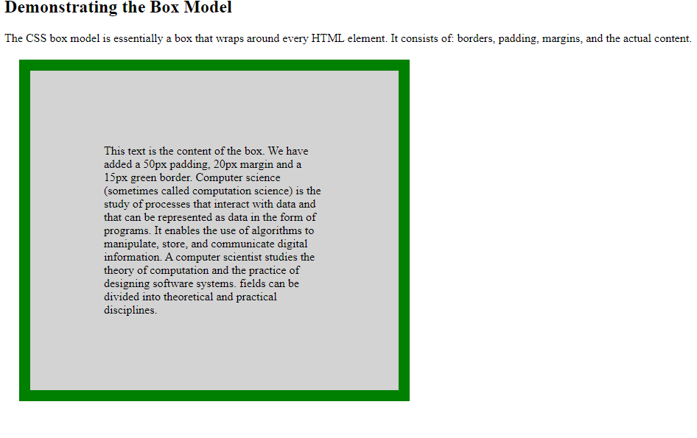

Slide 64
CSS Borders
The CSS border properties allow you to specify the style, width, and color of an element's border.\
The border-style property specifies what kind of border to display.
The border-width property specifies the width of the four borders.The width can be set as a specific size (in px, pt, cm, em, etc) or by using one of the three pre-defined values: thin, medium, or thick.
The border-color property is used to set the color of the four borders.The color can be set by:
name - specify a color name, like "red"
Hex - specify a hex value, like "#ff0000"
RGB - specify a RGB value, like "rgb(255,0,0)"
Transparent
Note: The "border-width" & “border-color” property does not work if it is used alone. Always specify the "border-style" property to set the borders first.

Slide 65
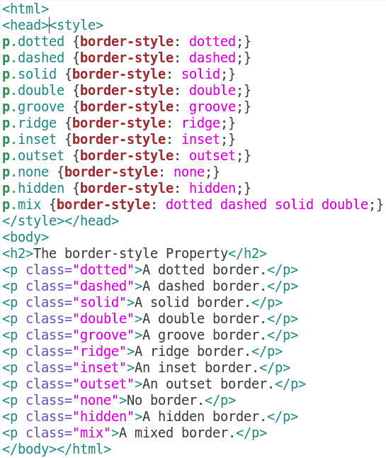
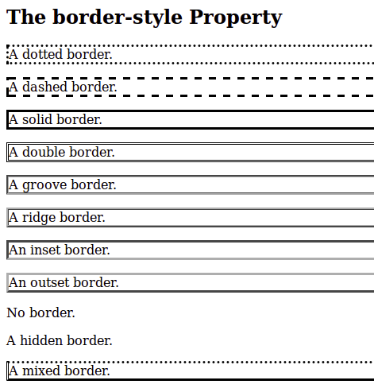
CSS Border-style Example
border.html
output

Slide 66
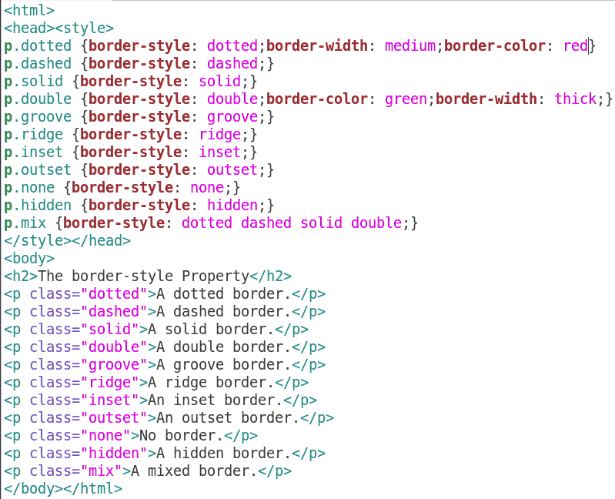
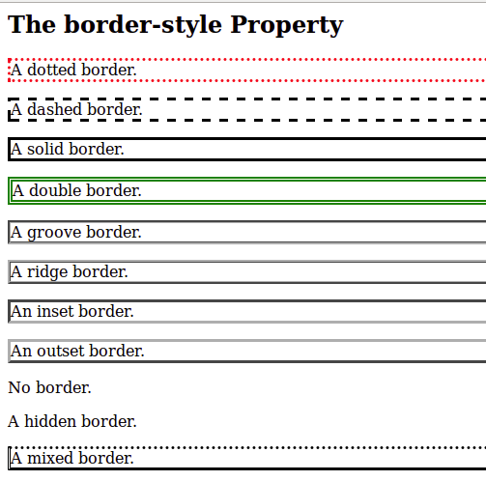
CSS Border-color and Border-width Example
border.html
output

Slide 67
CSS Margins
The CSS margin properties are used to generate space around elements.
CSS has properties for specifying the margin for each side of an element:
margin-top
margin-right
margin-bottom
margin-left
All the margin properties can have the following values:
auto - the browser calculates the margin
length - specifies a margin in px, pt, cm, etc.
% - specifies a margin in % of the width of the containing element
inherit - specifies that the margin should be inherited from the parent element

Slide 68
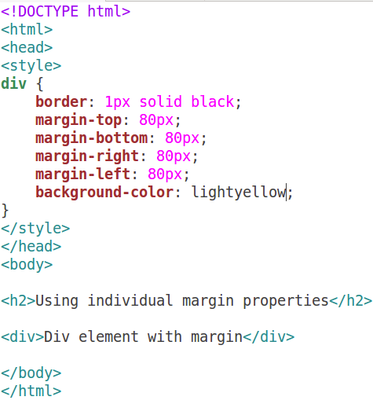
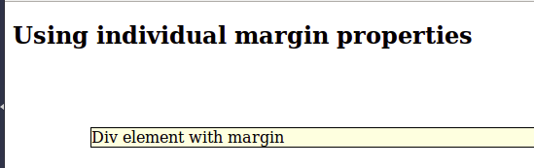
CSS Margins Example
margin.html
output

Slide 69
CSS Padding
The CSS padding properties are used to generate space around content.
The padding clears an area around the content (inside the border) of an element.
CSS has properties for specifying the padding for each side of an element:
padding-top
padding-right
padding-bottom
padding-left
All the padding properties can have the following values: length - specifies a padding in px, pt, cm, etc.
% - specifies a padding in % of the width of the containing element
inherit - specifies that the padding should be inherited from the parent element
It works same as margin

Slide 70
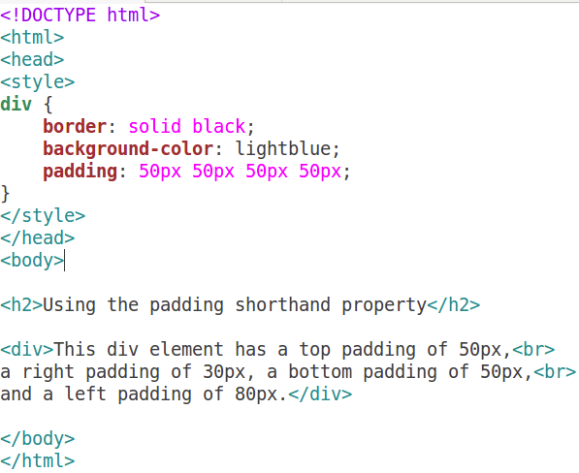
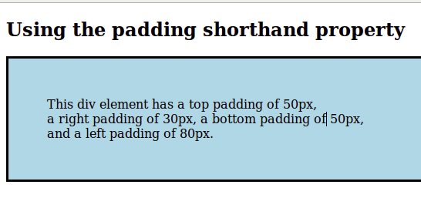
CSS Padding
padding.html
output

Slide 71
CSS Shorthand: Margin & Padding
For margin and padding (and others), CSS provides a number of shorthand properties that can save on writing lines and lines of code. Instead of writing this:
#container {
margin-top: 0;
margin-right: 5px;
margin-bottom: 6px;
margin-left: 5px;
padding-top: 20px;
padding-right: 10px;
padding-bottom: 30px;
padding-left: 12px;
}
0
12
Content Area
5
5
12
10
30
6

Slide 72
Cont’d..
You can also apply just one value, example:
#container {
padding: 20px;
margin: 5px;
}
Which will apply the value
specified equally on all 4 sides
5
20
5
Content Area
5
20
20
20
5

Slide 73
Cont’d..
And you can apply two values, example:
#container {
padding: 10px 20px;
margin: 0px 5px;
}
The first value is applied to
the top and bottom
The second value is applied to
the left and right
0
10
5
Content Area
5
20
20
10
0

Slide 74
Cont’d..
A useful value to remember is ‘auto’:
#container {
padding: 10px 20px;
margin: 0px auto;
}
Usually applied to the
Left & right areas of
the margin property,
auto is useful for
centering a block
Container element in the
browser window
0
10
auto
Content Area
auto
20
20
10
0

Slide 75
Box model
All of the items in your webpage generate invisible “boxes” – you have to figure out how all of those boxes will fit into your page, like a puzzle.
Image with link
Small print text, bullet list
Image
Set of links (navigation)
Regular text

Slide 76
CSS Lists
CSS properties, which can be used to control lists:
list-style-type allows you to control the shape or appearance of the marker.
list-style-position specifies whether a long point that wraps to a second line should align with the first line or start underneath the start of the marker.
list-style-image specifies an image for the marker rather than a bullet point or number.
list-style serves as shorthand for the preceding properties.
marker-offset specifies the distance between a marker and the text in the list.

Slide 77


CSS Lists
list.html
output

Slide 78
CSS Positioning
The position property specifies the type of positioning method used for an element.
Static Positioning: The default positioning for all elements is position:static, which means the element is not positioned and occurs where it normally would in the document.
Relative Positioning:Changes the position of the HTML element relative to where it normally appears.
Absolute Possitioning: When you specify position:absolute, the element is removed from the document and placed exactly where you tell it to go

Slide 79
CSS Relative Positioning
When you set the position relative to an element, without adding any other positioning attributes (top, bottom, right, left) nothing will happen.
When you add an additional position, such as left: 20px the element will move 20px to the right from its normal position.
Here, you can see that this element is relative to itself. When the element moves, no other element on the layout will be affected.

Slide 80


CSS Relative Positioning

Slide 81
CSS Absolute Positioning
This type of positioning allows you to place your element precisely where you want it.
The positioning is done relative to the first relatively (or absolutely) positioned parent element. In the case when there is no positioned parent element, it will be positioned related directly to the HTML element (the page itself).
An important thing to keep in mind while using absolute positioning is to make sure it is not overused, otherwise, it can lead to a maintenance nightmare.

Slide 82


CSS Absolute Positioning

Slide 83


CSS Positioning Example
output
position.html

Slide 84
CSS3
CSS3 is the latest standard for CSS.
CSS3 is completely backwards-compatible with earlier versions of CSS.
CSS3 has been split into "modules". It contains the "old CSS specification" (which has been split into smaller pieces). In addition, new modules are added.
Features:
Border-radii
New color model
Box shadows
Border-image
Css 3D transform
Css Columns
Multiple background

