Slide 1
GO
Data Structures in

Slide 2
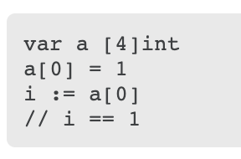
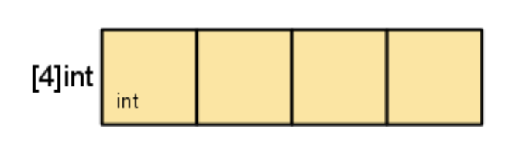
Arrays var var_name [size]data_type
Defines length and type.
var Arr1 [4]int is different than var Arr2 [5]int.
type [4]int represents an array of four integers.
The in-memory representation of [4]int is just four integer values laid out sequentially.
Go’s arrays are values. An array variable denotes the entire array.
Variable is not a pointer to the first array element like C, C++ or Java

Slide 3


Slices make([]data_type, len, cap)
A slice literal is declared just like an array literal, except you leave out the element count.
Arrays are inflexible.
Slices has no specified length.
You can make slices in following way
If you omit cap then it defaults to len.

Slide 4
Slices
The zero value of a slice is nil.
The len and cap functions will both return 0 for a nil slice.
A slice can also be formed by “slicing” an existing slice or array.
Same can be done on array as well to create the slice

Slide 5


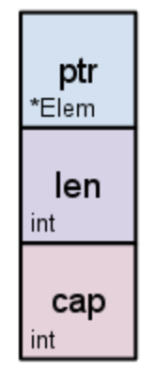

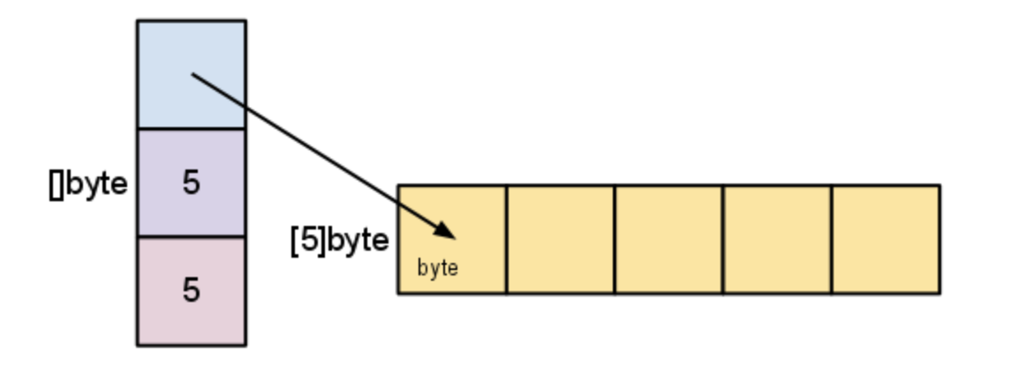
Slice Internals
A slice is a descriptor of an array segment.
It consists of a pointer to the array, the length of the segment, and its capacity (the maximum length of the segment).
Our variable s, created earlier by make([]byte, 5), is structured like this:

Slide 6

Slice Internals
The length is the number of elements referred to by the slice. The capacity is the number of elements in the underlying array (beginning at the element referred to by the slice pointer).

Slide 7
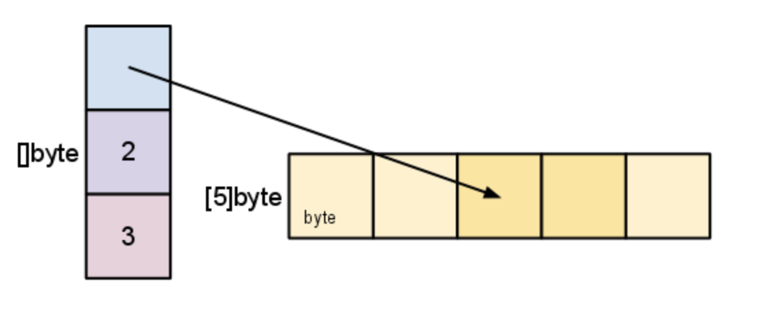
Slice Internals
As we slice s, observe the changes in the slice data structure and their relation to the underlying array
s = s[2:4]

Slide 8
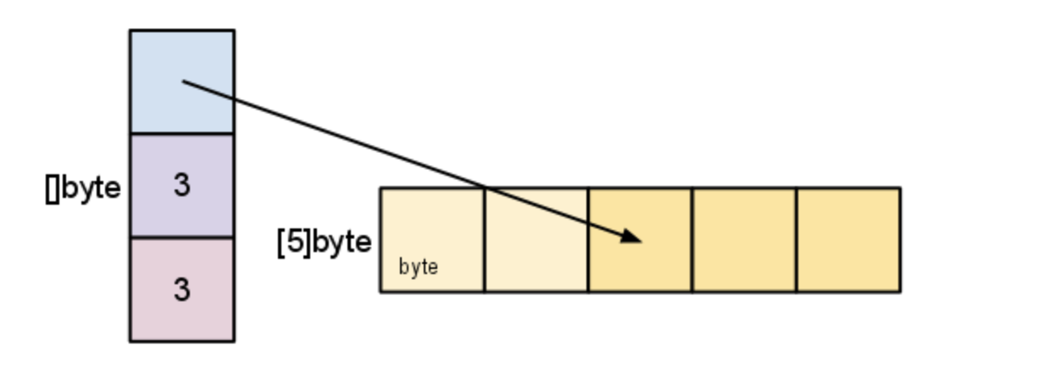
Slice Internals
Earlier we sliced s to a length shorter than its capacity. We can grow s to its capacity by slicing it again
s = s[:cap(s)]

Slide 9
Slice Internals
What is slice capacity when sliced from an Array?
var Arr = [10]int{1, 2, 3, 4, 5, 6, 7, 8, 9, 10}
S := Arr[startIndex:endIndex]
cap(S) = len(Arr) – startIndex
This is because slices created from an array share the same memory as array until reassigned or capacity grows beyond the array length and append is used to grow slice. A new underlying array to slice is created.

Slide 10
Do we have Array Index Out of Bounds?
No but yes
A slice cannot be grown beyond its capacity.
Attempting to do so will cause a runtime panic, just as when indexing outside the bounds of a slice or array.
Similarly, slices cannot be re-sliced below zero to access earlier elements in the array.

Slide 11
Growing Slices
Grow Slices
Manual
Automatic
append function does all for you.
Create a big enough slice using make function.
Copy the elements from older slice to new slice.

Slide 12
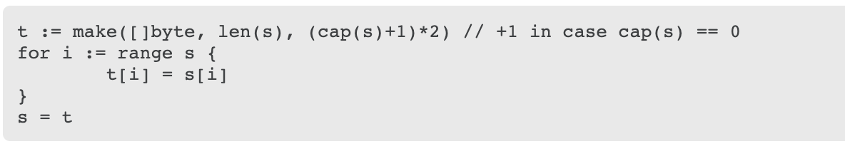
Growing slices -Manual
To increase the capacity of a slice one must create a new, larger slice and copy the contents of the original slice into it.

Slide 13
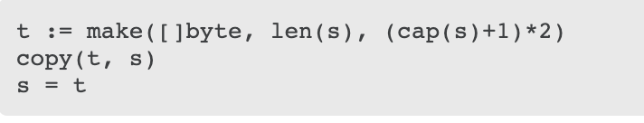
Growing slices -Manual
The looping piece of this common operation is made easier by the built-in copy function. As the name suggests, copy copies data from a source slice to a destination slice. It returns the number of elements copied.
func copy(dst, src []T) int

Slide 14
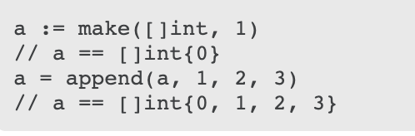
Growing slices -Automatic
append function handles all the nuisances we saw on previous slide.
func append(s []T, x ...T) []T
Always accept the return from append

Slide 15
Two-dimensional slices
#TODO
Pratyaksh

Slide 16
Maps
#TODO
Implement your own map
Naman

Slide 17
Linked Lists
#TODO
Implement your own
Pankaj

Slide 18
Stack
#TODO
Implement your own
Siddharth

Slide 19
Queue
#TODO
Implement your own
Vikram

Slide 20
Set
Must #TODO
No default implementation, learn it for sure.
Find out what go suggests

Slide 21
Trees
#TODO
Implement your own
Kanhaiya

Slide 22

Structs
Are we back to C?

Slide 23
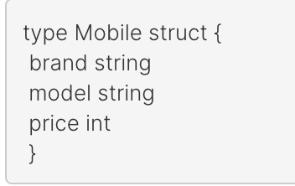
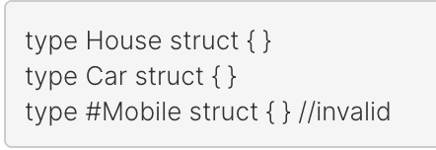
How to define one?
A struct is defined by using type and struct keyword along with the meaningful name.

Slide 24

How to use one?
We can create an instance of our struct Mobile in following ways:-
var mob Mobile:- Creates local variable and sets default values
mob:=new(Mobile):- Allocates memory to all fields by setting default values and returns a pointer to it (*Mobile).
mob:=Mobile{brand:“Samsung”,model:”Galaxy”,price:24500}
mob:=Mobile {“Samsung,Galaxy,24500”}
Always pass the field values in the same order in which they are declared in the struct. Also, we can’t initialize only a subset of fields with the above syntax.

Slide 25
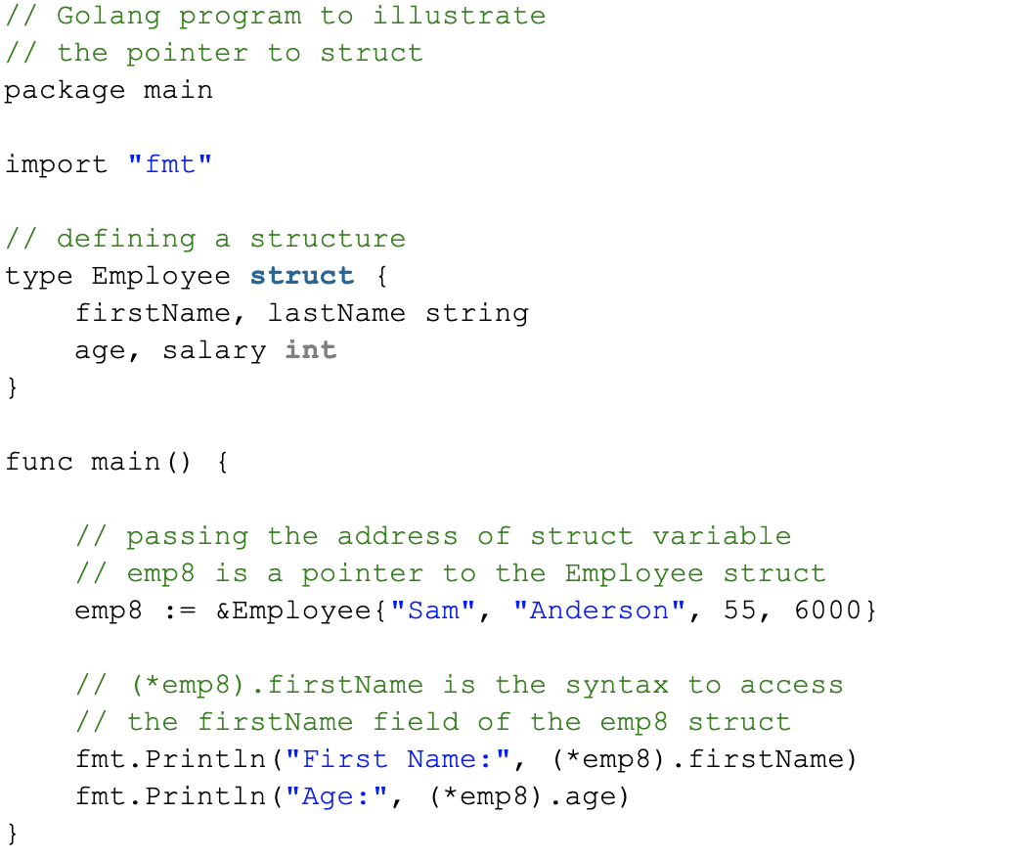
Pointers to a struct – With or without *
z

Slide 26
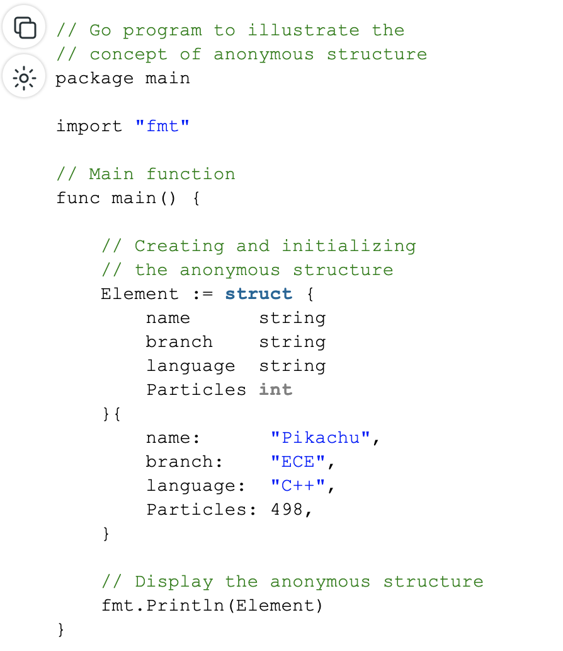
Anonymous Structs
variable_name := struct{ // fields }{// Field_values}

Slide 27
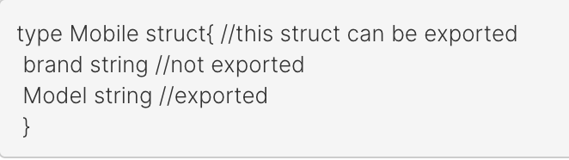
Accessibility and Visibility of struct and variables
If first letter of the struct name or variable name is uppercase then it is visible outside that package.

Slide 28
Go and OOPS
Encapsulation → state [“fields”] behaviour [“methods”] export / unexported
Reusability → Inheritance [“Embedded Types”]
Polymorphism → Interfaces
Overriding → Promotion

Slide 29
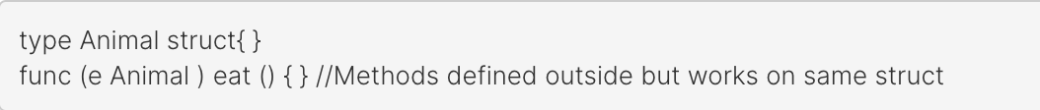
Structs and Methods
In Java or C++, methods are composed within struct or class.
But in Go, they are ‘associated’ with struct.

Slide 30
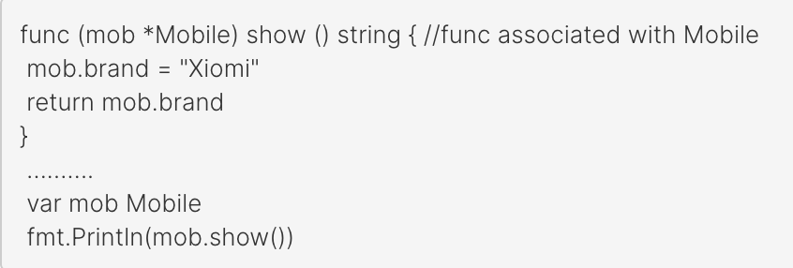
Structs and Methods
z
func (receiverName receiverType) functionName(arguments) returnType

Slide 31

Structs and Methods
Methods having pointer receivers can modify the value to which the receiver points. Example on next slide.
We can define a method on any type defined in struct as well as from same package.
We cann’t define method on type from another package.

Slide 32
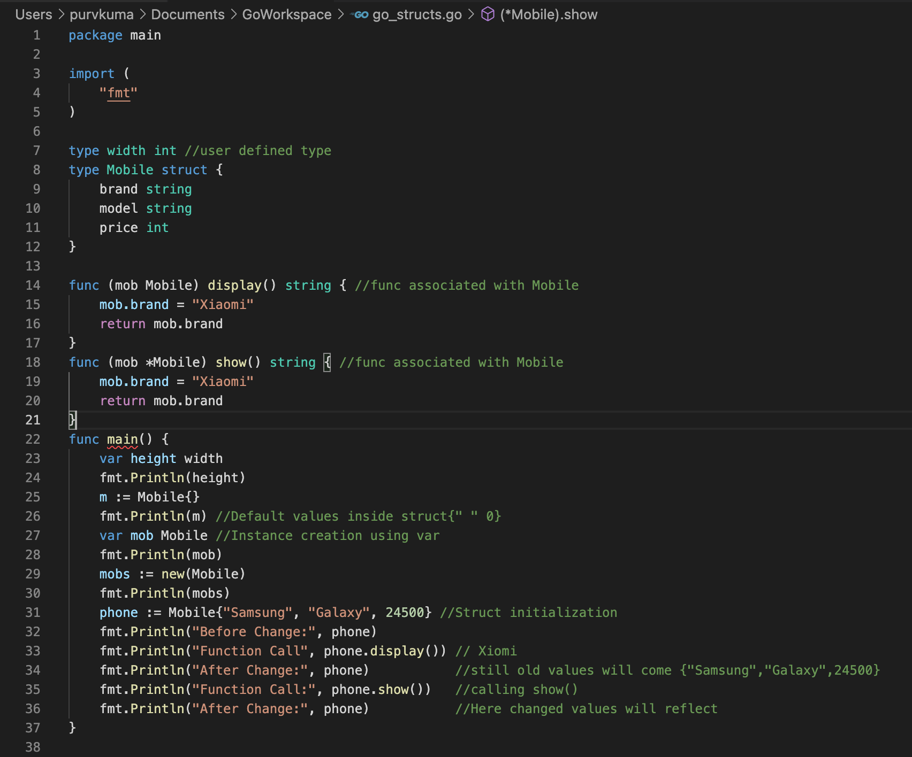

Slide 33
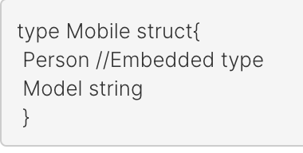
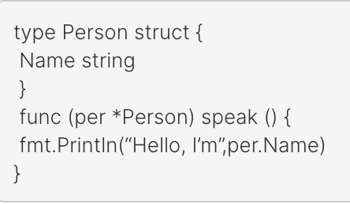
Embedded Types
A struct’s properties/fields usually represent has-a relationship like an inheritance.
To access the struct Person fields we can use type name:
mob:=new(Mobile)
mob.Person.speak( )

Slide 34
Promotion
Embedding is the composition, not inheritance.
Go supports something called “promotion” where the fields and methods of the embedded type become available to the embedding type.
This is something like inheritance but actually not inheritance.

Slide 35
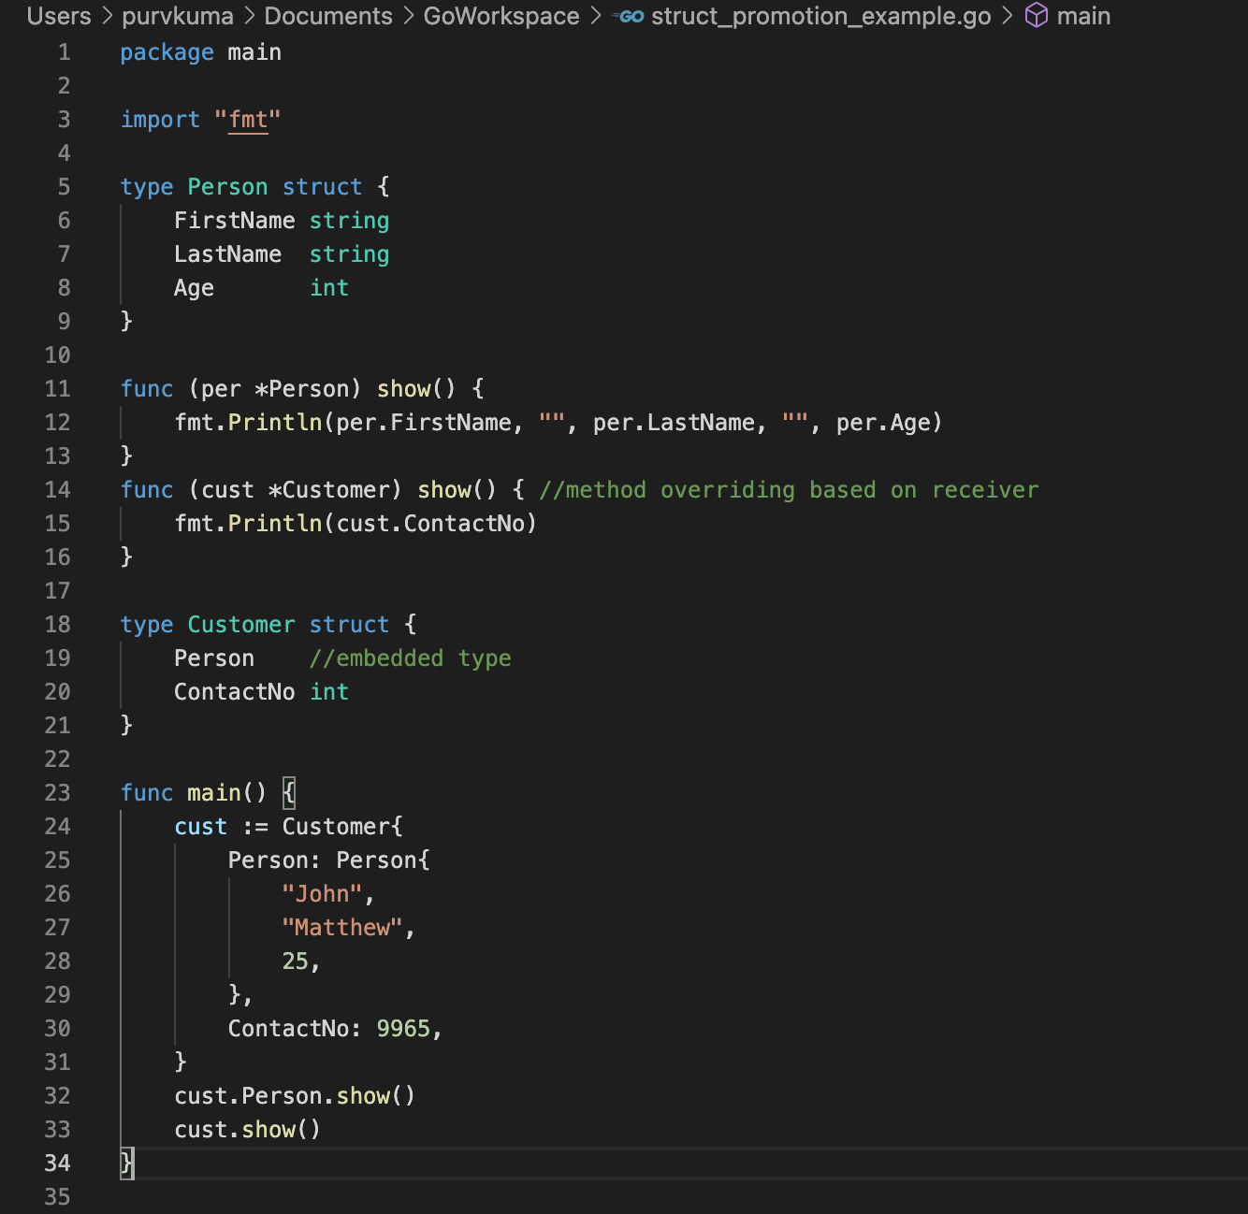

Slide 36
Methods and Functions
z
Are you wondering? Why Today Again?

Slide 37
Methods are Function! Why?
What is a function?
Something which allows you to process
func main()
What is a method?
A method is a function with a special receiver argument.
func (v Vertex) Abs() float64

Slide 38
Wanna create your own type and methods?
You can declare a method on non-struct types, too.
You can only declare a method with a receiver whose type is defined in the same package as the method.
You cannot declare a method with a receiver whose type is defined in another package.
Get Your Hands Dirty!

Slide 39
Types of methods and functions
Methods/Functions
Value Receiver
Pointer Receiver

Slide 40
Why two name for similar things?
Apart from methods having receiver type, there is a difference:-
Functions with a pointer argument must take a pointer.
Methods with pointer receivers take either a value or a pointer as the receiver when they are called.
See for yourself!

Slide 41
When to use what?
Two reasons:-
Method can modify the value that its receiver points to.
To avoid copying the value on each method call.
A suggestion, all methods on a given type should have either value or pointer receivers, but not a mixture of both.

Slide 42
Interfaces
A way to specify the behaviour of an object.
Ideology: If something can do this, then it can be used here.
An interface type is defined as a set of method signatures.
A value of interface type can hold any value that implements those methods.

Slide 43
No implements keyword!
Interfaces are implemented implicitly.
Try it out!

Slide 44
Interface values
Under the hood, interface values can be thought of as a tuple of a value and a concrete type:
(value, type)
Check the type!

Slide 45

Missing python’s dynamic type casting?
Go has got you empty interfaces?

Slide 46

Scratch your mind some more!
Type assertions
Type switches

Slide 47
Some Important Go Interfaces
Stringer interface – toString of your struct or object
Error Interface – Handle your errors gracefully
Reader Interface – Write your own input handler
Let's Try Them!

Slide 48
Polymorphism
Let’s see an example!

Slide 49

Thank You!

