Slide 1
ELECTION ALGORITHMS
ADITH KRISHNA SRINIVASAN

Slide 2
ELECTIONS
There are at least two basic strategies by which a distributed system can adapt to failures.
  operate continuously as failures occur and are repaired
  The second alternative is to temporarily halt normal operation and to take some time out to reorganize the system.
    The reorganization of the system is managed by a single node called the coordinator.
    So as a first step in any reorganization, the operating or active nodes must elect a coordinator.

Slide 3
ELECTION AND SYNCHRONIZATION
Similar
  Like Synchronization, all processors must come to an agreement about who enters the critical region (i.e. who is the leader)
Different
  The election protocol must properly deal with the case of a coordinator failing. On the other hand, mutual exclusion algorithms assume that the process in the critical region (i.e., the coordinator) will not fail.
  A new coordinator must inform all active nodes that it is the coordinator. In a mutual exclusion algorithm, the nodes not in the critical region have no need to know what node is in the region.

Slide 4
ELECTION ALGORITHMS
The two classical election algorithms by Garcia-Molina
    Bully Algorithm
    Invitation Algorithm
  Ring Algorithm

Slide 5
The Bully Algorithm
Assumptions
  Each node has access to some permanent storage that survives node failures.
  There are no transmission errors.
  The communication subsystem does not fail

Slide 6
The Bully Algorithm
State Information For Election
  Status
    Down,Election,Reorganization,Normal
  Co-ordinator
    The Current co-ordinator of the node
  Definition
    The State Information of the task being performed - the application algorithms, list of the participating nodes

Slide 7
The Bully Algorithm
Each process has an associated priority (weight). The process with the highest priority should always be elected as the coordinator.
How do we find the heaviest process?
Any process can just start an election by sending an election message to all other processes
If a process Pheavy receives an election message from a lighter process Plight, it sends a take-over message to Plight. Plight is out of the race.
If a process doesn’t get a take-over message back, it wins, and sends a victory message to all other processes.

Slide 8

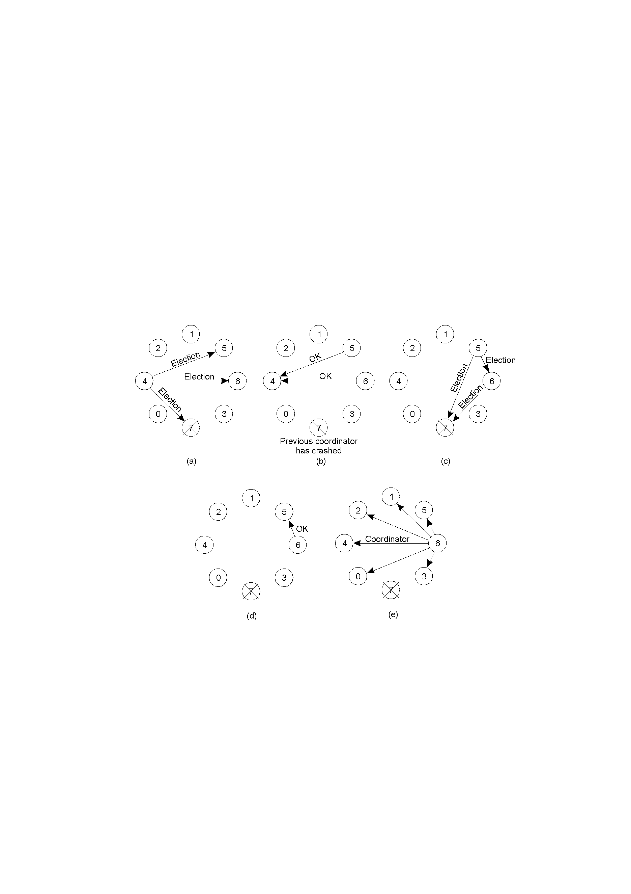
The Bully Algorithm
The bully election algorithm
        Process 4 holds an election
    Process 5 and 6 respond, telling 4 to stop
    Now 5 and 6 each hold an election

Slide 9
  Process 6 tells 5 to stop
  Process 6 wins and tells everyone

Slide 10
Bully Algorithm: Properties
Assume n processes initially
  Worst Case:
    Smallest process initiates election
    Requires O(n2) messages
  Best Case:
    Eventual leader initiates election
    Requires (n-1) messages

Slide 11
The Invitation Algorithm
Bullying algorithm fails for asynchronous systems
The invitation algorithm classifies nodes into ‘groups’ and elects a co-ordinator for every group
An additional state variable is indroduced for this asynchronous election
  Group Number
    Identifier of the group the processor belongs to

Slide 12
The Invitation Algorithm
When Processor p wishes to establish itself as the new co-ordinator , it sends out invitations to the potential participants
Groups that can communicate try to coalesce into larger groups
Periodically the group co-ordinator searches for other groups

Slide 13
The Invitation Algorithm
Starting a new Group
  If a node does not hear from its co-ordinator for a long time, the node declares its own group
  It could start sending invitations to all the other participants of the old group

Slide 14
A Comparison of the two Algorithms
Logical Structure
  Bully –
    Simple and Efficient because it imposes a logical structure on processors
  Invitation –
    Might take a long time for groups to merge because of no strongly defined structure

Slide 15
A Comparison of the two Algorithms
Synchronous Vs Asynchronous
  Bully
    Makes very strong use of bounded response time which are mostly unrealistic
  Invitation
    Works correctly in the presence of timing failures

Slide 16
Election in a Ring
Process priority is obtained by organizing processes into a (logical) ring. Process with the highest priority should be elected as coordinator.
Each process has a successor
  Initiation:
    A process sends an ELECTION message to its successor (or next alive process) with its ID
    Each process adds its own ID and forwards the ELECTION message
  Leader Election:
    Message comes back to initiator
    Initiator announces the winner by sending another message around the ring

Slide 17
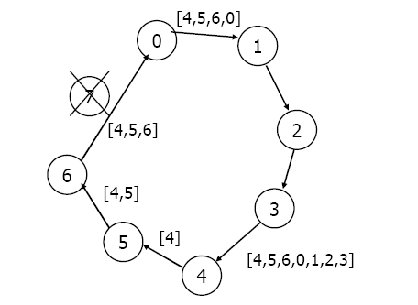
Ring Algorithm: Initiation

Slide 18
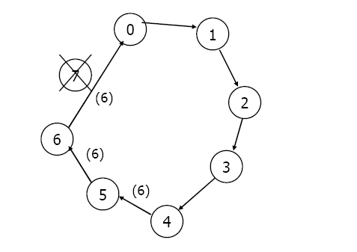
Ring Algorithm - Election

Slide 19
Ring Algorithm: Properties
If only 1 process initiates election:
  Requires 2n messages
Two or more processes might simultaneously initiate elections
  Still ensures election of the same leader
  Results in extra messages

Slide 20
REFERENCES
Elections in a Distributed Computing System
  HECTOR GARCIA-MOLINA,
Distributed Systems
  Andrew S.Tenenbaum,Marten van Sten
Distributed Operating Systems & Algorithms
  Randy Chow, Theodore Johnson
A Leader Election Algorithm in a Distributed Computing System(1995)
  Tai Woo Kimo, Eui Hong Kim, Joong Kwon Kim ,Korea Institute of Science and Technology
Leader election algorithms for wireless ad hoc networks (2003)
  Vasudevan, S. DeCleene, B. Immerman, N. Kurose, J. Towsley, D.
  Dept. of Comput. Sci., Massachusetts Univ., Amherst, MA, USA;

